Slide 1


Enhancing Quality in Open Learning in China through Learning Design
Reporting on some findings from 7 professional development Learning Design and Course Creation (LDCC) Workshops in China
Tom Olney: Senior Manager, Learning and Teaching
Mark Endean: Senior Lecturer, E&I
Duncan Banks: Lecturer, LHCS

Slide 2
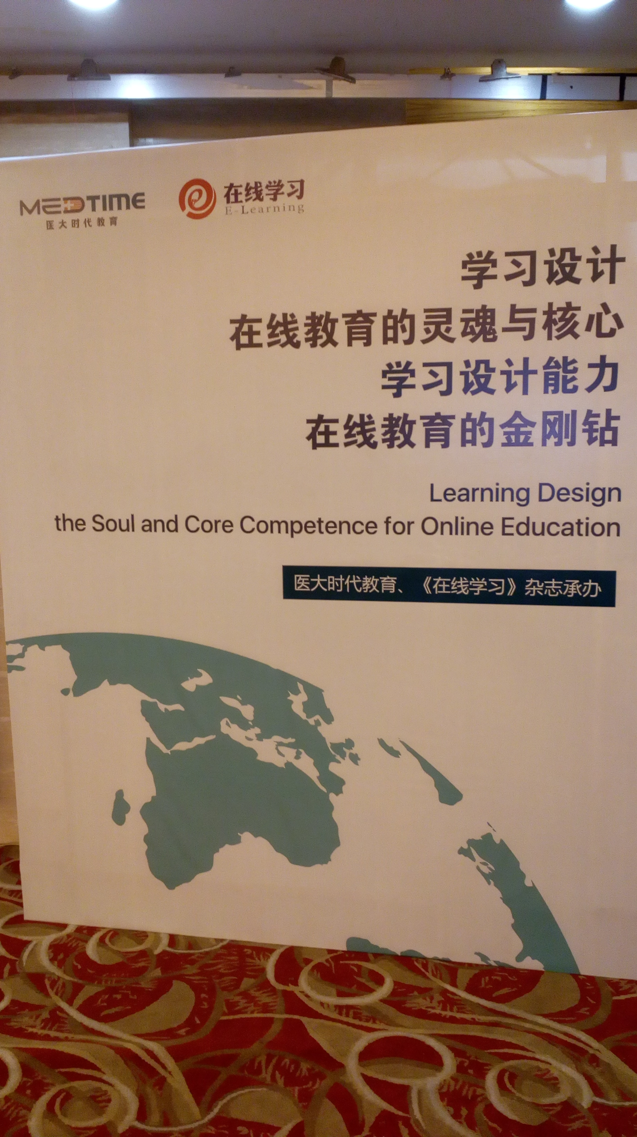

Background & key challenge
Quality enhancement is a significant challenge for all regional Chinese OUs (Zhang & Li, 2019)
In China, ‘it is ingrained in people’s [policymakers, practitioners, researchers and the public] minds that campus education is the preferred model to produce the best qualified graduates.’ (Li & Chen, 2019)
Zhang W & Li W (2019) Transformation from RTVUs to Open Universities in China: current state and challenges. International Review of Research in Open and Distributed Learning, 20 (4), pg. 1-20. https://doi.org/10.19173/irrodl.v20i4.4076
Li W & Chen N (2019) Chapter 2: China in Zawacki-Richter O & Qayyum A (eds) Open and Distance Education in Asia, Africa and the Middle East. Springer Briefs in Education.

Slide 3
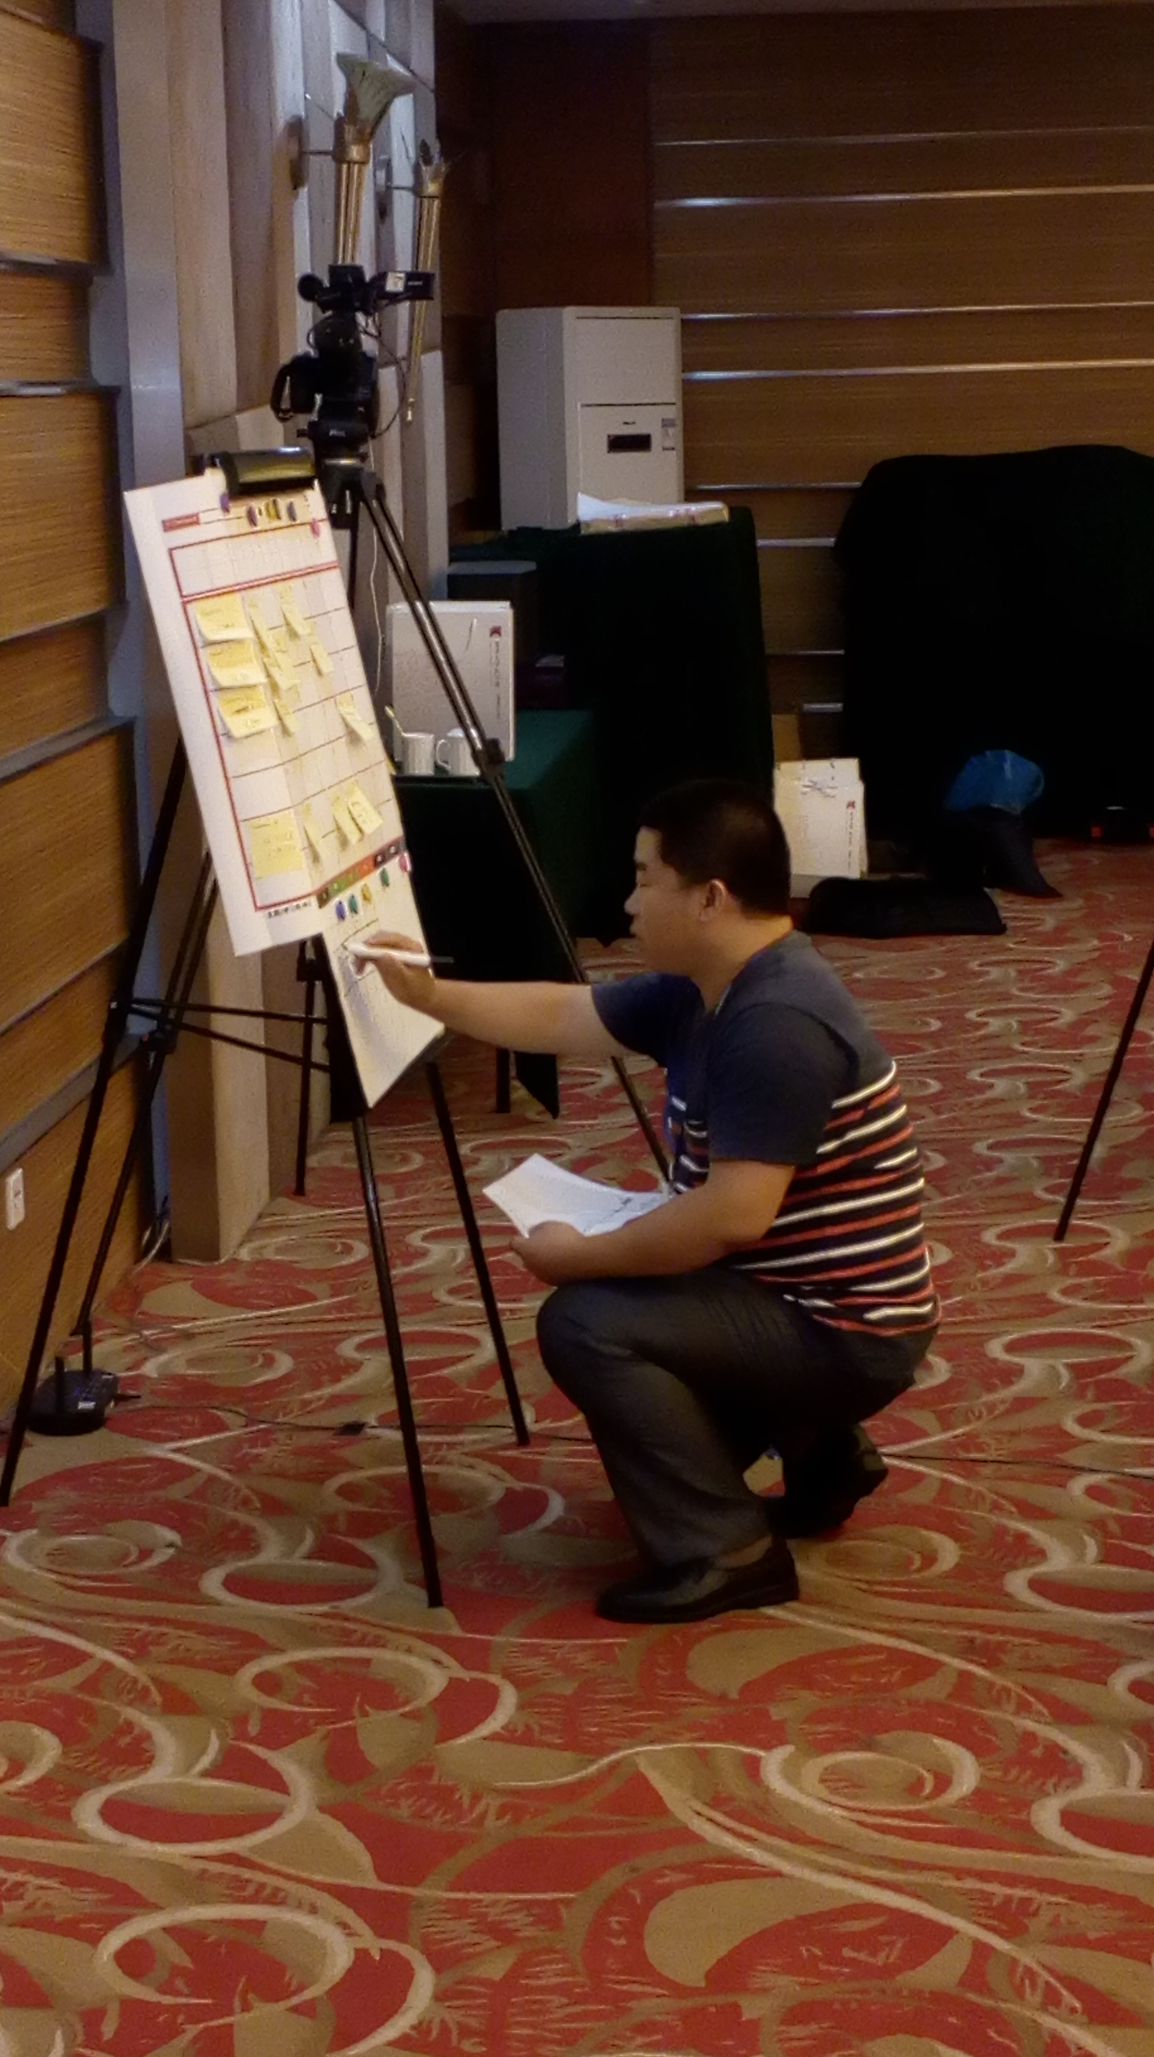
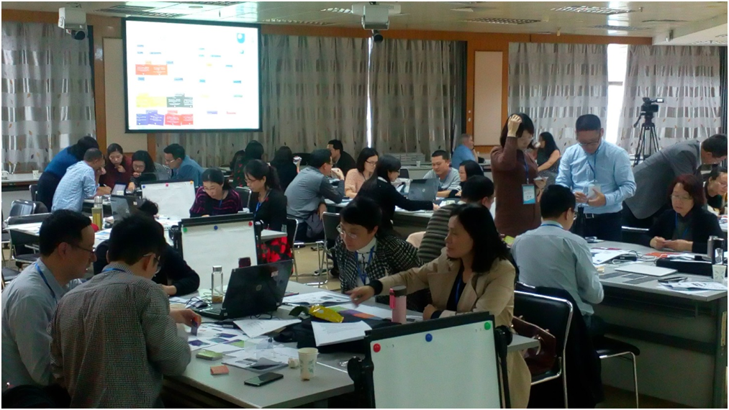
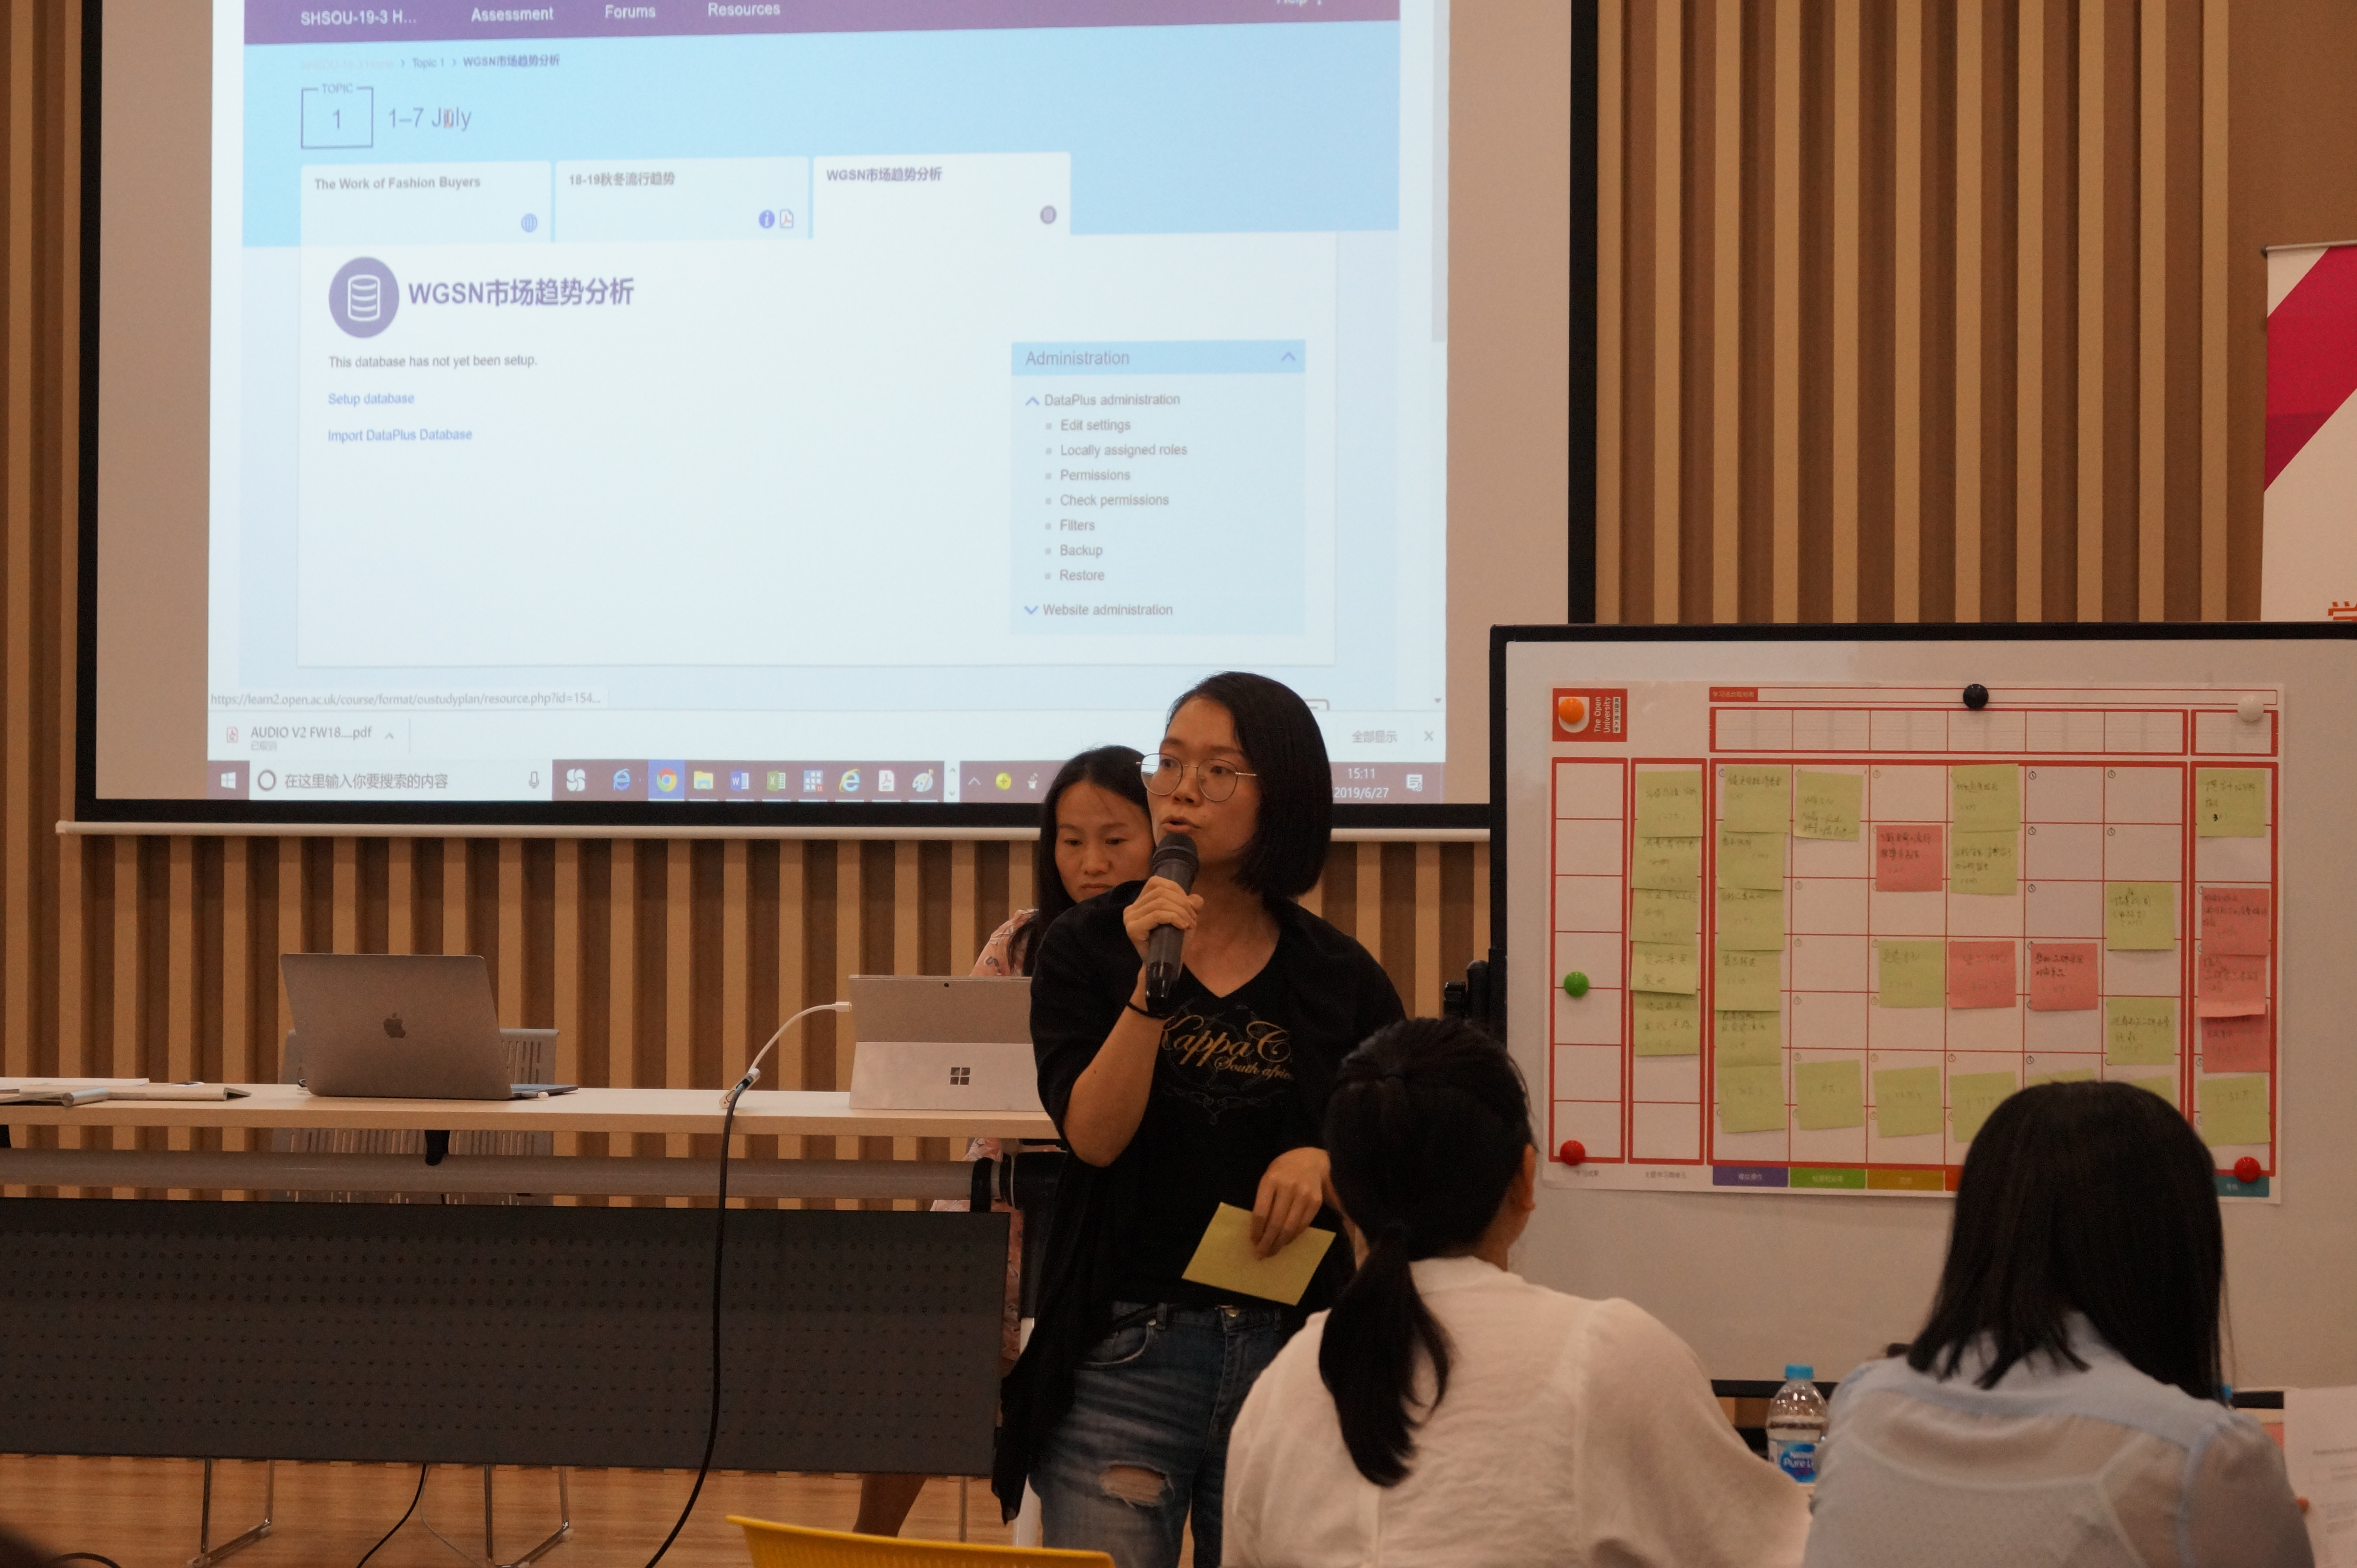
The LDCC Workshop

Slide 4
The LDCC Workshop – content & learning outcomes
Day 1
Course creation at the OU​​
Introduction to learning design​​ and the UKOU VLE
Establishing a team
Writing a vision statement and developing a student profile
By the end of the LDCC workshop participants will be able to:
outline ways in which the UKOU’s Learning Design process provides a student-centred approach to developing online courses
relate online course website design to the student learning experience
adapt what they have learnt from the UKOU’s current practice to create purposeful learning activities for their own students working online
demonstrate, to an audience of teachers and managers at their own institution, how they will use the knowledge they have gained from the workshop to enhance their own teaching practice.
Day 2
Writing Learning Outcomes​​
Using the Activity Types Classification ​to map out a course
Considering student workload and time​​ in the student experience
Populating the module website​
Day 3
Linking assessment, activities and learning outcomes
Building assessment tasks​
Populating the module website, cont.​
Presenting and sharing

Slide 5
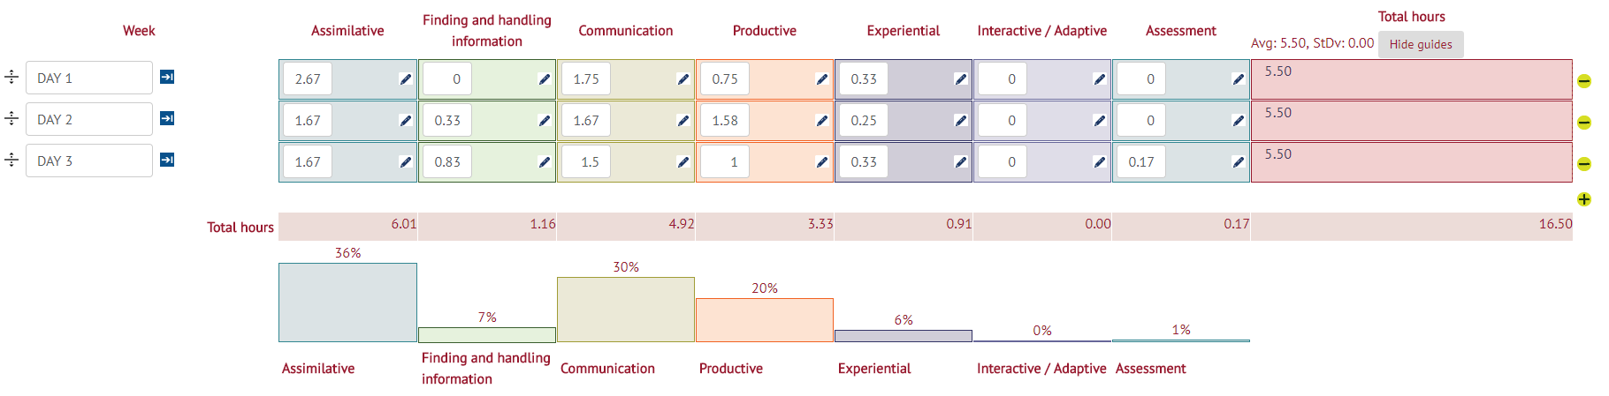
The LDCC Workshop – participant experience

Slide 6
Research Questions
We wanted to know:
RQ1. How easy or difficult did Chinese practitioners perceive implementing the UKOU LDCC approach in their own institution to be?
RQ2. What did Chinese practitioners perceive as the most important thing that would need to change in order to make the implementation of the UKOU LDCC approach easier?
RQ3. Which skills and competencies might Chinese practitioners want to develop to leave them well placed to successfully implement the UKOU LDCC approach?

Slide 7
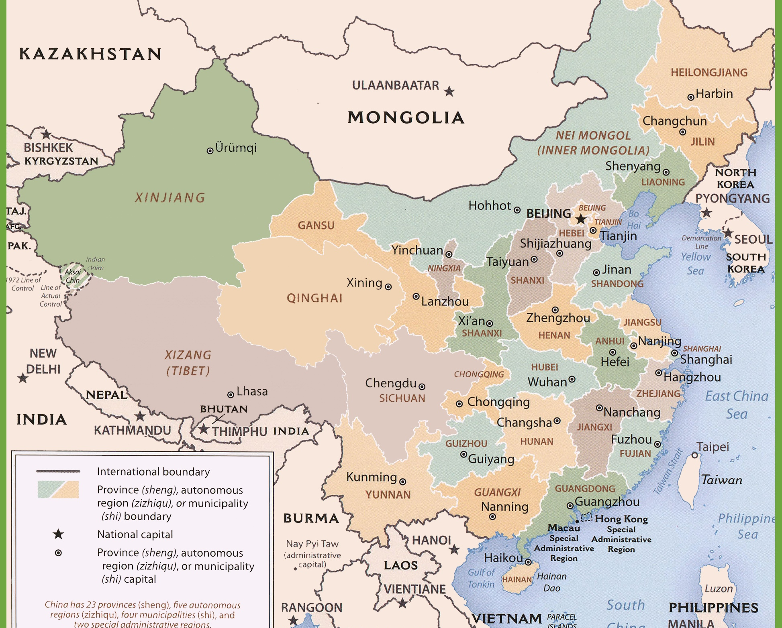
Chinese OU Network and Data Collection
Chinese OU Network consists of:
OU China (based in Beijing) which operates 44 branches, over 1000 colleges and 3000 learning centres nationwide.
5 Regional OUs (Beijing OU, Jiangsu OU, Shanghai OU, Guangdong OU and Yunnan OU)
220 participants from seven LDCC Workshops that took place on the central campus of 3 regional OUs Nov 2017 and June 2019.
OUZ
OUX
Question A. ‘On a scale of 1 to 4 how easy or difficult do you think it would be for your branch/institution to implement the learning design and course creation approach we have demonstrated in the LDCC workshop over the last 3 days?’
Question B. ‘In your opinion, what is the most important thing that would need to change, in order to make the implementation [of the UKOU approach to learning design and course creation] easier?’
OUY

Slide 8
RQ1 – Perceived ease of implementation
RQ1. How easy or difficult did Chinese practitioners perceive implementing the UKOU LDCC approach in their own institution to be?
Overall:
‘difficult’ or ‘very difficult’ (61.6%)
‘easy’ or ‘very easy’ (39.4%).
When compared across institutions however it is clear that this view was not universally held.
OUZ staff (84.7%), clearly perceive the UKOU LDCC approaches to be much more difficult to implement that either OUX (63.0%), or OUY (41.1%).

Slide 9
RQ2 – what would need to change?
RQ2. What did Chinese practitioners perceive as the most important thing that would need to change in order to make the implementation of the UKOU LDCC approach easier?
11 key themes were identified (references =212)
Comparison
OUX: Teamwork and technical systems of equal importance. Also data and LA quite (comparatively) important.
OUY: Technical systems were referenced heavily. Less emphasis on with bureaucratic systems.
OUZ: Teamwork was considered very important (referenced by 50% of participants). Technical systems less important.
 | Theme | No of references
1 | The way teams are established and operated (teamwork) | 64
2 | Technical systems (platform/website/IT) | 44
3 | Student-centred approach to pedagogy | 36
4 | Bureaucratic systems (organizational/institutional/national) | 20
5 | Time (academic workload) | 14
6 | Use of data and learning analytics | 9
7 | Assessment design | 8
8 | Teaching and learning pedagogy (general) | 8
9 | Ability of students to learn | 4
10 | Designing learning outcomes | 3
11 | Engagement of students | 2

Slide 10
RQ3 – Instructional Design Competencies Framework (IBSTPI)
PROFESSIONAL FOUNDATIONS
1. Communicate effectively in visual, oral and written form.
2. Apply research and theory to the discipline of instructional design.
3. Update and improve knowledge, skills, and attitudes pertaining to the instructional design process and related fields.
4. Apply data collection and analysis skills in instructional design projects.
5. Identify and respond to ethical, legal and political implications of design in the workplace.
PLANNING AND ANALYSIS
6. Conduct a needs assessment in order to recommend appropriate design solutions and strategies.
7. Identify and describe target population and environmental characteristics.
8. Select and use analysis techniques for determining instructional content.
9. Analyse the characteristics of existing and emerging technologies and their potential use.
DESIGN AND DEVELOPMENT
10. Use an instructional design and development process appropriate for a given project.
11. Organise instructional programs and/or products to be designed, developed and evaluated.
12. Design instructional interventions.
13. Plan non-instructional interventions.
14. Select or modify existing instructional materials.
15. Develop instructional materials.
16. Design learning assessment.
EVALUATION AND IMPLEMENTATION
17. Evaluate instructional and non-instructional interventions.
18. Revise instructional and non-instructional solutions based on data.
19. Implement, disseminate and diffuse instructional and non-instructional interventions.
MANAGEMENT
20. Apply business skills to managing the instructional design function.
21. Manage partnerships and collaborative relationships.
22. Plan and manage instructional design projects.
IBSTPI (2012) Instructional Design Competencies International Board of Standards for Training, Performance and Instruction (Retrieved from https://ibstpi.org on 22/12/19)

Slide 11
RQ3 – Instructional Design Competencies Framework (IBSTPI)
RQ3. Which IBSTPI skills and competencies might Chinese practitioners want to develop to leave them well placed to successfully implement the UKOU LDCC approach?

Slide 12
RQ3 – Instructional Design Competencies Framework (IBSTPI)
PROFESSIONAL FOUNDATIONS
1. Communicate effectively in visual, oral and written form.
2. Apply research and theory to the discipline of instructional design.
3. Update and improve knowledge, skills, and attitudes pertaining to the instructional design process and related fields.
4. Apply data collection and analysis skills in instructional design projects.
5. Identify and respond to ethical, legal and political implications of design in the workplace.
PLANNING AND ANALYSIS
6. Conduct a needs assessment in order to recommend appropriate design solutions and strategies.
7. Identify and describe target population and environmental characteristics.
8. Select and use analysis techniques for determining instructional content.
9. Analyse the characteristics of existing and emerging technologies and their potential use.
DESIGN AND DEVELOPMENT
10. Use an instructional design and development process appropriate for a given project.
11. Organise instructional programs and/or products to be designed, developed and evaluated.
12. Design instructional interventions.
13. Plan non-instructional interventions.
14. Select or modify existing instructional materials.
15. Develop instructional materials.
16. Design learning assessment.
EVALUATION AND IMPLEMENTATION
17. Evaluate instructional and non-instructional interventions.
18. Revise instructional and non-instructional solutions based on data.
19. Implement, disseminate and diffuse instructional and non-instructional interventions.
MANAGEMENT
20. Apply business skills to managing the instructional design function.
21. Manage partnerships and collaborative relationships.
22. Plan and manage instructional design projects.
IBSTPI (2012) Instructional Design Competencies International Board of Standards for Training, Performance and Instruction (Retrieved from https://ibstpi.org on 22/12/19)

Slide 13

Implications and Further Work
Submitted paper to GLL.
Link with visiting scholars programme from China.
Build links with other international partnership types of work.
Further research around the extent to which cultural differences may play a role in design approaches for ODL teaching and learning approaches by using an adapted set of Hofstede Dimensions (Parrish & Linder-VanBerschot, 2010).
Parrish P & Linder-VanBerschot J (2010) Cultural Dimensions of Learning: Addressing the Challenges of Multicultural Instruction. International Review of Research in Open and Distance Learning, vol 11, no 2.

Slide 14
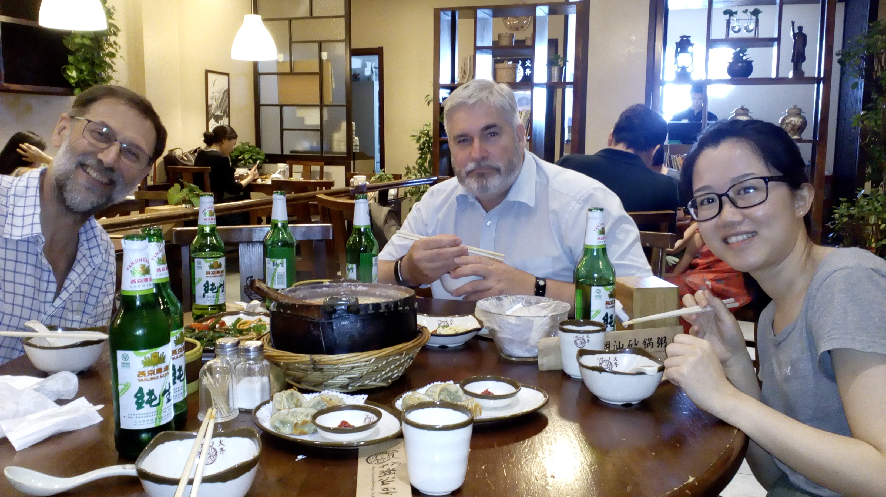
Questions?

