Slide 1


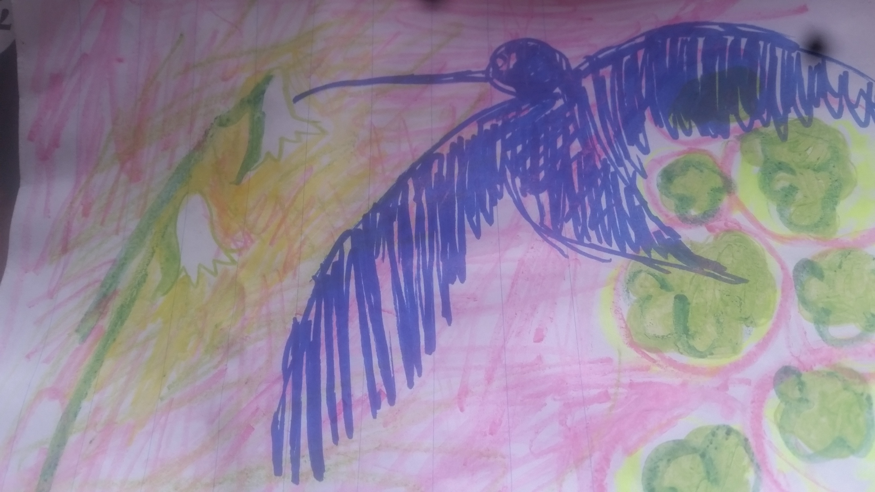
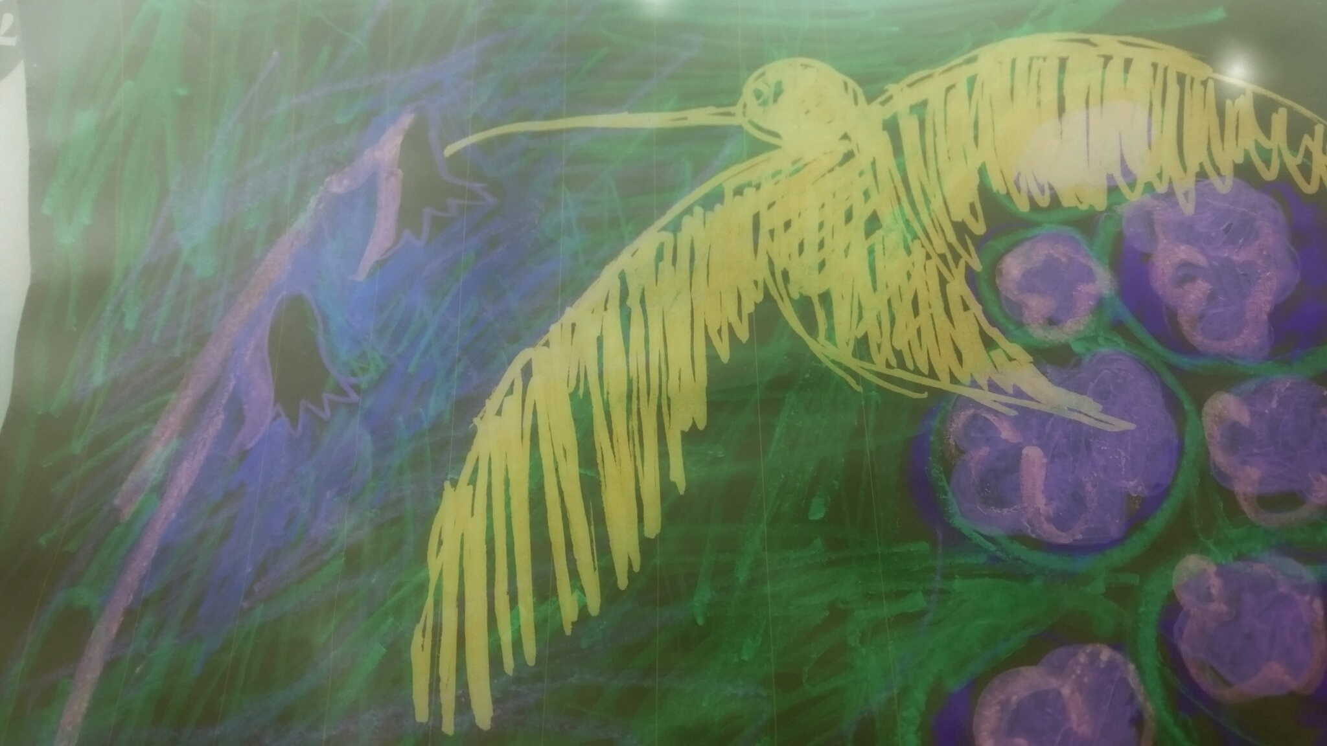
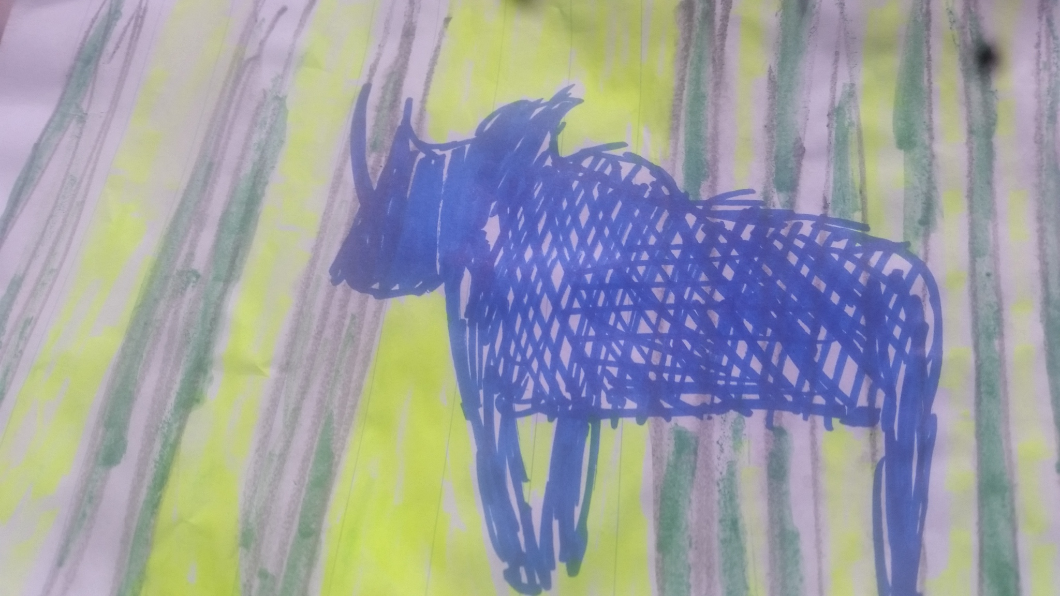
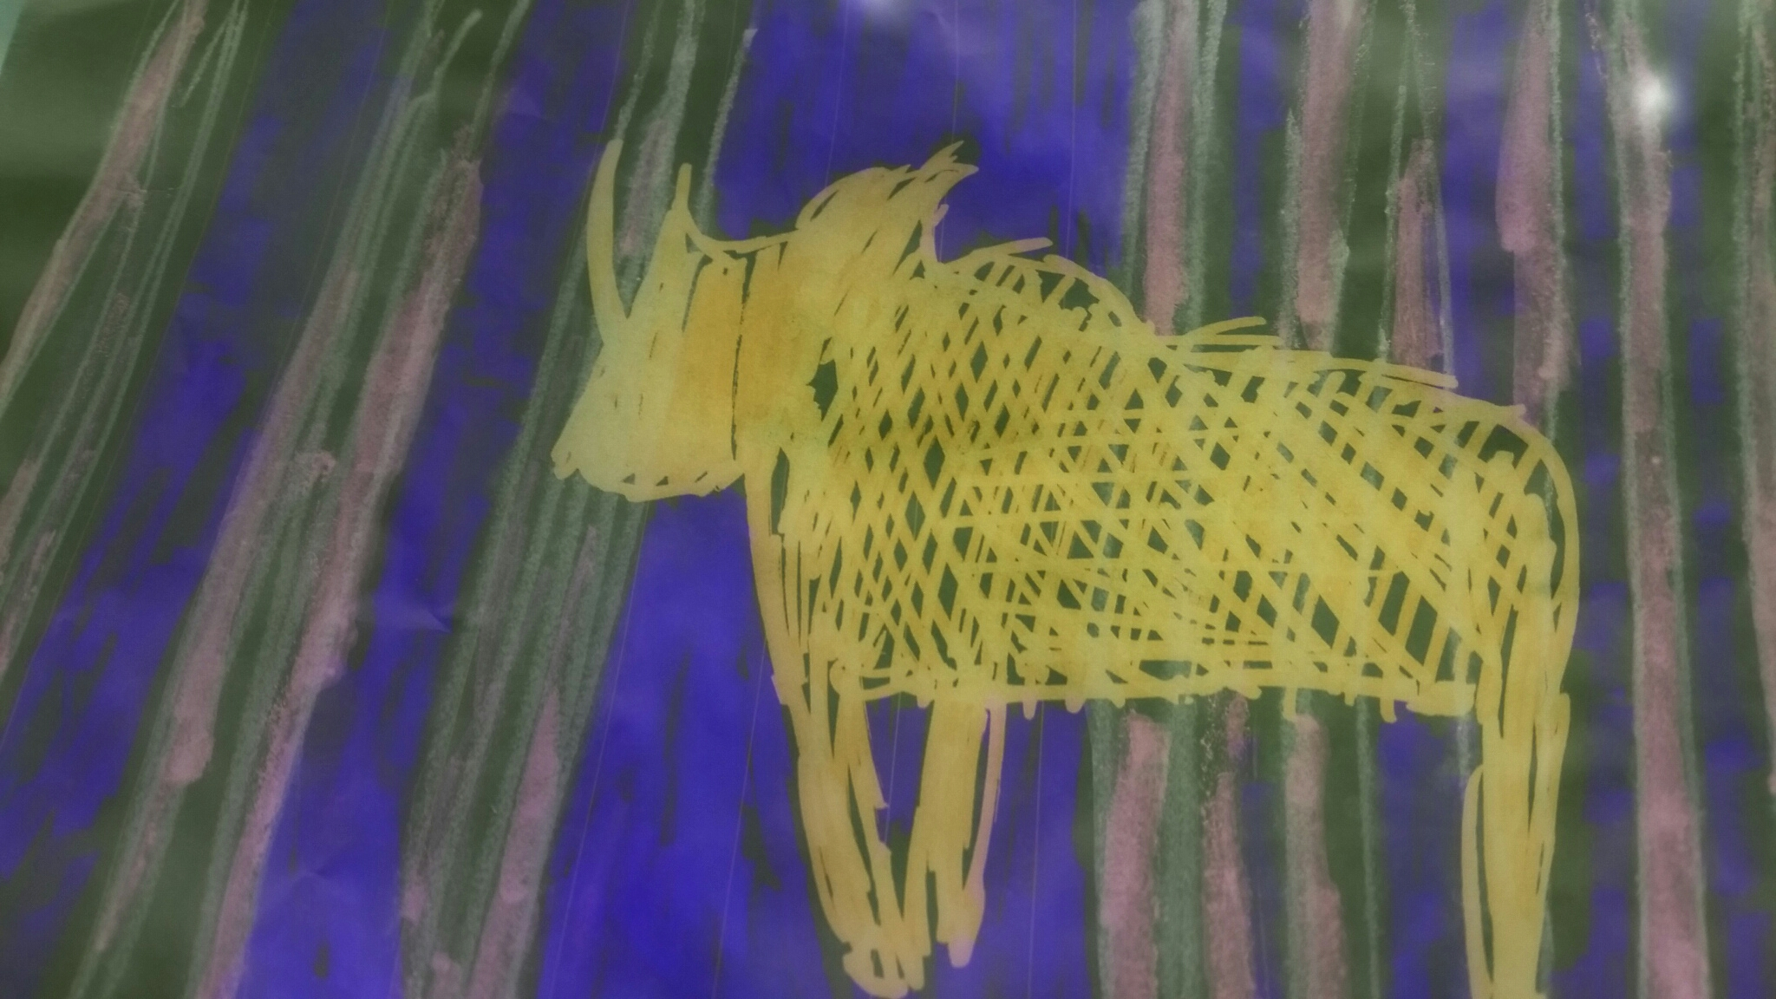
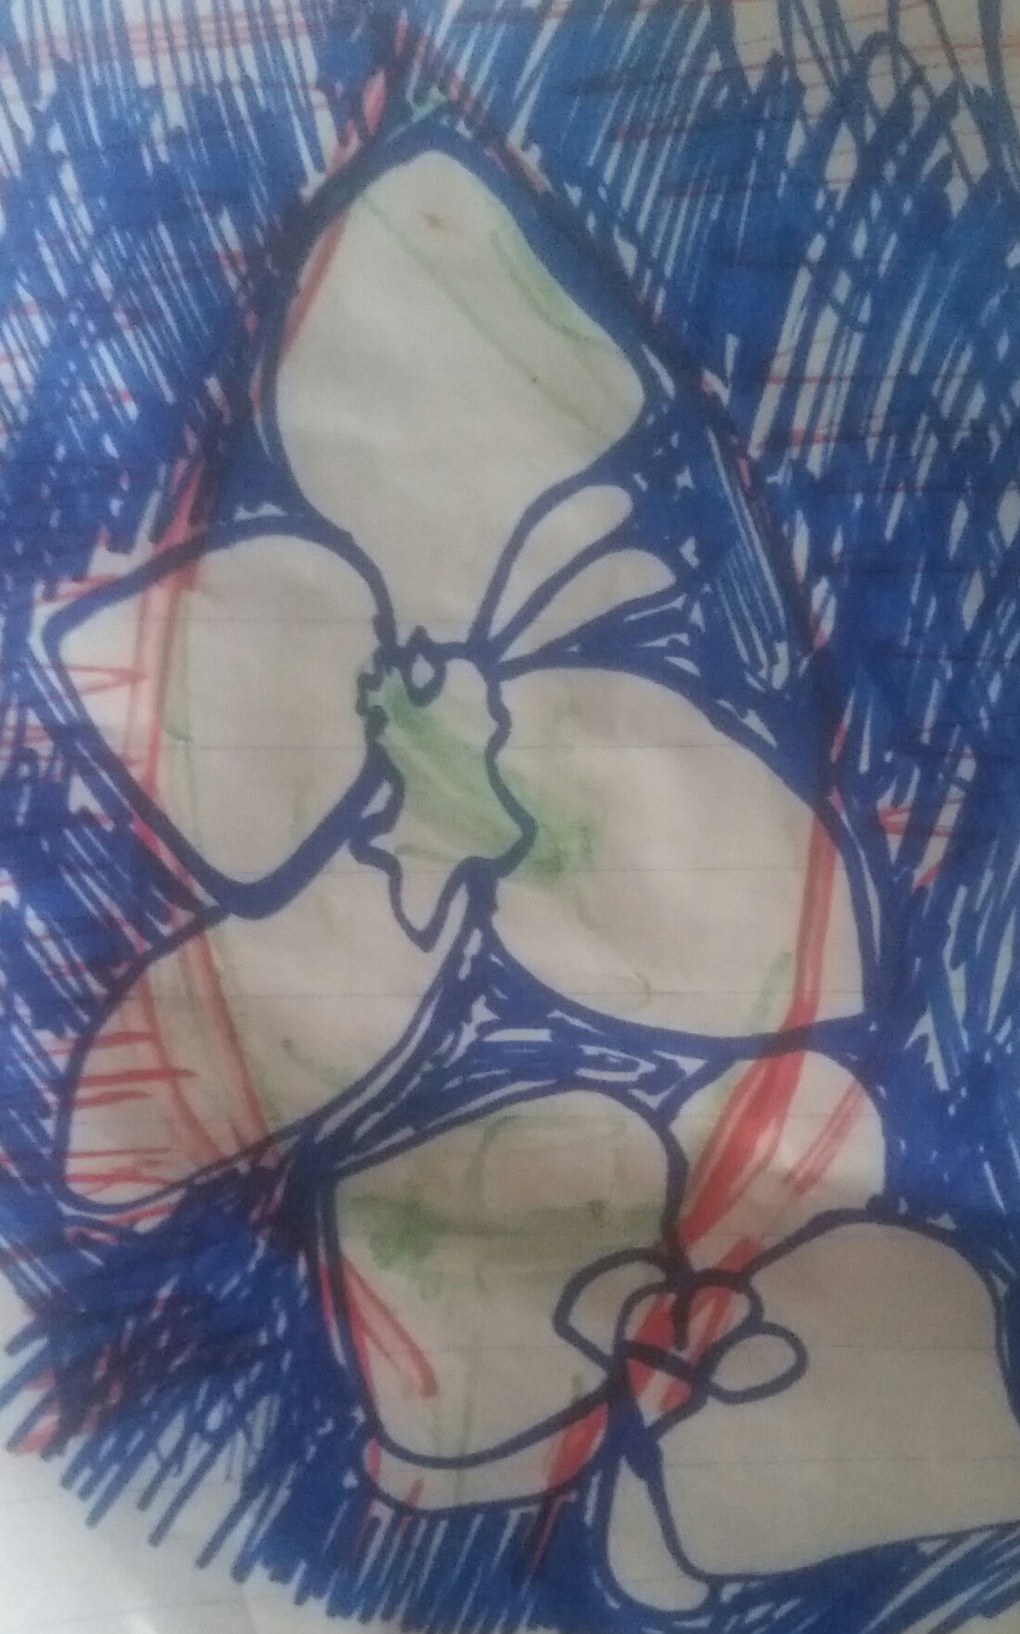

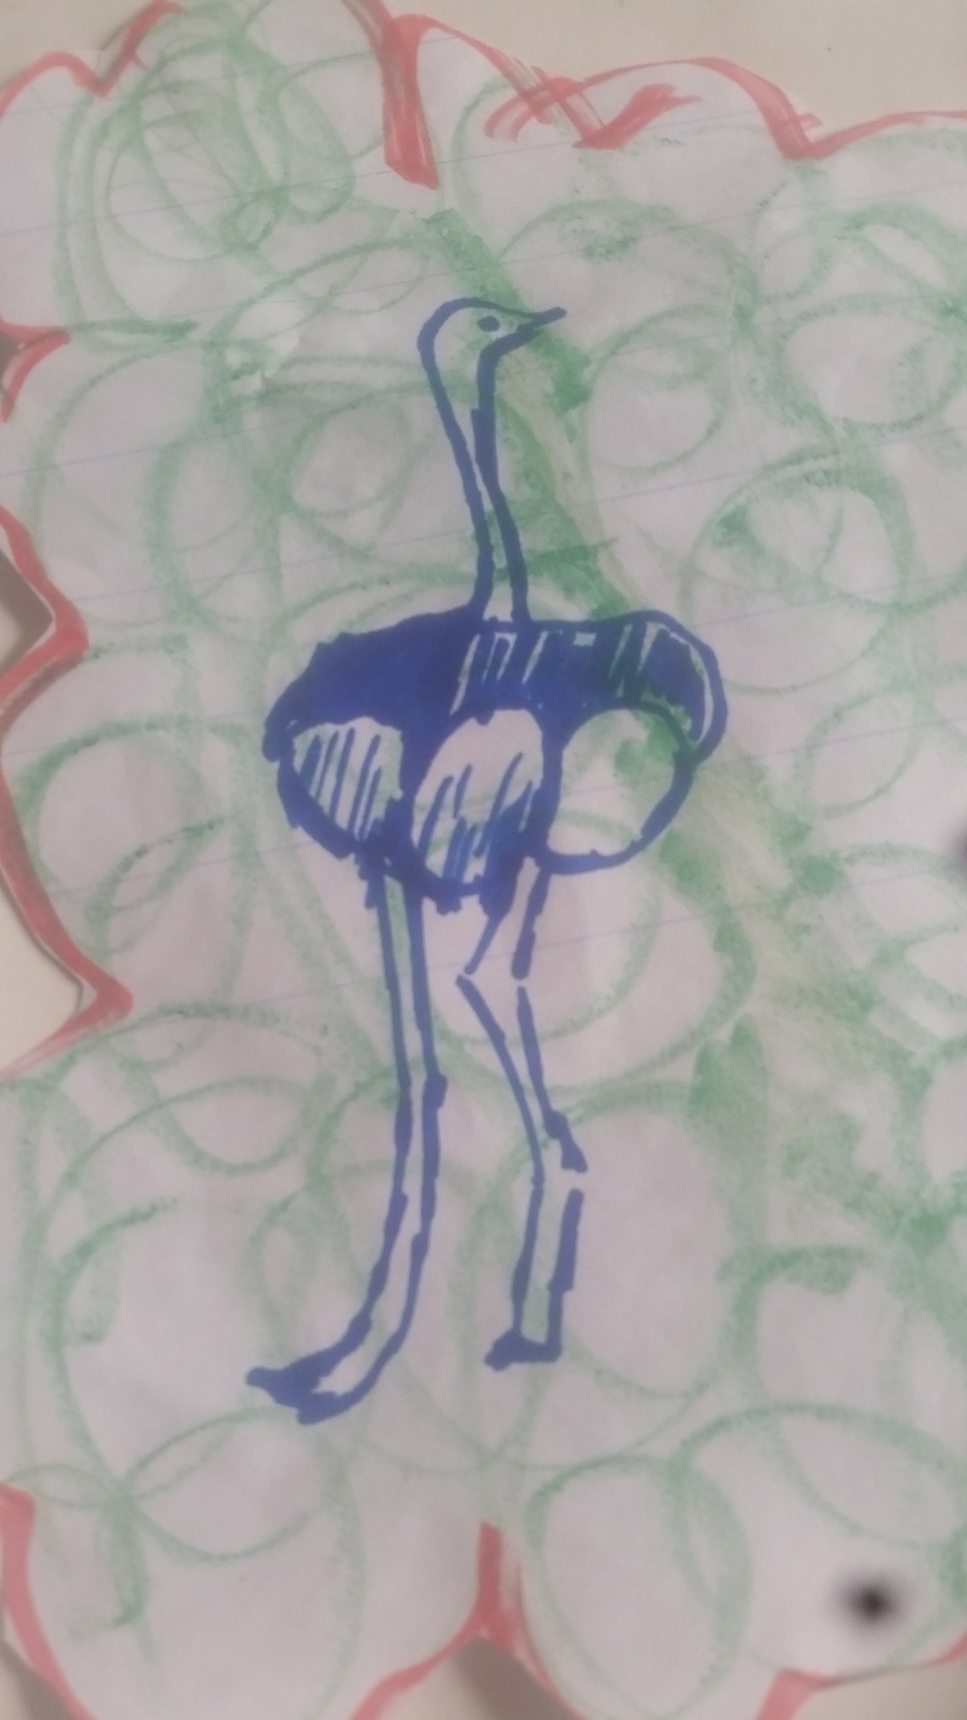
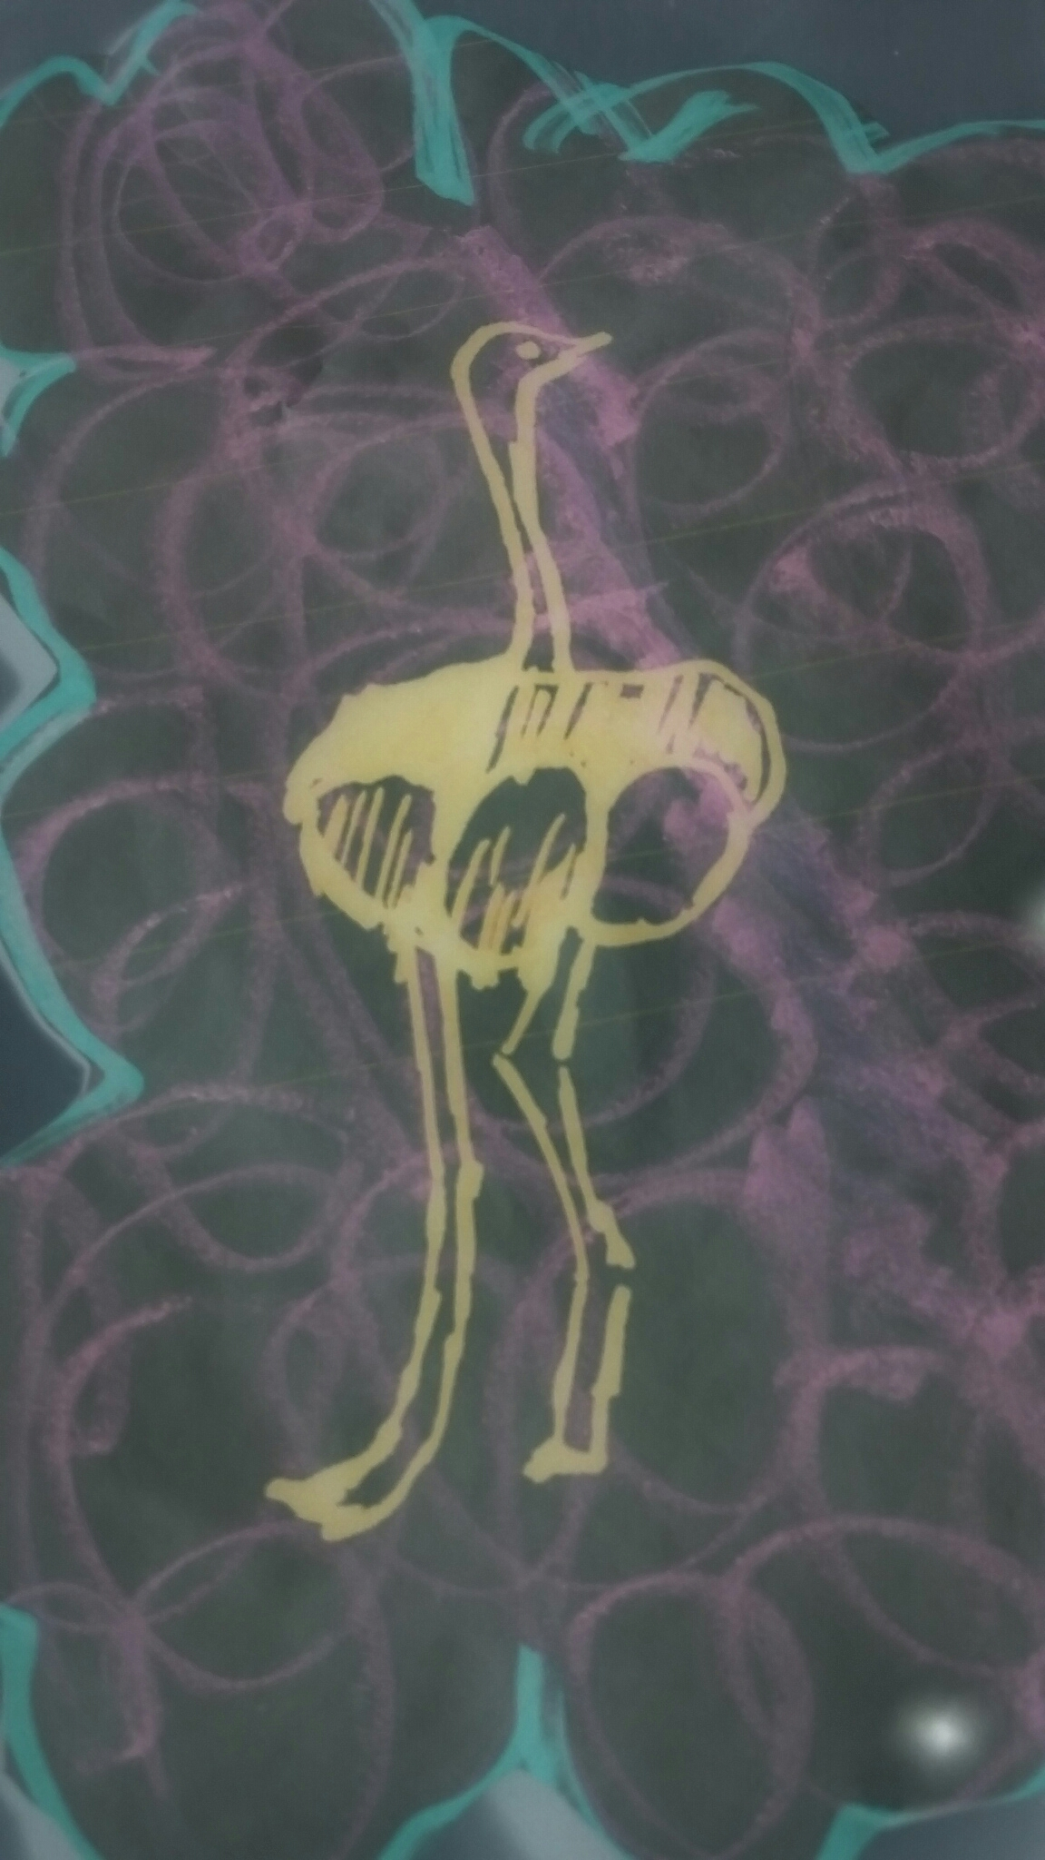
Giving practical support to MSc students in the Global South
Stephen Burnley
Sinead O’Connor
School of Engineering and Innovation

Slide 2
Background
The Commonwealth Scholarship Commission provides bursaries for students from Commonwealth countries to take distance-learning Masters qualifications.
The OU has benefitted from this source of funding since 2006.
Funding includes the provision of in-country tutorials.
E&I has gained c£500,000 in the past six years and has around 20 students currently studying, 8 graduates and 10 students beginning their studies in November 2020.
Are we meeting the needs of these students?

Slide 3
Project aims
To appreciate the academic and social cultures of our students.
To understand how we can best support our Commonwealth Scholars.
To produce internal guidance on supporting CSC students and other students in similar circumstances.
To disseminate our findings in the literature.

Slide 4
Mixed Methods
Quantitative
Official/ available Statistics
Pass/fail
Retention
Qualitative
a. Focus groups
Collective
Study logistics/ Online experience/Support
Qualitative
b. 1-1 personal narratives
Deep Hanging Out
Vignettes
Portraiture

Slide 5
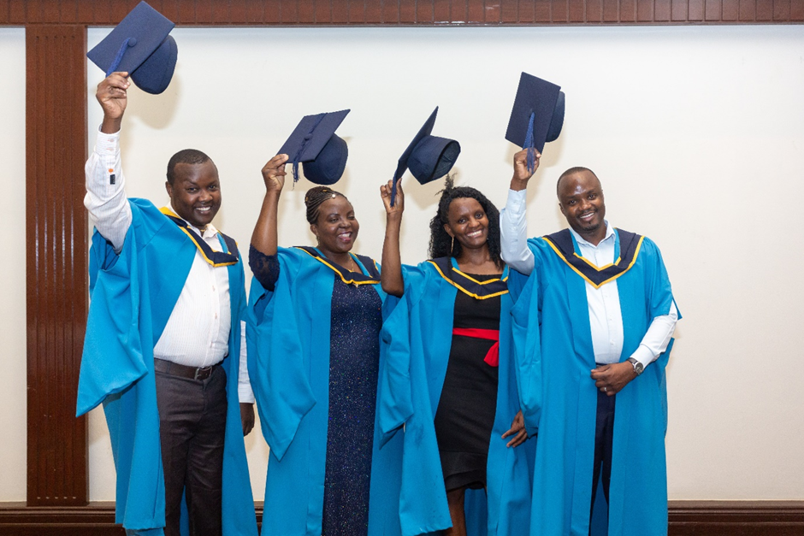
The statistics

Slide 6
Student performance – the statistics
Cohort 1 – started Nov 2015
Started in 2015 | 11
Withdrew – no qualification | 2
Left with PG Diploma | 1
Still studying | 1
Graduated with MSc | 7

Slide 7
More statistics
Cohort 2 – started Nov 16
Started in 2016 | 7
Withdrew – no qualification | 1
Withdrew – PG Certificate | 2
Awaiting final module results | 4
Cohort 3 – started Nov 17
Started in 2016 | 13
Withdrew – no qualification | 2
Still studying | 11 (8 on final module)

Slide 8
How can we support these students?
The following findings are based on:
  Discussions with ALs;
  Informal discussions with students at in-country day schools and tutorials;
  Student-led focus group;
  In-depth one to one interviews with students.

Slide 9
Provision of study materials
Provide key texts as print and online/PDF resources.
  Not all students have:
    Peace and quiet at home (women in particular);
    Electricity;
    The internet (certainly not cheap high speed fibre broadband).
Provide online study guides:
    Deliverable via the VLE and smartphone apps;
    Students often work in the field and in remote areas;
    (“Field” means an area of land where crops are grown).
Of course, this is what many programmes already do

Slide 10
AL support
Students appreciate the personal contact and rapid return of assignments (thanks to all our ALs).
Face to face tutorials/day schools should be provided.
These need to take account of:
  Journey times (overnight bus journeys are common);
  Tiredness;
  Need for breaks for reflection, food and relaxation.
Students appreciate building a good relationship with their ALs
  Where possible, ALs should deliver more than one module.

Slide 11
Study support
Additional support for students to become familiar with:
  UK academic traditions;
  Taking a critical approach to data/resource analysis and their writing.
Good academic practice needs to be stressed throughout the programme.
Student status recognition in their country
  Provision of international student ID cards.
  Letters of support/authentication for project module students.

Slide 12
Peer support
Hold tutorials for different modules/cohorts at the same time and venue:
  Fosters a student community;
  Cheaper/safer for the OU.
Encourage formation of alumni/graduate groups.
Hold in-country “graduations”:
  Allows extended families to celebrate;
  Provides photographic evidence;
  Helps establish the OU’s credentials.

Slide 13
Conclusions
Commonwealth scholars are well-motivated, keen and have excellent retention and progression rates.
However, they have needs that many of their UK students don’t have.
We asked the students, and they told us what they need/want.
Many of these needs can be met relatively easily.
A question for the qualification leads – why don’t we make similar provision for all students?

