Slide 1


eSTEeM 2020 Day 2 Session N
OpenSTEM Africa:
Strengthening science education in Ghana
STEM: Kerry Murphy, Maria Velasco, Sarah Davies, Janice Ansine & Clem Herman
WELS: Jane Cullen (Academic Director), Eric Addae-Kyeremeh, Kris Stutchbury & Olivier Biard
CENDLOS: Joshua Mallet
V2

Slide 2
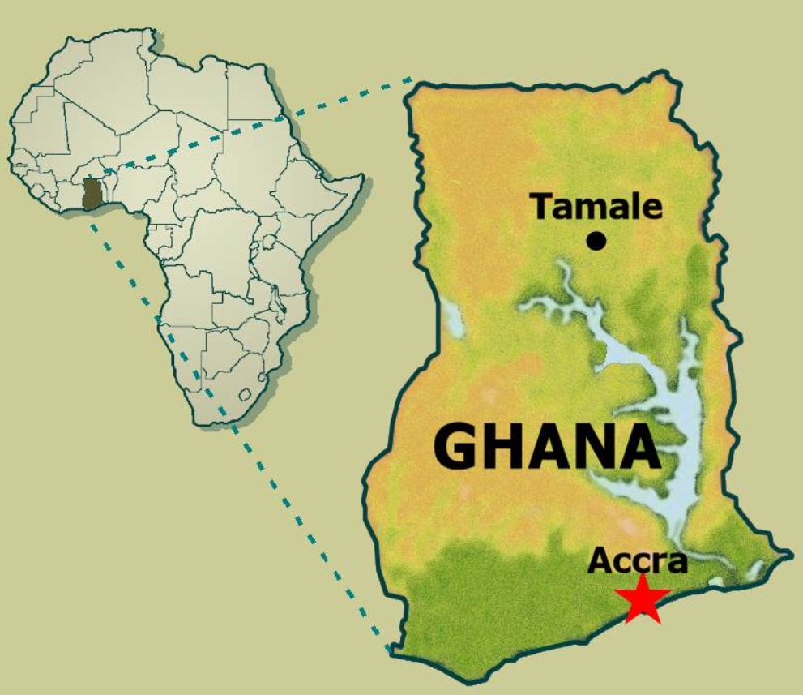

Slide 3

Challenges for the teaching & learning of science subjects
Increase in student numbers
Access to internet
Access to ICT equipment & skills in using ICT
Using smartphone/tablets in school
Access to science laboratory, equipment and materials
Young people, especially girls, transitioning to study sciences at tertiary level and into STEM careers
(source: Ministry of Education/Ghana Education Strategic Plan 2018-2030)

Slide 4
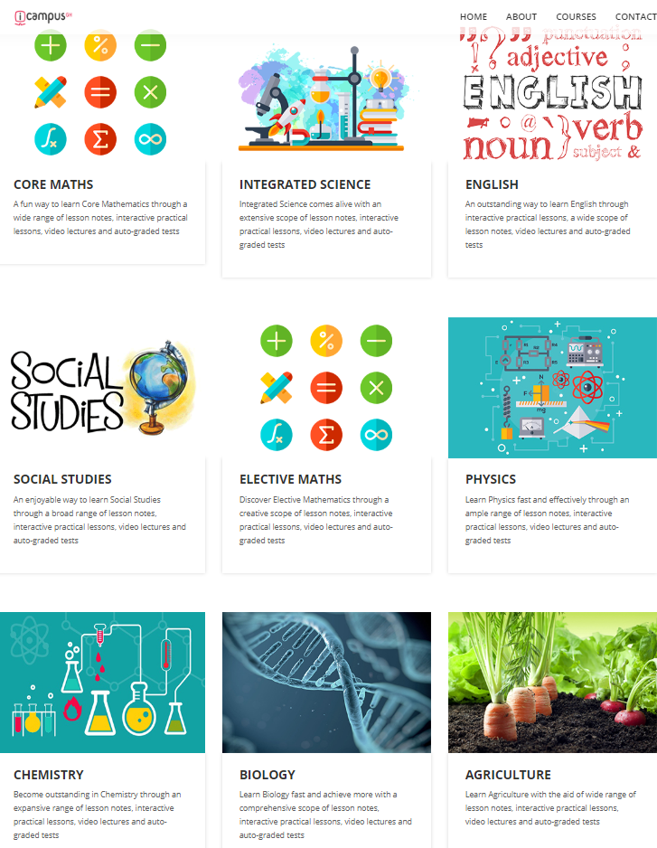
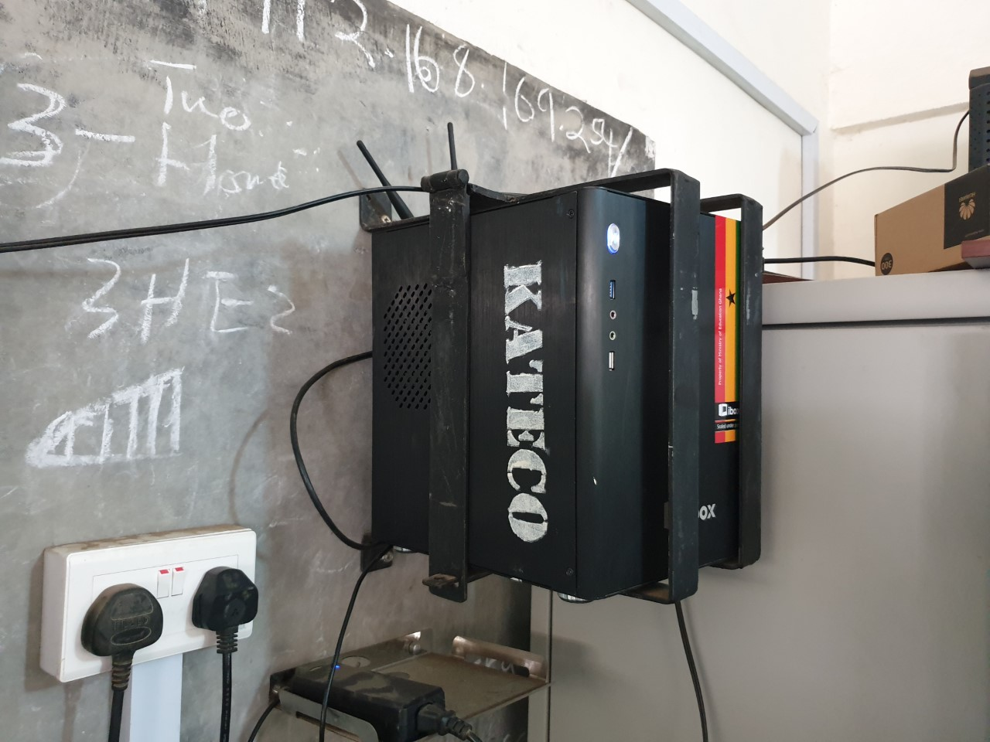
iBox in Senior High School
Content
Kaneshie SHS, Accra
https://www.icampusgh.com

Slide 5
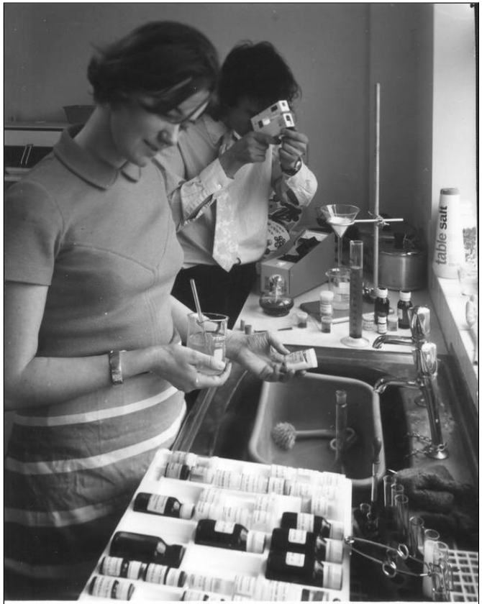
Practical science teaching at the OU
Historical perspective
Home experimental kits and broadcasts
  Microscope, skulls, chemicals, rubber balls etc
Residential laboratory based classes
  6 day residential practical programmes
  Embedded in theory modules
  Free-standing modules
Onscreen interactive experiments
  CD/DVD by mail
  Web-delivered-downloadable
  Online

Slide 6
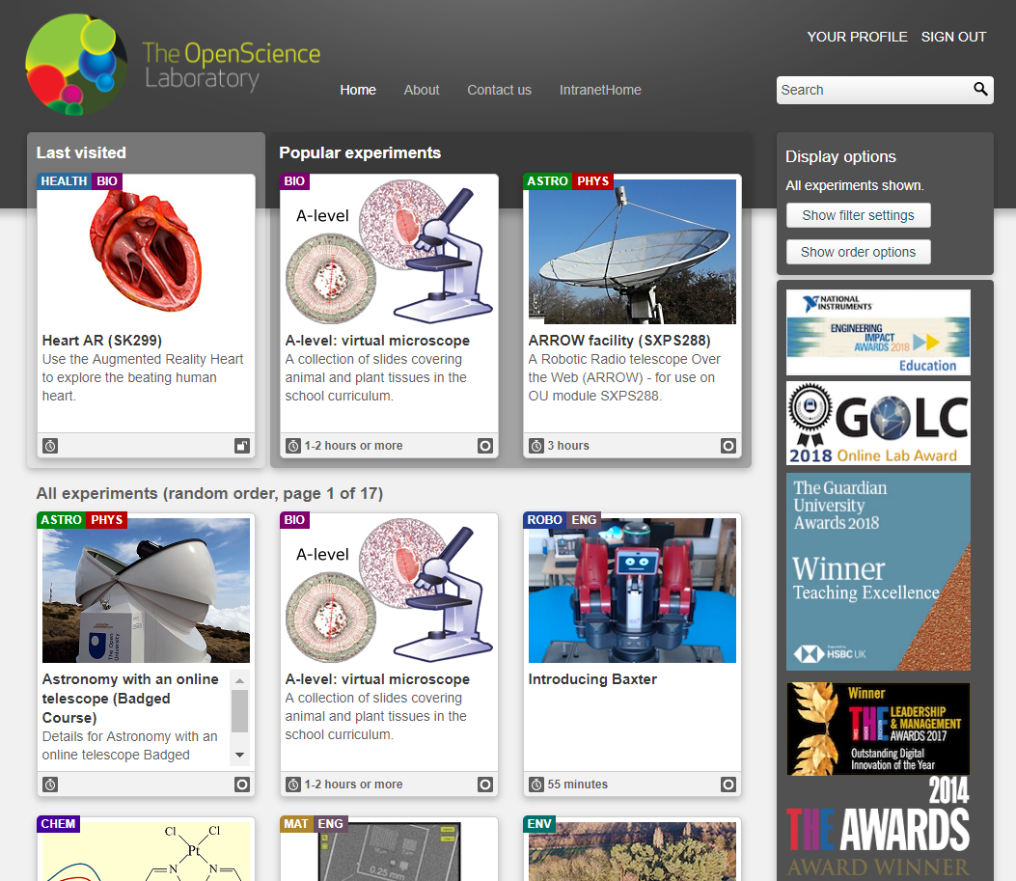
Teaching Practical Science
without a physical laboratory
Onscreen virtual instrument
Immersive laboratory experience
Object manipulation in 3D space
Citizen science platforms
https://learn5.open.ac.uk/course/view.php?id=2

Slide 7
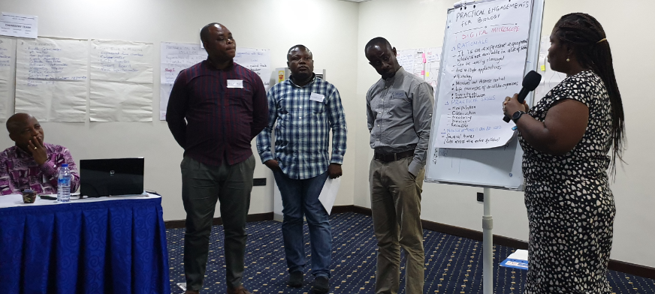
Senior High School education
Lesson Objectives
Background
Practical onscreen app
Summary and Conclusion
Quiz
In Service CPD
Leadership
Gender
Co-design workshop with Senior High School teachers
in Accra, Ghana, July 2019

Slide 8
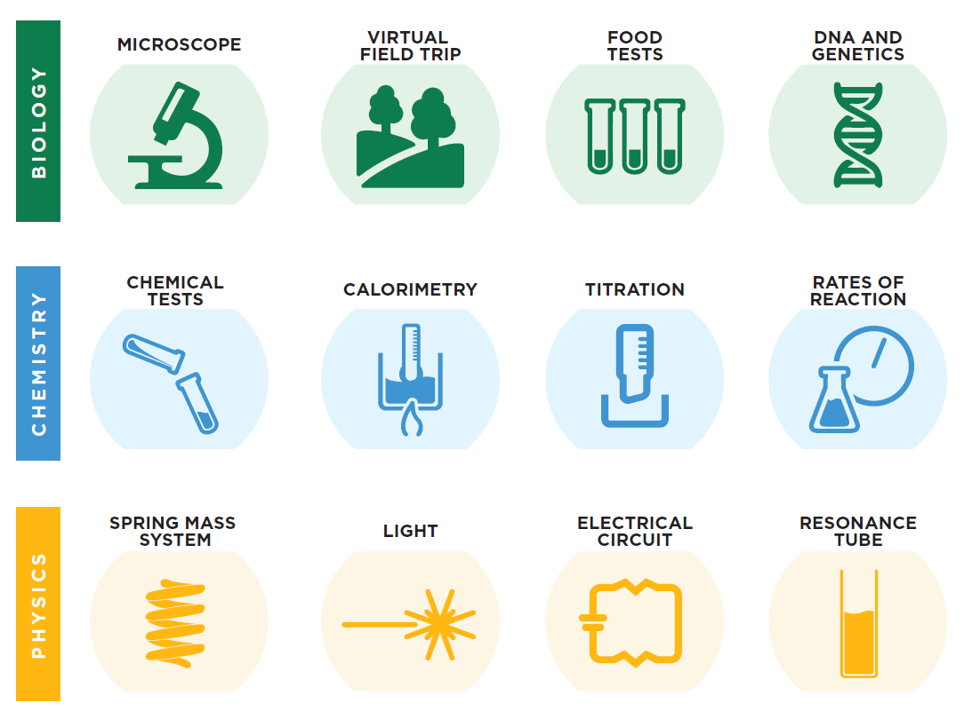
The 12 practical science apps: Ghana virtual laboratory

Slide 9
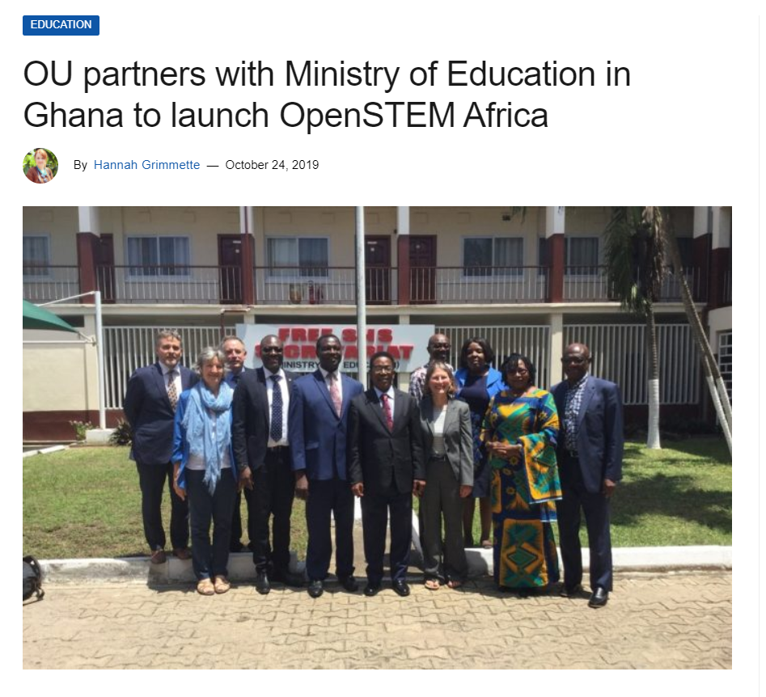
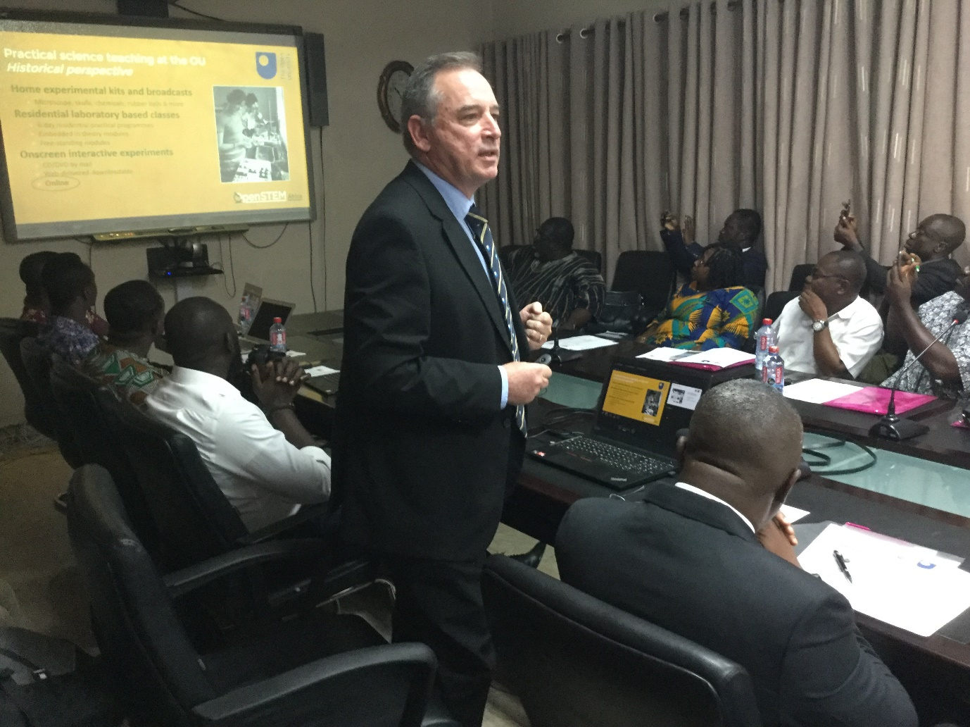

Slide 10
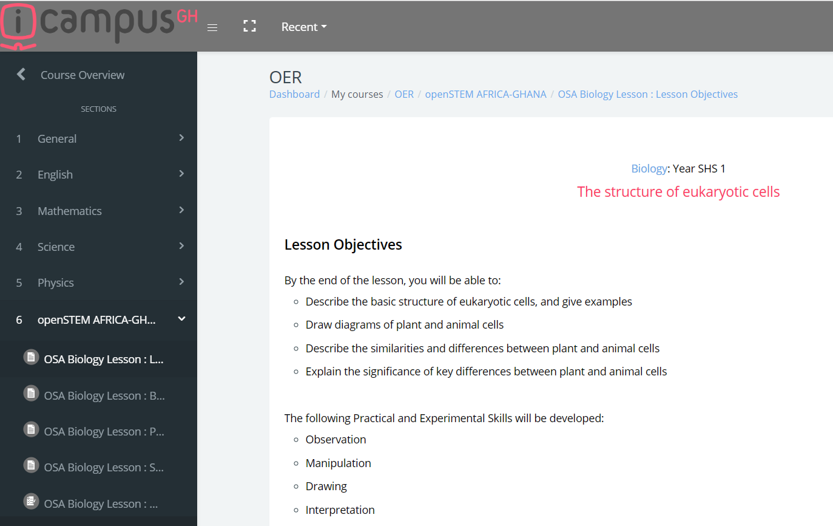
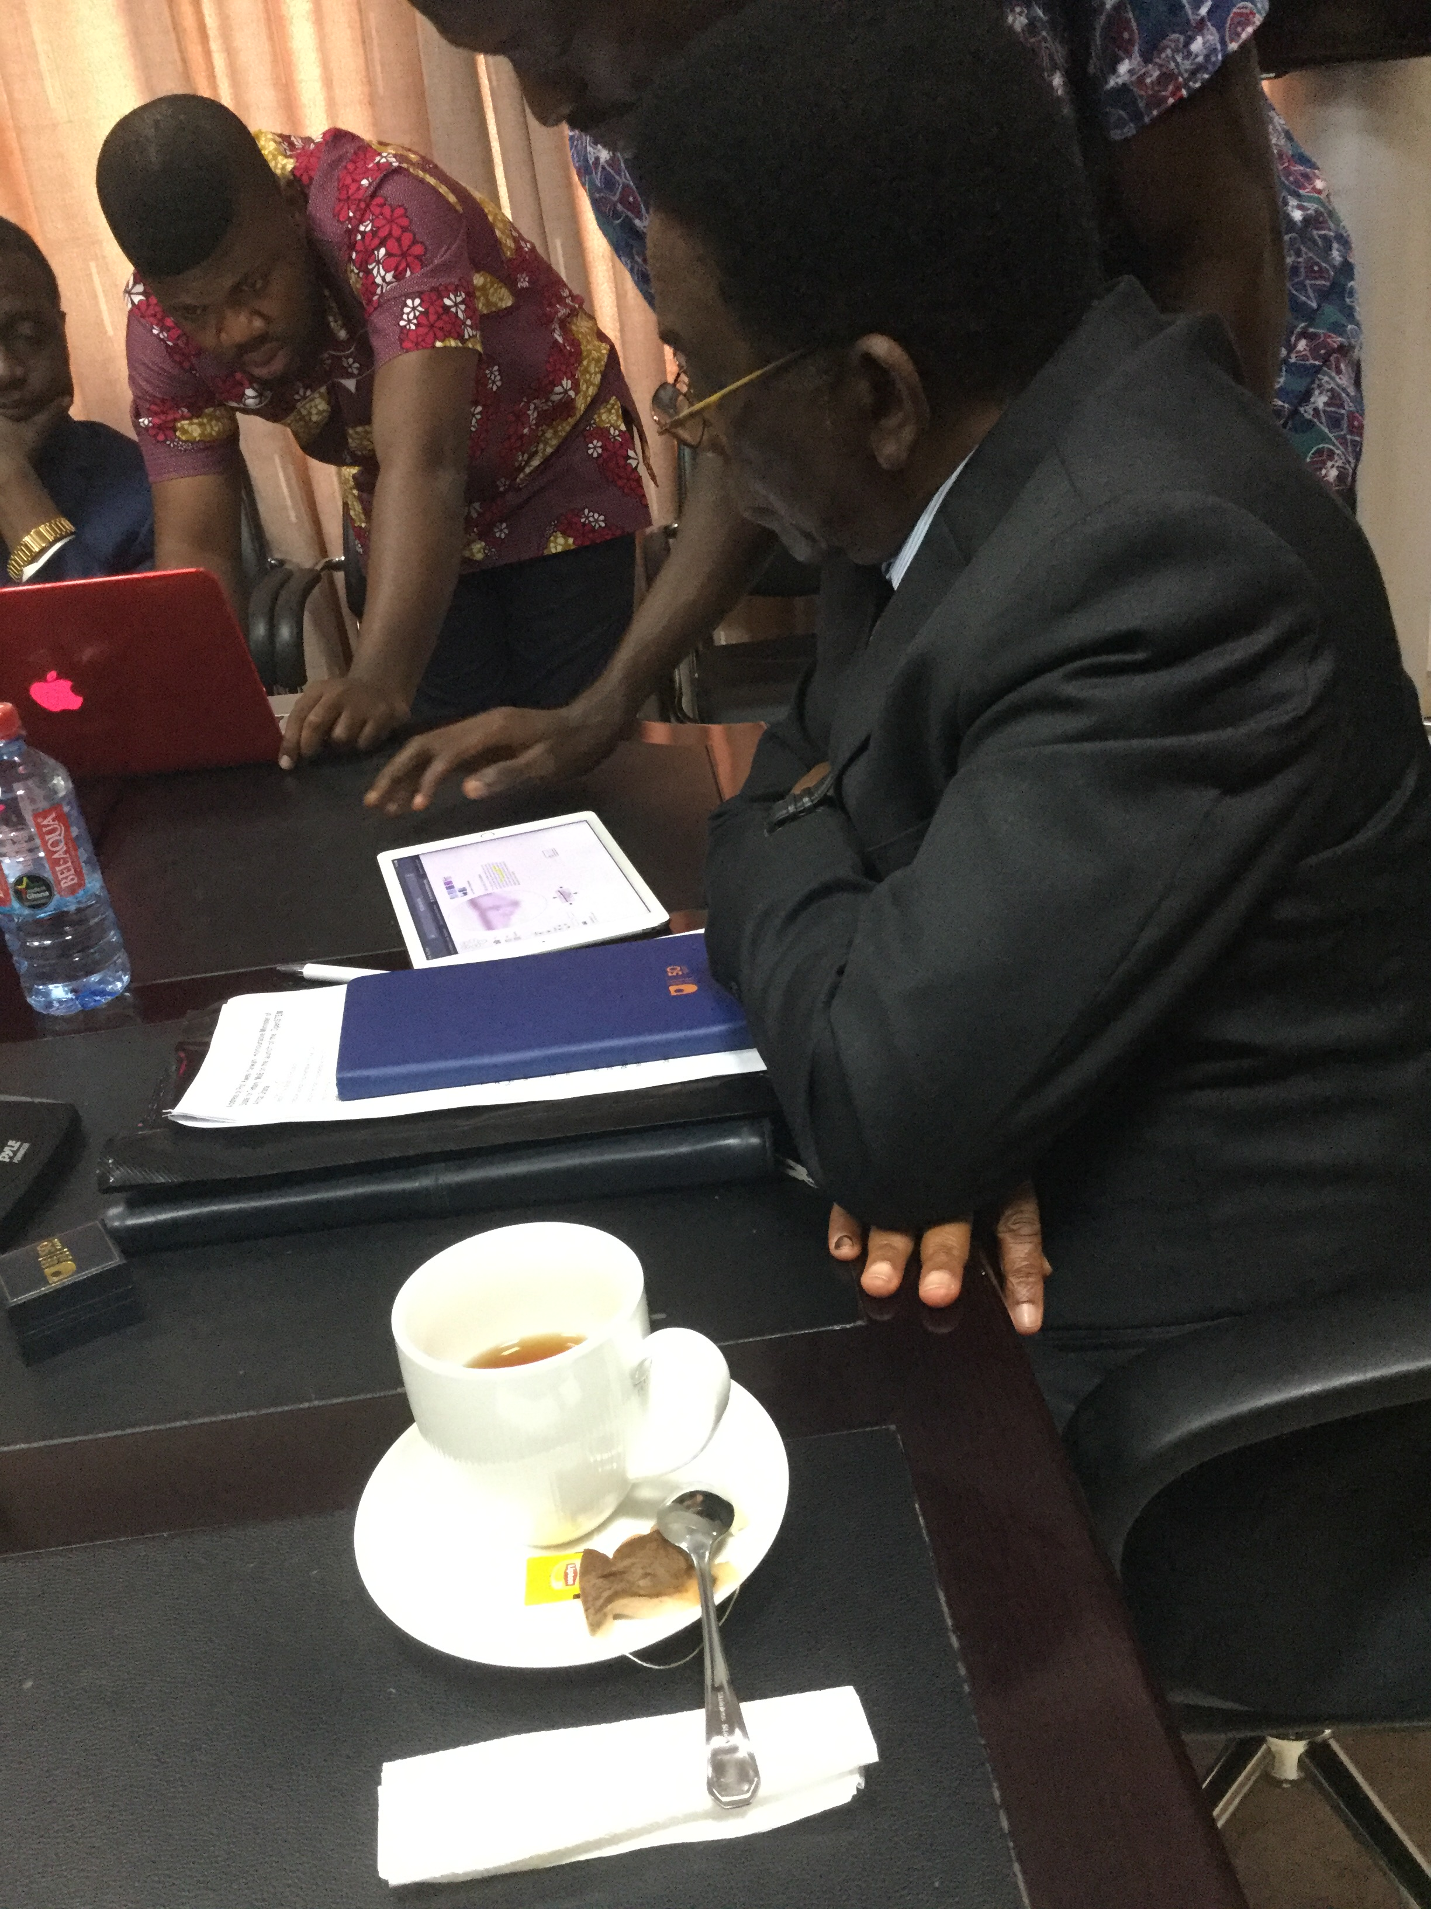
The 1st lesson & practical science app
Biology: virtual microscope

Slide 11

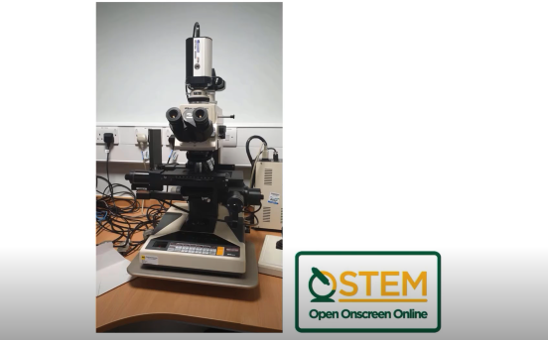
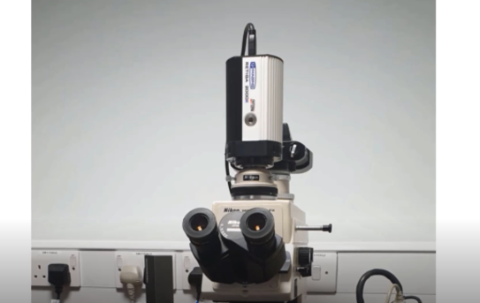
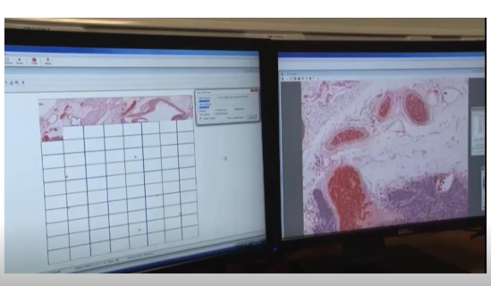
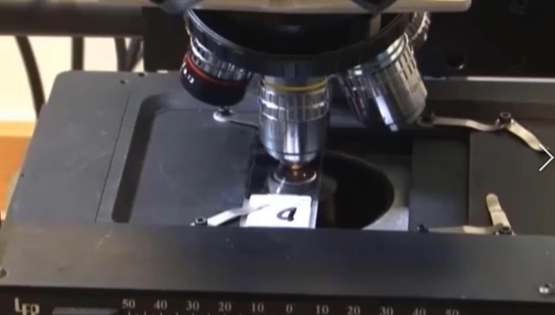
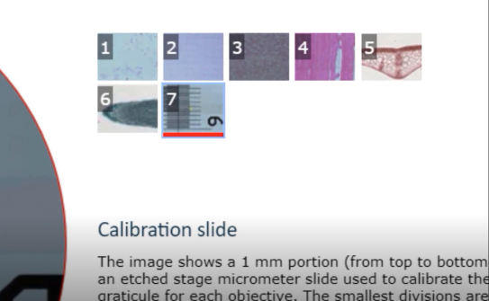
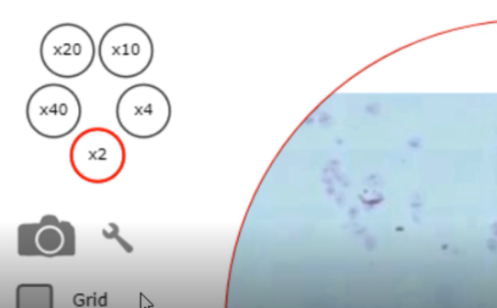
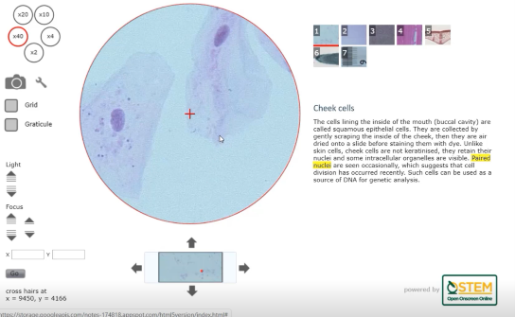
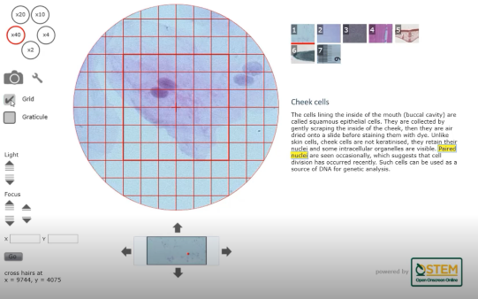
OSA Virtual microscope – introductory video

Slide 12



Slide 13

kerry.murphy@open.ac.uk

