Slide 1



Putting Innovation into Practice
Enhancing the STEM curriculum through scholarship
Trevor Collins¹, Rebecca Ferguson² and Eileen Scanlon²
1. Knowledge Media Institute
2. Institute of Educational Technology
eSTEeM 9th Annual Conference
Thursday 30th April 2020

Slide 2
Workshop overview
Problem: Translating educational research into teaching practice
Review of approaches
  Innovations in systemic reform (Blumenfeld et al., 2000; Fishman et al., 2004)
  Bridging the research practice gap (Hirschkorn and Geelan 2008)
  Beyond prototypes: Enabling innovation in TEL (Scanlon et al., 2013)
  Translating Research into Teaching Practice (NRC 2012)
  Case study example: Stadium Live – labcasts and fieldcasts
Activity: SoTL at the OU – Putting your innovations into practice
Plenary: Pathways for scholarship informed practice

Slide 3
Translating research into teaching practice
“The field of Technology Enhanced Learning, despite some notable exceptions, is rife with results that never made it across the valley of death.”
Prof Richard Noss
Director, Technology Enhanced Learning Research Programme (Scanlon et al., 2013)
Figure from (Barr, Baker, Markham and Kingon 2008)

Slide 4
Innovations in systemic reform
Framework for research on systemic technology innovations (Blumenfeld et al., 2000; Fishman et al., 2004)
Critical components:
  teacher learning,
  assessment,
  technology planning, and
  organisational structure and leadership.
Systemic issues
  Usability: School culture, capability and policy/management (diagnostic tool)
  Scalability (beyond research sites)
  Sustainability
Figure from (Blumenfeld et al., 2000)
Notes:
Framework for research on systemic technology innovations (Blumenfeld et al., 2000; Fishman et al., 2004)
Context
- Scaling up technology-embedded project-based science education in US schools (Blumenfeld et al., 2000)
- Critique of cognitive oriented technology innovations (Fishman et al., 2004)

Slide 5
Bridging the research practice gap
Critical literature review on implementation of research in education (Hirschkorn and Geelan 2008)
Two cultures
  Education craft
  Education research
Bridging two cultures: Research informs practice and practice informs research (research by practitioners)
Causes of the research-practice gap
  Cultural factors: different communities (values, rituals and institutions)
  Structural factors: characteristics that imped knowledge exchange (time to engage, inaccessible, irrelevant, variable outcomes)
Approaches to closing the gap
  Fix the practitioners: access, skills and autonomy
  Fix the researchers: responsible for serving profession, skills in applying research
  Fix the research: pursue varied forms of research
  Research translation roles: brokers between researchers and practitioners (findings r and needed p)

Slide 6
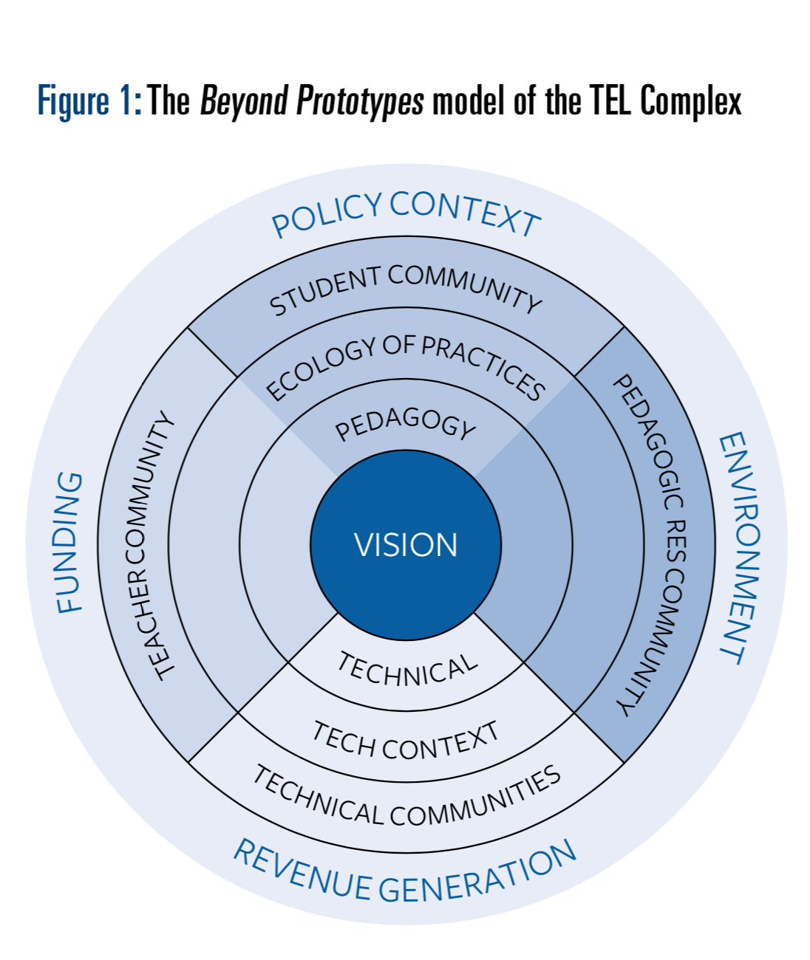
Beyond prototypes
Enabling innovation in Technology Enhanced Learning (Scanlon et al., 2013)
Key insights
  The TEL Complex: “pay close attention to the entire process of implementation”
  Persistent Intent: “embedded over periods of years … sustainable change is not a simple matter of product development, testing and roll out”
  Bricolage: “informed and directed exploration of technologies and practices”
  Evidence: “TEL innovation requires evidence that the projected educational goals have been achieved”
Figure from (Scanlon et al., 2013)

Slide 7
Translating Research into Teaching Practice
A synthesis of literature on Discipline Based Education Research (DBER in HE Science and Engineering) (NRC 2012)
Components of successful efforts to translate research into practice
  Sustained, focussed effort (four weeks, one semester or longer)
  Feedback on teaching practice (coaching and feedback)
  Deliberate focus on changing faculty conceptions about teaching and learning (deep, conceptual change required to replace existing conceptions with a better understanding)
Putting reform into context
  Institutional factors: Department/school context and culture, institutional priorities and reward systems, student engagement and feedback, faculty member’s beliefs
  The change process: through communities – DBER scholars, professional development scholars, higher education scholars; would benefit from cross-community communication
Notes:
Government funded project – National Research Committee in UK (bit like Royal Society in UK)
Started from two workshops in 2008 – funded project

Slide 8
Summary
Framework on systemic technology innovations
  Usability: School culture, capability and policy/management (diagnostic tool)
  Scalability (beyond research sites)
  Sustainability
Research-practice gap
  Cultural and structural factors
  Fix the practitioners, fix the researchers and fix the research
  Role of research translators
Beyond prototypes
  Attention to whole process
  Persistent intent (time and effort)
  Informed and directed exploration
  Evidence of achieving goals
Translating research into teaching practice (DBER in HE)
  Sustained, focussed effort
  Feedback on teaching practice
  Deliberate focus on deep, conceptual change to replace established conceptions

Slide 9
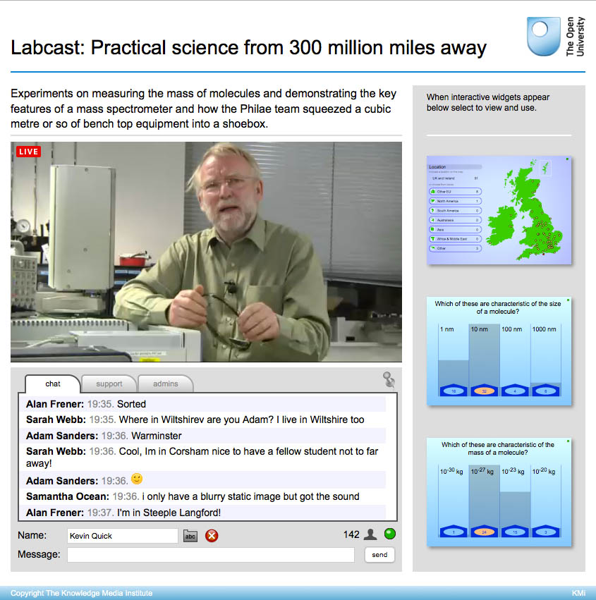
Case study example
Stadium Live: Creating and embedding labcasts and fieldcasts
Culture
Capability
Sustainability
Research translators
Persistent intent
Informed and directed exploration
Feedback on teaching practice
Evidence of achieving goals

Slide 10
Activity: SoTL at the OU
Putting your innovations into practice – pathways for scholarship informed practice
  Culture
  Capability
  Sustainability
  Research translators
  Persistent intent
  Informed and directed exploration
  Feedback on teaching practice
  Evidence of achieving goals
One rapporter per group to bring back key points
Breakout Rooms for discussion
  Red Room (E&I and LHCS)
  Green Room (EEES and SPS)
  Blue Room (C&C, KMi and MS)
Focus on your school context and come back with strengths and recommendations

Slide 11
Pathways for scholarship informed practice
Strengths
Recommendations

Slide 12
Bibliography
Barr, S.H., Baker, T., Markham S.K. and Kingon A.I. (2008) ‘Bridging the Valley of Death: Lessons Learned from 14 Years of Commercialization of Technology Education.’ Academy of Management Learning & Education, Vol 8, No 3, pp. 370-388.
Blumenfeld, P., Fishman, B.J., Krajcik, J., Marx, R.W. and Soloway, E. (2000) ‘Creating Usable Innovations in Systemic Reform: Scaling Up Technology-Embedded Project-Based Science in Urban Schools.’ Education Psychologist, Vol 35, No 3, pp. 149-164.
Fishman, B.J., Marx, R.W., Blumenfeld, P., Krajcik, J. and Soloway, E. (2004) ‘Creating a Framework for Research on Systemic Technology Innovations.’ The Journal of Learning Sciences, Vol 13, No 1, pp. 43-76.
Hirschkorn, M. and Geelan D. (2008) ‘Bridging the Research-Practice Gap: Research Translation and/or Research Transformation.’ The Alberta Journal of Educational Research, Vol 54, No 1, pp. 1-13.
National Research Council (2012) ‘Discipline-Based Education Research: Understanding and Improving Learning in Undergraduate Science and Engineering.’ Washington, DC: The National Academies Press.
Scanlon, E., Sharples, M., Fenton-O’Creevy, M., Fleck, J., Cooban, C., Ferguson, R., Cross, S. and Waterhouse, P. (2013) ‘Beyond prototypes: Enabling innovation in technology-enhanced learning.’ TLRP Report. Available online at http://oro.open.ac.uk/41119/

