Slide 1
Developing “use value mindsets” to enhance undergraduates’ perceptions of learning mathematics in a first-year service mathematics environment
Andrew Potter and Gerry Golding
eSTEeM conference online April 2020

Slide 2
Agenda
Service mathematics
Discovering Mathematics (MU123)
Our Challenge
Our Objective
Our Methodology
Where to now?

Slide 3
Service Mathematics
What is Service Mathematics and how does MU123 differ?

Slide 4





Engineering Mathematics
OU convention
Normal convention
Providing a good grounding in mathematics for all students
Easier to deliver when dealing with campus based cohorts in bitesize modules 5 - 10 credits
Computing & IT (60%)
MU123
Economics & Business (10%)
Maths & Stats (5%)
Education. Open Degree, etc. (25%)

Slide 5
Discovering Mathematics MU123
Some details

Slide 6
MU123
Providing a good grounding in mathematics for all students
Pre-calculus level 1
30 credits
4 iCMAs
4 TMAs
EMA
31 week presentations J and B
Approx 3,800 students per year
Materials: Hard copy and Online
Approx 150 tutors
Online support resources
Tutor group size 20
Tutorials F2F and Online

Slide 7
Our Challenge
Making maths more enjoyable, useful and relevant to all our students

Slide 8
Our Challenge
Designed to cover a broad range of mathematical topics
  Basic arithmetic skills …… exponential functions
Students come from diverse backgrounds
  Different agendas and baggage
MU123 has consistently performed well from a retention and progression point of view since its inception.
What’s the problem?

Slide 9
Our Challenge
Create a learning environment that encourages students to engage in more depth with the module by:
  Promoting the relevance of Level-one study
    Discouraging “doing enough to pass”
  Promoting the relevance of Mathematics for their discipline.
    Usefulness beyond ticking a box
  Discouraging “a reliance on memory from past mathematical study”
Forming habits of limited engagement with materials and an over reliance on past memories can inhibit the development of resilience. (Hernandez, Martinez and Williams, 2013)

Slide 10
Our Objective
Defining what we see as the issue.
What does the literature say?
How do we investigate this?

Slide 11
Our Objective
We define a “use value mindset” as:
A frame of mind that endorses the perception of studying mathematics being inherently enjoyable and/or useful to future study and career goals.
It promotes engagement with deep conceptual learning and self-gratification – in contrast to the perception of studying mathematics having only a tangible “exchange value”.
We define an “exchange value mindset” as:
A frame of mind that fosters a strategic focus on imminent assessment, where passing grades are exchanged for progression and accreditation.
Please note that while we are using the word “mindset” to suggest orientation to learning (Blenkinsop, McCrone, Wade, & Morris, 2006), we do not mean to map these mindsets to Carol Dweck’s more well-known work on growth and performance mindsets.

Slide 12
How are these values perceived in the literature
Its value is “the extent to which students find studying mathematics important in attaining their current or future goals” (Kooken, Welsh, McCoach, Johnston-Wilder, & Lee, 2016)
“Learning confers the accumulation of educational capital, which can be exchanged for economic capital (e.g. a career) at an appropriate exchange rate determined by social factors”. (Bourdieu, 1990, 1991, 1998)
“Use value” of mathematics learning as “useful to the learner and to society in general… It should not be thought of as a value which is solely focused on the utility of its applications”. (Williams, 2011, 2012)
The “exchange value” of mathematics learning is equated with its status as a “strong subject”: a passing grade in mathematics can be exchanged for other commodities, such as a qualification, or a desirable career. (Williams, 2011, 2012)

Slide 13
What we believe
Many MU123 students develop what we have defined as an “exchange value” mindset:
  Not appreciating the relevance of level-one study
  focusing solely on strategic approaches to gaining a passing grade
  failing to appreciate the “use value” of their mathematical studies.
Previous mathematical ability
  early materials present limited challenge.
Negative perceptions of the usefulness of mathematics in general.
Primary objective is
  to investigate, keeping an open mind
  use emerging evidence to develop suitable interventions.
Our intention is to complement, rather than prioritise one mindset over the other (Williams, 2012).

Slide 14
Our Methodology
A holistic view of where we are going with this

Slide 15
Methodology
What does a student want to get out of the module?
Combined two resources into “tutor reflective journals”
  Students’ reports on two strategically placed questions in coursework.
  Tutors’ in-depth knowledge of their students
In TMA01 students are asked:
to briefly describe their reasons for studying the module
to reflect on factors that might influence their work.
In their final assignment (TMA04) prior to the EMA, they are asked:
to reflect on how their studies so far fit in with their wider study interests and future study plans.

Slide 16
Tutor Reflective Journals
Tutors were asked to use their experience and personal judgement to assess
if the students’ responses to these questions was reflected:
in the students’ engagement with the module materials
in the presentation of their work,
in any specific interactions between the tutor and students outside of the normal support involved in correspondence teaching,
in their perceived general attitude towards study:
  did they come across as being proactive and/or enthusiastic about their learning?
  was there a sense of doing just enough to pass with minimal effort?

Slide 17
Tutor Reflective Journals
We enlisted the help of five tutors.
All teach across both presentations
A tutor from each of the four nations
A fifth tutor was chosen from the remaining dual presentation tutors
Each tutor has a group of approximately 20 students
  200 students across both presentations.
All five tutors are female
  a limitation of our methodology we have had to accept based on the demographic of our tutor cohort, workload, willingness to participate, and who teach on both presentations.
We have made the assumption that the tutors themselves are not systematically biased in a way that will affect the results.

Slide 18
Tutor Reflective Journals
The tutors will attend a recorded online focus group after TMA04 on each presentation. (refinement)
The tutors will submit their anonymised reflective journals soon after the completion of the final coursework.
Thematic analysis will be used to distil the experience of 200 students to give us a representative picture of our students’ perceptions of the module and its relevance.
We will share our findings initially with the five tutors in a second focus group to discuss our interpretation of their reflective journals and seek any refinements.
Each tutor will be paid for their time spent completing the reflective journals and attending the focus groups.

Slide 19
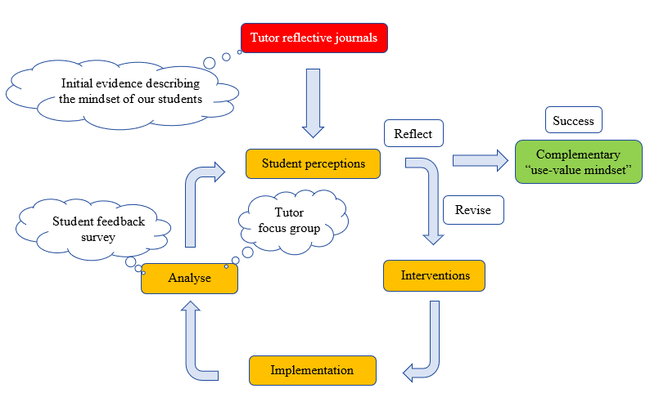
Holistic view

Slide 20
Where to now?
Discussion
Potential Interventions

Slide 21
Discussion
CETL MSOR and BSRLM
Refined our methodology
Covid-19 delays
We will share these refined student perceptions with the wider module team and colleagues from other schools that use MU123 on their pathways
The module team have had some initial discussion about potential interventions, and we will use these perceptions to inform/support/refine these interventions.

Slide 22
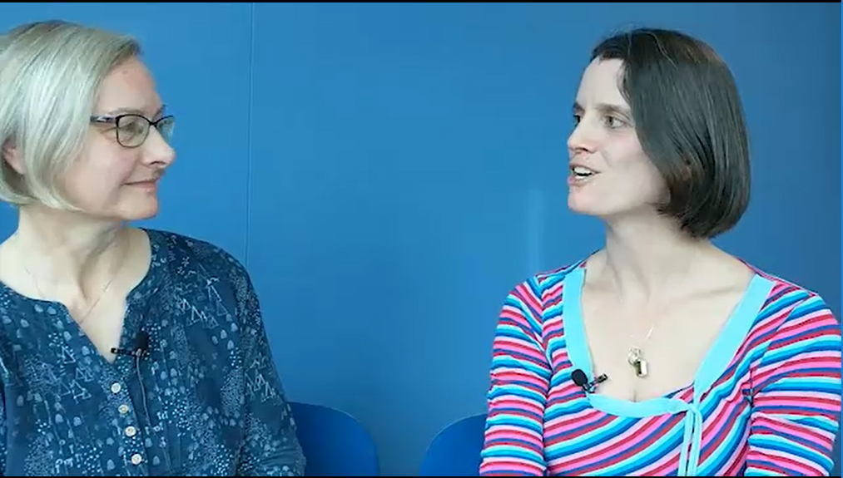
Potential Interventions
Life after MU123 seminars/videos: online recorded seminars/videos with former MU123 students or tutors from the schools that use MU123 to give the students an opportunity to learn about how/why mathematics is used in their discipline.
Contextualisation of TMA questions: Introducing choices in different contexts to suit different pathways.
Post-Christmas online activities: there is a fear that it may be difficult for some students to self-motivate after the Christmas break, especially when there is no assessment due. Having some activities that require student engagement may help.
Forum/tutorial activities for different pathways: having context-specific activities that encourage students to work on context-specific mathematics problems which are more challenging than MU123 presents.

Slide 23
Initial findings and Conclusion
Some tutor quotes which appear to justify our work:
…my experience is that too many of those doing this course apparently under duress, just to get a pass, just rely on stuff they learned at school, often seemingly without actually using the course material, tutorials, or tutor guidance (and then infuriatingly repeating these errors in successive TMAs, despite much time spent trying to assist them with feedback). Those who start with having forgotten or never having done some of the topics often do better because if they actually study the course, the teaching in the course materials (and, I humbly suggest, by tutors) is so good.

Slide 24
Initial findings and Conclusions
"I'm studying computing / communication technologies, so there are no topics in the module that are relevant to my career or study plans"
I have just marked one, who was clearly at the start a CBA computer science student, who really liked the golf simulation question - he said he could imagine himself coding something like this: it really did inspire him. He gained … for his final TMA after scores of … on the others and was clearly making a much bigger effort with all aspects.
“So for some students the contextualisation of the TMA questions is working - but maybe it needs to be embedded into some of the earlier questions to inspire this realisation sooner. I really struggle to understand how a student can work through all the questions they have to complete the TMAs, and still think maths has got nothing to do with computer science. I can understand why they might not like it, but not how they can still believe it irrelevant!”

Slide 25
THANK YOU

