Slide 1
How are students using extensions and what is the impact on their success?
Catherine Halliwell – Associate Lecturer
Cath Brown - Student

Slide 2

Why ARE WE DOING THIS?
Anecdotally – more extension requests from students
Extensions can be a mixed blessing
              may be vital for short-term success, confidence, retention
              can lead to problems later –compressing available time
More students studying at high intensity – more clashing
deadlines
Why us?
              Unique perspectives
              Non-judgemental – reporting experiences of peers
CAMPAIGN ASSETS
eSTEeM themes: Supporting Students, Assessment
University strategic priority: Student Success – supporting full time & flexible study intensity

Slide 3
WHAT DO WE WANT TO FIND?
Do students studying at high intensity have more
extensions?
How does use of extensions relate to success on a
module?
How are students using extensions?
CAMPAIGN ASSETS

Slide 4
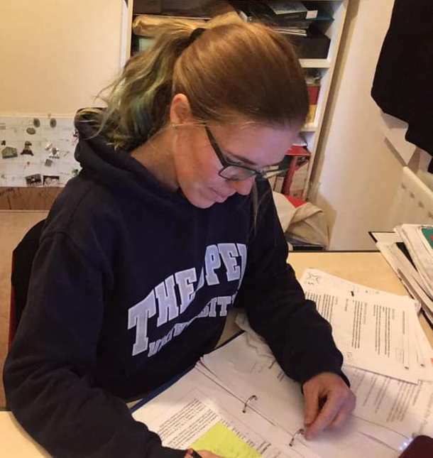
How ARE we doING it?
1 & 2: Quantitative (statistical) methods
3: Student focus groups & AL focus groups
CAMPAIGN ASSETS
Do students studying at high intensity have
more extensions?
How does use of extensions relate to success on a module?
How are students using extensions?

Slide 5
HOW COULD it help?
Identify assessment “pinch points”
Revision of assessment strategies
Support with workload management
Support with decision-making
Evidence-based advice
CAMPAIGN ASSETS

Slide 6
WHAT ARE WE LOOKING AT?
Level 2 Biology / Health Science
    S294, S295, SXHL288, SK299, SDK228
    30 credits each so many doing multiple modules
    Workload a known issue for Health Sci
17J, 18J data
Only students on Nat Sci or Health Sci
CAMPAIGN ASSETS

Slide 7
AL Focus groups
How/ why do you think students are using extensions
    Happening due to clashes
    Students studying at high intensity balancing workload
    Life getting in the way
    Mental health a common reason
    Specific medical/ disability/ or mix
    Not putting in the hours regularly
    Some still don’t complete whole TMA
    No feeling of asking for extension to gain unfair advantage
CAMPAIGN ASSETS
“…all sorts of reasons …half of mine are probably to do with ill health, relationships or whatever,
but ..there were a lot …who just plain don’t cope with the workload at second level and come in
from level 1 doing 60 points and they think doing two 30 point courses at level 2 is going to be
absolutely fine and then they are horrified if they are doing S294 and SK299”

Slide 8
AL Focus groups
What sort of impact do you feel extensions have on student
performance on the module overall
    Beneficial to “serious” students
    Allows them to complete to the best of their ability
    Improves retention
    “Serial extension” students – gets them through but
    long-term impact on study habits?
CAMPAIGN ASSETS
“more often there is a … positive impact on the student to have extensions. It is far easier …
allowing students a bit of time to give them the ability to complete a piece of work to the best of
their ability that they might not of managed otherwise. …there are other students who might
have frequent extensions and they might perform poorly overall on the module, but considering
they are performing better than they would have done without the extensions …., I don’t
generally find a knock on impact”

Slide 9
Data – an overview
For 17J & 18J
    1654 students on Nat Sci or Health Sci studying these modules
    8779 assignments submitted by students who finished module,
    of which 1562 (17.8%) had an extension granted
CAMPAIGN ASSETS

Slide 10
Extensions increasing?
Proportions of TMAs on which an extension was granted
Presentation | Able bodied | Disabled | Total
17J | 14.44% | 23.89% | 16.45%
n | 3434 | 925 | 4359
18J | 15.21% | 29.88% | 19.12%
n | 3242 | 1178 | 4420
Confidence interval for difference | (-0.94%, 2.47%) | (2.20%, 9.78%) | (1.07%, 4.27%)
CAMPAIGN ASSETS

Slide 11
Variation by module
Proportions of TMAs on which an extension was granted
 | Able bodied | Disabled | Total
S294 | 11.43% | 22.02% | 13.85%
n | 2380 | 704 | 3084
S295 | 14.09% | 31.05% | 18.72%
n | 660 | 248 | 908
SDK228 | 17.26% | 30.91% | 20.54%
n | 1350 | 427 | 1777
SK299 | 16.57% | 30.47% | 20.14%
n | 1545 | 535 | 2080
SXHL288 | 19.58% | 29.70% | 22.22%
n | 741 | 189 | 930
CAMPAIGN ASSETS

Slide 12
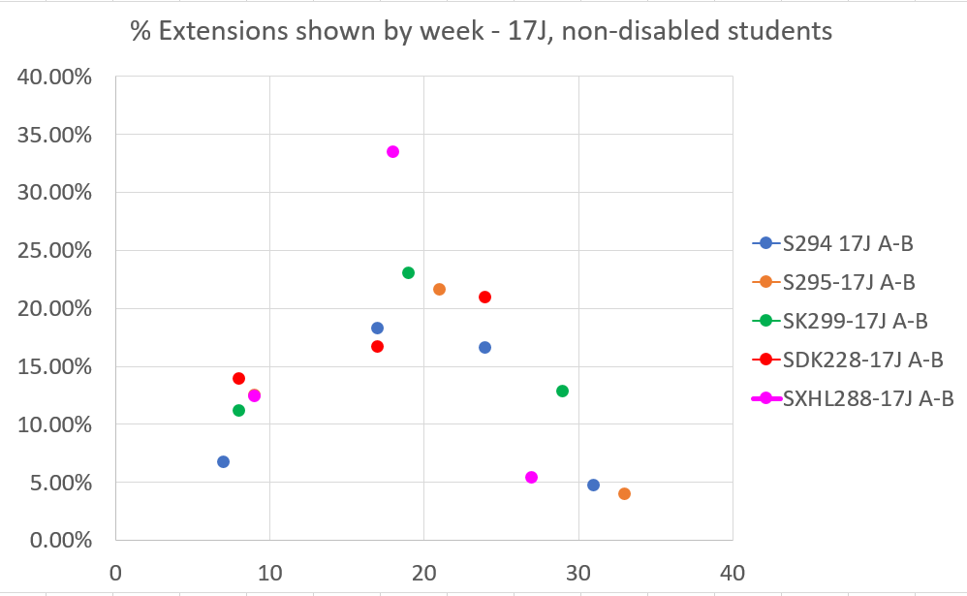
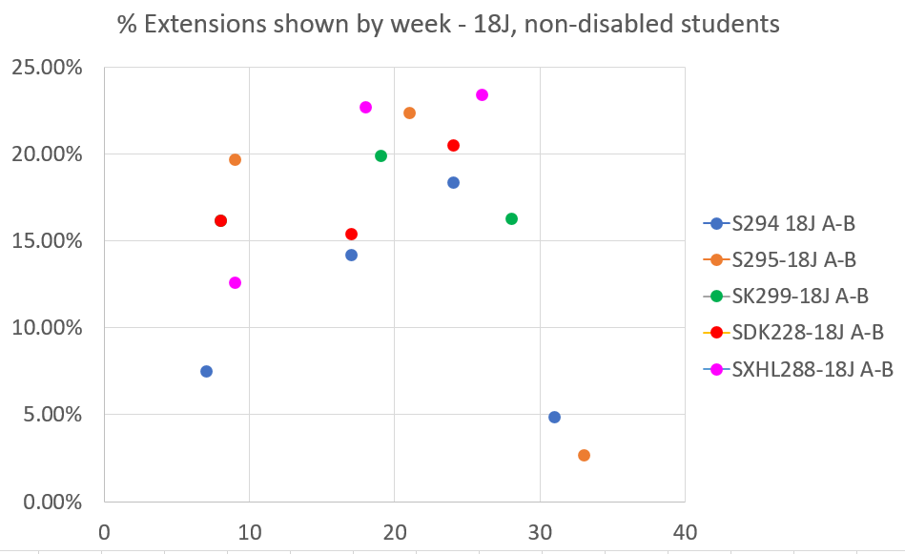
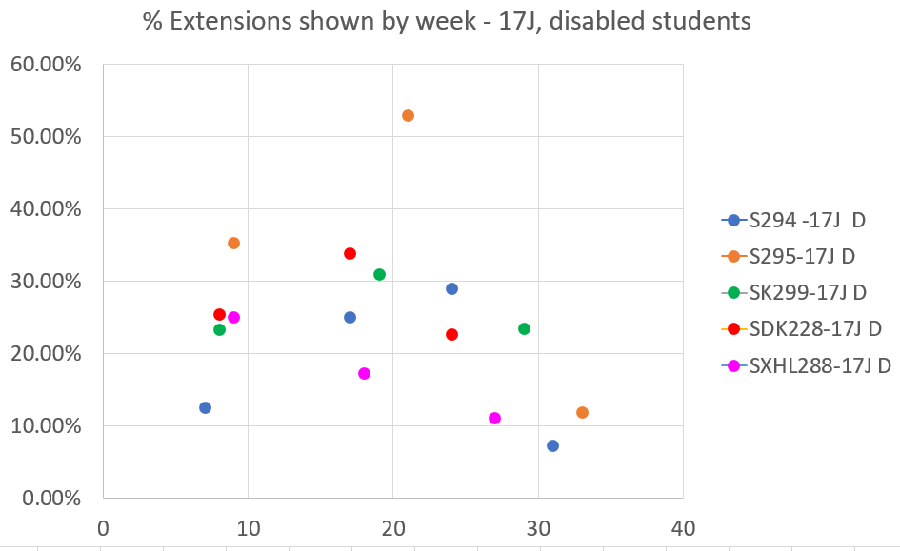
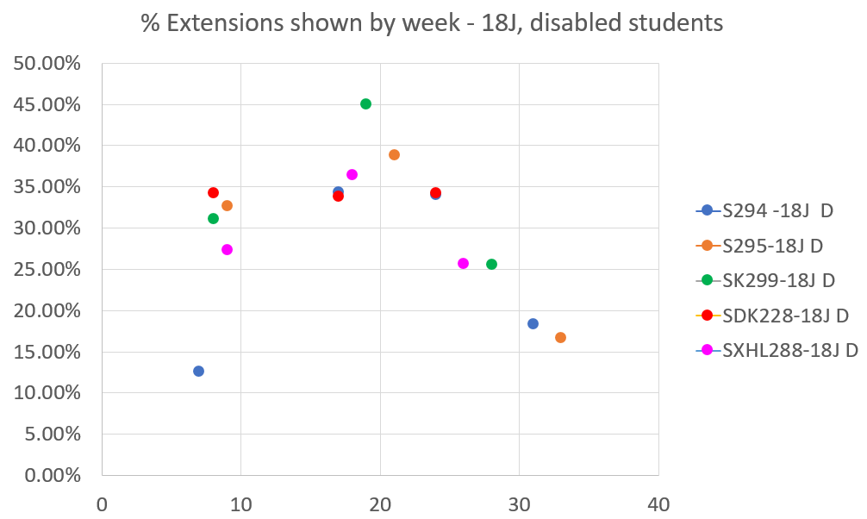
TRENDS ACROSS THE YEAR
Proportions of TMAs on which an extension was granted
Students with no disability
Students with a disability
17J
18J
Notes:
Students with a disability

Slide 13
SUCCESS AND EXTENSIONS
Correlations between score and extension length – 17J
(Only shown if p < 0.05)
 | S294 17J |  |  |  | S295 17J |  |  | SK299 17J |  |  | SDK228 17J |  |  | SXHL 17J
 | TMA 01 | TMA 02 | TMA 03 | TMA 04 | TMA 01 | TMA 02 | TMA 03 | TMA 01 | TMA 02 | TMA 03 | TMA 01 | TMA 02 | TMA 03 | TMA 01 | TMA 02 | TMA 03
Non-disabled |  |  | -0.12 | -0.15 |  |  |  |  | -0.12 |  |  | -0.13
Disabled |  |  |  | -0.38
CAMPAIGN ASSETS
 | S294 18J |  |  |  | S295 18J |  |  | SK299 18J |  |  | SDK228 18J |  |  | SXHL 18J
 | TMA 01 | TMA 02 | TMA 03 | TMA 04 | TMA 01 | TMA 02 | TMA 03 | TMA 01 | TMA 02 | TMA 03 | TMA 01 | TMA 02 | TMA 03 | TMA 01 | TMA 02 | TMA 03
Non-disabled |  | -0.16 | -0.23 |  |  |  | -0.35 | -0.25 | -0.23 | -0.15 |  |  |  | -0.40
Disabled |  | -0.24 | -0.26 |  | -0.28 | -0.31 |  | -0.27 | -0.19

Slide 14
SUMMARY & NEXT STEPS
Summary
              A lot of data! Not straightforward/ clearcut
              Where there is a statistically significant correlation with
              attainment, it is small and negative
              Are we serving our disabled students well?
Next steps
              Full AL focus group analysis using NVivo
              Student focus groups
              Relationships with study intensity & with module outcomes
CAMPAIGN ASSETS
Acknowledgements: eSTEeM, Data & Student Analytics, our project mentor, Rachel Hilliam

