Slide 1
Factors influencing female participation in PhySci Postgrad. research programs
Anne-Marie Gallen & Clare Reger (E&I Open University), Mark Bowden (University of Liverpool)

Slide 2
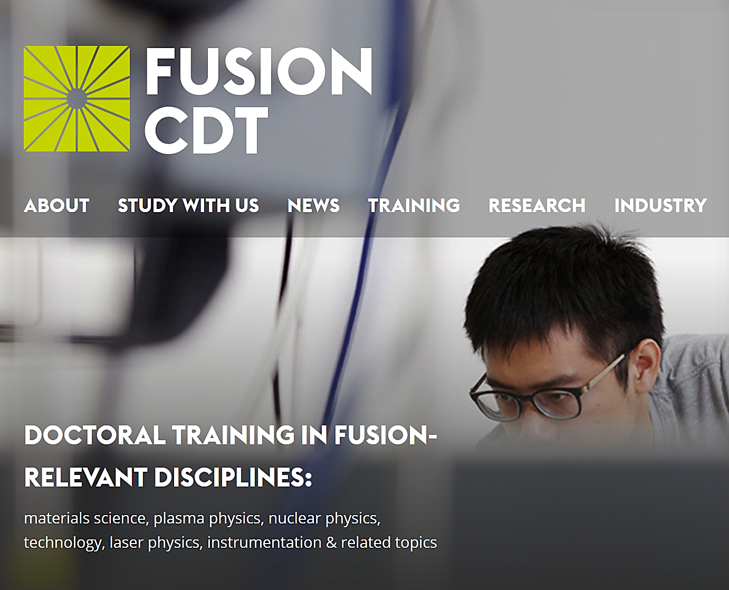
Background
Fusion CDT is the sole provider of nuclear fusion doctoral graduates over the past 7 years https://www.fusion-cdt.ac.uk/.
Only 18% of these are female, compared to the sector average of ~25%.
The UK civil nuclear industry has adopted a target of 40% female participation by 2030.
This research project aims to understand why this is and what can be done to change it.

Slide 3

Our Project
Project Aim: to conduct a scoping study into why fewer female graduates choose fusion PhDs than other similar subjects.
We started by conducting survey into motivations and decision-making processes that resulted in 21 female students’ decisions to undertake a nuclear fusion Ph.D.
Objective: information that can be used to better inform recruitment strategies for the CDTs
Overall goal: to use the results of this small-scale, short-term study to provide the basis for externally-funded research into choices of women in physical/engineering sciences

Slide 4
Plan
Stage 1:Survey
Why? The survey acts as a low-stakes buy-in to encourage participation Helped to gain a picture of the overall field and demographic Aid in the formation of questions for further research | Who? The survey was sent out via the nuclear Fusion CDT to all female Ph.D. candidates and graduates of Fusion
Stage 2: Interviews
Why? Results from the survey were used to inform the rest of the study. Further research was determined by the number of willing participants. Survey results also informed questions for interviews. Semi-structured interviews designed | Who? Interviews were conducted with a subset of willing participants from the survey stage It is recognised that participants were therefore self-selecting

Slide 5
Survey
Carried out the survey among the participants from group of ~20 women who have entered the field within the last decade.
The survey response rate was 35%
To investigate the underlying factors that affect woman choosing a PhD subject area within Physical Sciences, we began by surveying to design a semi-structured interviews.
Following the survey we identified 3 volunteers from the 7 respondents who were interviewed by phone. Transcripts have now been completed.

Slide 6
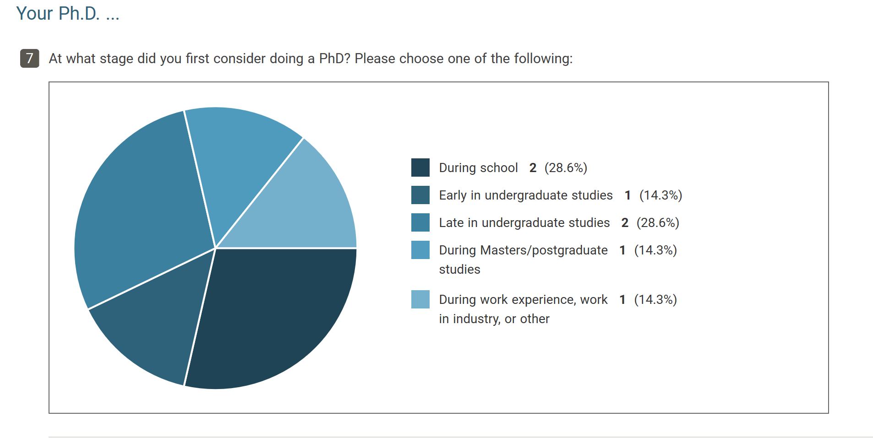
Results:

Slide 7
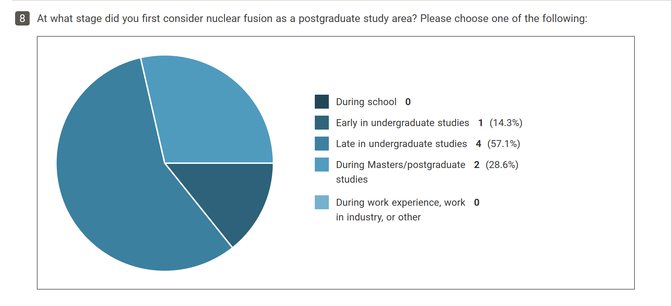
Results:

Slide 8

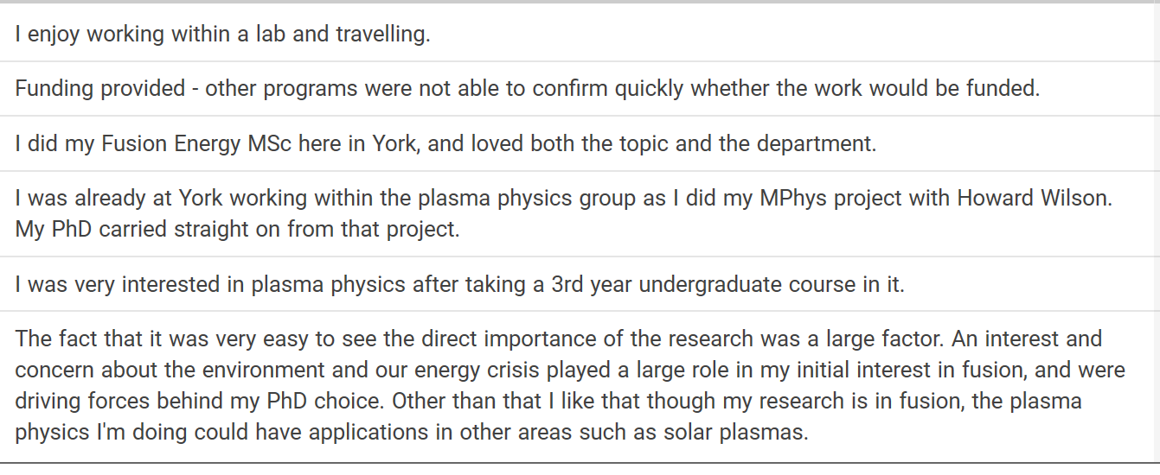
Open questions
Are there any other particular factors that you think are relevant to your decision to do a PhD in nuclear fusion?

Slide 9
How to deal with three interviews…
Looking for patterns in such a small sample is unproductive
The three interviews will be used as illustrative cases; a holistic approach using case studies to complement the data.
Working on literature review around women in STEM, and the constraints they face when they make choices about their subject areas within STEM
‘Life course research’ will look at how these women they feel about these factors at a particular stage in their life and if their perceptions change
The narrative outcomes will be used illustratively alongside the survey data.

Slide 10
THANK YOU
Acknowledgement: all images courtesy of Fusion CDT

