Slide 1

eSTEeM Conference 2020
Exploring the use of labcasts
to support associate lecturers
Venetia Brown, Dr. Alan Cayless & Dr. Jo Jarvis
Knowledge Media Institute
School of Physical Sciences

Slide 2
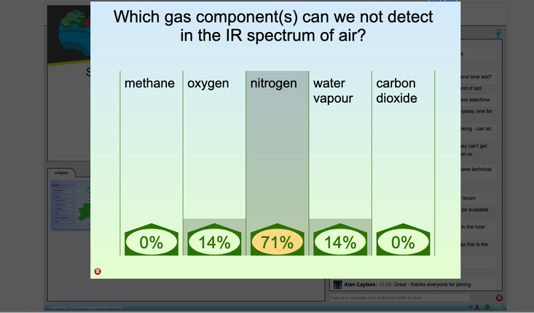
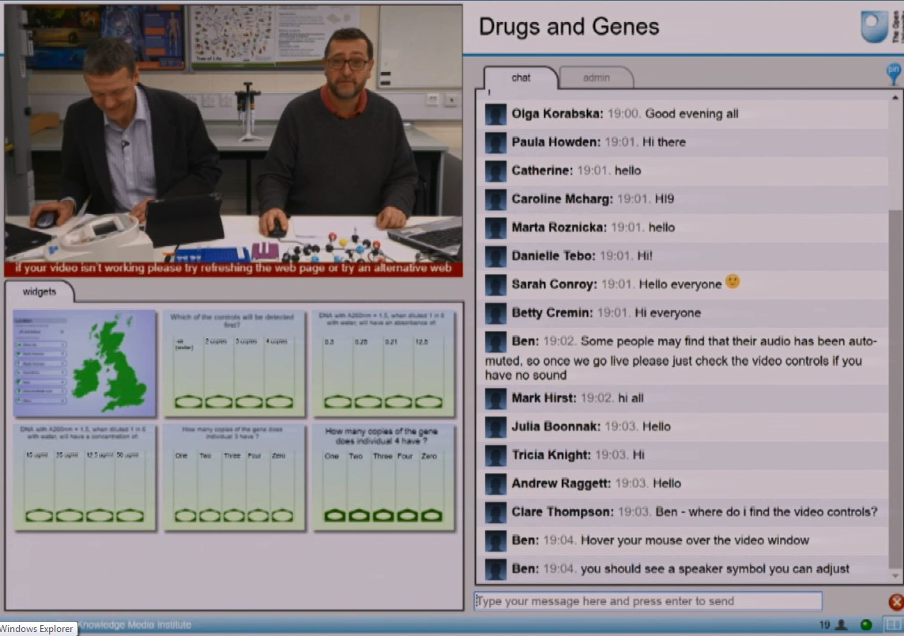
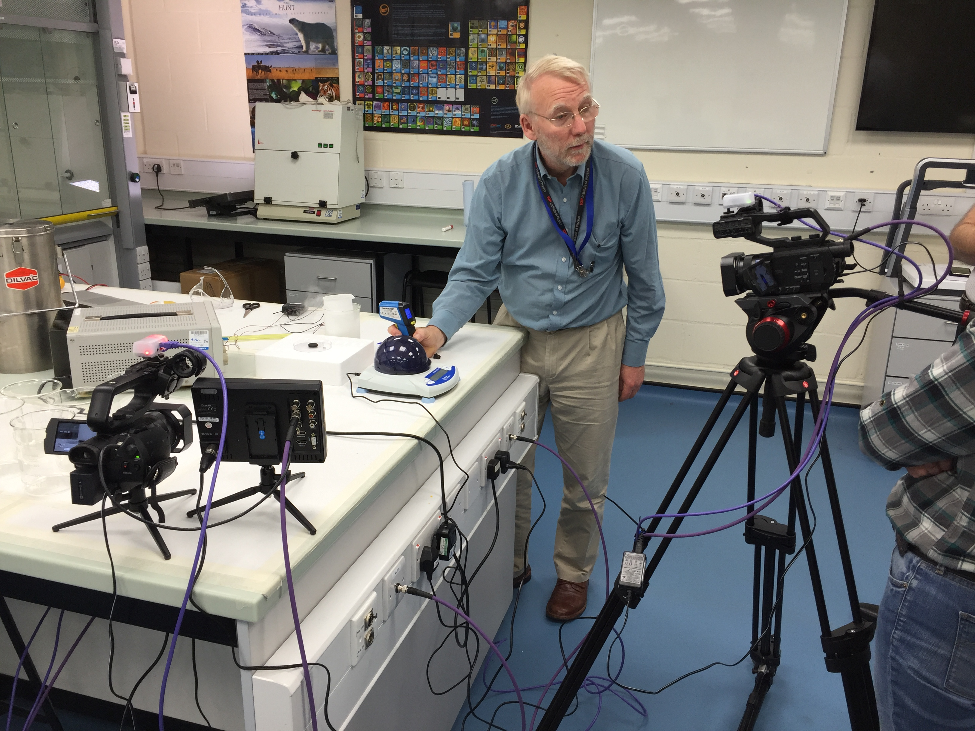
Research context
Live web broadcasts known as labcasts and fieldcasts.
Integrate video streaming and synchronous chat messaging.
Audience polling widgets allow bi-directional questions and answers.

Slide 3
Research question and design
In what ways can a labcast support module tuition strategy and promote a ‘sense of community’ across the ALs and module team?
SXPS288 ‘Remote experiments in physics and space’
155 students; 10 ALs
ALs sampled 60% (N=6)
Remote attendance of live labcast
Pre/post questionnaires
Focus Groups
Mixed methods
Quantitative
Qualitative

Slide 4
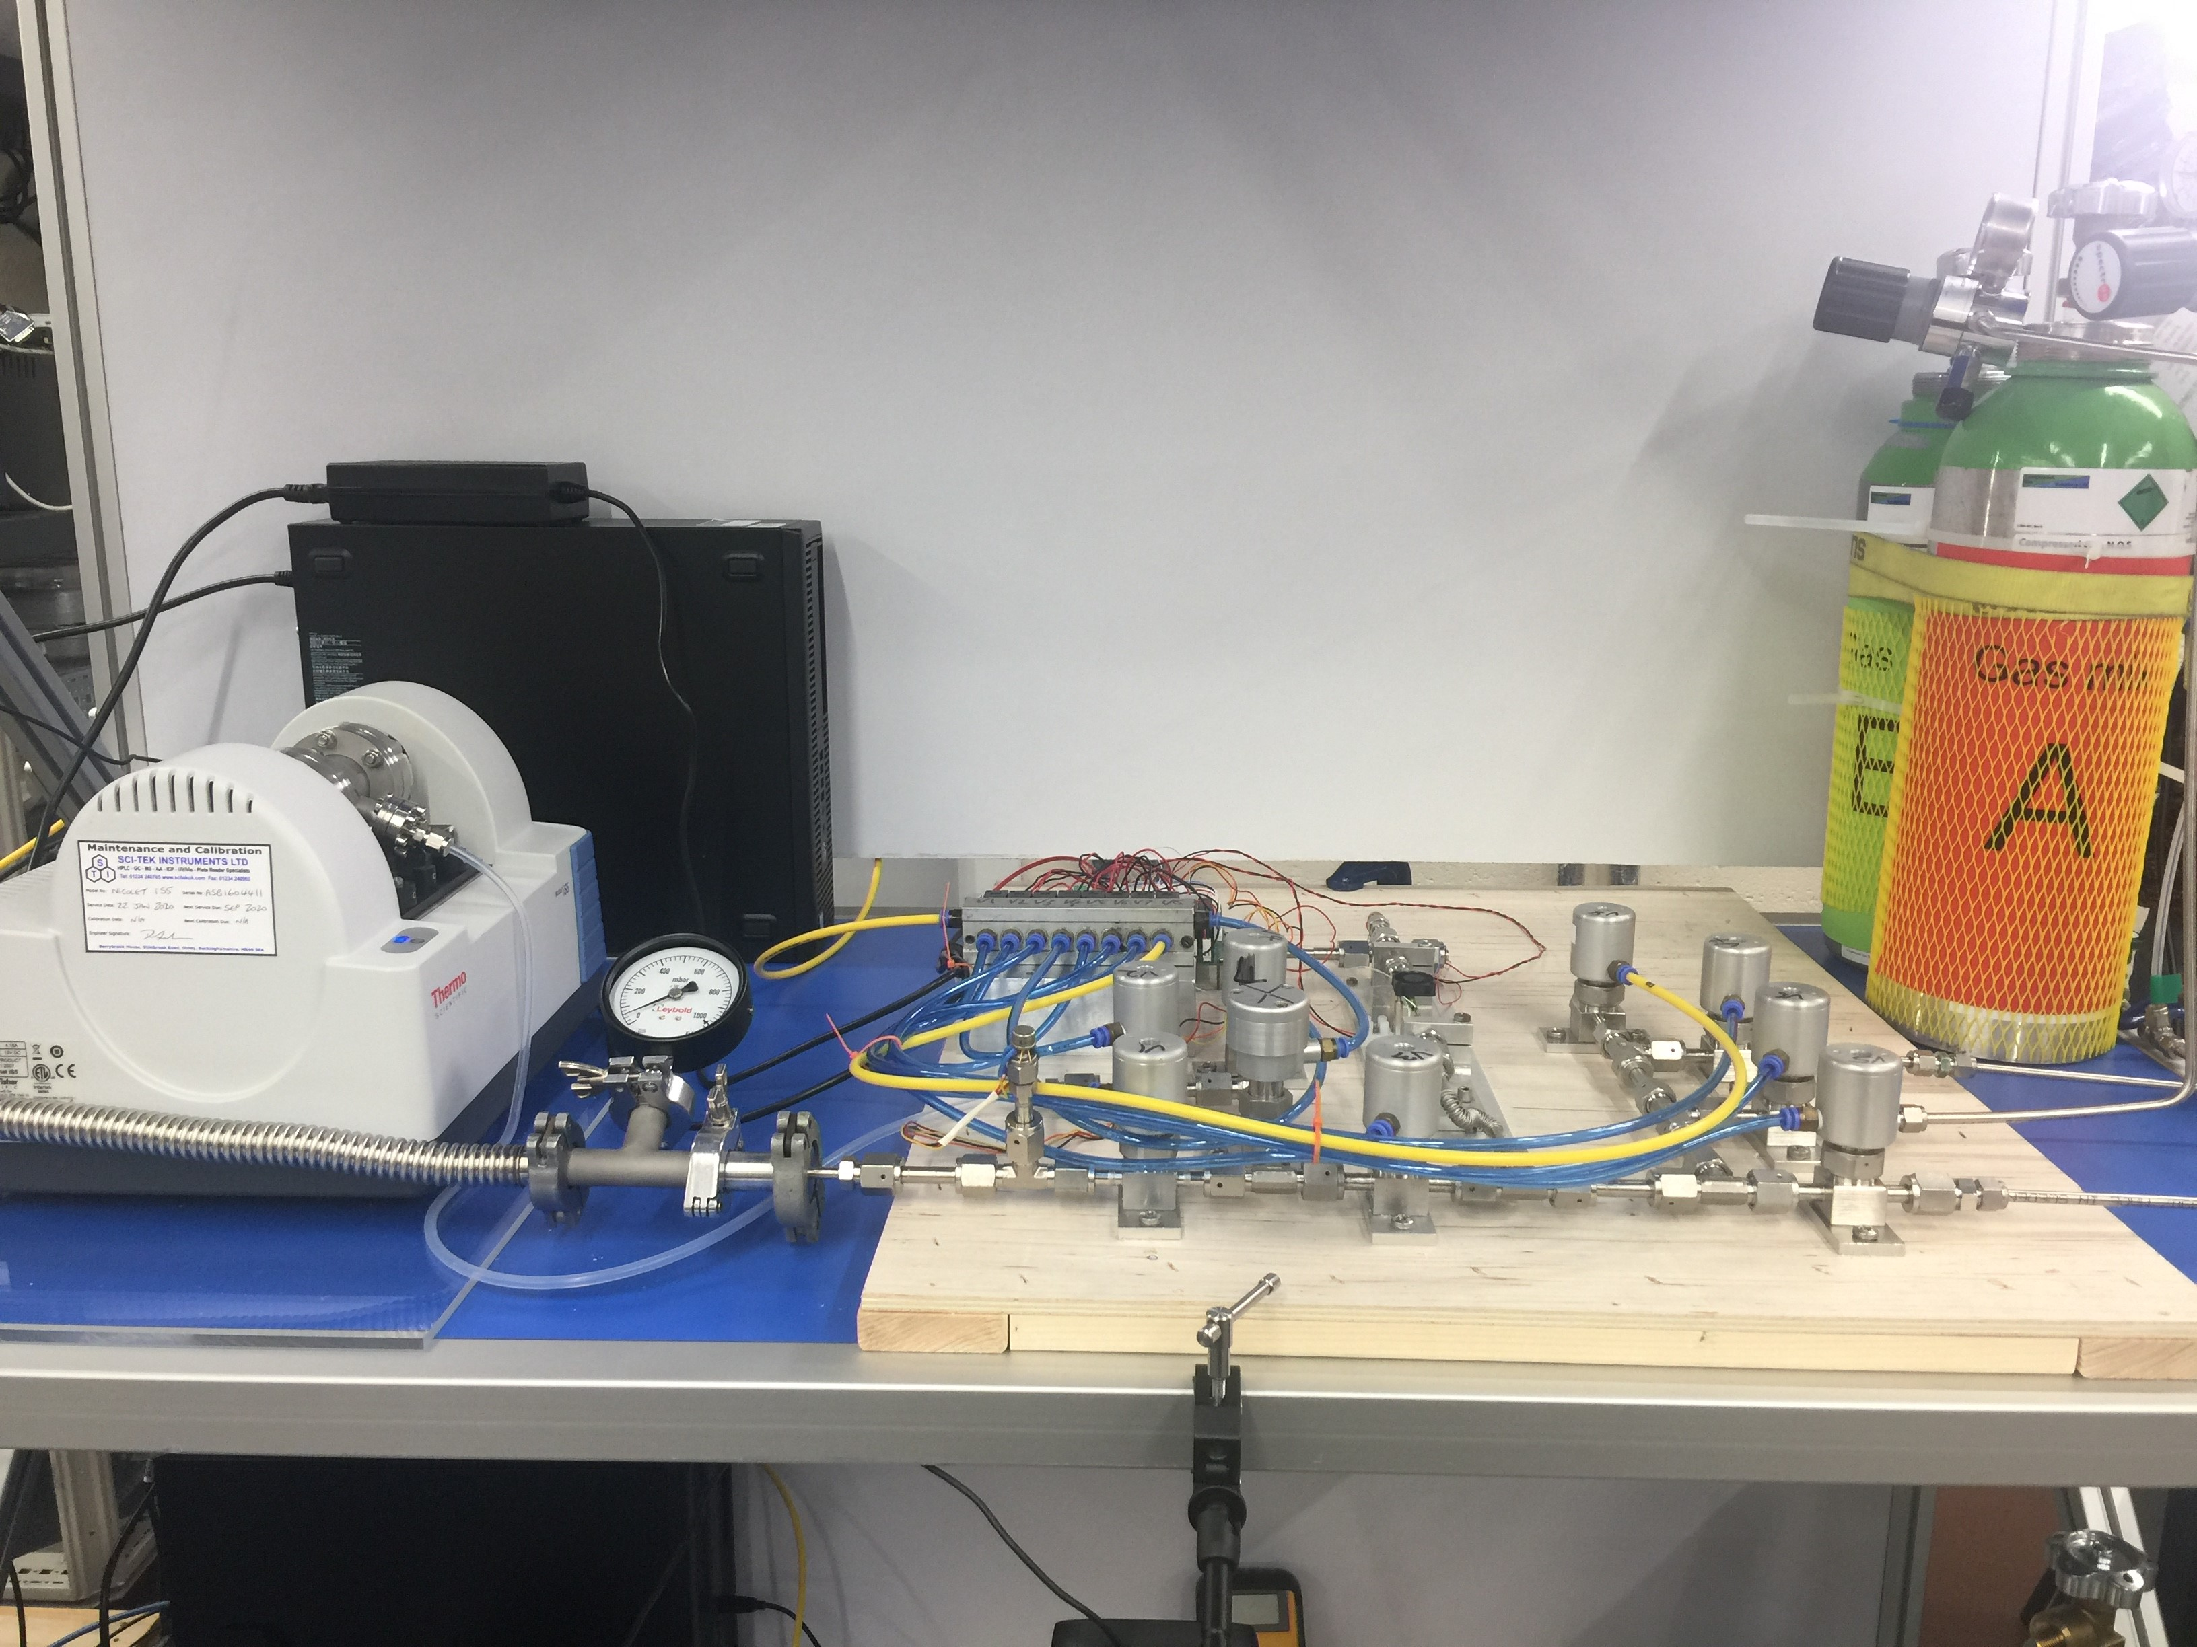
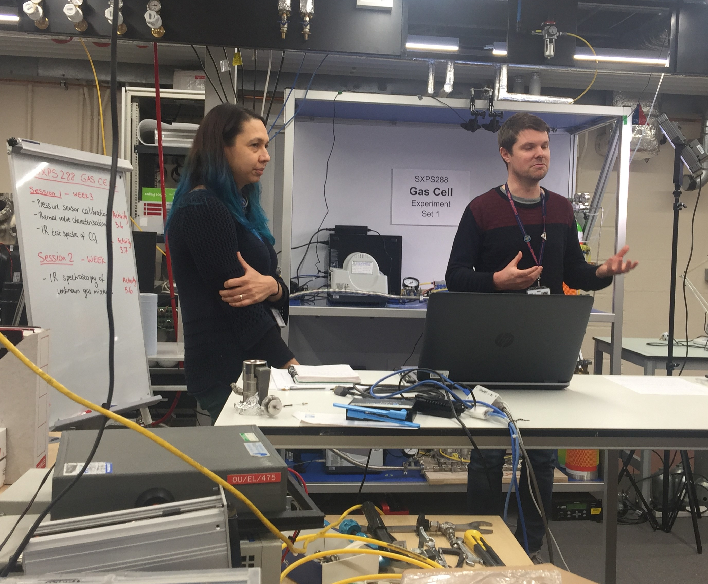
Tutor brief labcast
Notes:
Second part of the tutor briefing for the Mars project
Visit the lab live to introduce the gas cell experiment involving the infrared spectroscopy of gases representing planetary atmospheres.
Opportunity for tutors to see the experiment ahead of the students; experience taking part in a labcast and ask questions during the session

Slide 5
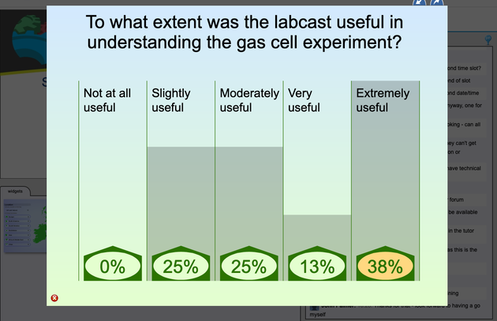
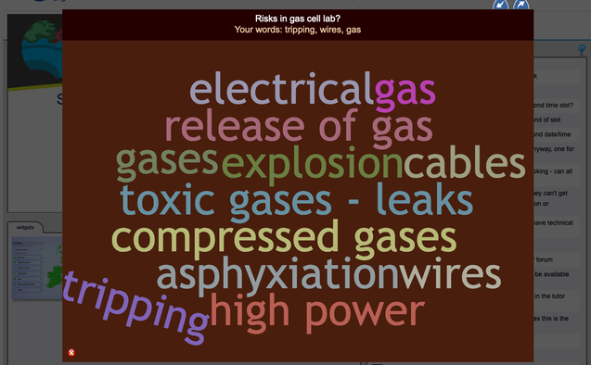
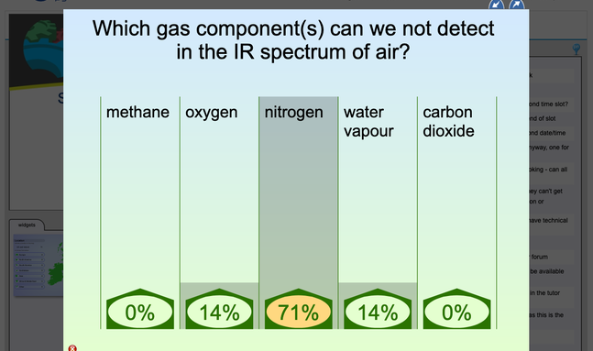
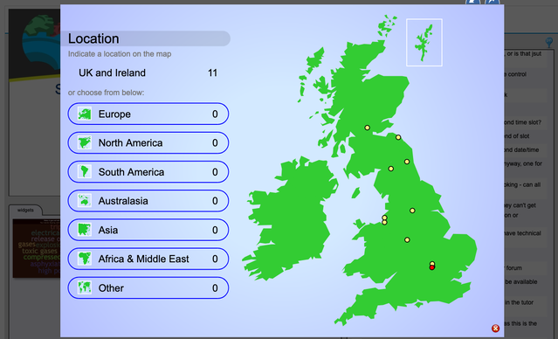
Interactivity
Labcast Analytics
Unique Users | 14
Unique Users in Event Window | 11
Unique Users Post Event | 5
Interactive Users | 10
Total chat messages | 78
Unique Users | 11

Slide 6
Quantitative results
Pre-survey
Post-survey

Slide 7
Quantitative results
Pre-survey
Post-survey

Slide 8
Quantitative results
Pre-survey
Post-survey

Slide 9
Qualitative comments
Themes | What do you expect to gain from the labcast?
Informative | “An overview of the Mars atmosphere project, an introduction to the gas cell experiment. I expect to be able to see the apparatus” (RESP01)
Confidence | “I hope that it will make things clearer and also speed things up for when I try the experiment. All these lead into being able to give more confident tutorials in the next two weeks”(RESP04)
Community | “It's nicer to "meet" colleagues in real time than watch a recording”. (RESP02)
Student support | “To learn how to use the equipment so I can better support students” (RESP05)

Slide 10
Qualitative comments
How did your experience with the labcast align with your expectations? (post-survey)
“I did find the student Labcast more detailed and therefore more useful” (RESP05)
“I had been expecting that it would be distinctively different from the student version, with more inside information for us on the analysis which the students would need to undertake, expected results and possible pitfalls”. (RESP02)
“It was less useful than I'd expected, there was no material presented that required the presenters to be in a lab”. (RESP04)
“Not quite as useful as I'd hoped”. (RESP03)
“It aligned well. I expected to get an overview of the experiment, to see it in action and to see what the interface looked like” (RESP01)

Slide 11
Conclusions and future work
Results show that ALs generally found the labcast useful in understanding the student project and experiment
Post survey comments revealed experience of the labcast didn’t align with prior expectations
Run focus groups to further explore issues from questionnaires
Reflect on how students ‘did the science’ and AL experience of marking related TMA
Interview module team and presenters on labcast purpose and strategies

Slide 12
eSTEeM Conference 2020
Exploring the use of labcasts
to support associate lecturers
Venetia Brown, Dr. Alan Cayless & Dr. Jo Jarvis
Knowledge Media Institute
School of Physical Sciences

