Slide 1
Building a community of STEM ALs - extension of the STEM-ByALs-ForALs programme to include more social learning opportunities
Janet Haresnape, Rupesh Shah, Nirvana Wynn and Barbara Jones
eSTEeM conference April 2020

Slide 2
The STEM-ByALs-ForALs programme of online events
Programme of regular monthly workshops has been running since 2015
Helps ALs to share good practice in a friendly supportive environment
Aims to foster peer support and improve community cohesiveness
Now expanded to include more social learning opportunities
Notes:
Currently four members of the STEM ByALs-ForALs organising team (Janet, Rupesh, Nirvana and Barbara)

Slide 3
1. Programme has been running since 2015
1. Programme of regular monthly workshops
STEM-ByALs-ForALs
Who has:
Never heard of the programme?
Heard of it but never attended any events?
Attended events?
Attended at events and been a presenter?
STEM-ByALs-ForALs website
https://learn3.open.ac.uk/course/view.php?id=300723

Slide 4
1. Programme has been running since 2015
1. Programme of regular monthly workshops
Phase | Date | AL Cohort | Platform | No. of workshops
1 | Feb 2015-Jun 2016 | Science ALs | OU Live | 12
2 | Oct 2016 – July 2017 | STEM ALs | OU Live | 10
3 | July 2017-date | STEM ALs | Adobe Conect | 27 to date
New recent additions: Informal ‘coffee and chat’ drop-ins
Online Journal Club sessions
Notes:
All take place in an online room identical to those ALs use for tutorials (Initially OU Live, then Adobe Connect)

Slide 5
1. Programme has been running since 2015
1. Programme of regular monthly workshops
Regular workshops – approximately monthly – 50 to date since 2015
Both daytime and evening
Attendance varies from 15-40 ALs per workshop
Any STEM AL can submit a suggestions for a workshop
We work with presenters to ensure workshops are:
Accessible for all STEM ALs
Include opportunities for active participation/ discussion
Presenters are paid 1DL day – funded by ALSPD
Attendance is added to AL’s Staff Development record
Feedback collected from participants after each workshop

Slide 6

1. Programme has been running since 2015
1. Programme of regular monthly workshops
Ideal situated learning environment (Lave and Wenger, 1991) for ALs
Fosters peer support – friendly supportive environment
Helps relieve ALs isolation – they meet in real time
Encourages community cohesion (Haresnape et al, 2020)
By Adobe - Adobe, Public Domain, https://commons.wikimedia.org/w/index.php?curid=87529900

Slide 7

1. Programme of regular monthly workshops
Most popular workshops relate to the core AL role, especially supporting students
Popular workshops have included:
Engaging students with online materials
Encouraging students to talk in online tutorials
Getting to grips with breakout rooms
Supporting students with mental health/emotional wellbeing needs
Individual support sessions – what works well?
Tips for speeding up TMA marking
http://www.thebluediamondgallery.com/wooden-tile/s/support.html (creative Commons)

Slide 8

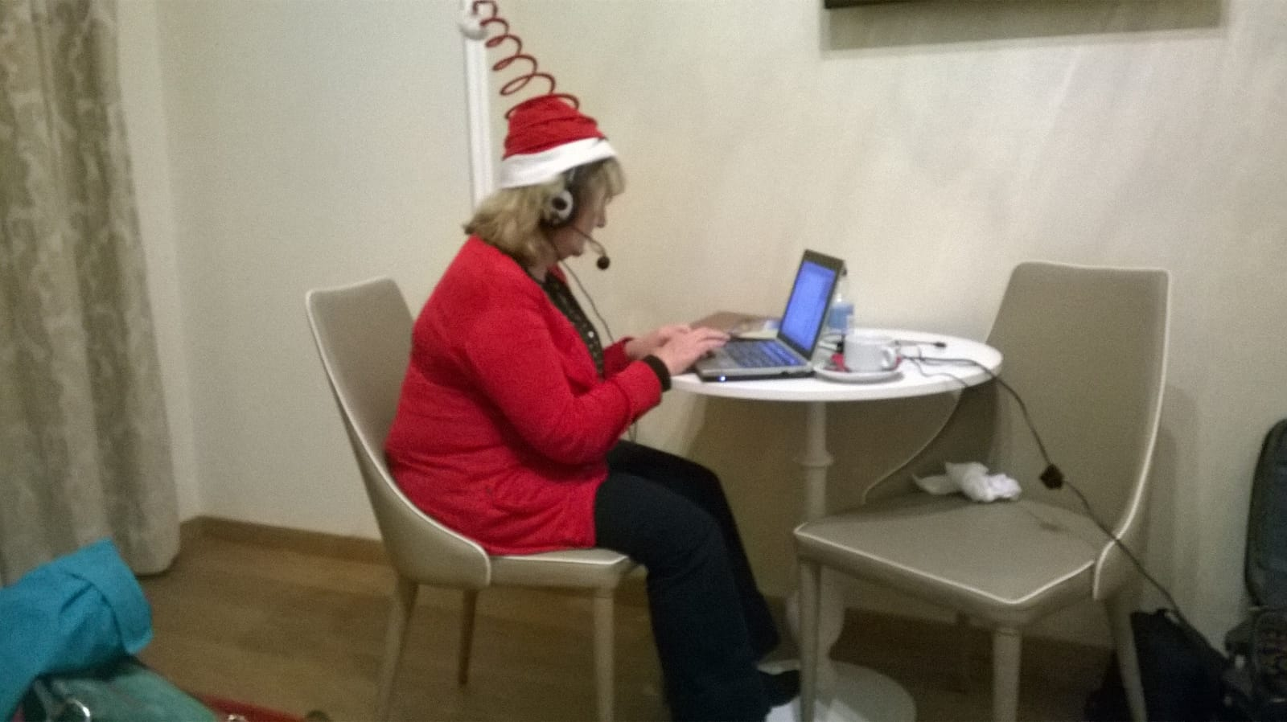
1. Programme of regular monthly workshops
We have tried to include anything which will be popular
By Images_of_Money's profile - www.flickr.com, https://commons.wikimedia.org
Online Christmas party
Studying with the OU as an AL
Tutoring multiple modules
Using the AL Development fund
Neuroeducational based approaches to teaching
Income tax refunds – tips for ALs
Online Christmas party

Slide 9
2. Helps ALs to share good practice
Analysed feedback from workshops in phases 1 and 2 from
200 participants (35% response rate)
6 Presenters (67% response rate)
7 Regular participants (54% response)
Free text comments from participants include:
Comments specific to workshop – passed to presenters
Comments relating to programme as a whole - analysed using Nvivo
Notes:
Main themes to emerge from free text feedback comments
Sharing indicating that the respondent valued the opportunity to share practice, enhance skills, or pick up ideas or tips from others
Community indicating that participation had helped the respondent to feel part of a community
Empowering respondents felt stimulated, inspired, enriched or empowered
Reassuring providing clarification, feeling reassured, building confidence, feeling encouraged or instilling renewed enthusiasm
All respondents gave comments which mentioned Sharing

Slide 10
2. Helps ALs to share good practice
Main themes to emerge from free text feedback comments
Sharing indicating that the respondent valued the opportunity to share practice, enhance skills, or pick up ideas or tips from others
Community indicating that participation had helped the respondent to feel part of a community
Empowering respondents felt stimulated, inspired, enriched or empowered
Reassuring providing clarification, feeling reassured, building confidence, feeling encouraged or instilling renewed enthusiasm
All respondents gave comments which mentioned Sharing

Slide 11
2. Helps ALs to share good practice
Percentage of respondents in phases 1 and 2 whose free text comments related to the following themes; Sharing, Community, Empowering , Reassuring, Negative comments and Thank you (respondent thanked presenter and/or organisers of the programme)

Slide 12
3. Aims to foster peer support and improve community cohesiveness
2. Helps ALs to share good practice
Percentage of respondents in phases 1 and 2 whose free text comments related to the following themes; Sharing, Community, Empowering , Reassuring, Negative comments and Thank you (respondent thanked presenter and/or organisers of the programme)

Slide 13
Really reassuring to see my practice was in keeping with
other ALs. We work in isolation so much of the time – it’s very useful to find out how everyone else approaches things
Comments from participants
Helps me to feel part of the community. Until recently, I hadn't met a single soul from the OU (was recruited online for an online course). The chance to hear thoughts of other ALs was invaluable
One hour invested; many hours saved in the future
Community was mentioned more in phase 1 than phase 2
Phase 1 – Science – pool of 500 ALs
Phase 2 – STEM – pool of 1500 ALs – building community is much more of a challenge!

Slide 14

4. Programme now expanded to include more social learning opportunities
Social learning (Wenger and Wenger-Traynor, 2015)
New AL contract
ALs should become more integrated into the OU STEM community
ALs can learn together to develop new understandings and practices
Might shape the changing landscape in which they work
Tomas2015/Adobe Stock
Notes:
STEM pool of 1500 ALs: Building community cohesion is a challenge!

Slide 15

Programme
4. Programme now expanded to include more social learning opportunities
Informal ‘coffee and chat’ drop-in sessions – suggested and organised by STEM AL, Isobel Richards
Four sessions so far, not recorded
Small numbers of participants (<10), but good feedback
Clearly much appreciated by some
Photo from Creative commons

Slide 16

Programme
4. Programme now expanded to include more social learning opportunities
Online Journal Club for ALs – ALs give mini-presentations
Run long same lines as OJCs run for students by Fi Moorman and Karen New
    Summary of journal article
    Snippet of news in their academic field
    Aspect of their research or topic of scholarship interest
  2 sessions to date, friendly and informal, not recorded
  7 AL mini-presentations, no presentation fee
  5-15 attendees
  Opportunity for ALs to build ‘academic currency’ and potential to disseminate to a wider audience

Slide 17
STEM-ByALs-ForALs Summary
Moving forward
Programme provides opportunities:
For ALs to lead workshops and expand skills portfolio
Share good practice, tips and ideas – situated learning situation
Build community cohesion
Build academic currency – important aspect of new AL contract
Engage in social learning
Hope to continue regular workshops – if funding from ALSPD continues – and continue with informal social learning events
STEM-ByALs-ForALs website
https://learn3.open.ac.uk/course/view.php?id=300723

Slide 18
- What experience do you have of being part of a productive community of online learners?
- What made it productive, and how could your experience feed into our programme?
Email STEM-ByALs-ForALs@open.ac.uk with any suggestions

Slide 19

Particular thanks to all AL colleagues – both presenters and participants - who have helped to make this programme such a success
http://www.thebluediamondgallery.com/wooden-tile/s/support.html (creative Commons)

Slide 20
STEM-ByALs-ForALs website
https://learn3.open.ac.uk/course/view.php?id=300723
References
Haresnape, J., Aiken. F and Wynn, C. (2020) Sharing good practice and encouraging community cohesion online: a programme of tutor-led online events for Open University tutors, Open Learning: The Journal of Open, Distance and e-Learning, DOI: 10.1080/02680513.2020.1752165
Lave, J., and E. Wenger. (1991). “Situated Learning: Legitimate Peripheral Participation”. Cambridge: Cambridge University Press.
Wenger, E., Wenger-Trayner, B. (2015) Communities of Practice: a brief introduction [online] Available from: http://wenger-trayner.com/wp-content/uploads/2015/04/07Brief-introduction-to-communities-of-practice.pdf

