Slide 1

Student perceptions and development of employability skills in a multidisciplinary, level 4 science module
Dr Fiona Aiken FHEA – F.J.Aiken@open.ac.uk
Dr Chris Hutton SFHEA – Christopher.Hutton@open.ac.uk
Staff Tutors in Earth and Environmental Science
The Open University

Slide 2
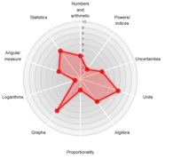
Outline
Background
Context
Research questions and approach
Results and Discussion
Conclusions

Slide 3
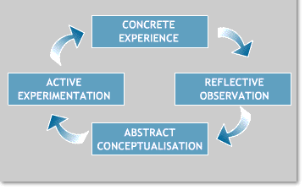
Background
The national picture
Employability skills have to be embedded in all HE courses
Key review – Wakenham, 2016
Skills development is strongly liked to Personal Development Planning (PDP)
Students are encouraged to self-assess skills, and then reflect to plan improvements.
  E.g. Kolb’s Learning Cycle
Image credit: https://www2.le.ac.uk/departments/doctoralcollege/training/eresources/teaching/theories/kolb

Slide 4

Context
Skills development on S112
Science: concepts and practice
  New, multidisciplinary module from Oct 2017
  60 credits
  FHEQ Level 4
  Focussed on skills
Students regularly self-assess skills using a radar diagram
  Required in each of 6 assignments, with reflection

Slide 5
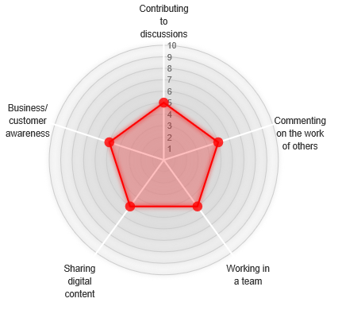
Context
We looked at two groups of Learning Outcomes
  1. Collaborating with others …

Slide 6
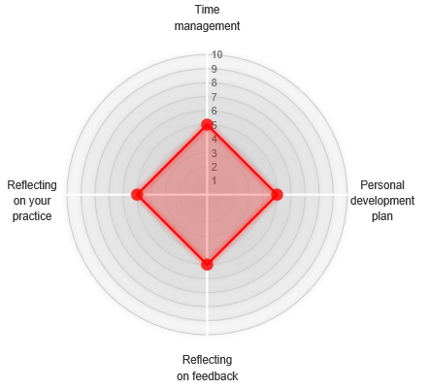
Context
2. Self reflection and planning…

Slide 7
Research Question 1 and Approach
Tutor Focus Group
a
Assignment submissions
Student Questionnaire
To what extent do students demonstrate development of employability skills through S112?
a
a

Slide 8
Research Question 2 and Approach
What are students’ perceptions of their employability skills development through S112?
Student Questionnaire
Tutor Focus Group
a
a

Slide 9
Results and discussion
Initial quantitative results
Analysed student self assessment scores in assignments
Analysed student opinions of radar diagrams using Likert scale
These are interim results – to be enriched by qualitative data
Results from free text questions, and tutor focus group to be analysed (thematic analysis)

Slide 10
Results and Discussion
Student assignments (n = 19) : Collaborating with others

Slide 11
Results and Discussion
Student assignments (n = 18): Self reflection and planning

Slide 12
Results and Discussion
Student questionnaire (n = 115; 18% response rate)
Of the skills we looked at:
  > 80 – 85% thought they were “important” and “developed well by the module”, except…
  Business and Customer Awareness (31% and 37%)
93% used the radar diagrams tool
  Of these, 65 % only used them to complete an assessment

Slide 13
Results and Discussion
Student Questionnaire

Slide 14
Conclusions
Students showed improvement in self-assessment scores, except Business and Customer Awareness
  Questionnaire supports this - least valued skill
  Embed at qualification level, not module
Most engaged with radar diagrams to gain marks
Majority found radar diagrams usable and understandable
< 50 % students found value in radar diagrams for PDP
Future work: qualitative data analysis on tutor focus groups and open questions from questionnaire

Slide 15
References
Archer, W. and Davison, J. (2008) Graduate Employability: What do employers think and want? [Online], The council for Industry and Higher Education https://aces.shu.ac.uk/employability/resources/0802Grademployability.pdf (Accessed 26 Jan 2018)
Higher Education Policy Unit (2015) Employability; Degrees of Value, [online] https://www.hepi.ac.uk/2015/12/10/2928/ (accessed 18th Apr 2019)
Lowden, K., Hall, S., Elliot, D. and Lewin, J. (2011) Employers’ perceptions of the employability skills of new graduates [Online], Edge Foundation. Available at https://aces.shu.ac.uk/support/staff/employability/resources/Edge_employability_skills.pdf (Accessed 26th Jan 2018)
Wakeham, W. (2016) Wakeham review of STEM degree provision and graduate employability [Online], HM UK Government. Available at: https://www.gov.uk/government/uploads/system/uploads/attachment_data/file/518582/ind-16-6-wakeham-review-stem-graduate-employability.pdf (Accessed 22 Feb 2017).
Wakeham, W. (2017) Keynote presented at HEA STEM Conference 2017: Achieving Excellence in Teaching and Learning. Manchester, UK, 1-2 Feb [Online]. Available at https://www.heacademy.ac.uk/system/files/downloads/prof_sir_william_wakeham_hea_stem_conference_presentation.pdf (Accessed 26 Jan 2018).

Slide 16
Any questions?...
Thank-you for attending
Dr Fiona Aiken FHEA – F.J.Aiken@open.ac.uk
Dr Chris Hutton SFHEA – Christopher.Hutton@open.ac.uk
Staff Tutors in Earth and Environmental Science
The Open University
Acknowledgements: Isabella Henman, Jane Kendall-Nicholas and Niusa Marigheto

