Slide 1
WHAT ARE THE CAREERS INFORMATION, ADVICE AND GUIDANCE NEEDS OF LEVEL 1 COMPUTING AND COMMUNICATIONS STUDENTS?
David Conway and the STEM Careers and Employability Services Team

Slide 2
Introduction
As a result of a growing number of OU students studying for career motivations and greater service usage of Careers and Employability Services (CES), there has been significant University wide investment and increased emphasis on employability (e.g. Enhanced Employability and Career Progression project).
CES provide 1:2:1 and 1:2:many (e.g. forums) career related learning services, activities and resources
Choice and design of 1:2:many is based upon learning analytics, student feedback, employer feedback, industry/market trends and intelligence, input from faculty and professional experiences of staff within CES.
VOICE is the OU Customer Records Management system which logs 1:2:1 careers contact known as service requests (SRs)
VOICE SR Categorisation cannot be used effectively to understand needs at present as themes are too broad

Slide 3
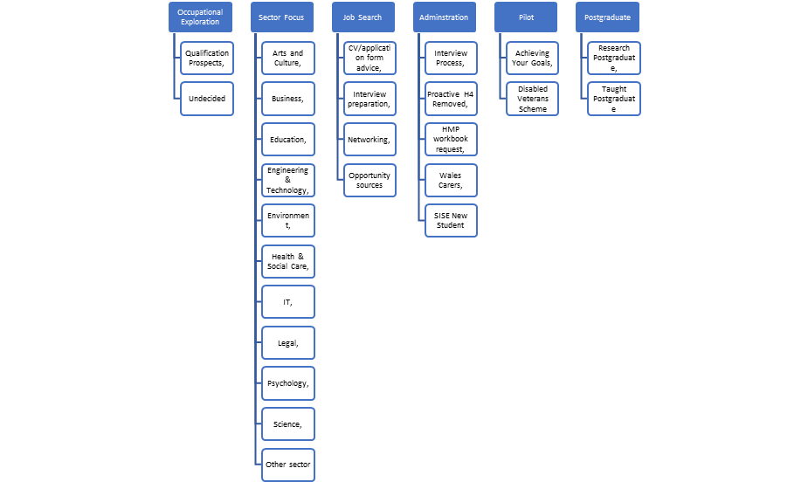
6 broad themes with broad sub areas

Slide 4
Level 1 CES usage and School of Computing and Communications
Approximately 50% of careers SRs are from Level 1 learners
Very different to “brick universities” where majority of careers 1:2:1s are with 2nd and 3rd year students
Potential reasons (other than Level 1 modules are our largest cohorts):
  Mature 1st year students (21 years +) have a clearer idea of what career they wish to pursue long term and are more likely to engage with career services (Zhu 2018)
  Mature students typically have wider range of study motivational constraints in comparison with younger adult learners (Harnett, St George and Dron 2011, Baxter 2012, Bawa 2016)
School of Computing and Communications (C&C) students are one of the highest CES users (1:2:1 + 1:2:many)

Slide 5
Aims and objectives
The aim of this study was to complete a manual analysis of ALL Level 1 C&C careers SRs in the 2018-2019 academic year (August 2018 to July 2019), categorising each to sub themes and areas below already achieved in VOICE.
The objective of the project was to:
Enhance knowledge of the careers information, advice and guidance needs of Level 1 C&C learners
  Developing this knowledge as to why careers SRs are raised in C&C may enhance services provided by CES and C&C curriculum design

Slide 6
Method
  190 SRs (142 students) from Level 1 C&C modules were manually evaluated individually by an OU Careers and Employability Consultant (CEC) or Employability Adviser (EA)
  Each SR was evaluated on 2 occasions blind (i.e. unknown if SR had been evaluated by peer already)
  Description of perceived themes within each SR were recorded by CEC or EA
  An CEC not involved within the evaluation compared identified themes within each SR
  All SRs where the CEC/EA were in agreement on themes found were included in results.
  The number of occasions themes were found in all SRs and hierarchal coding to sub levels below existing in VOICE were used to report results

Slide 7
Results
  45 SRs were excluded from results (39 SRs were for VOICE admin reasons, 6 unmatched themes)
  Most careers SRs were multifaced and had numerous complex themes unsurprisingly!
  Themes found in SRs were able to be categorised up to 3 levels deeper than in VOICE
  74 SRs were created by webform, 71 SRs created by staff referral

Slide 8
Results 2

Slide 9
Results 3
  The 4 most common SR themes had sub themes and sub areas
    The most regular sub themes were:
    Career options if I change from OU C&IT to ?? (15) (Careers related qualification choice advice)
    How C&IT module choice impacts career options(11) (Careers related module choice advice)
    Career options with OU C&IT degree (11) (Careers, information, advice and guidance)
    How to gain any practical experience in C&IT (8) (Gaining practical experience)
    What qualification is best for my career OU C&IT or ?? (7) (Careers related qualification choice advice)
  No significant reoccurring sub areas were found at a deeper level
    e.g. Learners were interested in changing from C&IT to 10 different qualifications

Slide 10
Discussion
  Results show Level 1 C&C learners who seek or are referred for 1:2:1 careers support have complex CIAG needs and regularly:
    Are unsure if they are studying the correct qualification and/or pathway for professional goals
      Part time students are twice as likely to change career plans in the 1st year in comparison with full time students (Callender and Williams 2012)
      Wrong choice of study is a highly significant factor in early university withdrawal (Comfort et al 2002)
    Consider career beyond context of qualification
      Wide range of study motivations, careers related questions and motivational constraints
    Need to be referred to careers services
      mature student careers paradox?? – poor prior experiences with career advice, lack of understanding of what happens in 1:2:1 careers intervention, its purpose, value (Brimrose, Barnes and Hughes 2008)
      Unaware of CES?? – Approximately 73% of Levels 0-4 STEM students aware of CES. Could this figure be lower at level 1?

Slide 11
Recommendations
  CES needs to be prominent pre and during Level 1 C&C activities - Greater emphasis on careers, information and guidance before and early within a students university life (very different to brick university)
  Waiting until Level 1 teaching starts to promote careers support may be too late for some!
    Pre entry information, advice and guidance – right choice, 1st time
  Level 1 C&C careers activities could involve (some of which has began and all of which augments other good work):
    Enrolment career readiness survey – proactively offer support to students identified with career needs (Achieving Your Goals Pilot in Scotland)
    Promotion of CES in pre module/induction/welcome activities
    Employer engagement (e.g. virtual fairs, internships)
    Improved links between curriculum and CES (embedding employability in curriculum, reference CES services)
    Personal development planning for academic and professional reasons (FutureYOU)

Slide 12
Conclusion
    CEC’s and EA’s supporting Level 1 C&C students must be highly knowledgeable in careers related learning, the education sector and the jobs market beyond computing and IT to effectively support learners who typically have complex careers, information, advice and guidance needs
    Level 1 C&C students are most likely to require 1:2:1 careers support relating to qualification or module choice
    Although previous evidence suggests 1st year mature students are more likely to seek careers support in comparison to younger full-time students, this study highlights how mature learners often need service referral. This could be due to career service student perceptions, understanding and awareness
    Increased inclusion of careers and employability pre entry and during (e.g. AYG, Employability Framework and FutureYOU) Level 1 C&C may enhance Level 1 student retention, progression and success

Slide 13
References
Baxter, J. (2012). Who am I and what keeps me going? Profiling the distance learning student in higher education. The International Review of Research in Open and Distributed Learning, 13(4), 107-129.
Bawa, P. (2016). Retention in Online Courses: Exploring Issues and Solutions—A Literature Review. SAGE Open. https://doi.org/10.1177/2158244015621777.
Bimrose, J., Barnes, SA and Hughes, D (2008). Adult career progression and advancement: a 5 year study of the effectiveness of guidance. Available at: https://warwick.ac.uk/fac/soc/ier/publications/2008/eg_report_4_years_on_final.pdf (22/4/2020).
Callender, C and Wilkinson, D (2012). FUTURETRACK: PART TIME HIGHER EDUCATION STUDENTS – the benefits of part time higher education after three years of study. Available at: https://hecsu.ac.uk/assets/assets/documents/futuretrack_part_time_students_report_oct2012.pdf (22/4/2020).
Comfort, H., Baker, P. and Cairns, L. (2002). A Qualitative Study Investigating Factors which Help and Hinder Learning Progression FE to HE. Report on the Transitions Project. Leicester College, UK.
Hartnett, M., St. George, A., & Dron, J. (2011). Examining motivation in online distance learning environments: Complex, multifaceted, and situation-dependent. The International Review of Research in Open and Distance Learning, 12, 20-38.
Zhu, C (2018). AGCAS First Year Career Readiness Research. Available at: https://www.agcas.org.uk/write/MediaUploads/First-year_Student_Career_Readiness_Report_2018_-_final_9_July_2018.pdf (1/4/2020).

