Slide 1
Strategies to support students and tutors with online collaborative projects: an action research project
Dr Shirley Evans – STEM Computing and Communication

Slide 2
About me
OU tutor for 22 years
OU student for 10 years
Background in inclusive technology and accessibility
Currently tutoring on TM111 and TM255
Also work in research in dementia care

Slide 3
Purpose of this session
This session is about an Associate Lecture led scholarship project entitled ‘Strategies to support students and tutors with online collaborative projects: an action research project.’
Participants will have the opportunity to reflect on their own practice and/or experiences and strategies they might employ in future online group work activity.

Slide 4
Impetus behind eSTEeM project
Tutoring on modules with collaborative projects since 2009 – T215 and TM255
Block 2 whole module is around the collaborative project
I have always felt that I could be supporting students more effectively - opportunity to investigate and reflect

Slide 5
Research question and aims
The research question is:
How can tutors best support students to successfully engage in online collaborative projects?
The aims of the research are to:
Better understand which strategies best support students to engage with online collaborative projects.
Better understand which strategies best support tutors to support students.
Produce tips, guidelines, training materials and resources to support tutors to help concerns before and during the activity with a view to optimising learning for students.

Slide 6
Research question and aims
This work builds on the specific (T215) work of Hilliard (2017) and Donelan and Kear (2017), wider research on online group works such as Booth (1996), Salmon (2004), and Fry (2014) as well as lead and co-lead tutor experiences of facilitating online collaborative projects for over ten years.
Reflections by students on previous modules on the group work in the relevant TMA question indicate that many students have concerns about the group work that they may not voice elsewhere.
Many do say that they did enjoy it in the end but for some who have a diagnosis of anxiety, and others, it can be quite a painful experience.
In addition facilitating the group work can be stressful for tutors in terms of ensuring that students have the opportunity to engage sufficiently, balancing student initiative with tutor support and marking the group work fairly.

Slide 7
Project Group Work Overview
Runs from early December to third week of February – 10 weeks including 2 weeks break.
Starts immediately after Block 1. Project Groups (usually 3 groups of 6) need to be set up before the end of Block 1
end of week 11 (20/12): ground rules and means of group working established (question 1)
Break over Christmas and New Year
end of week 15 (31/01): individual storyboards complete (question 3a)
end of week 16 (7/2): website and sketch completed and made available to other groups (questions 2 and 3b)
end of week 17 (14/2): evaluations of other group’s work completed and returned (question 4); Q5 reflection
Thursday of week 18 (21/2): TMA 02 submitted.

Slide 8
Methodology
A mixed method action research approach was taken.
Qualitative data was collected to gauge perceptions of strategies implemented.
Quantitative data from the module will be used to ascertain student online activity, success and retention rates as agreed with the Module Chair.
Tutors directly involved kept a reflective diary of student support which included a record of strategies used and reflection on how successful they were, how time consuming and how stressful they found them.
Students were interviewed/surveyed before, during and after the group work to help understand their experience.
Tutors were surveyed post group work to gauge their experience and a sample were interviewed to follow up on key points.

Slide 9
Strategies implemented
Tutors to ring/contact students before the start of the group work, mid-way and post group work
Worked example (s) of how students should engage in the forums developed - how much is expected and the nature of the posts.
Weekly bulletins for tutors developed as to what is coming up and which they can personalise for their tutor groups
Exemplar messages for tutors to post with clear information as to what takes place and when.
Tutors to run individual project group activity at start of group work.

Slide 10
Summary of data collected
3 x tutors and reflective diaries
15 other tutor responses and 8 follow-up interviews – 50%
12 students recruited (5, 4,3) – interviews/questionnaires – 20%
Supplementary data
Reflections on moderating Block 2 Forum
TM255 student survey

Slide 11
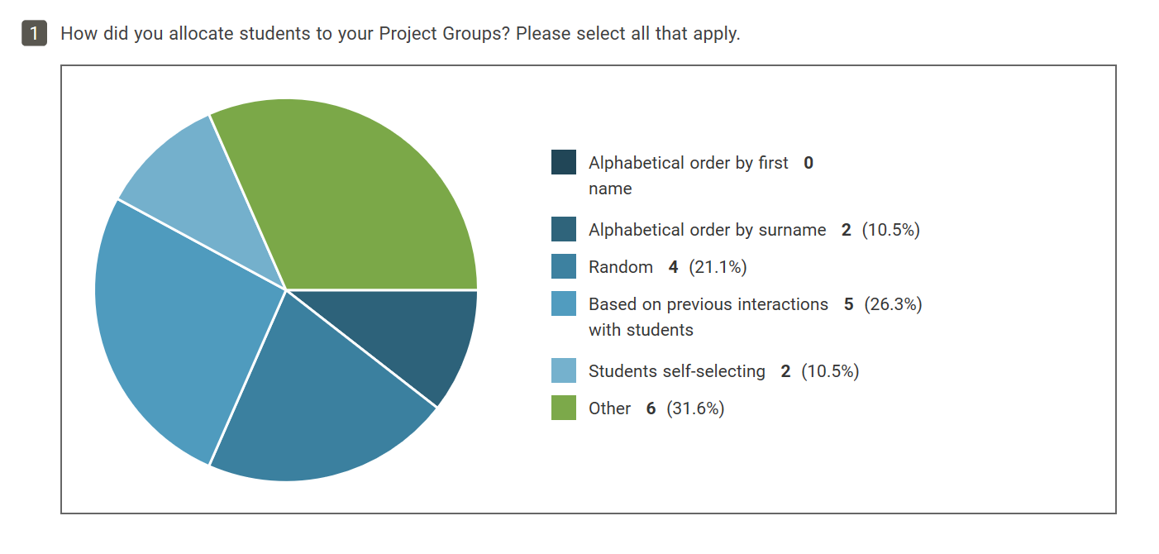
Early findings

Slide 12
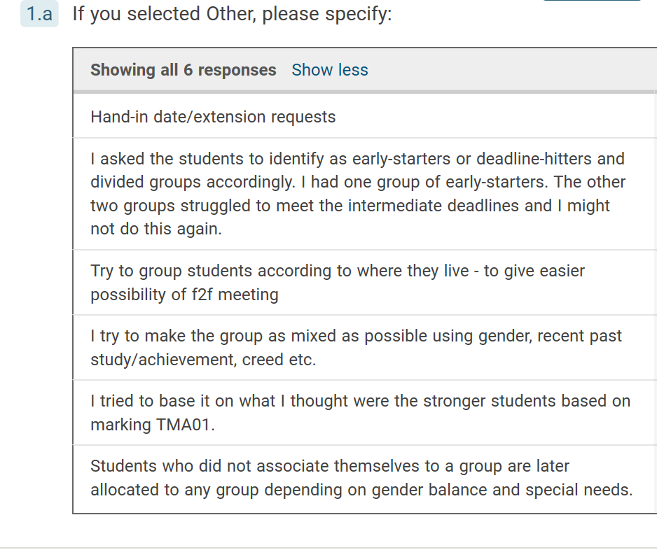
Early findings

Slide 13
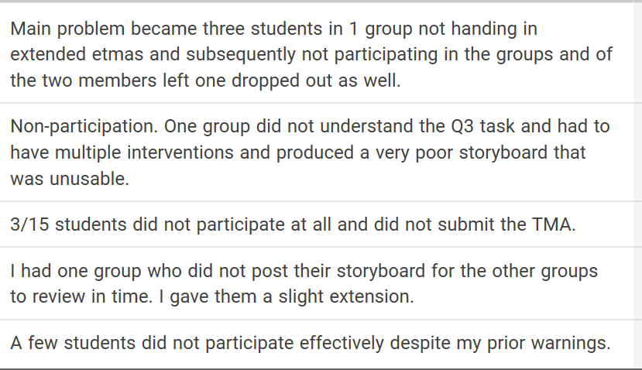
Early findings
2. Do you feel you had enough information to allocate students to Project Groups? Y = 7 N = 8
3. Did you experience any issues with student engagement in the group work? Y = 15
3a

Slide 14
Early findings
2. Do you feel you had enough information to allocate students to Project Groups? Y = 7 N = 8
3. Did you experience any issues with student engagement in the group work? Y = 15
3a
4 Were you contacted by students regarding the lack of engagement by other students? Y = 14 N = 1

Slide 15
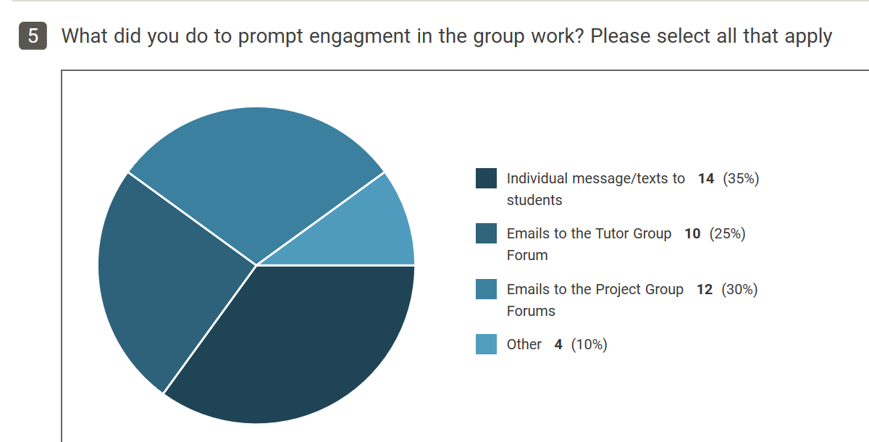
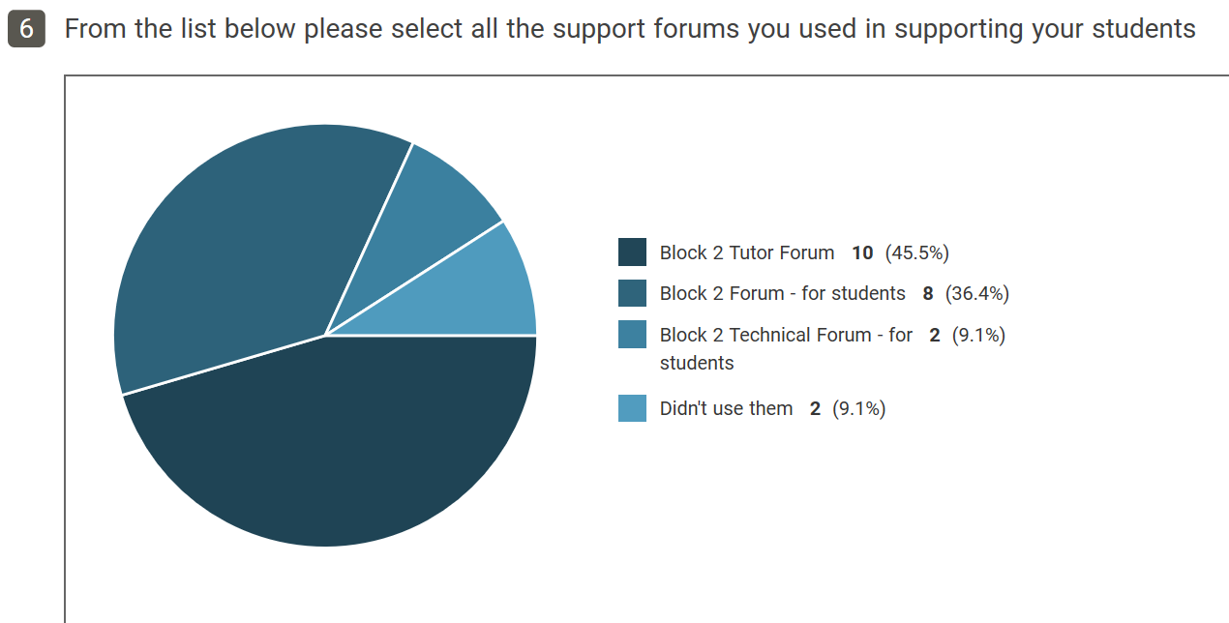
Early findings

Slide 16
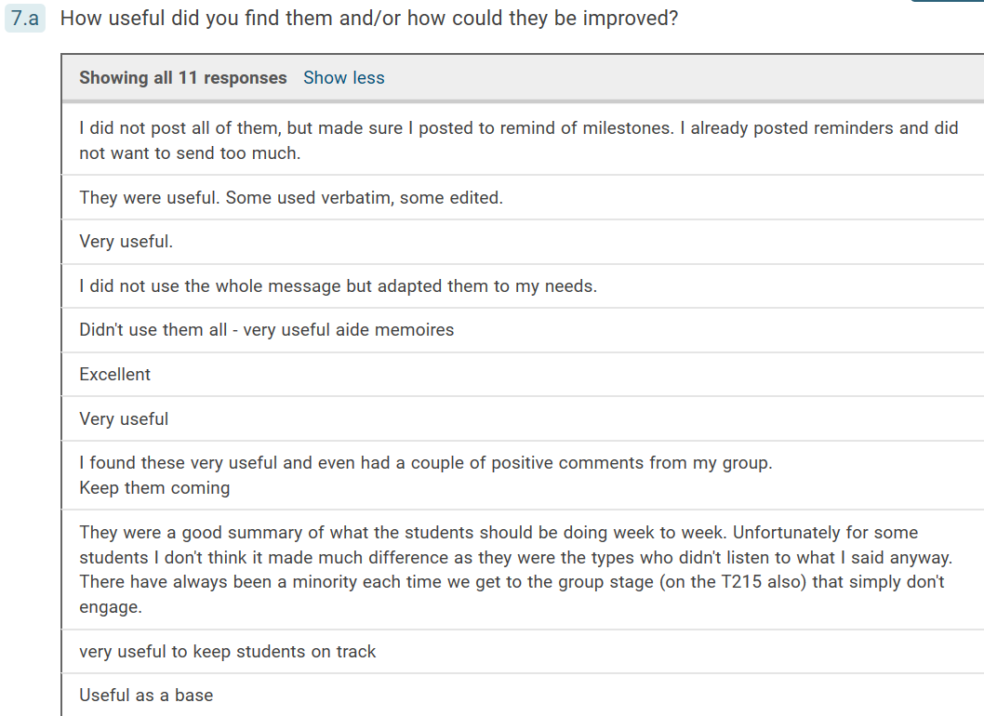
Early findings
7. Weekly support messages for tutors to adapt for students were posted in the Tutor Forum and Tutor Calendar. Did you use them?
Y = 11 N = 4

Slide 17
Early findings
Qs 8 and 9 – general comments
I have so far used groups of 5-6 but I may change this to 7-8 to reduce the risks of drop-outs
I feel the timing of this group project is problematic as some students seem to go off at Xmas and forget about the project.
Students should be reminded clearly at the beginning of the module about their responsibilities around group work.
Because of the tutor cluster arrangements, not all tutors would give a tutorial about the group work project (I don't think I did). I think it would be worthwhile that each tutor gives a tutorial to their group on the group work and that tuition time should some how be allocated to this (perhaps taking 30 mins out of the other tutorial time allocated for each tutor?)
Distance group working is always going to be tough, and I think that TM255 is a reasonable compromise.

Slide 18
Early findings
Students
Students appreciated the additional support
Main concern is engagement of other students – pre - and during the group work
Other pressures impinging on student ability to engage as much as they would like to.
Tutors
Concerns about student engagement – slow start; non-engagement – not able to address; lack of incentive
Insufficient information to group students – limited relationship between students and between tutor and students
Pattern of project groups – 1 group engaged other 2 less so
Complexity and timing of task
Assessing contributions

Slide 19
Emerging themes/framework
Purpose – student, tutor, module team, faculty, wider
Engagement – relationships tutor/student ; student/student
Nature and timing of task
Strategies – higher, intermediate and lower level

Slide 20
Questions and discussion
How can we encourage students to engage in online collaborative group work – what are the incentives/drivers?
Are we using the right technologies – building relationships; communication?
Do we need to review the nature of tasks and how crucial is timing?

Slide 21
Breakout Activity
Breakout Room A
Breakout Room B
Breakout Room C

Slide 22
Conclusion
The research question:-
How can tutors best support students to (successfully) engage in online collaborative projects?
Interim overarching conclusions:-
There are a number of low level strategies which tutors can implement and which students appreciate but they may only be effective with those students who are already engaged.
There are number of intermediate level strategies that the module team can implement such as addressing the complexity and timing of the task and to some extent the technologies utilised. This may go some way to addressing engagement.
Higher level strategies by faculty or above in terms of how to incentivise students to engage in group work are needed.

Slide 23
References
Booth, A. (1996) Assessing Group Work . In: A Booth and P Hyland (eds). History in Higher Education. Oxford: Blackwell, 276– 297.
Braun, V. & Clarke, V. (2006). Using thematic analysis in psychology. Qualitative Research in Psychology, 3, 77–101
Donelan, H. and Kear, K. (2017) ‘Creating and collaborating: students’ and tutors’ perceptions of an online group project’, International Review of Research in Open and Distributed Learning. Volume 19, Number 2
Fry, Heather, et al. A Handbook for Teaching and Learning in Higher Education : Enhancing academic practice, edited by Heather Fry, et al., Taylor and Francis, 2014. ProQuest Ebook Central
Hilliard, Jake (2017). Students’ Perceptions and Experiences Of Anxiety In An Online Collaborative Project.
MRes thesis The Open University.
McCutcheon, G., & Jung, B. (1990). Alternative perspectives on action research. Theory into Practice, 29, 144-151. EJ417491
Salmon,G., (2004). E-Moderating: The Key to Online Teaching and Learning: The Key to Teaching and Learning Online. Taylor and Francis
Seale, J., (2013), E-learning and Disability in Higher Education: Accessibility Research and Practice, Routledge

Slide 24
Thank you s.evans@open.ac.uk

