Slide 1
Single Component Assessment Exam and Exam Feedback: the S112 experience
Jim Iley and Nick Adams

Slide 2
BACKGROUND
S112 is second Stage 1 60-credit module in multiple qualifications
Eight learning outcomes
Single-component assessment: exam – only Stage 1 module in university
TMAs 01/03/04 assess topic learning
TMAs 02/05 assess practical work; TMA06 assesses communication
Exam assesses the remaining FIVE learning outcomes
No thresholds on any component
Exam
61%
TMA 02
10%
TMA 05
10%
TMA 06
10%
TMA 01
3%
TMA 03
3%
TMA 04
3%
Notes:
S112 linked to multiple quals – main ones being Q52, Q64, Q71, Q72, and new single hons quals R58 (biology), R59 (chemistry)
LOs – ideas/concepts; gather/analyse/interpret; basic maths solving; scientific method; communication; practical; collaboration; PDP
Exam strategy chosen to provide students with a ‘formative’ (in that it doesn’t count towards degree classification) learning experience of an exam
Students must take the exam to pass the module
TMAs 01/03/04 are built up from activities students undertake during topic learning
TMAs 02/05/06 assess LOs not easily assessed in the exam
Exam comprises five questions, one per learning outcome. Each is focused in one of the five S112 disciplines. Subject matter for each question varies by discipline each year
All data, figures, tables, extracts that students will work with in the exam are provided as seen material BEFORE the exam
Students can pass the module by gaining 66% on the exam

Slide 3
FINDINGS
Little gaming of the assessment strategy
Exam performance related to number of assignments submitted
Module outcome adversely affected by study of concurrent modules
S112 outcome better in terms of proportions of distinctions and failures: S111>U116>SDK100
Most popular subsequent modules in 18J were S294 and S295
Subsequent withdrawal highest from S215
Stage 2 performance shows correlation to S112 performance
S209 performance better than those who have not completed S112, but S215 performance poorer

Slide 4
Assignment submissions
No evidence of gaming
7 students did exam only (4 pass, 3 fail)
Assessment strategy appears to encourage assignment submission
Number of TMAs submitted | 2017J/% | 2018J/%
0 | 0.7 | 0.2
1 | 0.5 | 0.4
2 | 1.6 | 0.9
3 | 1.7 | 1.4
4 | 3.5 | 3.3
5 | 10.1 | 11.5
6 | 81.9 | 82.2
Notes:
Most students submit all assignments

Slide 5
Exam performance related to number of assignments submitted
No. of TMAs submitted | Number of students | Average exam score
0-2 | 35 | 59.6
3 | 26 | 60.5
4 | 56 | 57.9
5 | 180 | 62.6
6 | 1359 | 67.5

Slide 6
Module outcome adversely affected by study of concurrent modules
17J
No. of concurrent modules | Numbers of students | Average TMA score | Average exam score | Average overall score
0 | 550 | 76.6 | 66.5 | 70.4
1 | 179 | 69.4 | 65.9 | 67.2
2 | 22 | 64.6 | 62.4 | 63.3
18J
No. of concurrent modules | Numbers of students | Average TMA score | Average exam score | Average overall score
0 | 713 | 75.6 | 66.9 | 70.3
1 | 185 | 73.1 | 65.2 | 68.3
2 | 7 | 65.9 | 65.6 | 65.7
Notes:
Most S112 students who get to the exam are studying the module on its own (73.2% of 17J; 78.8% of 18J).
Performance highly consistent between presentations.
Studying a module alongside S112 appears to correlate with slightly reduced ‘traditional OCAS’ and OES scores.

Slide 7
Effect of previous module study on S112 outcome
Combined 17J and 18J cohorts
S112 result | S111 698 students | U116 401 students | SDK100 139 students
Distinction | 20.6% | 15.2% | 8.6%
Pass | 77.4% | 82.5% | 85.6%
Fail | 2% | 2.3% | 5.8%
Notes:
S111 prepares students better than U116 which is better than SDK100

Slide 8
Behaviour of 17J S112 students on 18J Stage 2 modules: S112 Passes
Most of the 17J S112 students studied S294 and S295
In absolute terms, withdrawals from S209 were the lowest

Slide 9
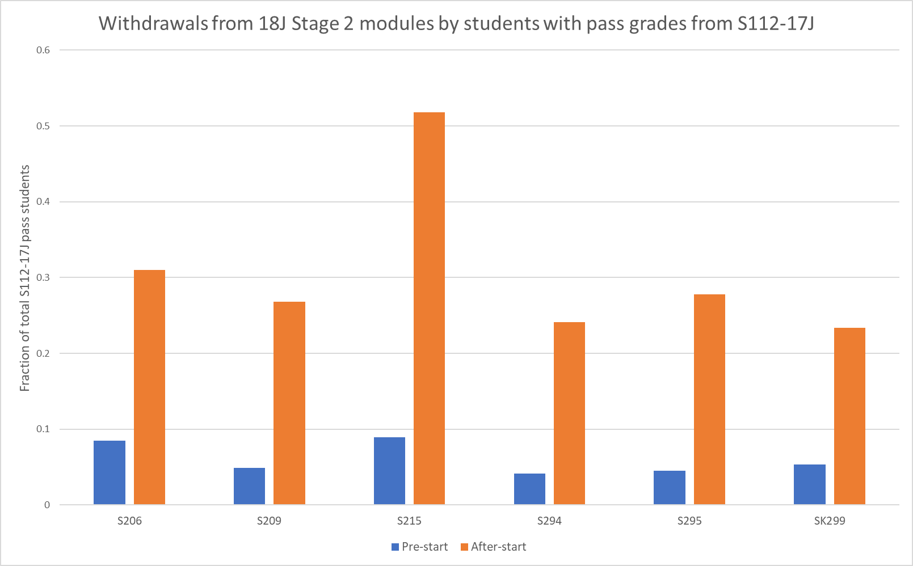
Withdrawals of 17J S112 students from 18J Stage 2 modules: S112 Passes
Students gaining a pass on S112 are more likely to withdraw from S215 than any other module by a factor of almost 2
S112 withdrawals are evenly spread across the module
Month | No. of S112-17J pass students withdrawing from S215-18J
Oct 2018 | 4
Nov2018 | 5
Dec 2018 | 5
Jan 2019 | 3
Feb 2019 | 4
Mar 2019 | 5
Apr 2019 | 0
May 2019 | 2
Jun 2019 | 1
Notes:
Pattern of withdrawals suggests it is not associated with specific topics/subjects

Slide 10
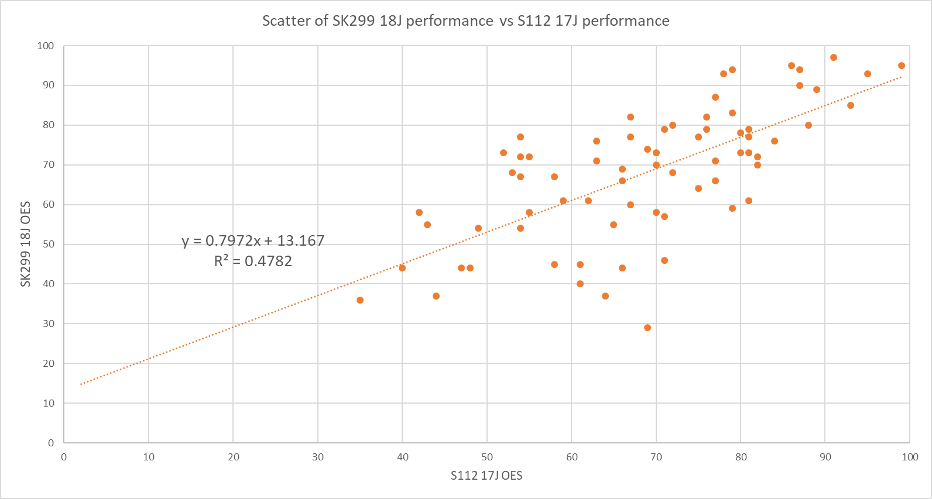
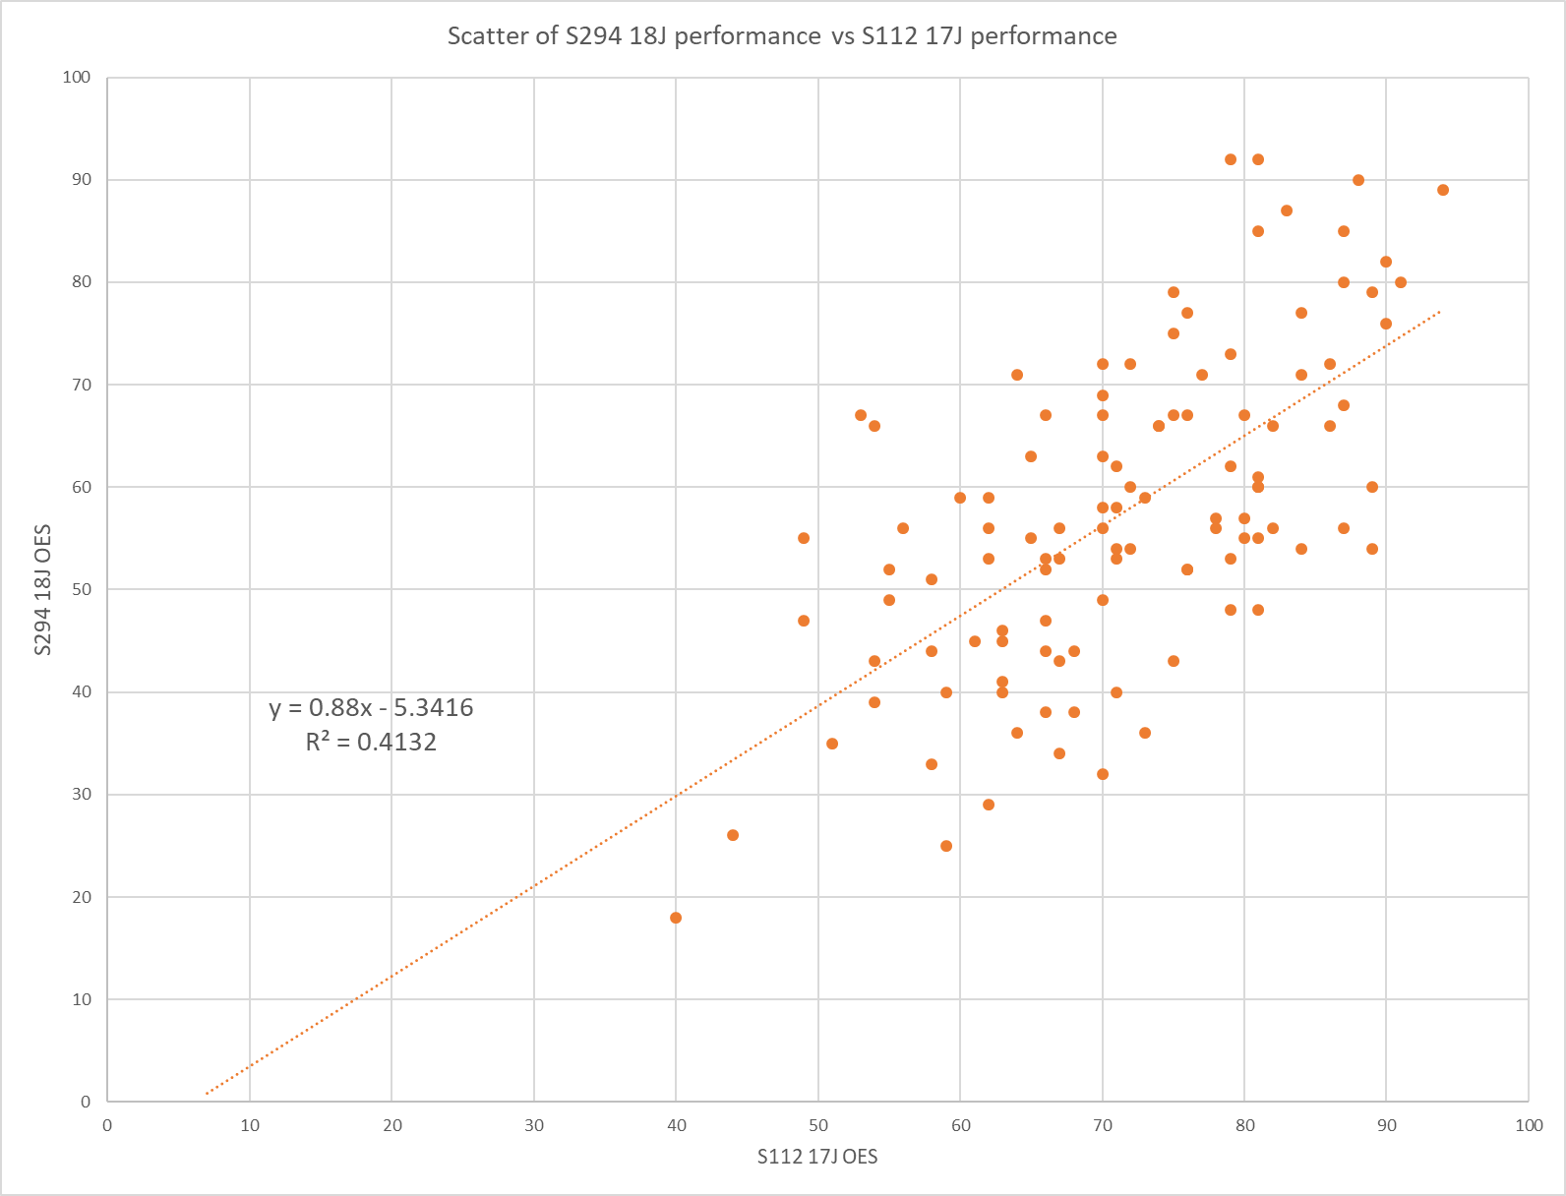
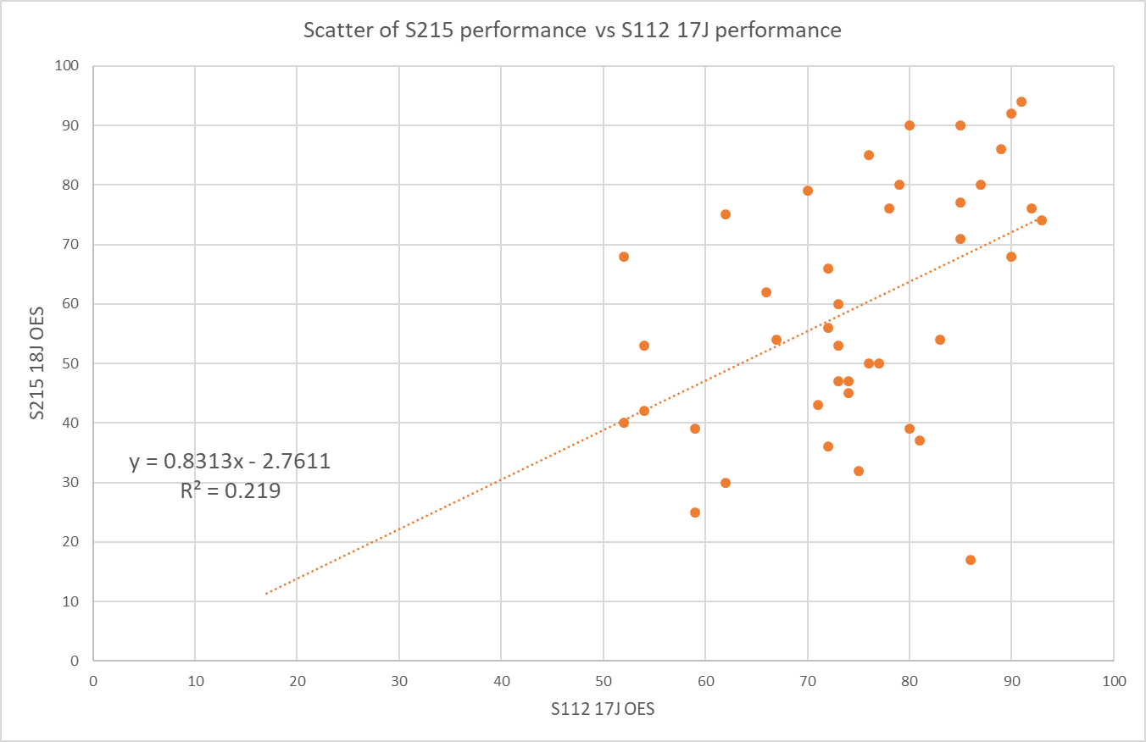
Stage 2 Module performance versus 17J S112 performance
Correlation between
Stage 2 exam performance and S112 exam performance
r² = 0.4-0.5 for 5 of 6 modules
For S215 correlation is considerably poorer
r² = 0.2
Some students do very well on S215 (but not S112); others very well on S112 (but not S215)
S294
SK299
r² = 0.5
r² = 0.4
S215
r² = 0.2

Slide 11
17J Student performance on 18J Stage 2 modules
S112 students versus ‘the rest’
Students who have completed S112 do better
OES
Students who have completed S112 do worse
  S112 students who then study S209 do slightly better than those who have not studied S112
  S112 students who then study S215 do slightly worse than those who have not studied S112

Slide 12
S112 and the exam feedback pilot
Nick Adams, Dan Berwick and Jim Iley
With grateful acknowledgement to the original Exam Feedback Pilot Team
(Sarah Clayton, Georgina Middlemiss, Judith Pickering)

Slide 13
APPROACH
Ran in 17J
Approach to feedback left open to participating module teams
S112 approach: fully automated using an Excel ‘form’ template
  algorithmic, programmable
  consistency across markers/feedback providers
  customised feedback based on input
  challenging setup but easy to operate at scale (c. 700 scripts)
  quick to produce custom feedback to be copied and pasted
Tried this approach with TMAs to mixed reception (largely negative)
Academic feedback ‘scripted’ by Dr Daniel Berwick
Translated/programmed by Nick Adams
Notes:
Approach to feedback left open to participating module teams – we had the freedom to decide on an approach using, say, a more tailored, bespoke system for providing feedback to students, or using more ‘canned’ approaches, like set phrases/generic feedback statements that markers could use.
S112 approach: fully automated using an Excel ‘form’ template
algorithmic, programmable – we could take an academic ‘script’ and translate it into logic that would result in a comment
some level of consistency across markers/feedback providers – there were c. 13 markers and exam feedback is not normally provided. So we needed a system that would ensure some consistency in the feedback being given to students, especially as the comments could otherwise be ‘open’
gave customised feedback based on input/student answers – canned, hopefully without it appearing or actually being too canned or generic, so that it was useful to students
challenging to setup but easy to operate at scale (c. 700 scripts) – investment in the setup given that marking periods are tight; dealing with c. 700 scripts so we needed something that could provide feedback quickly and easily.
quick for markers to produce custom feedback that can simply be copied and pasted– markers have limited time, often marking 60+ scripts during a short marking window. They were only being paid £2 per script to produce feedback (in addition to their marking fee), so the expectation was that markers would have, on average, five mins per script to produce feedback. The system needed to be quick for markers to produce consistent feedback
We had previously tried using automated feedback approaches on TMAs, which received a mixed (but largely negative) reception – ideas of removing professional identity / students not finding generic feedback helpful:
comments from the S112 tutor de-briefing (5 July 2018):
“I thought the generic feedback for TMA06 was much better than TMA02 - I'm happy to use it with my own”
“I quite liked the generic feedback for TMA06, with the addition of a tailored chunk at the start of the PT3”
“Feedback from my students was they felt the feedback was 'cold and impersonal' didn't really help with the tutor/student relationship”
“I'm sorry but I really don't think generic feedback on TMAs for level 1 students is not helpful to them”
“With the generic feedback I just wonder how new students will feel about this compared to competing institutes (sic) that do provided (sic) personalised feedback”

Slide 14
FINDINGS
Most common open comment from students (S112 or otherwise) - exam feedback is most useful alongside the student’s original script
Automated feedback works well but needs very careful crafting if it is to be:
  relevant to the student / look ‘human’;
  programmable; and
  easy for markers to use in a short period of time.
Feedback should prioritise questions most likely to cause problems = learning points
Single ‘voice’ (combining feedback comments from multiple question authors likely to require further work!)
5,000 character limit on OSCAR
Requires a bespoke template for each exam
Notes:
Here are some further thoughts / considerations for the approach S112 took.
5000 characters as a limit sounds like a lot but actually became a practical constraint – once you include headings, spaces, punctuation etc c. 750 words = around 4,500 characters. We wanted to avoid markers having to do any editing of the output.
By far the most common comment from students, across all modules in the pilot, was that the feedback is only really useful when they also have sight of what they wrote, and the OU does not return original or marked exam scripts to students.

Slide 15
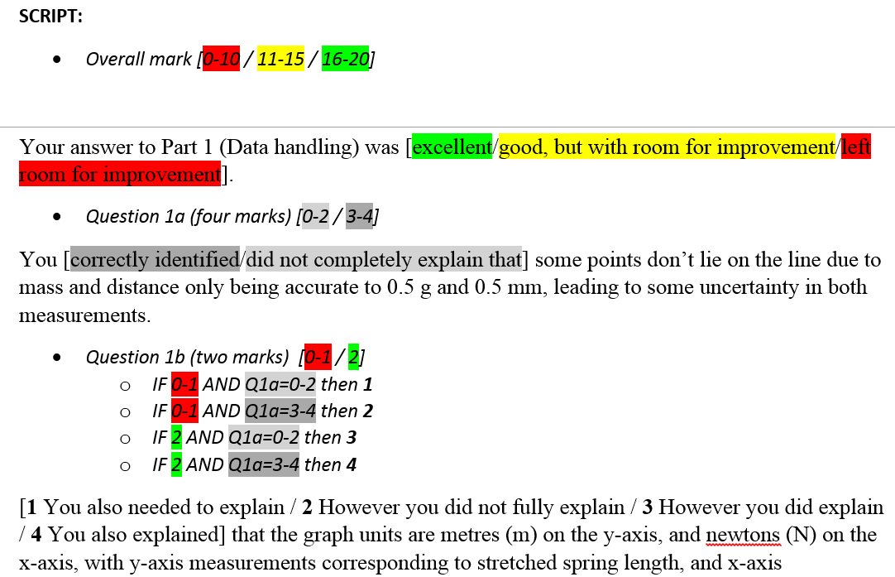
WHAT DID THIS LOOK LIKE IN PRACTICE?
Academic script
Notes:
Figure 1 A screenshot showing an example of the feedback ‘coded’ in Word by Dr Dan Berwick for the S112 examination feedback pilot (covering Questions 1a and 1b). The colours indicate where particular statements are needed on the basis of a characteristic, for instance overall score for the Part, a score for an individual question or a combination of the two.
Dan focused on the student experience, leaving the translation to me (Nick)

Slide 16
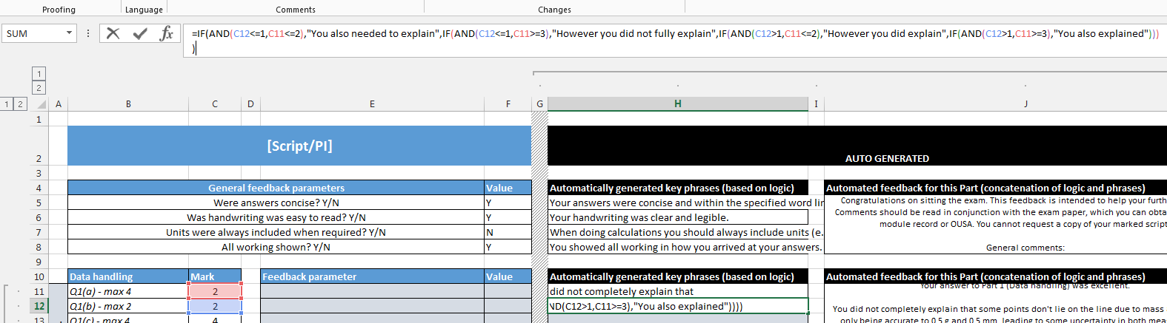
WHAT DID THIS LOOK LIKE IN PRACTICE?
Programmed feedback form
Notes:
Figure 2 A screenshot of part of the Excel spreadsheet feedback generator. This view covers the same feedback shown in Figure 1 (i.e. Question 1a and Question 1b). Cell H12 is selected in this view to show the logic statement (in the formula box towards the top) that was used to output the necessary key phrase for Question 1b in the resulting feedback. The larger box in column J used a concatenate statement to combine all of the key phrases and standard text into the appropriate order.

Slide 17
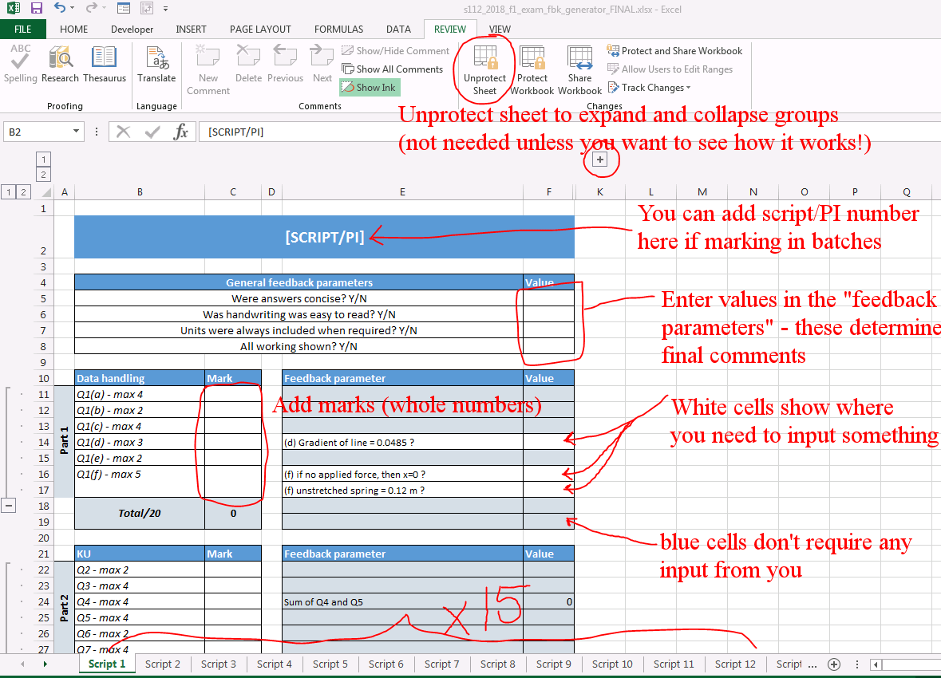
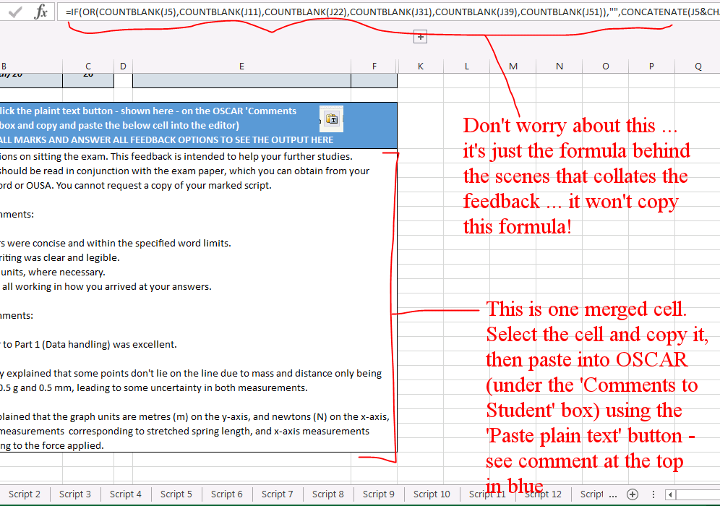
WHAT DID THIS LOOK LIKE IN PRACTICE?
Guidance to markers
Notes:
We produced step-by-step guidance to markers on how to use the feedback system and to add the feedback comments into OSCAR
The marker simply needed to fill in all of the marks for the script and answer a few basic questions in order to generate an extensive feedback comment that could then be copied and pasted directly into to the ‘Feedback on Your Answers’ box from the ‘Comments to Student’ tab on OSCAR when returning their marking.

Slide 18
HOW WAS IT RECEIVED?
By markers
Module | ‘Canned’ rating | ‘Positivity’ rating | %/students agree enough detail | %/students satisfied with feedback
S112 | 8 | 7 | 65 | 69
A227 | 5 | 8 | 54 | 69
DD209 | 0 | 7 | 23 | 48
DD211 | 3 | 2 | 35 | 53
DE200 | 7 | 3 | 52 | 59
KYN317 | 3 | 3 | 53 | 62
L203 | 3 | 5 | 67 | 86
L204 | 3 | 5 | 42 | 60
L211 | 3 | 5 | 38 | 65
“Generally this is working really well and is pretty idiot-proof in that all has to be completed before the comments appear in the box at the end.”
Pilot study evaluated marker experience by assigning ‘positivity’ rating
  S112 scored highly here
  Correlated with level of canned feedback
  Script markers generally happier when provided with illustrative text rather than creating feedback from scratch
Notes:
From Pilot report: “Based on the informal markers’ feedback received by the module team, each module was assigned a ‘positivity rating’ for how positive the markers felt about the process of providing exam feedback (see Appendix D). This positivity rating significantly correlated with the level of canned feedback provided, suggesting that script markers were happier to be involved in the feedback process when they were given illustrative text to adapt, in comparison to when asked to create tailored comments from scratch.” – this is likely to be a factor of marker workload and recompense for the work (markers were only paid £2 per script to produce feedback, so it needed to be done in a short period of time to be financially viable. S112 had highly ‘canned’ feedback.

Slide 19
HOW WAS IT RECEIVED?
By students
89.9% (89/99) agreed that they understood the feedback they received (2nd highest)
65.3% (66/101) agreed that there was enough detail in the feedback (2nd highest)
68.7% (68/99) agreed that they were satisfied with the feedback (3rd highest)
61.4% (62/101) agreed that the feedback helped them become aware of their strengths and weaknesses (3rd highest)
58.6% (58/99) agreed that the feedback would help them improve their skills in taking exams (3rd highest)
60.0% (60/100) agreed that the feedback would be useful as they go on to start their next module (3rd highest)
Notes:
These numbers are tabulated from responses to the student survey (Likert scale) as part of the exam feedback pilot project
Agreement here includes those who said they ‘Agree’ and ‘Strongly agree’
Take home points:
S112 performed well across the board in the measures, often placing second/third out of the nine modules in the pilot (number of responses from each group roughly the name n ~100)
Despite S112 being highly ‘canned’ (the only module trialling fully automated feedback), students indicated high levels of feedback utility and satisfaction.

Slide 20
FUTURE WORK
More detail on marker/module team experience
Repeat for future S112 exam, perhaps in conjunction with trial of making scripts available to students
Quantitative analysis of S112 specific open comment data
Notes:
More detail on marker/module team experience – module team was used as a proxy in exam feedback pilot but this was limited and it’s important to include direct marker perspectives in future studies
Repeat for future S112 exam, perhaps in conjunction with trial of making scripts available to students – it has been a couple of years now since the pilot ran but it has not been repeated owing to resource time to support it. Further repeats of providing exam feedback should consider the feasibility of making feedback available alongside a student’s original script, as a common point emerging from the first pilot. This has other potential implications (e.g. the prospect of more module results queries/challenges) and requires careful thought.
Quantitative analysis of S112 specific open comment data – the pilot was considering a range of different modules, taking different approaches, to evaluate the feasibility, overall, of providing examination feedback. So it necessarily took an holistic overview.

Slide 21
Questions?

Slide 22
Additional slides

Slide 23
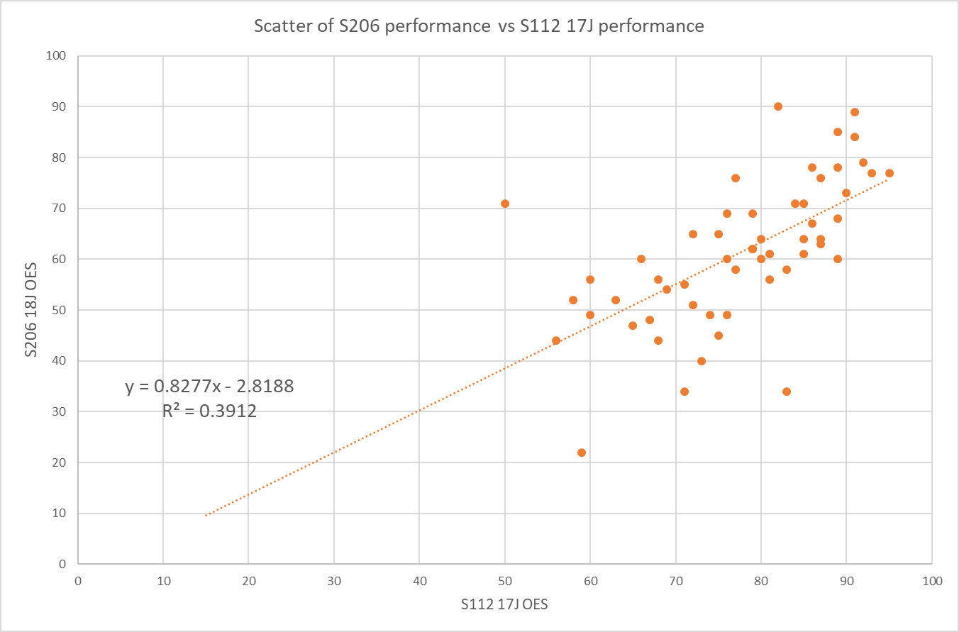
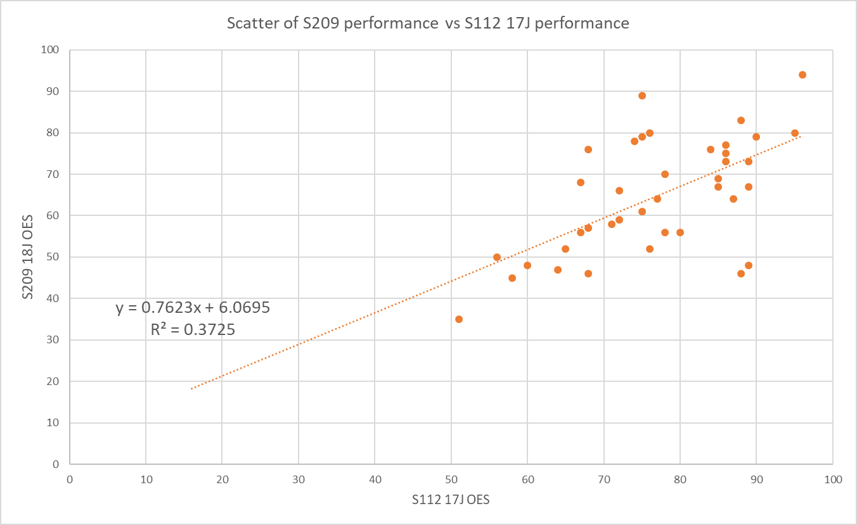
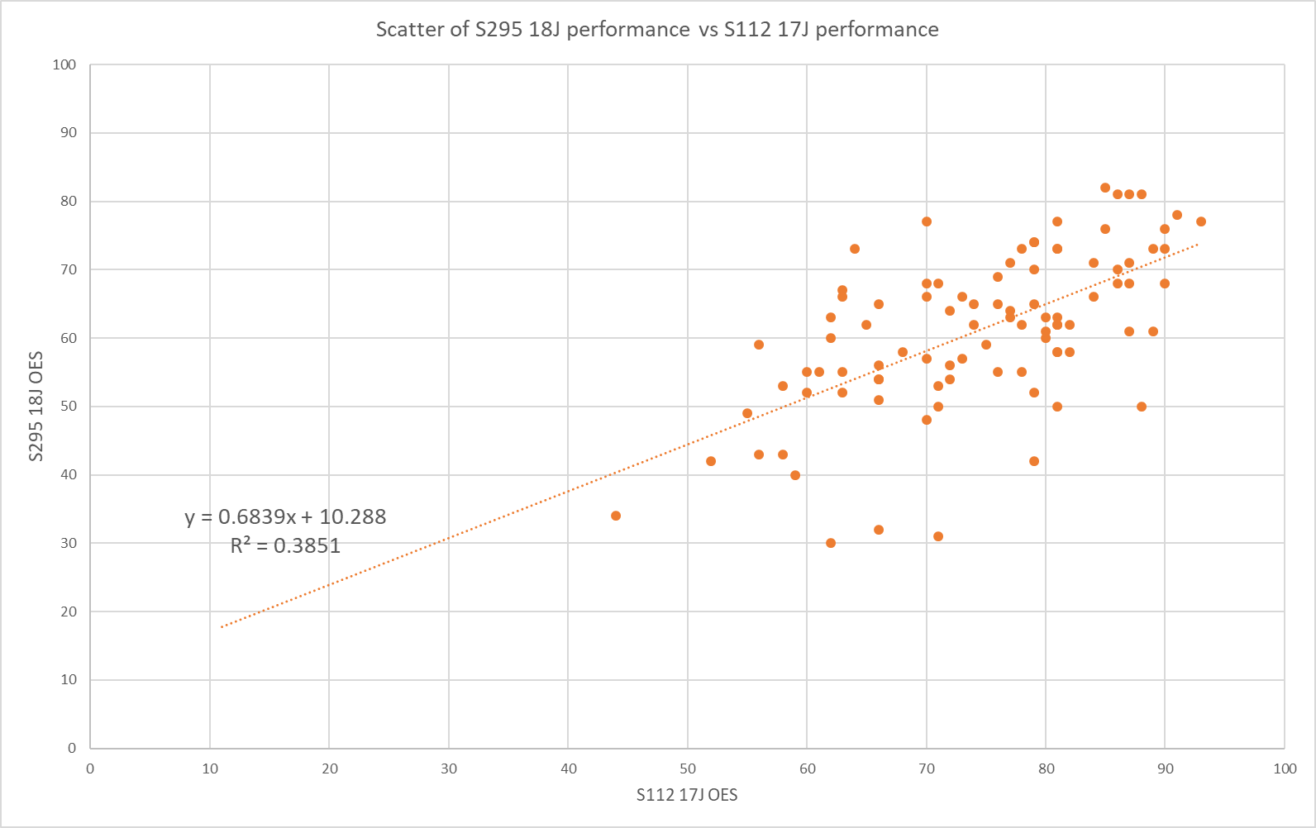
Stage 2 Module performance versus 17J S112 performance
Correlation between
Stage 2 exam performance and S112 exam performance
r² = 0.4-0.5 for 5 of 6 modules
For S215 correlation is considerably poorer
r² = 0.2
Some students do very well on S215 (but not S112); others very well on S112 (but not S215)
S206
S209
S294
S295
SK299
S215

Slide 24
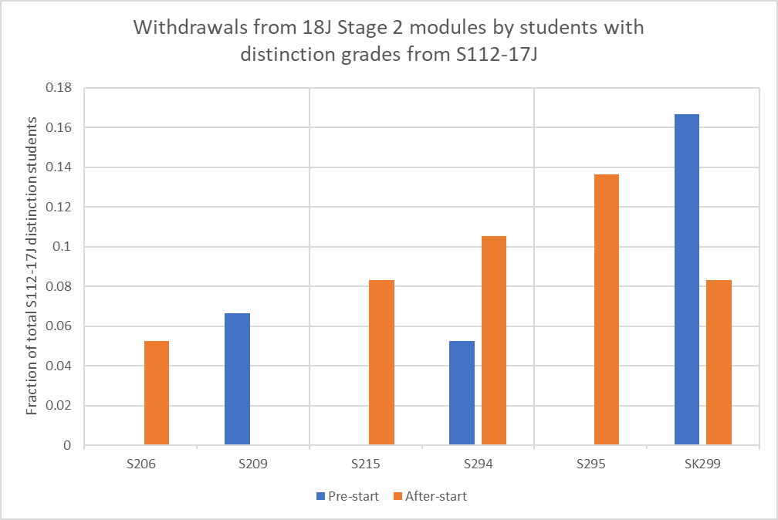
Withdrawals of 17J S112 students from 18J Stage 2 modules: S112 Distinctions
Students gaining a distinction on S112 are more likely to withdraw from SK299 than any other module

Slide 25
BACKGROUND
Project conceived under Students First Transformation ‘More Students Qualifying’ objective
Survey data (SEFAR project, 2015) indicated that “most students (70.6%) did not receive or were not satisfied with feedback from their examination”
Principle 5 of OU Principles for Assessment Practice:
“feedback should be given on all assessments to support students in moving forwards to their next assessment of module” (APC-2013-03-01).
Involved nine modules across FASS, STEM (S112) & WELS, spanning
Levels 1-3
Ran during S112’s first (17J) presentation – so used in 2018 F1 (June) conflation
Notes:
Introduction (from Exam feedback pilot report)
This project was conceived in support of one of the objectives of the Students First Transformation – ‘More Students Qualifying’, and as a direct result of student feedback in the 2015 Student Experience of Feedback, Assessment and Revision (SEFAR) student survey (Cross, Whitelock and & Mittelmeier). This report highlighted that “most students (70.6%) did not receive or were not satisfied with feedback from their examination”. There is also a requirement to address the need to meet Principle 5 of the OU Principles for Assessment Practice namely “feedback should be given on all assessments to support students in moving forwards to their next assessment of module” (APC-2013-03-01).
As a principle objective is to achieve ‘More Students Qualifying’, the project aims to support students more effectively in achieving a qualification at the OU and progressing to further modules. Feedback on exams is generally limited across faculties, with only a few cases where module teams have put a solution in place. Many other higher education institutions offer exam feedback to students, yet its feasibility at the OU has not previously been systematically explored. Data on the feasibility of providing exam feedback will shape OU priorities and policies. Here we explore staff and student experiences of an exam feedback pilot, with a ‘test and learn’ evaluation approach.
In particular, we were interested in whether providing feedback on exams:
a) is financially viable
b) is repeatable and scalable
c) makes positive contributions to Learning and Teaching
d) results in an improved student experience
We are also interested in finding out whether there is a ‘best practice’ method for providing exam feedback (e.g. are students more satisfied with tailored or canned/generic feedback?). We will explore this through analysis of the various feedback approaches adopted by the module teams participating in this project.

Slide 26
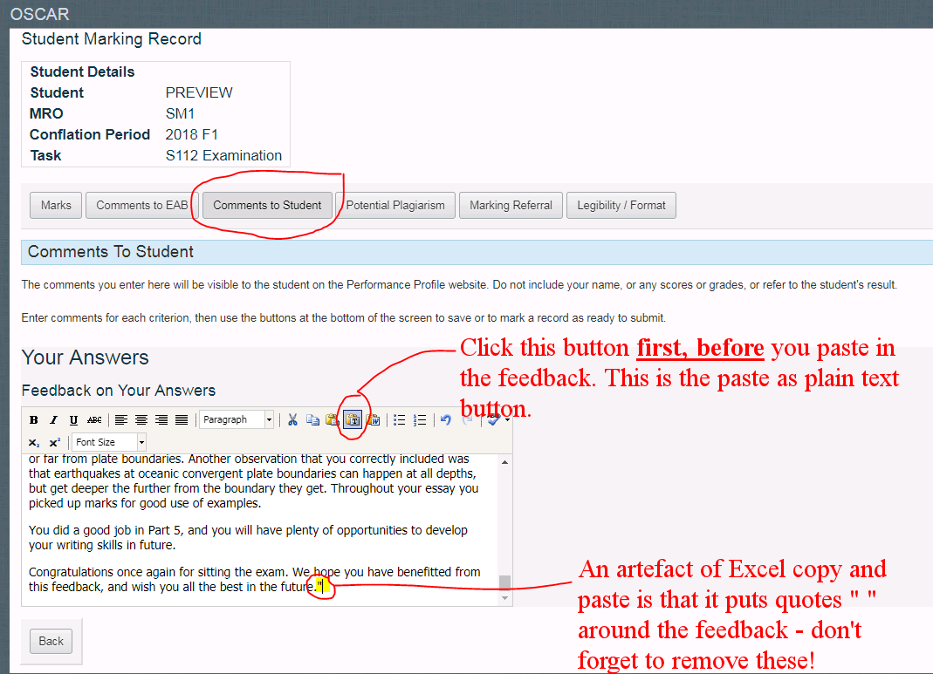
WHAT DID THIS LOOK LIKE IN PRACTICE?
Adding comments on OSCAR
Notes:
We produced step-by-step guidance to markers on how to use the feedback system and to add the feedback comments into OSCAR. This slide shows an annotated screenshot of the guidance produced.

Slide 27
REFERENCES/LINKS
Cross, Simon; Whitelock, Denise and Mittelmeier, Jenna (2016). Does the Quality and Quantity of Exam Revision Impact on Student Satisfaction and Performance in the Exam Itself?: Perspectives from Undergraduate Distance Learners. In: EDULEARN16 Proceedings, IATED Academy, pp. 5052–5061. Available at http://oro.open.ac.uk/46937/
APC-2013-03-01 New Models of Assessment and Tuition Assessment Principles
Exam Feedback Pilot – Evaluation Report Jan 2019
Provision of Examination Feedback (Office of the Pro-Vice-Chancellor (Students) intranet)

