Slide 1

















Using Real Time Student Feedback (RTSF) as an Emotion Awareness and Regulation Tool in an Assessed, Online, Collaborative Project
By Jake Hilliard, Patrick Wong, Karen Kear, Helen Donelan, and Caroline Heaney

Slide 2





Background
Over the last decade, research has increasingly highlighted the inextricable links between emotion and cognition as well as the profound effects emotions have in academic contexts (Pekrun and Linnenbrink-Garcia, 2012).
Although much of this research has been undertaken in individual face-to-face learning settings, such notions have also been evidenced in online and computer-supported collaborative learning environments (Henritius et al., 2019; Reis et al., 2018).
Being able to effectively regulate one’s emotions in online learning can be seen as a crucial process in learning (Xu et al, 2014); this is particularly important in social and collaborative online learning contexts which present a multitude of social, cognitive, and practical challenges that may impact group member’s emotional states (Webster, 2019).
With an increased understanding of the importance of emotions in these social online learning contexts, researchers have started to develop tools that can be used by students to help raise awareness of their emotions and help them regulate their feelings when undertaking collaborative activities (Järvelä et al., 2016).
One such tool is the Socio-Emotional Sampling Tool (SEST) (Webster and Hadwin, 2013) which has been designed for computer-supported collaborative learning tasks and aims to prompt students to metacognitively monitor and evaluate their current emotional state before, during and after collaborative activities.

Slide 3






Aim and research questions
The main purpose of this study was to explore the use of Real Time Student Feedback (RTSF) as emotion awareness and regulation tool in an assessed, online collaborative project.
The following research questions were addressed:
  What emotions do students experience during and after an assessed, online, collaborative project?
  What are students’ goals and strategies for regulating their emotions?
  What are students perceptions of using RTSF as an emotion awareness and regulation tool?

Slide 4
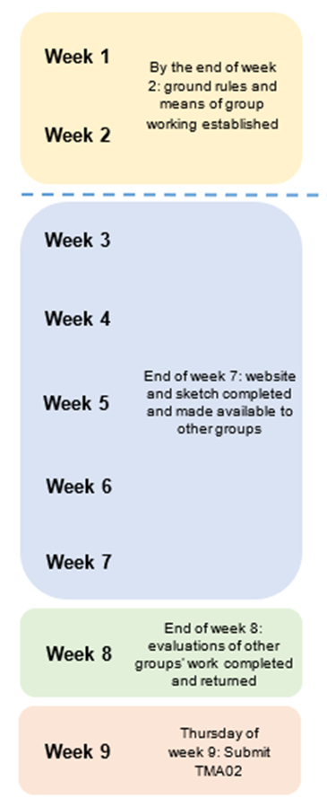
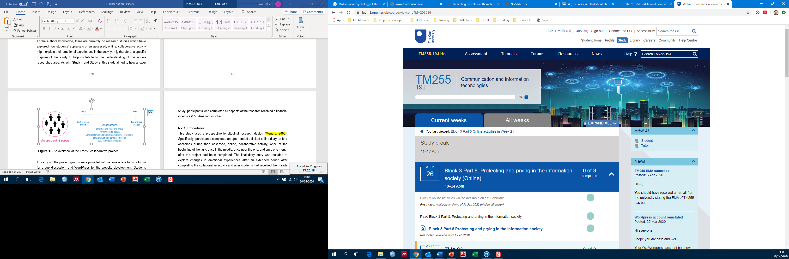
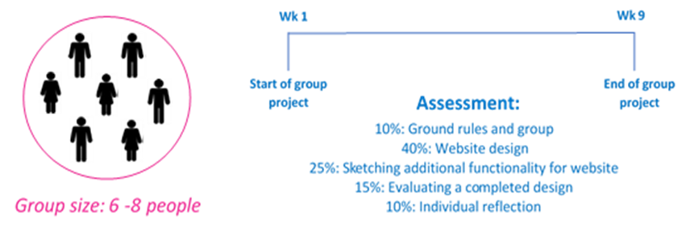
Study context
RTSF 1
(Before activity)
RTSF 2 (start of activity)
ASSESSED TEAM PROJECT
9-week collaborative project in which students work in small groups to produce a website for a specific client (e.g. a family-friendly hotel)
RTSF 3 (middle of activity)
RTSF 4 (after activity)

Slide 5
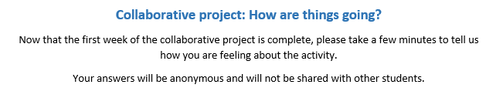
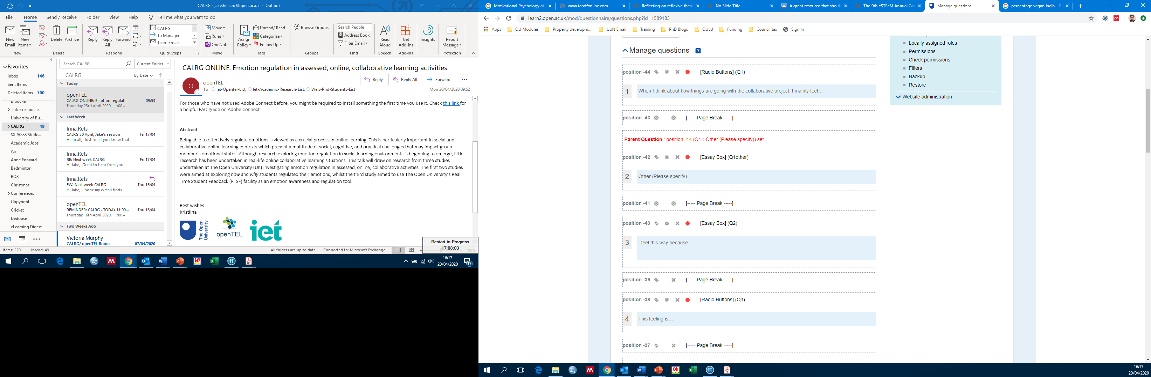
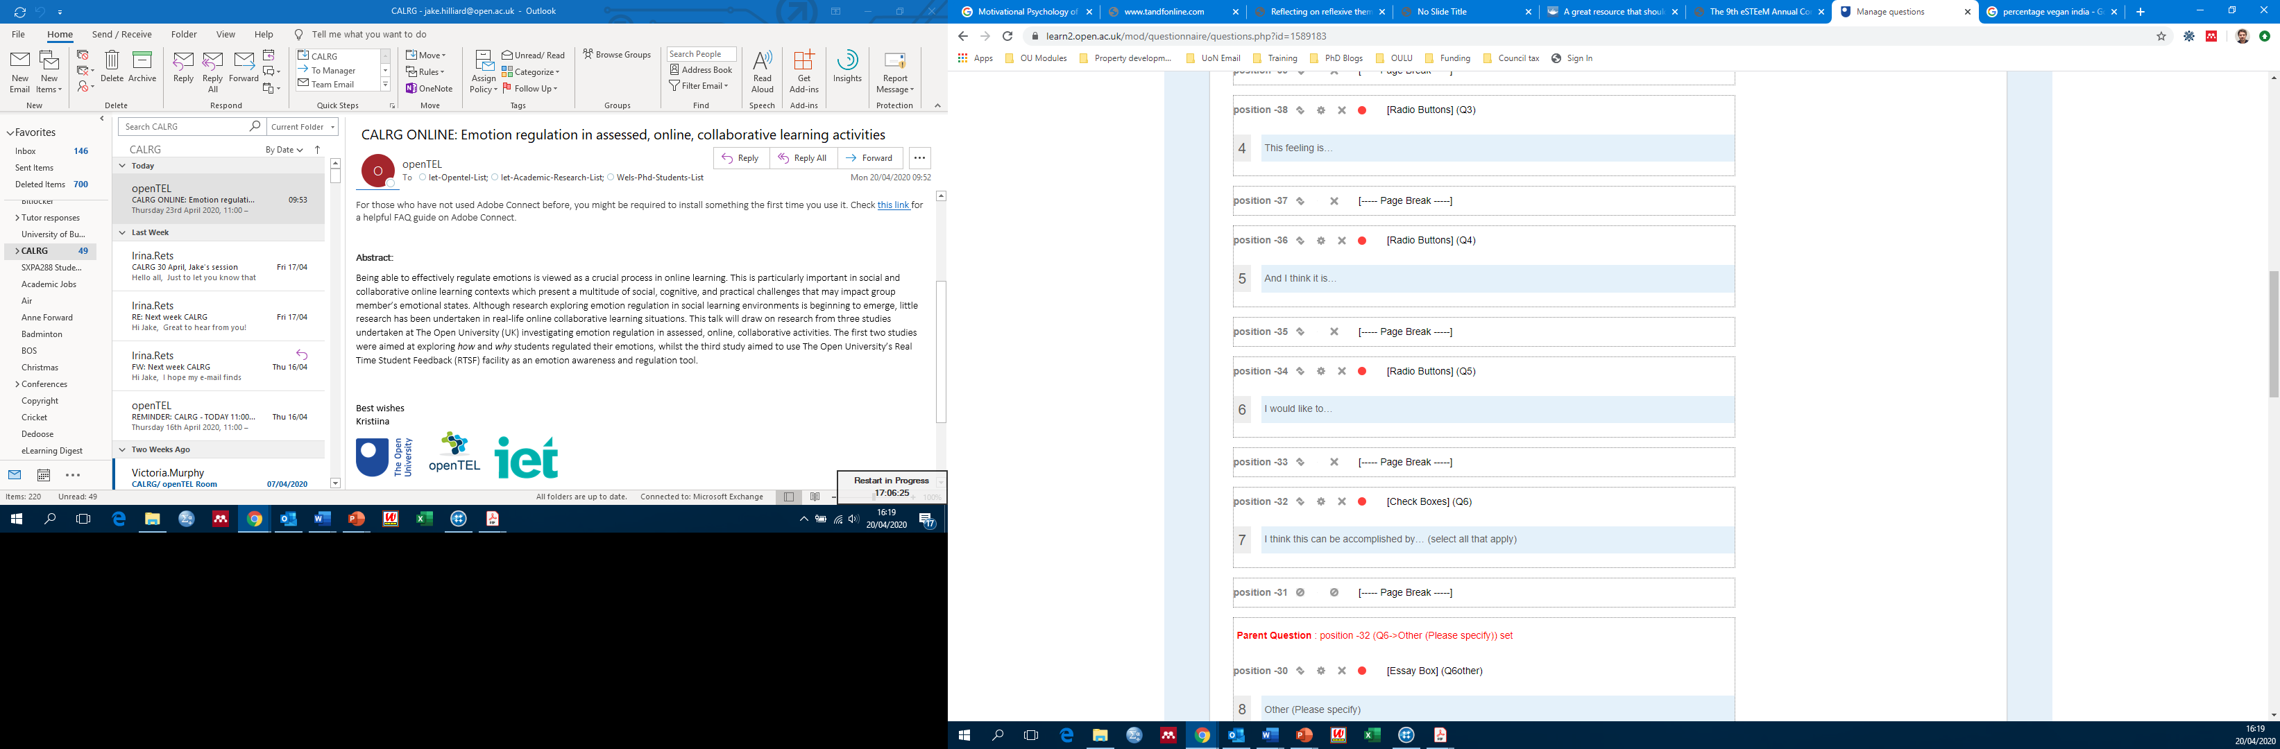
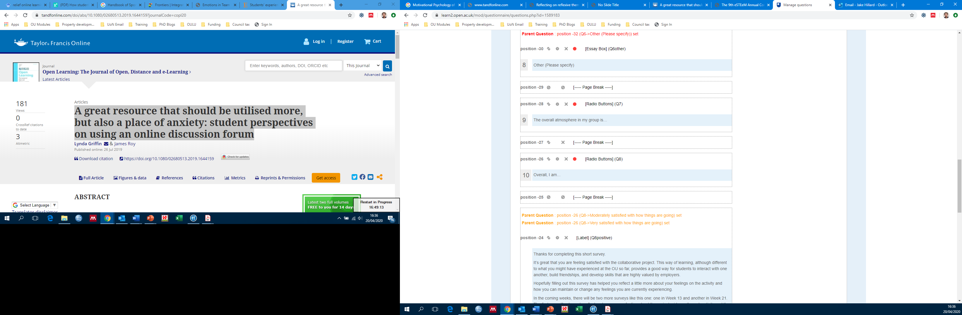
The RTSF emotion awareness and regulation tool
Excited
Anxious
Calm
Angry
Confident
Bored
Curious
Confused
Happy
Disappointed
Proud
Embarrassed
Relieved
Frustrated
Hopeful
Overwhelmed
Other
Feedback to students
Example: RTSF 2 and 3
Very or moderately satisfied with how things are going
Not very or not at all satisfied with how things are going
Thanks for completing this short survey.
We’re sorry to hear that you might not be as satisfied with the activity as you would like to be. We understand that online group learning can be challenging, especially at the OU, where many students have additional commitments that make it difficult to interact at specific times of the day. However, from previous experiences we have found that, although some students may experience some negative feelings during the activity, their reflections after the activity are often very positive.
Hopefully filling out this survey has helped you reflect a little more about your feelings on the activity, and how you can change (or maintain) any feelings you are currently experiencing. In the coming weeks, there will be two more surveys like this one: one in Week 13 and another in Week 21. The first one will ask you to reflect on how you are feeling about the project mid-way through the activity and the second will explore your feelings about the project after it has been completed. It would be great if you could fill out both of these.
Please also remember that if you ever feel you need more support, at any point during the project, you can always speak to your tutor about any issues you may be experiencing. There is also some additional information about study support on OU Support area.
Thanks for completing this short survey.
It’s great that you are feeling satisfied with the collaborative project. This way of learning, although different to what you might have experienced at the OU so far, provides a good way for students to interact with one another, build friendships, and develop skills that are highly valued by employers.
Hopefully filling out this survey has helped you reflect a little more about your feelings on the activity and how you can maintain or change any feelings you are currently experiencing.
In the coming weeks, there will be two more surveys like this one: one in Week 13 and another in Week 21. The first one will ask you to reflect on how you are feeling about the project mid-way through activity and the second will explore your feelings about the project after it has been completed. It would be great if you could fill out both of these.
Please also remember that if you ever feel you need more support, at any point during the project, you can always speak to your tutor about any issues you may be experiencing.
Open text box
Good
Bad
Neither good nor bad
Very strong
Strong
Moderate
Weak
Very weak
Talking to others in the group
Focusing on the task
Supporting and encouraging others in the group
Talking to my tutor
Creating a good plan
Thinking positively
Making sure that I don't become complacent
Changing the plan or approach
Carrying on as I am doing
Taking time to relax
Talking to family and/or friends
Changing my thoughts or beliefs
Other (Please specify)
Increase this feeling
Decrease this feeling
Maintain this feeling
Do nothing about this feeling
Positive
Negative Neutral
Very satisfied with how things are going
Moderately satisfied with how things are going
Not very satisfied with how things are going
Not at all satisfied with how things are going

Slide 6



Findings
Perceptions before the collaborative activity (RTSF 1)
281 respondents out of a possible 491
(57.2% response rate)
The majority of students were uncertain about the activity
Figure. Feelings about the assessed, online, collaborative activity, before it began.

Slide 7

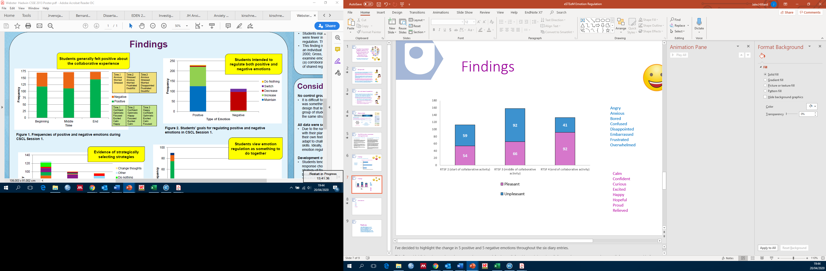
Findings
Emotions experienced during and after the collaborative activity (RTSF 2, 3 and 4)
Angry
Anxious
Bored
Confused
Disappointed
Embarrassed
Frustrated
Overwhelmed
A range of emotions were reported by students. During the middle of the activity more unpleasant emotions were reported whilst after the activity more pleasant emotion were reported. Overall, the emotions of anxiety, frustration and relief most frequently reported
Calm
Confident
Curious
Excited
Happy
Hopeful
Proud
Relieved
Figure. Frequencies of pleasant and unpleasant emotions reported during the assessed, online collaborative project.

Slide 8
Findings
Evaluation of emotions (RTSF 2, 3 and 4)
As may be expected, pleasant emotions were predominantly perceived as ‘good’ whilst most unpleasant emotions were perceived as ‘bad’. There was some instances where students perceived pleasant and unpleasant emotions as ‘bad’ and ‘good’, respectively.
Figure. Students’ evaluations of pleasant and unpleasant emotions during the assessed, online collaborative project.
Notes:
Need to explain why some pleasant emotions might be evaluated as ‘Bad’ and some pleasant emotions perceived as ‘Good’ – provide examples

Slide 9
Findings
Goals for regulating emotions (RTSF 2 and 3)
Students planned to predominantly maintain or increase pleasant emotions and decrease unpleasant emotions. There were some instances where students planned to increase unpleasant feelings and decrease pleasant emotions.
Figure. Students’ goals for regulating pleasant and unpleasant emotions during the assessed, online collaborative project.
Notes:
Need to explain why some pleasant emotions might be evaluated as ‘Bad’ and some pleasant emotions perceived as ‘Good’ – provide examples

Slide 10
Findings
Planned regulation strategies (RTSF 2 and 3)
To regulate pleasant and unpleasant emotions students planned to use a range of strategies. ‘Talking to others in the group’ and ‘Focusing on the task’ were the most frequently reported for both pleasant and unpleasant emotion.
Figure. Planned strategies for regulating pleasant and unpleasant emotions during the assessed, online collaborative project.

Slide 11
Findings
Group atmosphere and overall satisfaction (RTSF 2, 3 and 4)
Figure. Perceptions of group atmosphere in the assessed, online collaborative project.
Figure. Satisfaction of undertaking the the assessed, online collaborative project.

Slide 12
Findings
Feedback on using RTSF as an emotion awareness and regulation tool (RTSF 4)
58 students (45.6% of respondents) believed that RTSF surveys helped them become more aware of their emotions
41 students (32.3% of respondents) believed that RTSF surveys helped them regulate, or manage, their emotions
70 students (55.1% of respondents) stated that they did use the strategies selected in the RTSF surveys to help regulate their feelings
54 students (42.9% of respondents) ) stated that RTSF surveys prompted new ideas for regulating feelings during the project
Figure. After filling out the second (Week 11) and/or third (Week 13) short survey, did you use any of the strategies you selected to help regulate your feelings?
Figure. Did the strategies mentioned in the second and/or third surveys prompt any new ideas for how you could regulate your feelings during the project?
Figure. Did filling out the surveys help you become more aware of how you were feeling about the group project?
Figure. Did filling out the surveys help you regulate, or manage, your feelings in relation to the group project?

Slide 13
Conclusions
What emotions do students experience during and after an assessed, online, collaborative project?
  Start of activity: Approximately equal pleasant and unpleasant emotions (most reported: anxious, frustrated, hopeful and curious).
  Middle of activity: More unpleasant emotions (most reported: anxious and frustrated).
    Technical difficulties, e.g. WordPress problem, could be a reason for high levels of frustration.
  After activity: More pleasant emotions (most reported: relieved).
What are students’ goals and strategies for regulating their emotions?
  Respondents mostly aimed to maintain or increase pleasant emotions and decrease unpleasant emotions.
  Students planned to use a range of strategies to regulate emotions; ‘Talking to others in the group’ and ‘Focusing on the task’ were the most frequently reported for both pleasant and unpleasant emotion.
What are students perceptions of using RTSF as an emotion awareness and regulation tool?
  58 students (45.6% of respondents) believed that RTSF surveys helped them become more aware of their emotions.
  41 students (32.3% of respondents) believed that RTSF surveys helped them regulate, or manage, their emotions.

Slide 14
Conclusions
Benefits for the module team – an unbiased (by other students’ comments) insight into how students are feeling about the group work as the forums can seem very negative and one sided – the results indicate that actually the majority of students had a good experience and were happy with group project.
Benefits for students – a way of raising awareness of their emotions and strategies that they might consider for managing their feelings – but maybe also to inform future students that it is likely their emotions and feelings towards the project is likely to change over time.
Additionally, RTSF was easy/quick to get approved and embedded in the module website, and it allowed for quick responses that can be used to apply interventions.

Slide 15
Thank you
jake.hilliard@open.ac.uk
patrick.wong@open.ac.uk
karen.kear@open.ac.uk
helen.donelan@open.ac.uk
caroline.heaney@open.ac.uk

