Slide 1
Maximising online tutorial attendance on a high population level 1 module
Susan Pawley

Slide 2
The cost of providing regular online tuition is high
Historically in MST124 online tuition has centred around a cluster module
Tutorials tended to be organised at a similar time in each cluster for each learning event

Slide 3
Online tutorials
for unit 3 in 18J
Monday | Tuesday | Wednesday | Thursday | Friday | Saturday | Sunday
 |  |  | 1 November | 2 | 3 | 4
5 | 6 | 7 | 8 7-9pm (14 students) | 9 | 10 | 11 10-11am (10 students)
12 | 13 10-11:30 (12 students) 10-11:30 (1 student) 7-8:30 (4 students) 7:30-8:30 (6 students) 7:30-9:30 (10 students) | 14 7-8 (10 students) 7-8:30 (5 students) 7-8:30 (10 students) 7:30-9 (10 students) | 15 7-8:30 (10 students) 7:30-9 (6 students) 7:30-9:30 (15 students) | 16 | 17 10-11:30 (2 students) | 18 6:30-8(11 students)
19 | 20 12-1:30 (7 students) 7-8 (9 students) 7:15-9:15 (5 students) 7:30-9 (2 students) | 21 7-8:30 (4 students) 7-8 (4 students) 7:30-9 (8 students) 7:30-8:30 (9 students) | 22 7:30-9:30 (0 students) 8-9:15 (13 students) | 23 | 24 | 25 7-0 (2 students)
26 | 27 | 28 | 29 | 30 | 1 December | 2
3 8-9 (11 students) | 4 1:30-3 (3 students) | 5 | 6 | 7 | 8 | 9
10 | 11 | 12 7-8(0 students) | 13 | 14 | 15 | 16
17 | 18 7-8 (2 students) | 19 | 20 | 21 | 22 | 23
222 online attendees
115 face-to-face tutorials

Slide 4
The cost of providing regular online tuition is high
Historically in MST124 online tuition has centred around a cluster module
Tutorials tended to be organised at a similar time in each cluster for each learning event
The number of online tutorials for each learning event varied between clusters
The number of students that attend each tutorial varied from 15 students to zero students
The number of tutorials that were recorded varied between clusters.

Slide 5
As part of a larger body of work Claudi Thomas surveyed undergraduate students studying maths and stats modules on their views on the purpose of tutorials.
Link to main findings of survey

Slide 6
An anonymous survey containing 12 questions about the use of tuition time was sent out in May 2019 to approximately 2000 Maths & Stats OU undergraduate students. 334 responses were received in response to the survey.
The questions focused on what the students thought the purpose of tuition time should be and how this time should best be used to support their learning.
We also asked about practical issues such as length of tutorials,
timing, whether to record online sessions and how easy it was to use the LEM booking system.

Slide 7
Tuition time is a vital but expensive resource in the OU. Please indicate how you would like us to prioritise the use of tuition time on your module(s) to support your needs.
The priorities for the use of tuition time were as follows, with percentages given for the options of
‘very useful’ and ‘useful’ respectively:
1. Help with tricky topics (60.7% very useful, 32% useful)
2. Actively work through examples (57.2%, 29.1%)
3. Opportunities to ask questions (56.3%, 29.7%)
4. Cover core material (51.9%, 33.4%)
5. Help with assessment (52%, 31.9%)

Slide 8
6. Gain a deeper understanding of the material (43.9%, 39.8%)
7. Discuss solutions to examples sent out in advance (37%, 36.1%)
8. Interactions with OU staff (31.4%, 33%)
9. Motivation to keep going (31.6%, 26.3%)
10. Cover material lecture-style (27.7%, 30.3%)
11. Belong to a community of people interested in the subject (22.1%, 30.3%)
12. Help catch up with material (21.3%, 32.1%)
13. Interactions with other students (18.7%, 27.7%)
14. Cover extension material (16.3%, 38.3%)

Slide 9
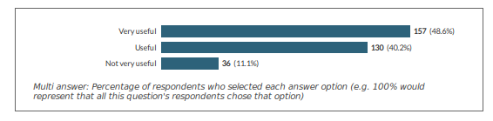
Please indicate how useful to your own learning you would find the following types of tutorials/tutor support, assuming for the moment that there are no factors that would prevent you from accessing this support.

Slide 10
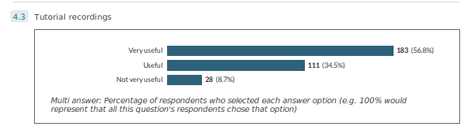
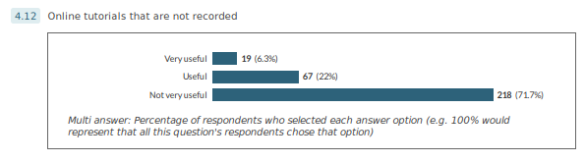

Slide 11
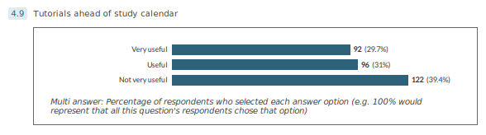
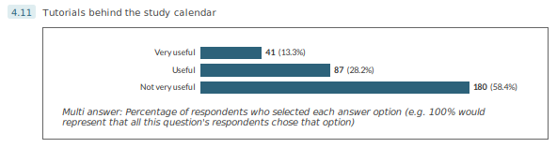

Slide 12
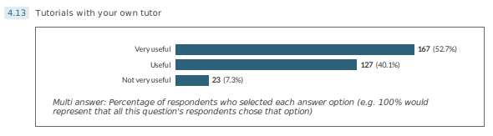
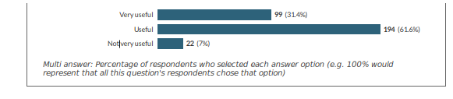

Slide 13
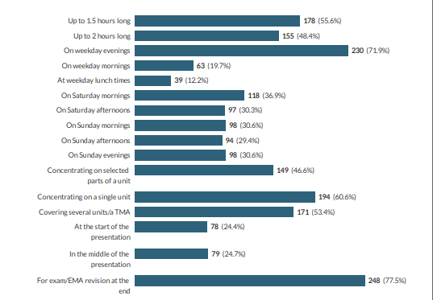
Time of
day

Slide 14
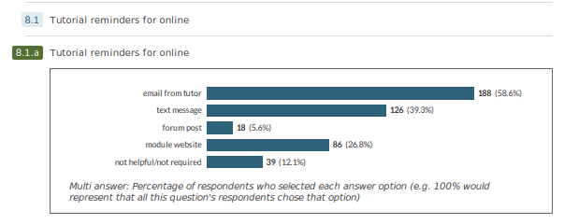

Slide 15
How did we respond

Slide 16
Changes to MST124
Pilot introduction of recorded module-wide tutorials in 18J.
Significantly increase the number of tutorials in the module wide room.
Fortnightly email reminders sent with schedules of module-wide online tutorials
Tutorial schedules for module-wide tutorials put on website.
Improved labelling of tutorials, to ease navigation.

Slide 17
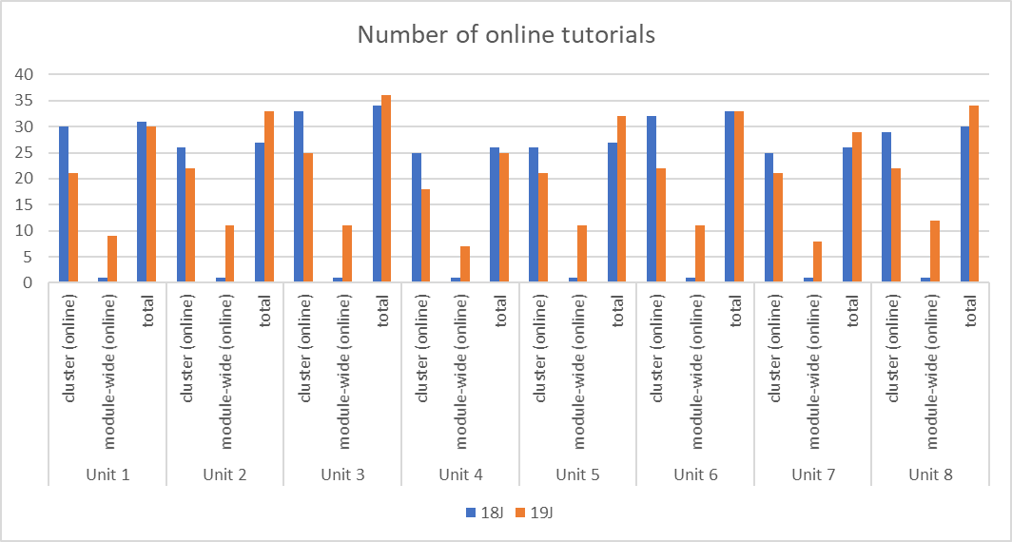

Slide 18
Tutorial Strands
Specialist tutorials
Weekday evening tutorials
Midweek daytime tutorials
Sunday evening tutorials
Saturday tutorials (TMA based)
Sunday morning tutorials (not a full programme)
Tutorial at a time suitable for students studying outside of the UK
Tutorial for students using the joint MST124/MST125 calendar
Tutorial for students using the joint MST124/M140 calendar
Tutorials in advance of tutorial calendar
Tutorials for students working behind module calendar
What’s in the box
Spot the mistakes
Drop-in tutorials
Notes:
Saturday tutorials tend to be longer ( 3 hours) with short breaks between each unit

Slide 19
Dear Student
Online tutorials for MST124 in the Online module-wide room
Hello. We hope all is going well as we head to the half way stage of the study calendar. Over the next couple of weeks the focus will be on Units 7 and 8 – Unit 7 being a continuation of Unit 6 with some additional concepts on the topic of differentiation as well as paving the way for the other strand of calculus – integration – and the following unit. With this is in mind, we have arranged for a number of tutorials to continue to support your learning.
In additional to these module wide tutorials, there will be face-to-face tutorials in various locations across the country as well as additional online tutorials in your online tutorial room. Please do take a look at the tutorial booking page and where possible attend the tutorial that is most suitable for you.
If you have any questions on the tutorials presented in the online module-wide room please email: mst124-team@open.ac.uk
Best Wishes
MST124 Module team
Notes:
Fortnightly email sent out to students – always light and informative remind students about the cluster tutorial and encourage students to book. Give them an email address which a team monitor for any problems,

Slide 20
Date | start time | end time | EventName | Tutor(s)
28-Jan-20 | 12:00 | 13:30 | Preparing for TMA03, focusing on Calculus (Unit 7) (module wide)- Midweek daytime tutorial | Rachel Cargill Thompson
28-Jan-20 | 19:00 | 20:30 | Preparing for TMA02 and focusing on Unit 6 Differentiation (module wide)- Tutorials for students working behind module calendar | Sarah Gasquoine, Linda Brown
30-Jan-20 | 12:00 | 13:30 | Preparing for TMA03, focusing on Calculus (Units 7 and 8) (module wide)- Tutorial at a time suitable for students studying outside of the UK - Unit 7 | Sarah Chyriwsky
30-Jan-20 | 19:00 | 21:00 | Preparing for TMA03, focusing on Calculus (Units 7 and 8) (module wide)- Tutorials in advance of tutorial calendar | Sarah Gasquoine, Liam O'Hare
02-Feb-20 | 19:00 | 20:30 | Preparing for TMA03, focusing on Calculus (Units 7 and 8) (module wide) Sunday tutorial - Unit 7 | Harry Gretton
05-Feb-20 | 19:30 | 21:00 | Preparing for TMA03, focusing on Calculus (Units 7 and 8) (module wide)- Tutorial for students using the joint MST124/M140 calendar - Unit 8 | Linda Brown, Colin Fulford
Notes:
Always send schedule of events in module wide room – table also added to module web-site.

Slide 21
Results (until face-to-face tutorials were cancelled)

Slide 22
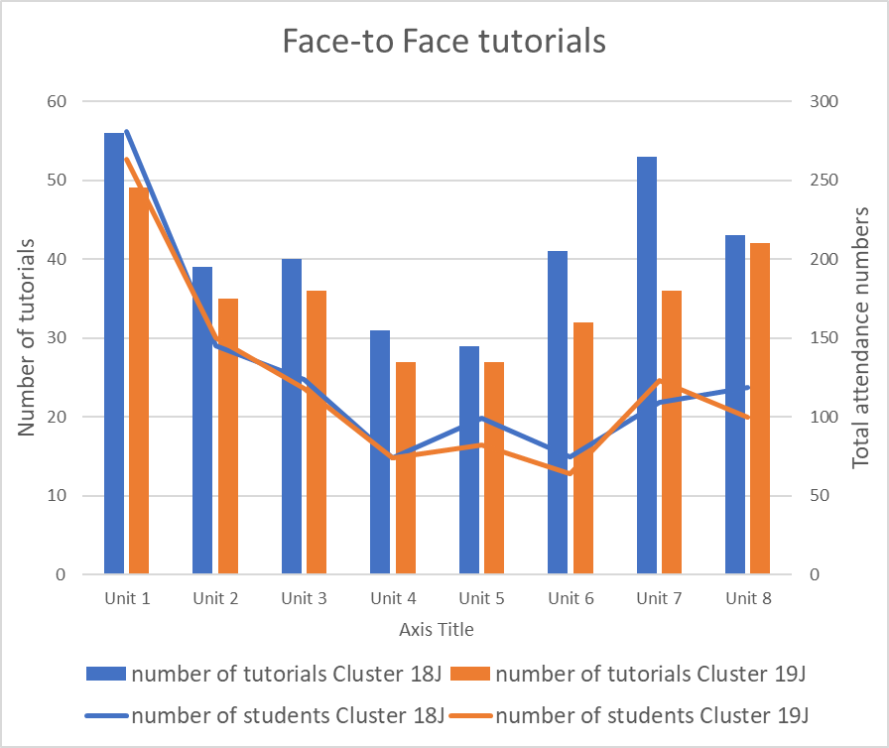
 | percentage of students attending
 | 18J | 19J
Unit 1 | 15% | 14%
Unit 2 | 8% | 8%
Unit 3 | 7% | 6%
Unit 4 | 4% | 4%
Unit 5 | 5% | 4%
Unit 6 | 4% | 3%
Unit 7 | 6% | 6%
Unit 8 | 6% | 5%

Slide 23
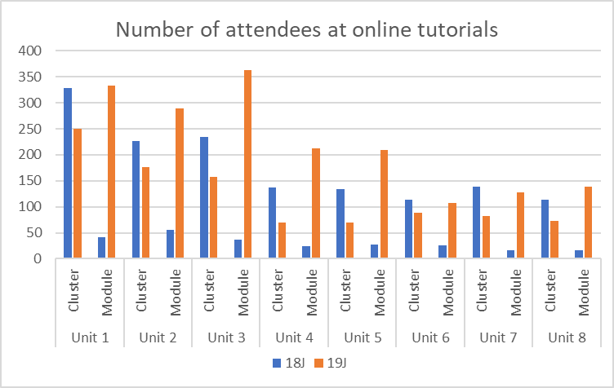
Notes:
Slight reduction in number of students using cluster tutorials. Larger increase in number of students using module-wide tutorials

Slide 24
Total number of students attending both cluster and
module-wide online tutorials
 | total number of students |  | percentage of students attending
 | 18J | 19J | 18J | 19J
Unit 1 | 370 | 584 | 20% | 30%
Unit 2 | 282 | 466 | 15% | 24%
Unit 3 | 272 | 521 | 14% | 27%
Unit 4 | 161 | 283 | 9% | 15%
Unit 5 | 161 | 278 | 9% | 14%
Unit 6 | 139 | 197 | 7% | 10%
Unit 7 | 154 | 209 | 8% | 11%
Unit 8 | 130 | 211 | 7% | 11%

Slide 25
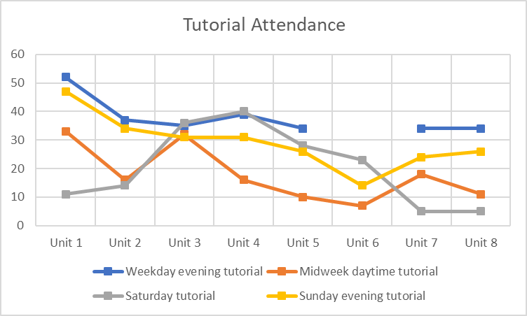
Number of students attending the main time of day tutorial strands

Slide 26
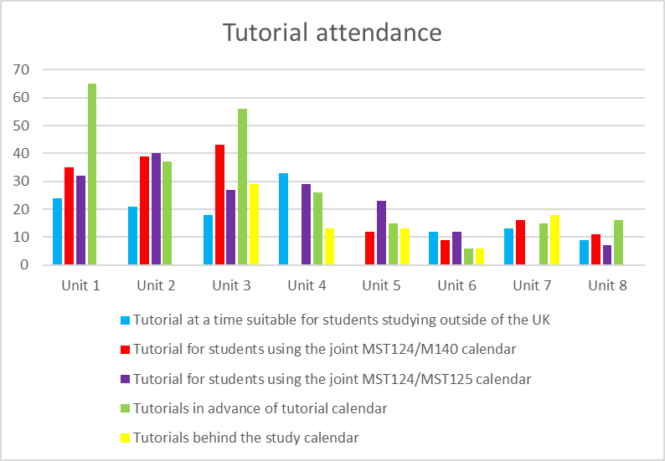
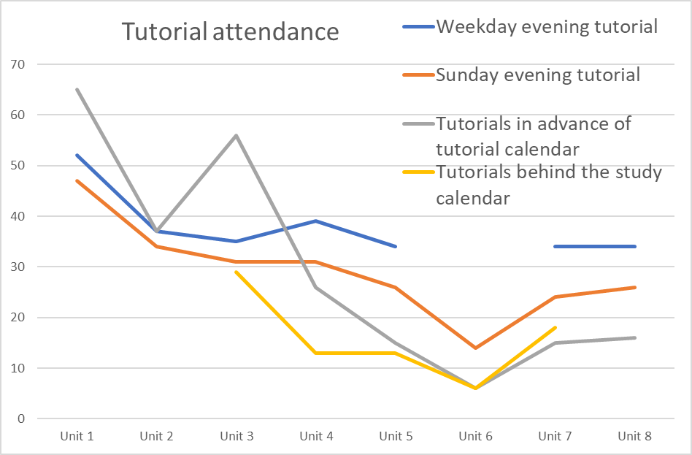
Number of students attending the special interest tutorial strands
Drop-in tutorials | number of students
TMA01 | 17
TMA02 | 14
TMA03 | 5
Specialist tutorials | number of students
Spot the mistakes | 35
What's in the box | 340
Notes:
Comment on “whats in the box” – number of students - carol

Slide 27
Notes:
To note – the tutorials in advance of the tutorial calendar are most popular, however as said before, this could be waning as we progress are currently the most popular.
Sunday evening tutorials are almost as popular as week day evenings despite only 30% of students saying they would find them useful.
There’s only been one tutorial for those students that are behind the calendar but this proved quite popular. The percentage of students studying M140/MST124 together is approx. 19% and mST124/5 is 10% , but a lot of students attend these tutorials.

Slide 28
Total number of students attending both cluster and
module-wide online tutorials
 | total number of students |  | percentage of students attending
 | 18J | 19J | 18J | 19J
Unit 1 | 370 | 584 | 20% | 30%
Unit 2 | 282 | 466 | 15% | 24%
Unit 3 | 272 | 521 | 14% | 27%
Unit 4 | 161 | 283 | 9% | 15%
Unit 5 | 161 | 278 | 9% | 14%
Unit 6 | 139 | 197 | 7% | 10%
Unit 7 | 154 | 209 | 8% | 11%
Unit 8 | 130 | 211 | 7% | 11%

Slide 29
THANK YOU
Any Questions

