Slide 1
The Mathematics and Statistics Study Site:
Facts, figures and further plans
eSTEeM conference
Wednesday 29th April
Rachel Hilliam, Gaynor Arrowsmith, Alexander Siddons,
Derek Goldrei and Cath Brown

Slide 2
Student experience
Mathematics and Statistics learning community
Morgan (2011)
First contact and Admissions
Pre-arrival
Arrival and orientation
Introduction to study at university
Re-orientation and re-induction
Outduction
Themes
Curriculum and assessment
Pedagogy
Support
Finance
Employment

Slide 3
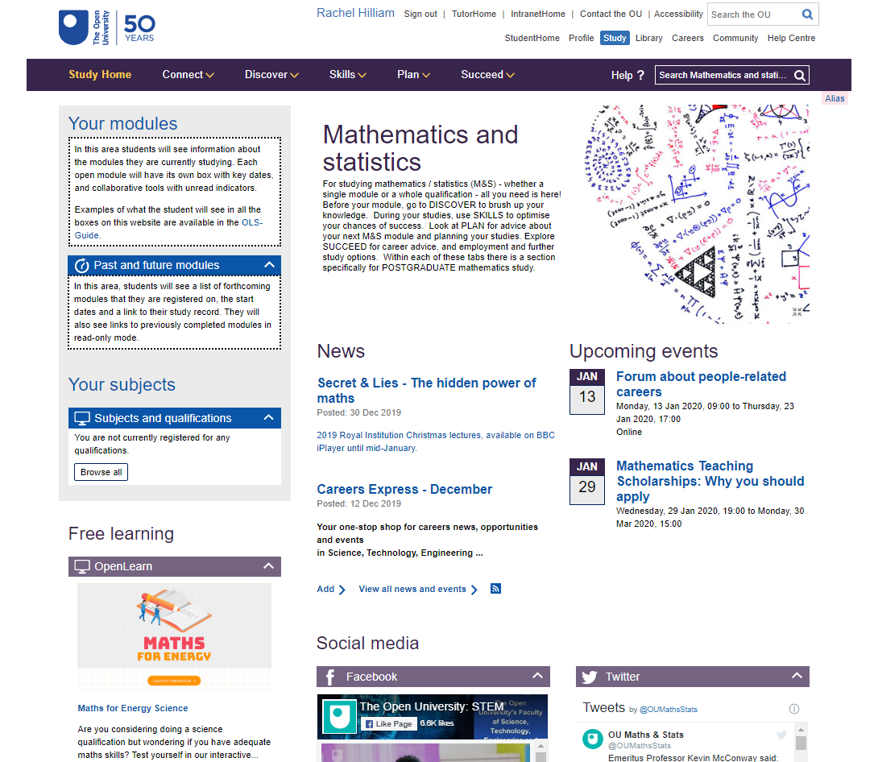
The Mathematics and Statistics Study Site

Slide 4
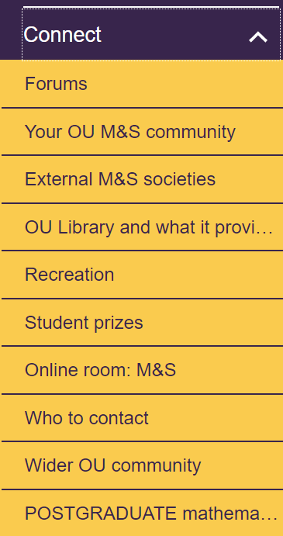
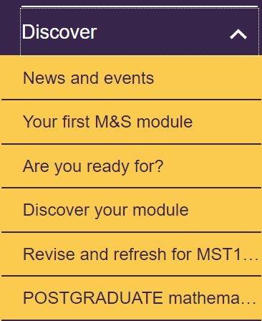
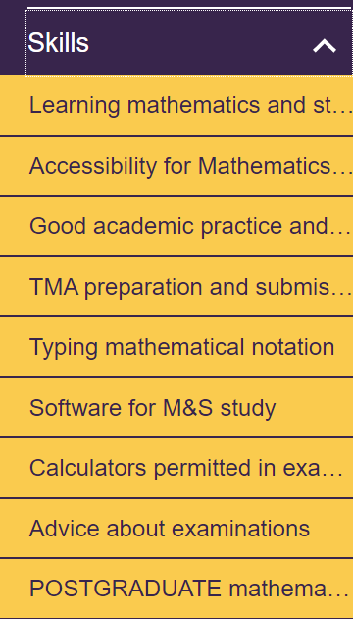
Mathematics and Statistics Study Site
Connect, Discover, Skills, Plan, Succeed

Slide 5
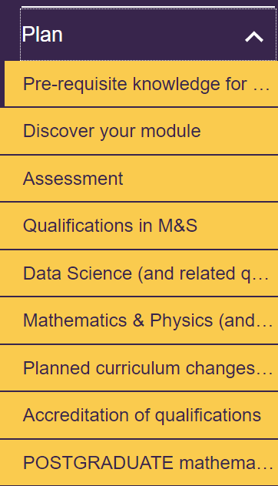
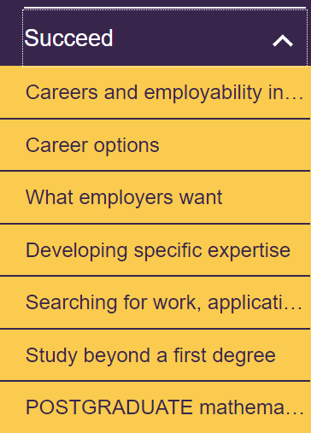
Mathematics and Statistics Study Site
Connect, Discover, Skills, Plan, Succeed

Slide 6
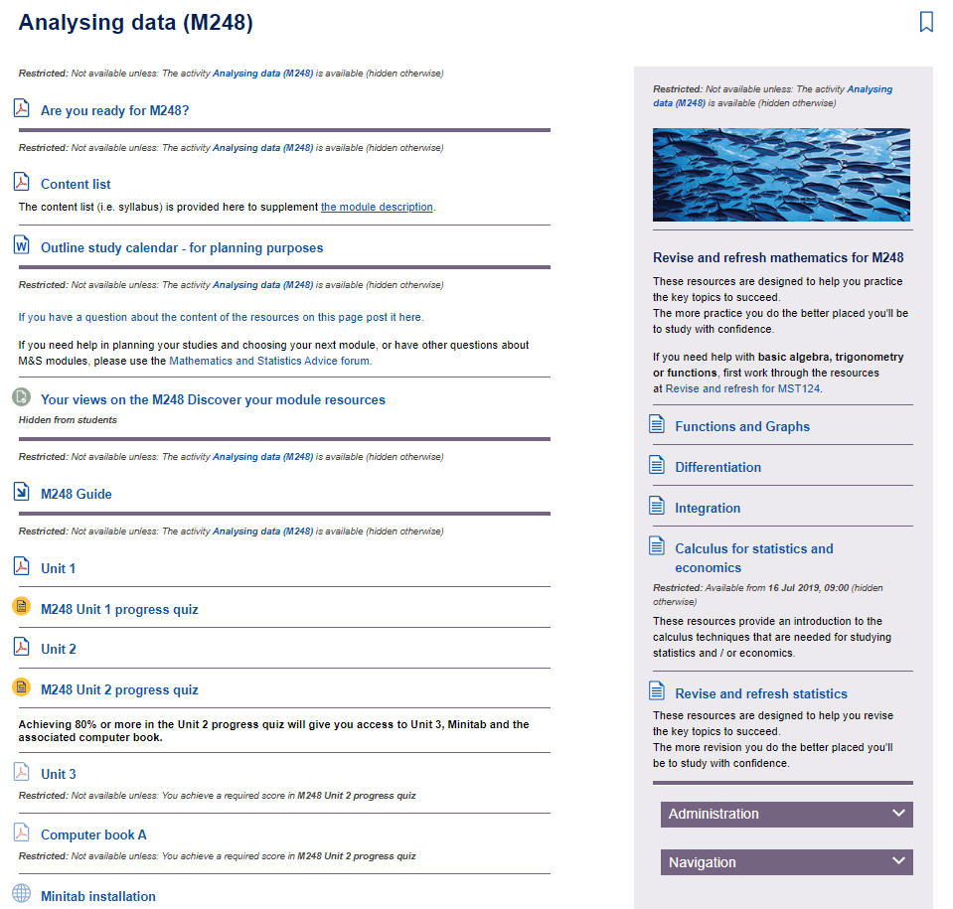
Discover Your Module

Slide 7
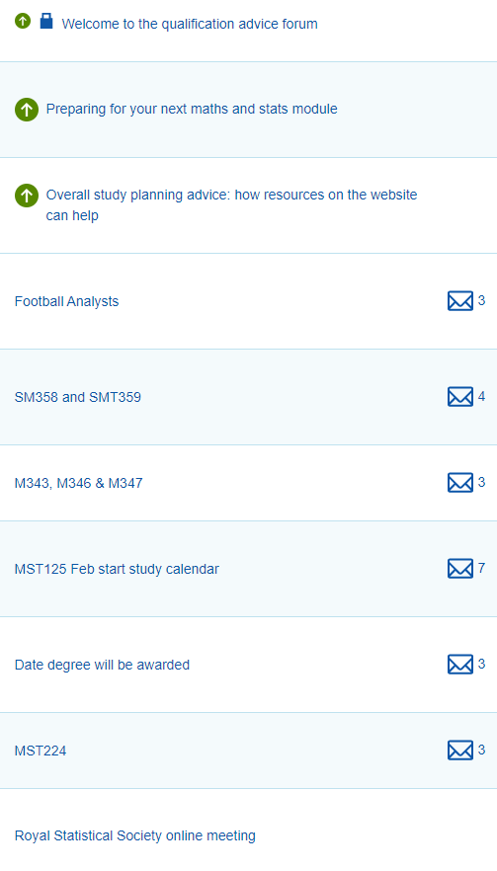
Forums
Module preparation forums
Mathematics education forum
Postgraduate café forum
Careers forum
Mathematics and statistics advice forum

Slide 8
The Mathematics and Statistics Students
Size of the student community
Qualifications:
Mathematics
Mathematics and Statistics
Mathematics and its Learning
Mathematics and Physics
Data Science
MSc Mathematics
Number of students linked to an M&S qualification
~ 8000
Number of students linked to an M&S qualification who are actively studying a module
~ 3500
Number of students M&S module counts
~ 13,500

Slide 9
Number of unique daily visits from M&S qualification students

Slide 10
Monthly visits
Total visits
Mean 12613 Min 3365
Max 21113
Unique visits
Mean 2293 Min 1053
Max 3442

Slide 11
Monthly visits by year

Slide 12
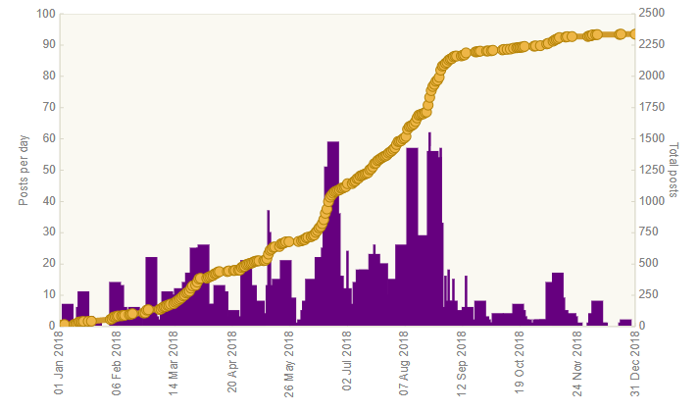
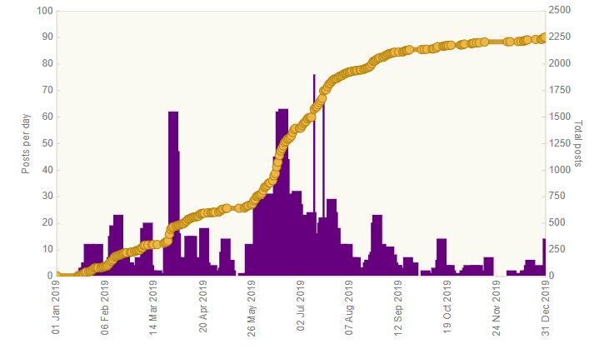
Forum usage
2336 posts in 2018 2251 posts in 2019
130 subscribers
78 discussion subscribers

Slide 13
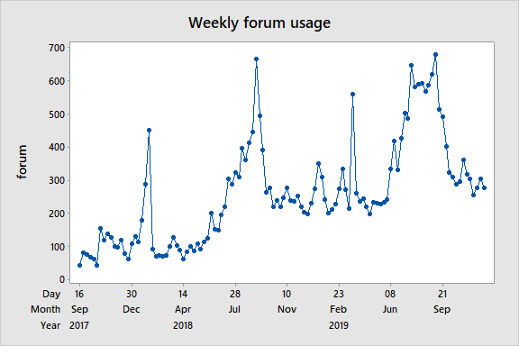
Weekly forum usage by M&S students

Slide 14
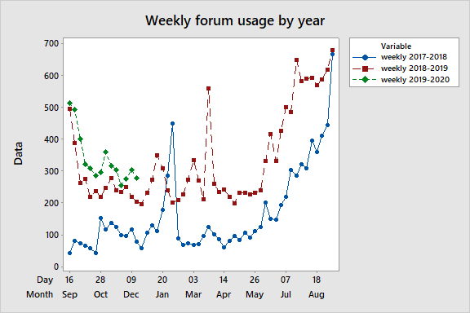
Weekly forum usage by M&S students per year

Slide 15
Other ‘events’
M&S Community
Face to face events
M500 revision weekend
M500 winter weekend
MSc weekend
M&S student day, Manchester, June 2018
M&S careers day, MK, April 2015
Statistics careers day, April 2014
Online events
IMA careers talk
RSS accreditation and careers talk
Careers forum
Student consultation

Slide 16
Future evaluation
Student questionnaire
How do students discover the site
What areas of the site are most useful and why
What is missing from the site
Which online and f2f have been attended and feedback
What resources and events would students like
Staff questionnaire – M&S ALs, STEMA SRSC

Slide 17
THANK YOU

