Slide 1
Perceptions, Expectations and Experience of Group Tuition: towards a shared understanding amongst stakeholders (part II: the student perspective)
Anne Campbell, Educational Developer, ALSPD
Anne-Marie Gallen, Senior Lecturer, Engineering and Innovation
Mark Jones, Senior Lecturer, Physical Sciences

Slide 2
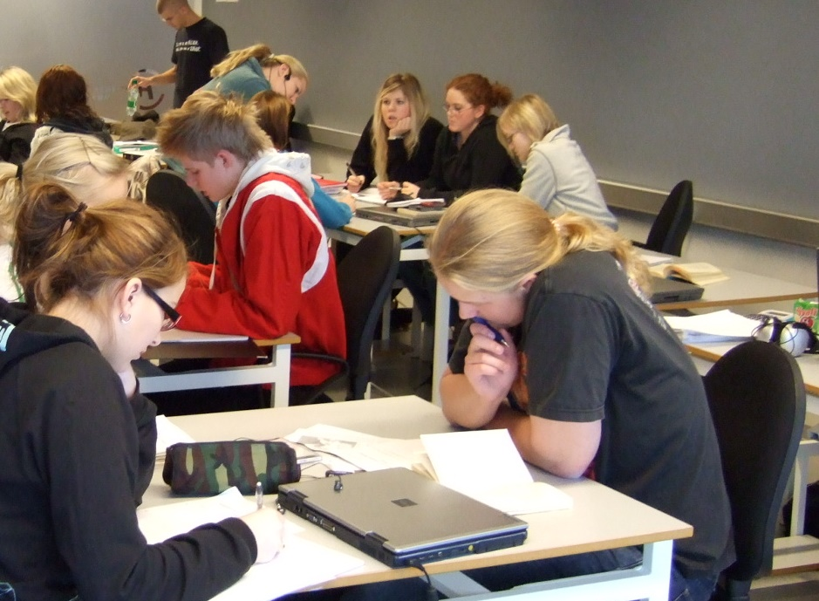


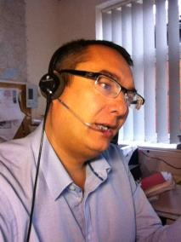


Background
Our research question
Do our students, teaching staff and other staff have common perceptions and expectations of what tutorials are for?

Slide 3

Why does a common perception matter?
Our tutorials are not mandatory. So student perception influences levels of attendance, as well as levels of participation during a tutorial.
Our authoring teams design tuition strategies, which may encourage or discourage students from attending/participating in learning activities during tutorials.
Our tutors design and run tutorials which influence student perceptions (the first tutorial can set expectations), and determine how students learn.
Other stakeholders can influence university-wide policy (e.g. professional services staff), or can affect tutor perceptions (e.g. staff developers).
From the literature, for example Ogina & Mampane (2013):
“A common understanding of the role of tutor is crucial so that tutors and students know what to expect in a tutorial session.”

Slide 4

Project aims
Image: freepik.com
Broadly, to work towards identifying and developing a common understanding of the tuition of groups, within the STEM faculty and across the university more widely.
      To investigate differences in perceptions of face-to-face and online tuition between different groups.
      To understand tutor perceptions of tuition
      (Phase 1, completed & published)
      To understand student perceptions of tuition
      (Phase 2, current)
      To understand other stakeholders’ perceptions
      (Phase 3, future)
To develop faculty and institutional advice for students, tutors and other staff to address mismatches.
To disseminate to staff developers, module authoring teams, relevant professional services staff, and throughout the sector.
Notes:
Note that this is not about investigating the implementation of the group tuition strategy per se, although obviously there is a clear influence in the current investigation. The initial investigation with tutors was done before GTP implementation and we suspect that tutor perceptions have changed.

Slide 5
Methodology
Phase 1: Associate Lecturer perceptions on the role of tutorials in distance learning, completed & published
Qualitative data collection via semi-structured conversations with 19 STEM tutors teaching at Level 1 (modules in Science, Engineering & Technology, Maths).
Thematic analysis.
Phase 2: Student perceptions of group tutorials (whether having attended a tutorial or not attended any tutorials)
Quantitative and qualitative data from a student survey: answered by 263 students studying five Level 1 modules. Initial reporting here.
Qualitative data collection through in-depth semi-structured interviews with 8 student volunteers from the survey group.
Full data analysis in progress

Slide 6
Results – purpose of tutorials
Modules surveyed: T192, T193, TM111, S111, SM123.
Responses shown as visualisation of Likert scale.
F2F versus online - "tutorials are important for..."
Q1 (Whole) and Q4 (Whole) show student perception of the different purposes of f2f (Q1) and online (Q4) tuition.
Breaking down Q4 between ‘New’ and ‘Continuing’ students shows how perceptions may change with experience.

Slide 7
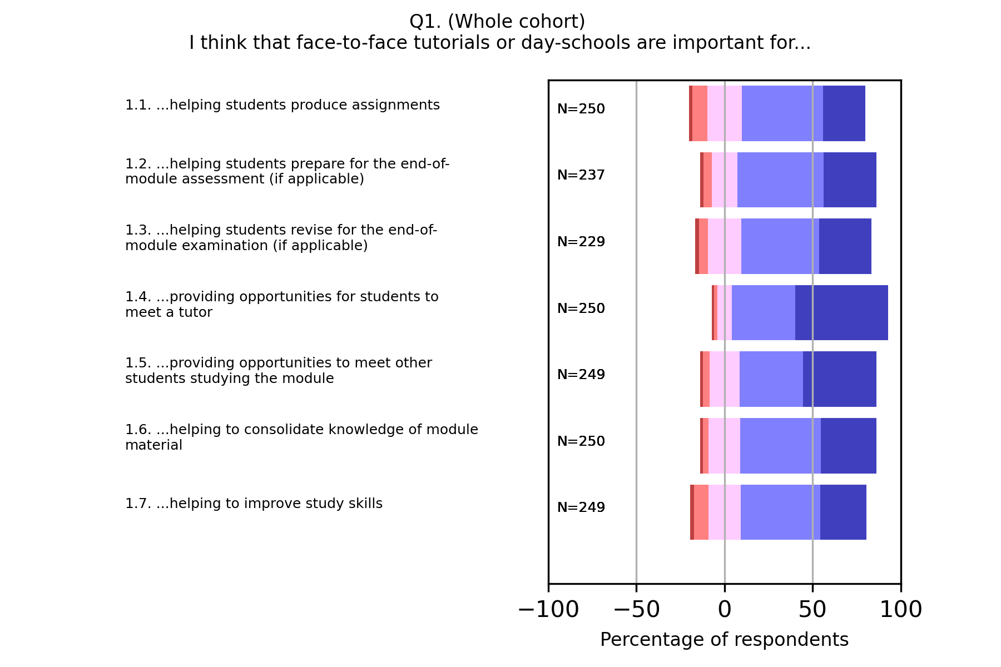
Q1 – Whole cohort

Slide 8
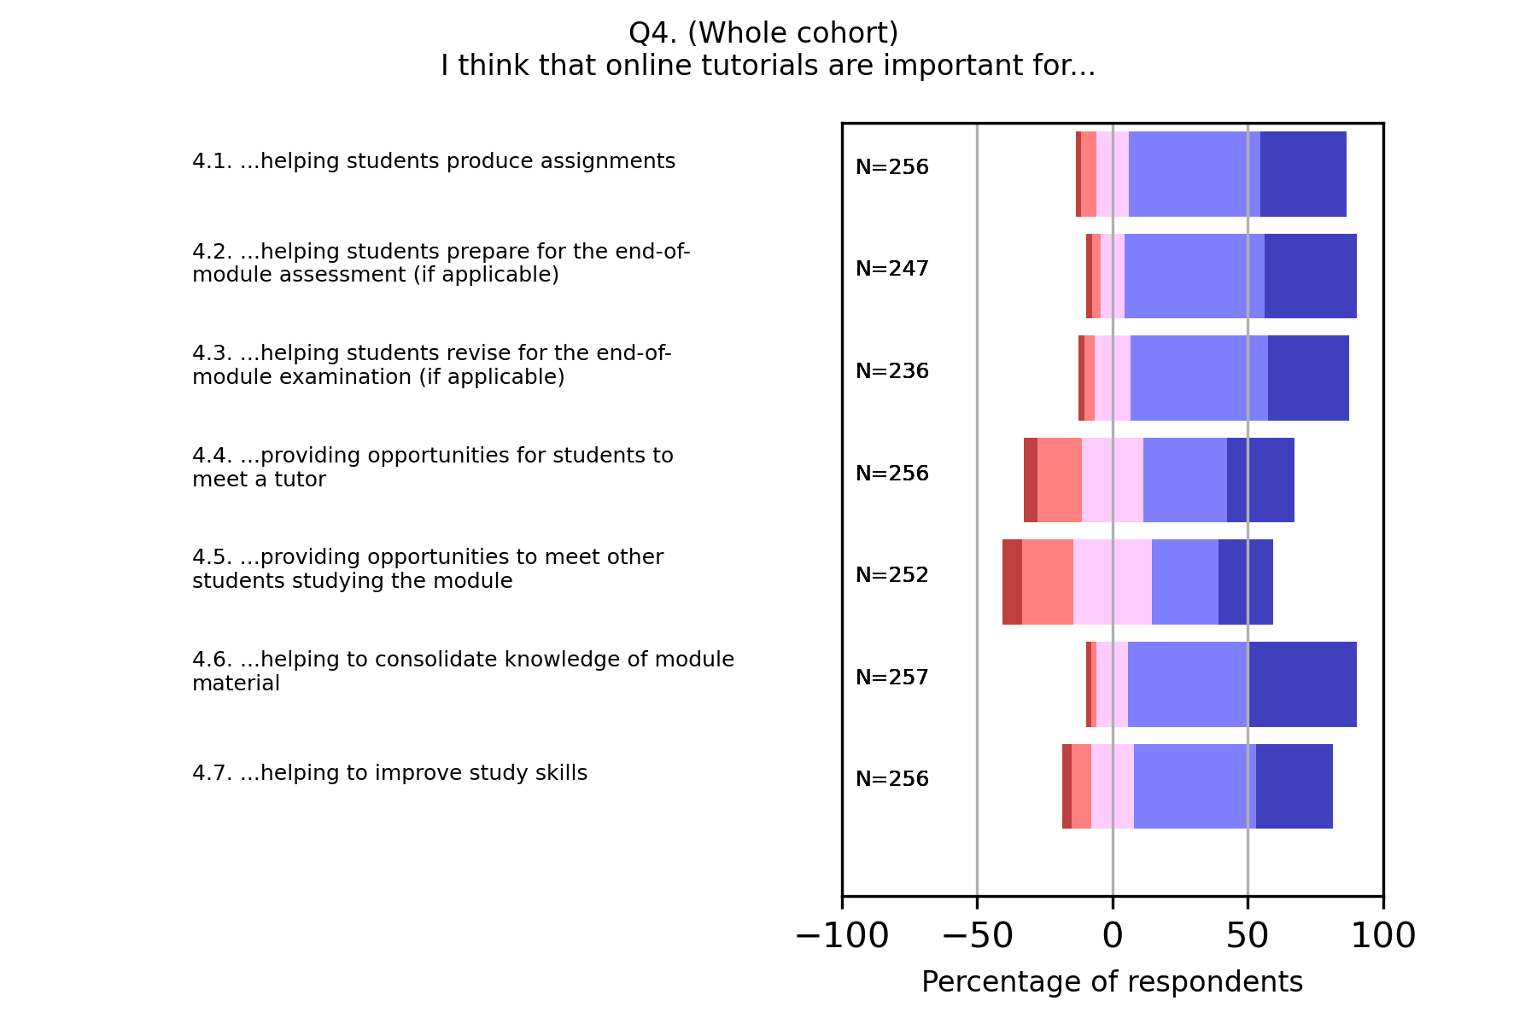
Q4 – Whole cohort

Slide 9
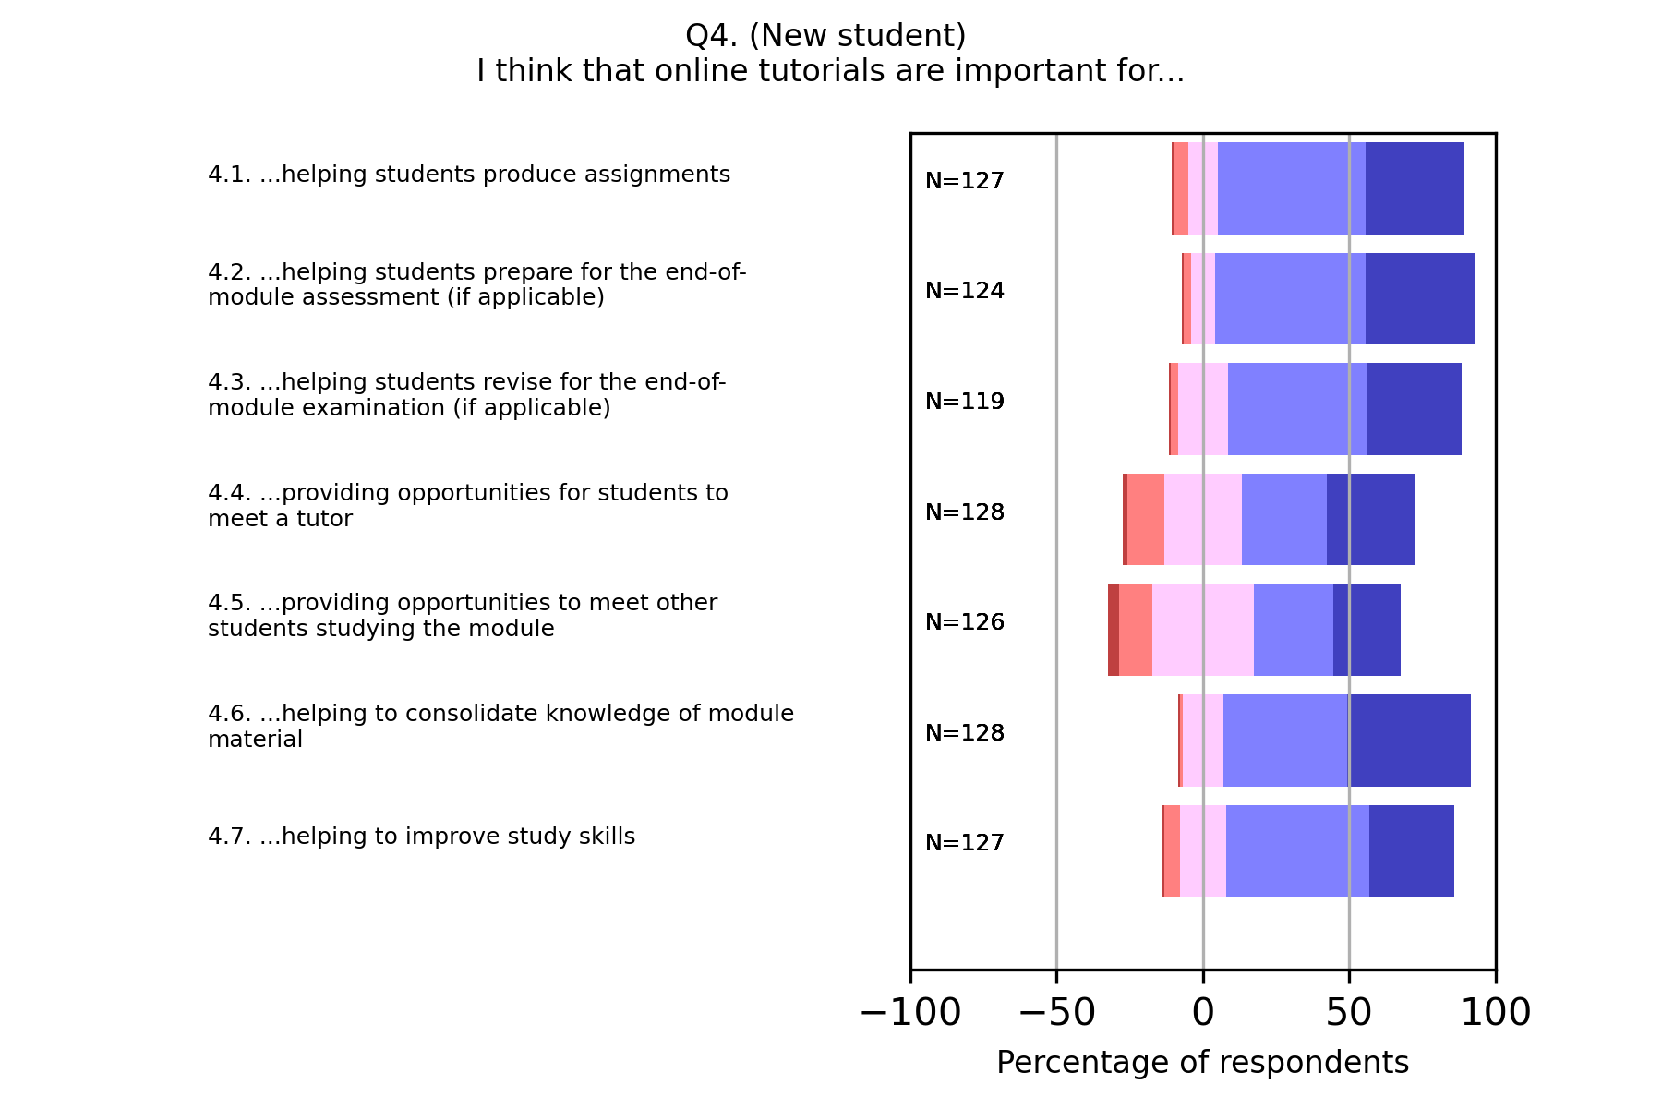
Q4 – New students

Slide 10
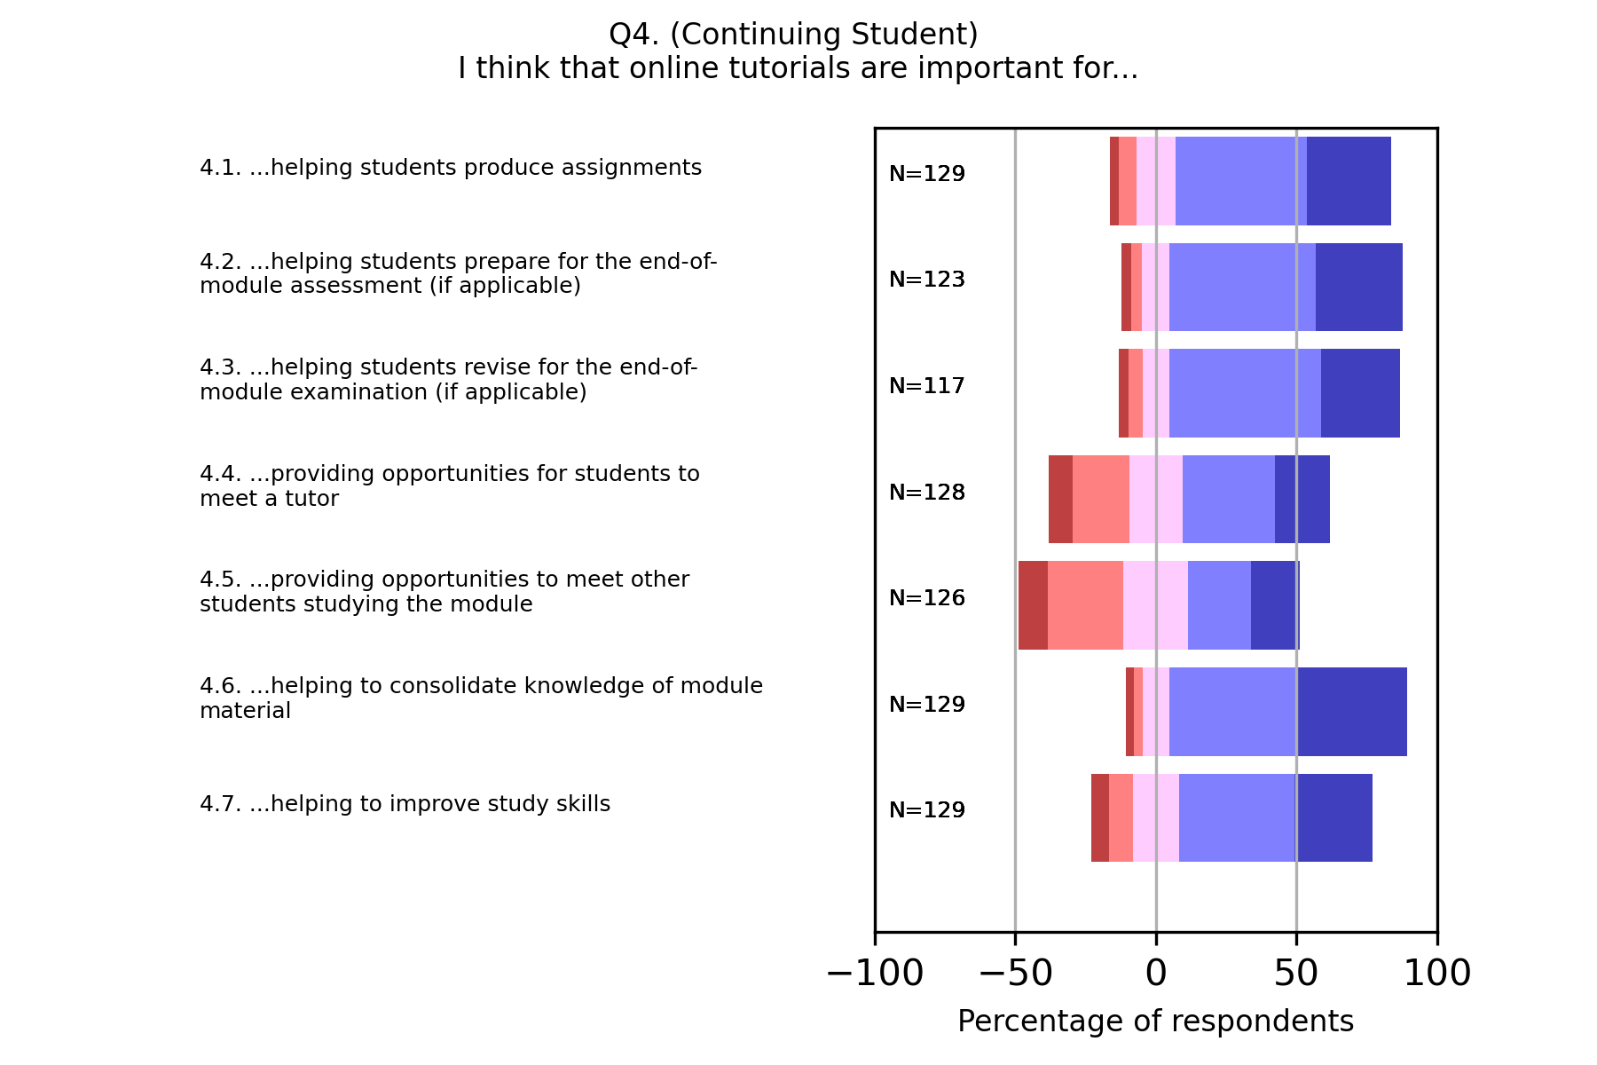
Q4 – Continuing students

Slide 11
Results – teaching methods
Modules surveyed: T192, T193, TM111, S111, SM123.
Responses shown as visualisation of Likert scale.
F2F versus online – teaching methods
Q2 (Whole) and Q5 (Whole) show student perception of appropriate teaching methods used in f2f (Q2) and online (Q5) tuition
Breaking Q5 down between ‘New’ and ‘Continuing’ students shows how perceptions may change with experience.

Slide 12
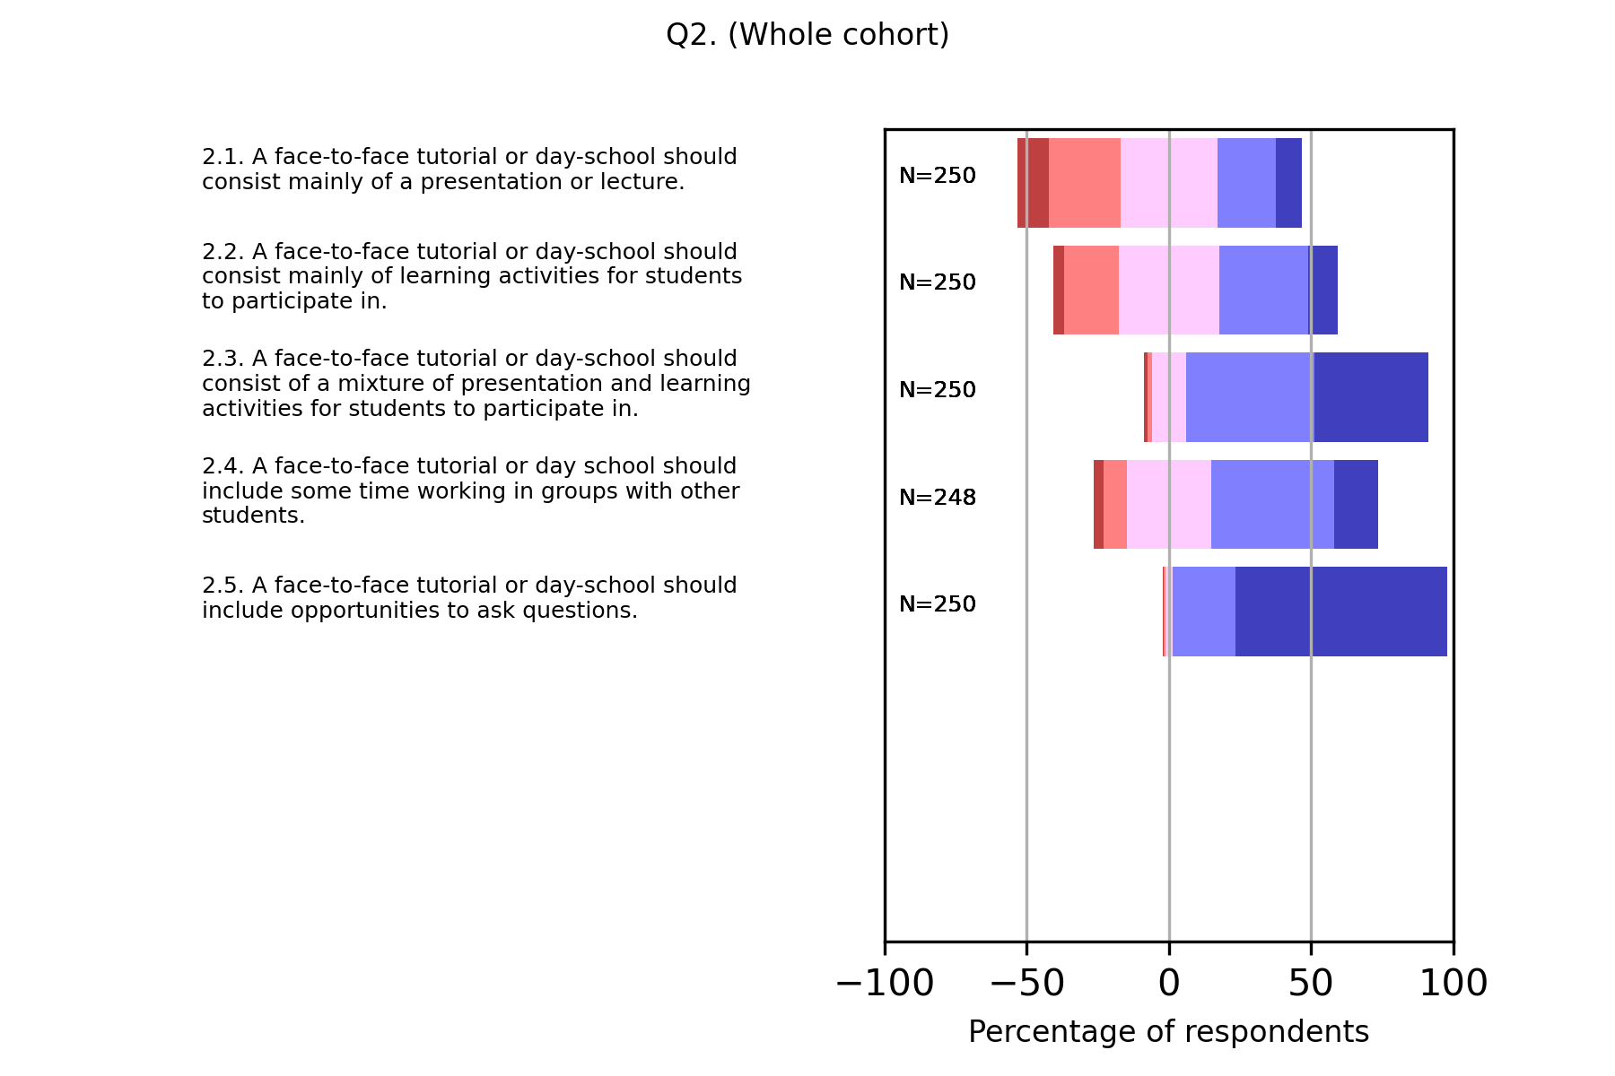
Q2 – Whole cohort

Slide 13
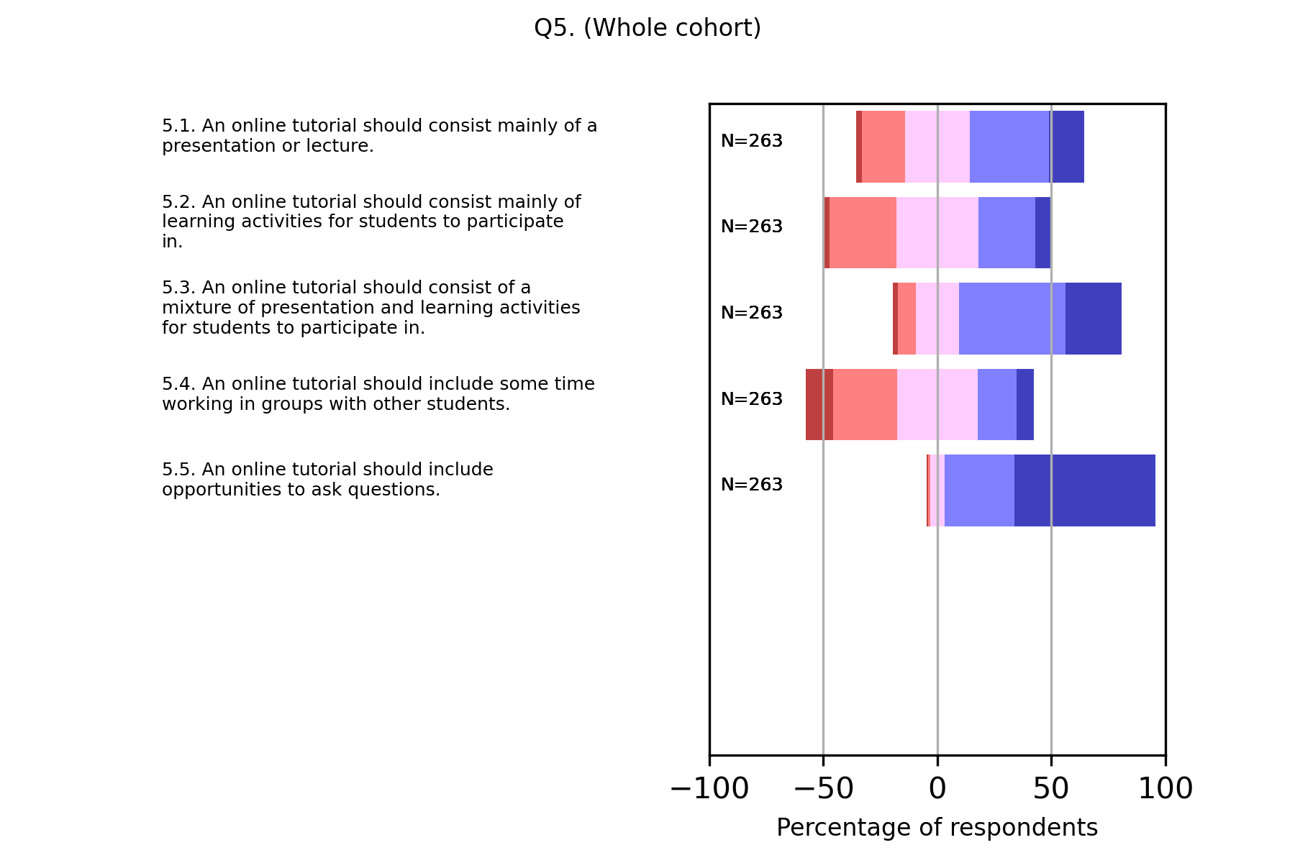
Q5 – Whole cohort

Slide 14
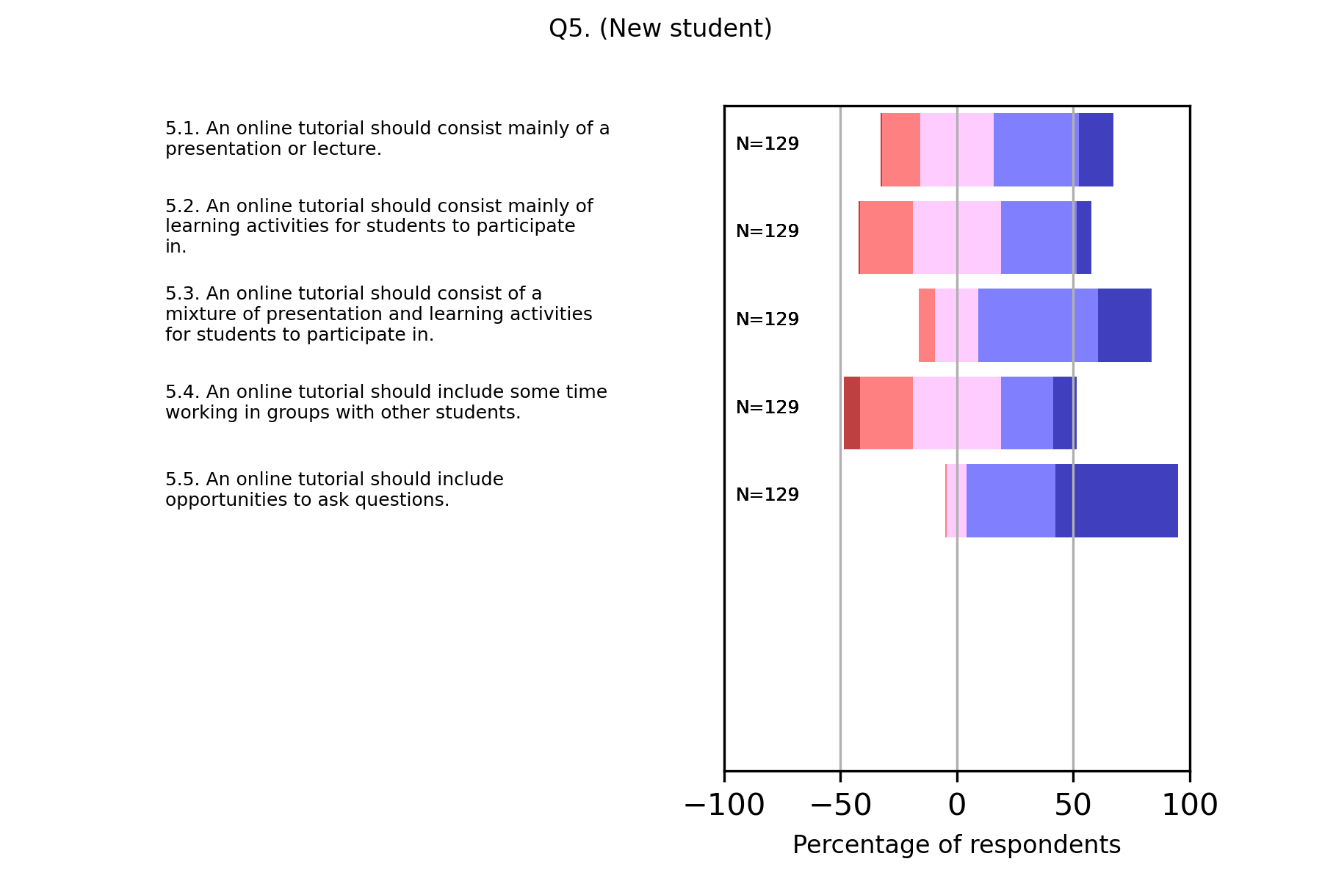
Q5 – New students

Slide 15
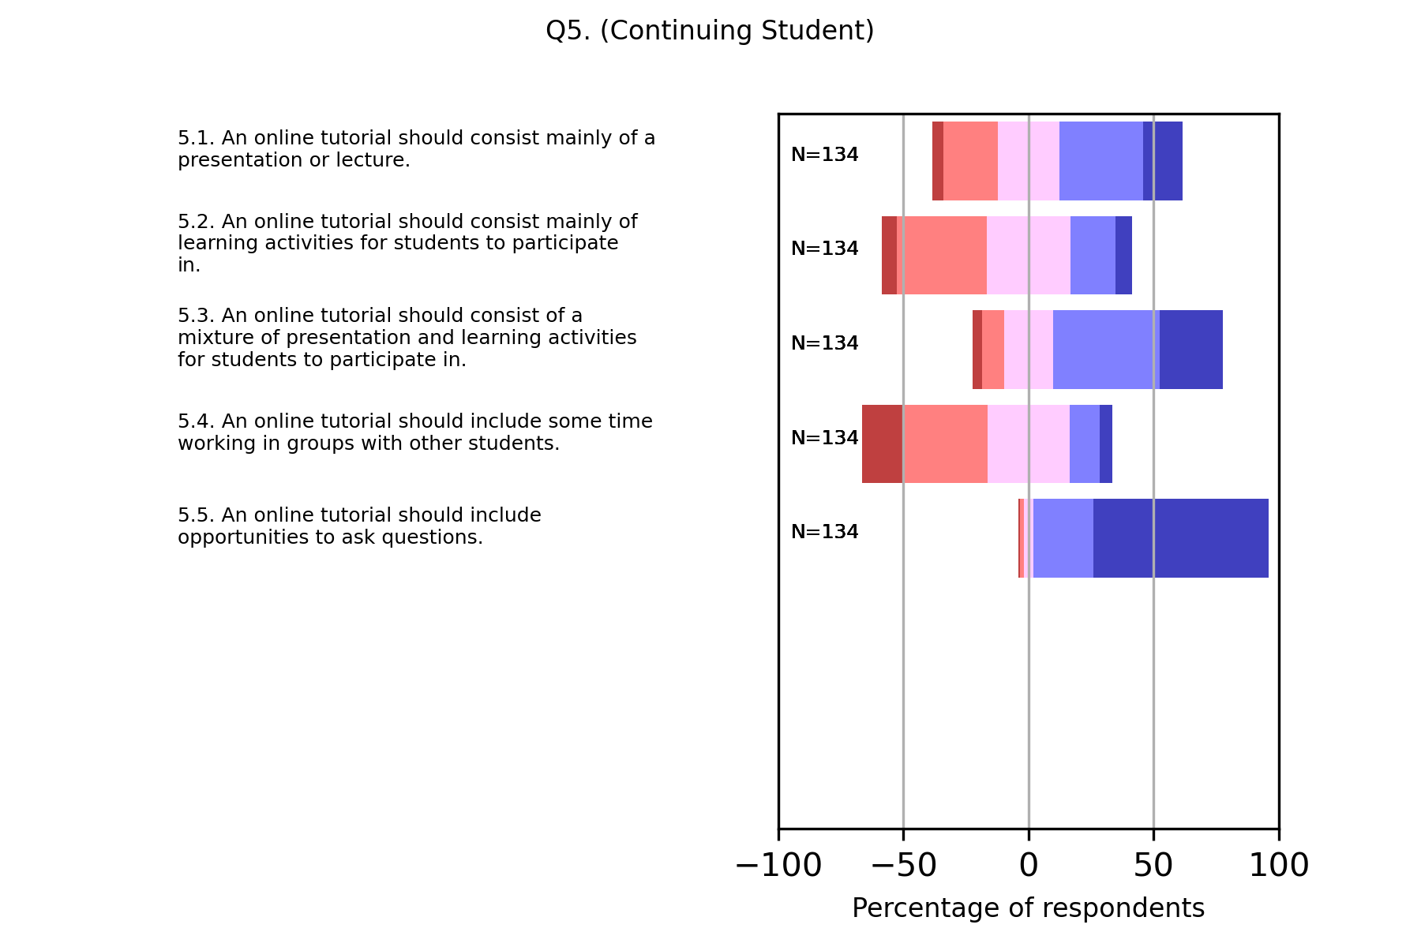
Q5 – Continuing students

Slide 16
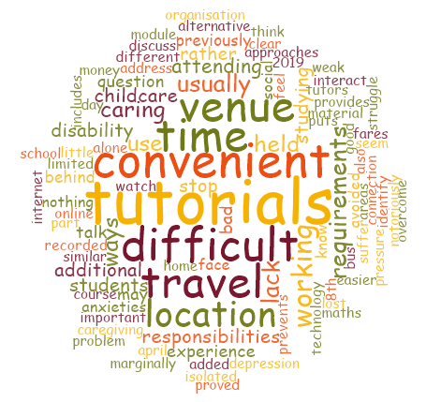
Initial review
There were 4 open questions including:
Question 1.a: If there are other important reasons for attending face-to-face tutorials and day-schools that are not covered above, please tell us here
Question 4.a: If there are other important reasons for attending online tutorials that are not covered above, please tell us here:
Question 7.a: As you chose 'Other', please tell us what other things have stopped you attending face-to-face tutorials or day-schools.
Question 8.a: As you chose 'Other', please tell us what other things have stopped you attending online tutorials.

Slide 17
Qualitative Analysis
Quotes from open questions:
“The key to triangulation is to see the same thing from different perspectives and thus to be able to confirm or challenge the findings of one method with those of another” (Laws 2003):
Face to face tutorials attracted most but not all positive comments:
"It is much easier to understand someone explaining something when you are in their presence". (f2f)
"Collaborative thinking. Sometimes it helps to learn things as a group so you can bounce ideas off each other". (f2f)
"These are a good way of getting used to how different tutors (and students) tackle answers in different ways". (Online)
"Easier on students that suffer from social anxiety or similar". (Online)

Slide 18
Qualitative Analysis
Quotes from open questions:
Negative responses related mainly to online:
"Generally, they haven't been especially useful as they lack any kind of meaningful interaction and it is difficult to ask questions / really engage with the content". (Online)
"...some are useless because they are merely presentations and do not require student involvement, so might as well watch the recording". (Online)
"I have found some tutors do not understand questions when asked that deviate from the scripted presentation". (Online)
_"One of the recent tutorials I went to I was completely lost and everything went too fast, it was a waste of my time, ...". (f2f)
.

Slide 19
Qualitative Analysis
Going deeper:
'Concepts emerge through the interrogation of the data, and the simultaneous interrogation of existing common sense and theoretical concepts drawn from the literature'. Hammersley, M. (2003) Discourse Analysis: bibliographical guide
"Limited by social anxieties/depression". (f2f)
"If your a nervous person lik I am you wouldn’t do an online tutorial therefore I think they are a waste of time for me …" (Online)
As a new student to OU, am still trying to manage a new system which has come into my life and trying to understand everything, so am not yet ready for online tutorials (Online)
At the first I don't know how can i attended online. I don't have experience on such things. (Online)
“I don't know what to expect so have avoided them.” (Online)
.

Slide 20
Where next?
Range of in-depth semi-structured interviews with volunteers from the survey
Criteria for selection initially:
Coverage of all modules (ideally 2 per module)
Preference for students who have not attended any tutorials
Preference for new students
Preference students with less than HE experience if possible
We achieved 8 interviews (4 female and 4 male) across all the modules.
All interviews have been transcribed and are ready for analysis...
Thank you all
Anne.Campbell@open.ac.uk; anne-marie.gallen@open.ac.uk; m.h.jones@open.ac.uk
.

