Slide 1
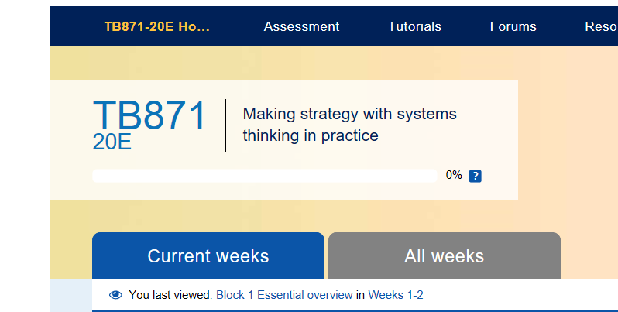
Curriculum innovation – transforming postgraduate learning systems for a world in turbulence
Rupesh Shah
Helen Wilding
Martin Reynolds
Ray Ison
Applied Systems Thinking in Practice (ASTiP) Group
The Open University

Slide 2
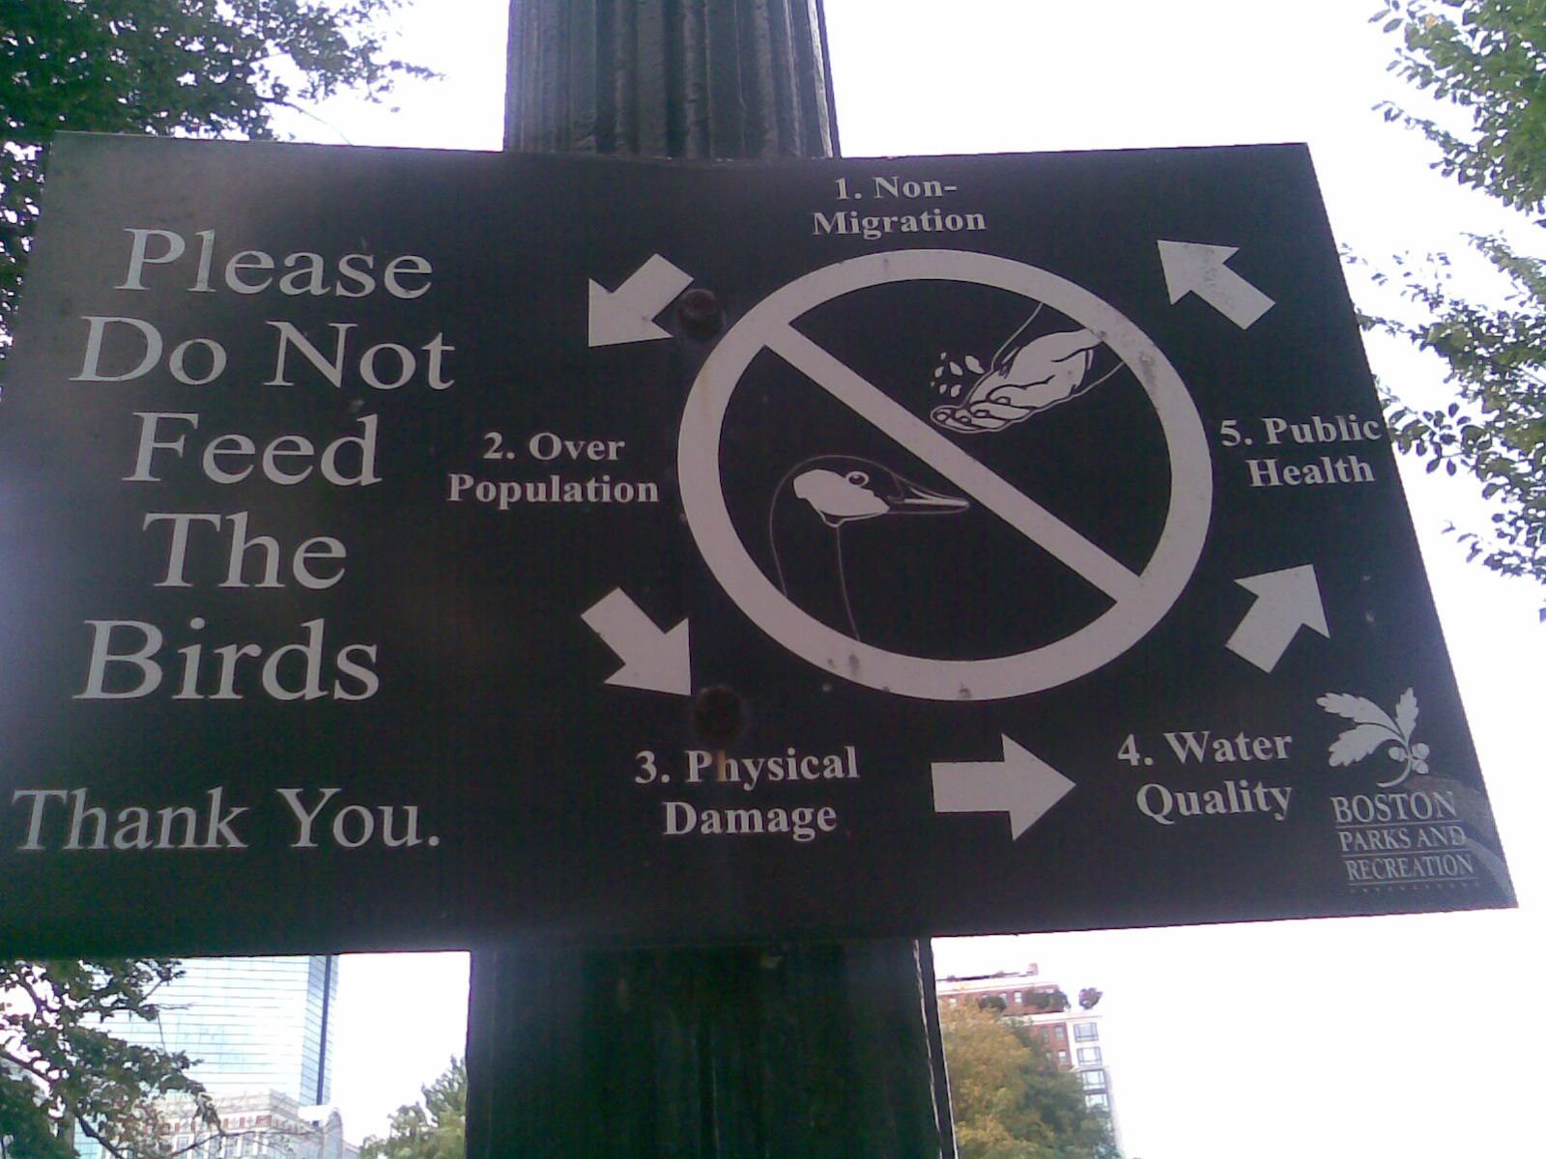
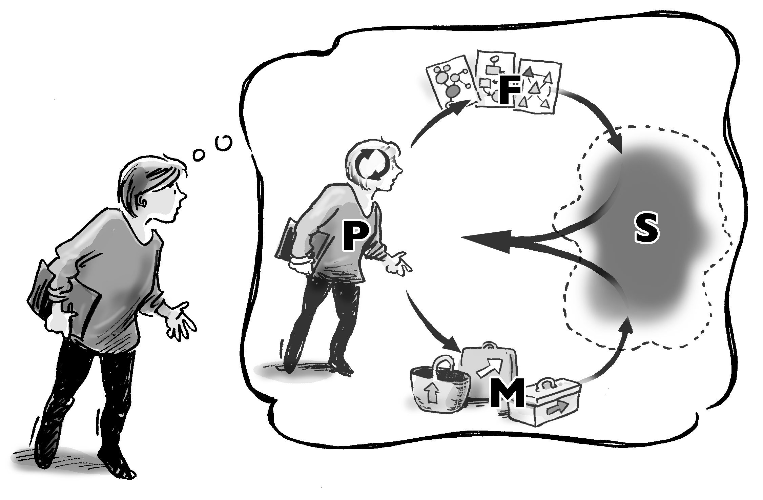
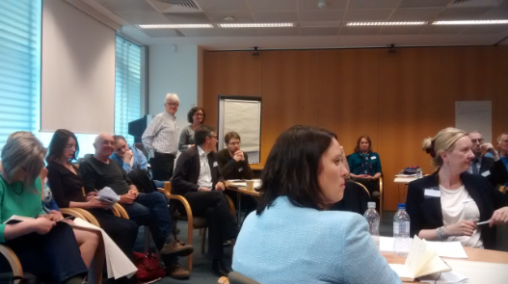
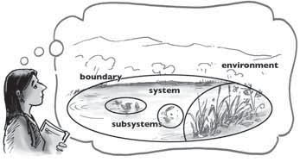
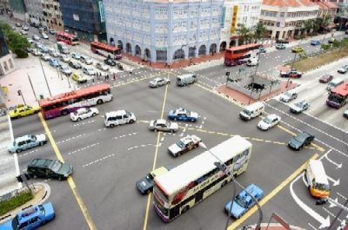
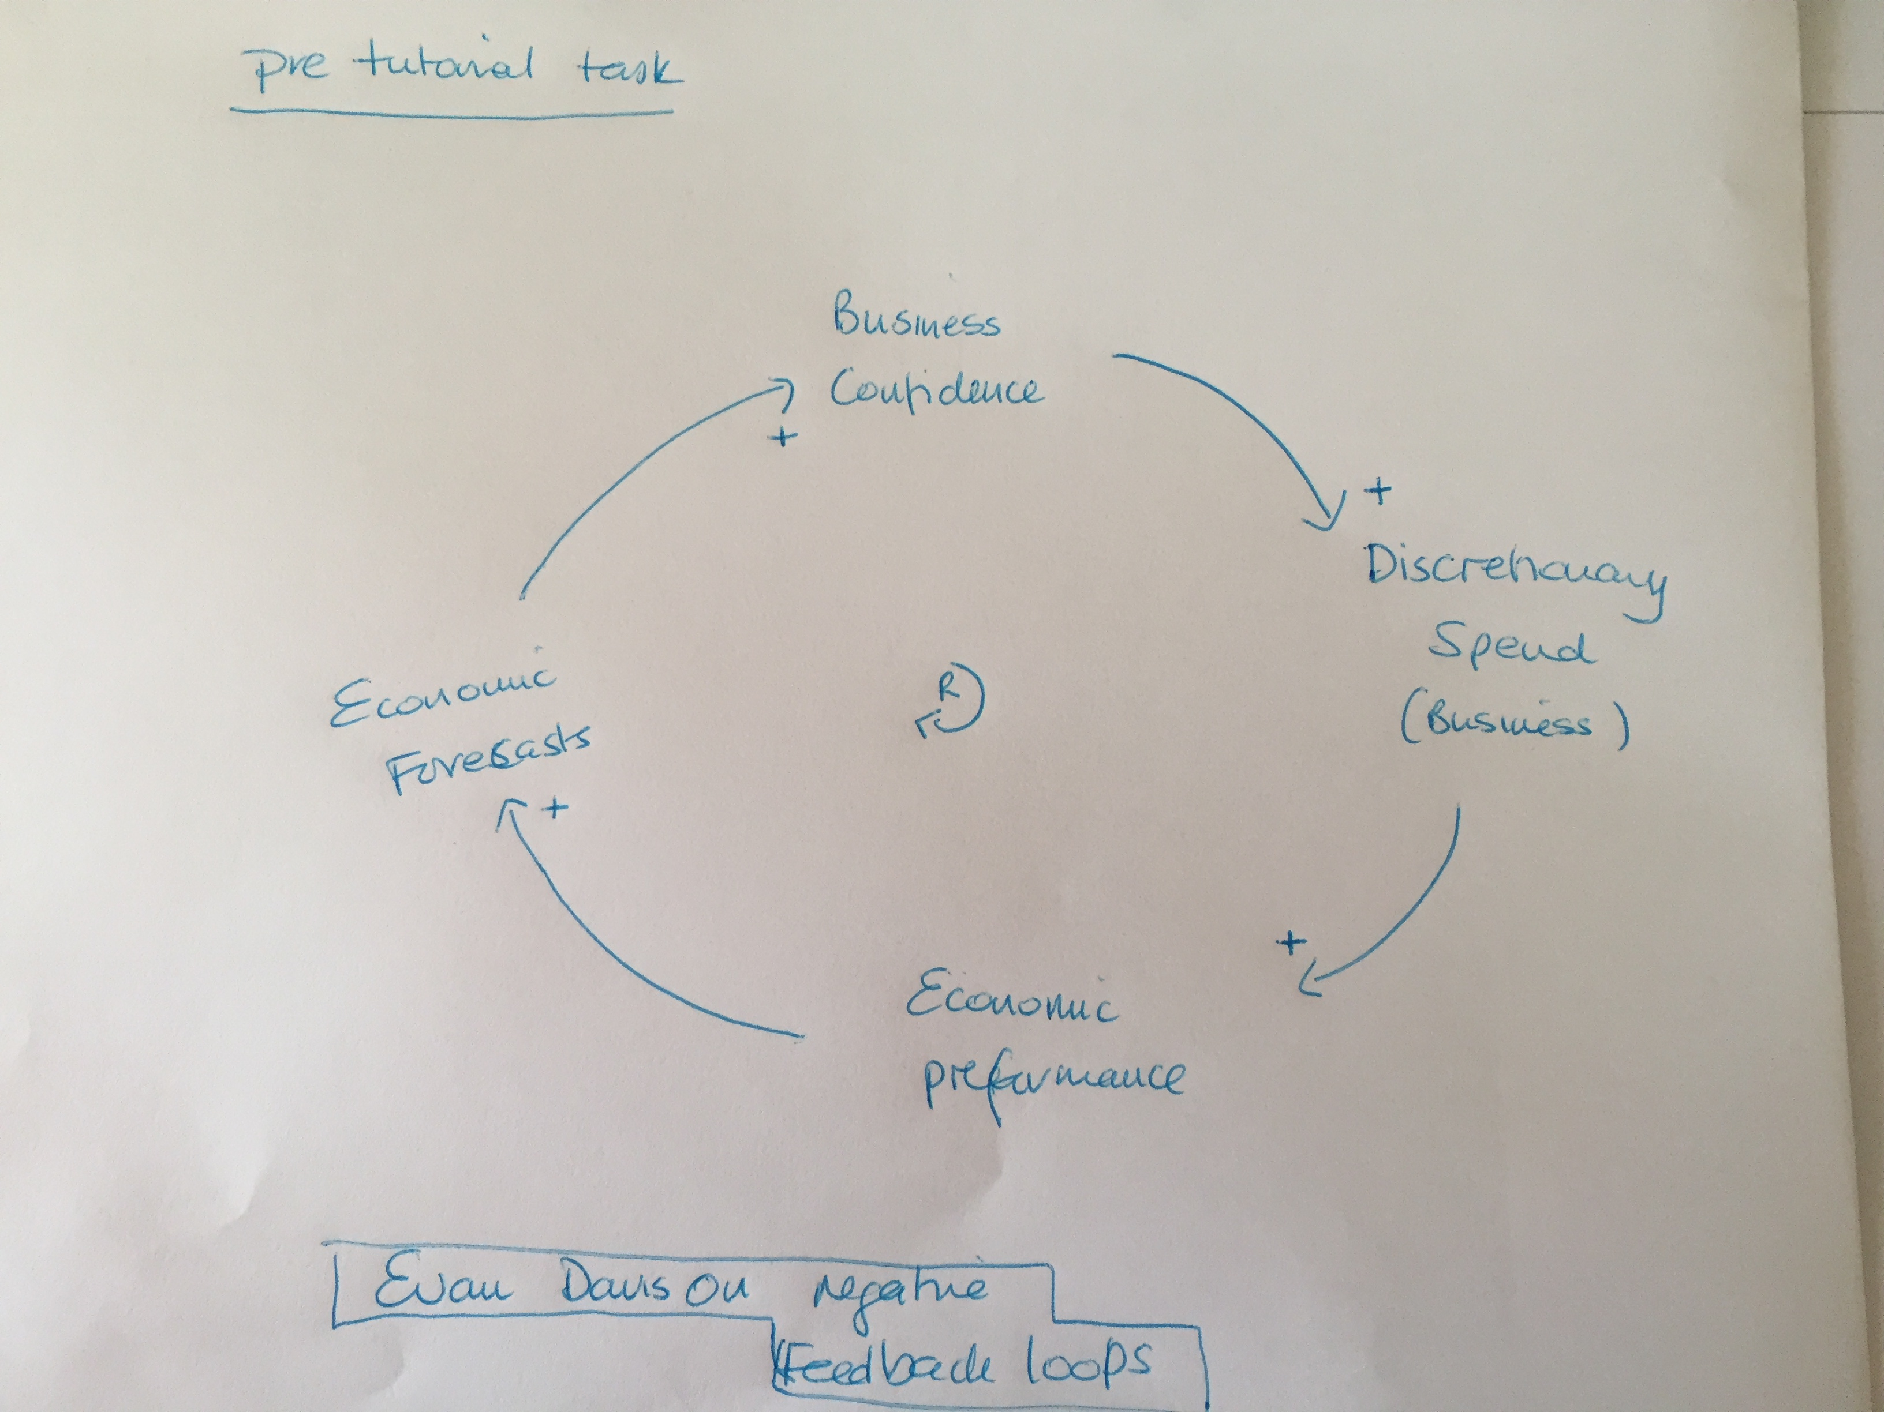
Our concern
Developing Systems Thinking in Practice through innovating practice postgraduate learning

Slide 3
Current eSTEeM research
Innovating for a STiP PG curriculum that enhances ability to practice
Forces that drive, afford and constrain the practice of innovating in PG curriculum?
Understanding praxis of innovation
Understanding experiences of innovating
Developing new curricula
Refresh of STiP PG modules
Looking at other experiences of innovation
Tracking own experience
Developing L7 apprenticeship

Slide 4
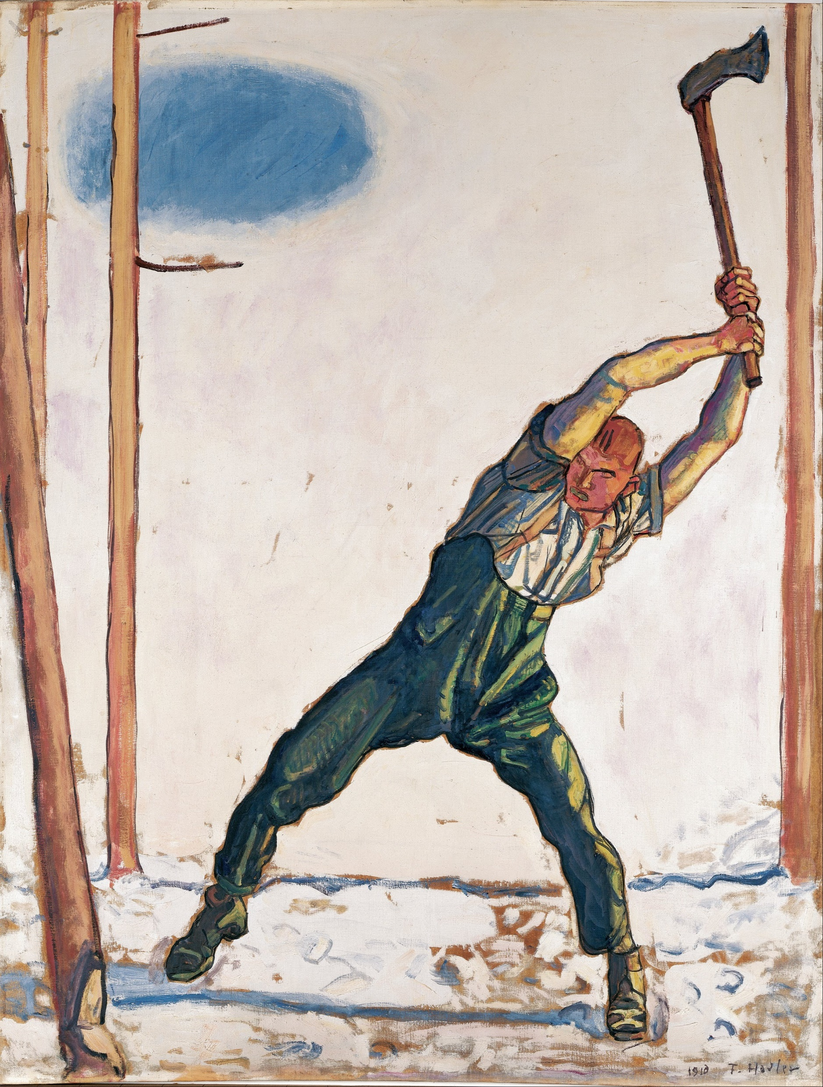
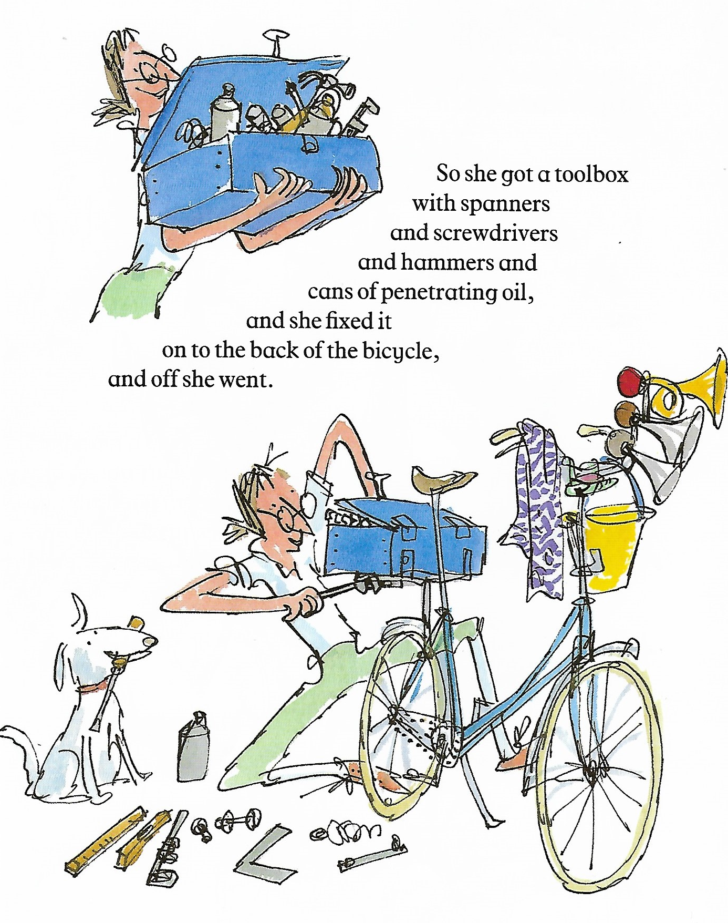
Some of our conceptual frames and foci:
Learning systems and Capability
Curriculum - a ‘learning system’
Practice - a capabilities approach
Woodcutter, Ferdinand Hodler
Mrs Armitage, Quentin Blake

Slide 5
External influences (market accrediting bodies, gvmt, bodies)
Innovating in OU learning systems – the what
Curriculum
Interface system
University based
Academic focused
Work-based
Experiential focused
Community of practice
Internal influences (mission, resources, governance, student characteristics, discipline)

Slide 6
Innovating in OU learning systems – the how
Learning about practice of innovating curriculum
Attitudes and background context of innovating
Drivers of innovating
Contextual factors that afford & constrain innovating

Slide 7
Some emerging thoughts
Limitations of framings around employability
Mission and purpose in turbulent times
Responsibilities for innovating

Slide 8
Some questions…
As we move on what practices, ways of working and norms do you want to take forward with you?
What do you want to let go and leave behind?
What circumstances would enable you to continue innovating curriculum at the OU?

Slide 9
eSTEeM-project publications
Blackmore, Chris; Ison, Raymond and Reynolds, Martin (2014). Thinking differently about sustainability: experiences from the UK Open University. In: Filho, Walter Leal; Azeiteiro, Ulisses; Alves, Fátima and Caeiro, Sandra eds. Integrating Sustainability Thinking in Science and Engineering Curricula. World Sustainability Series. Cham: Springer, pp. 613–630.
Blackmore, Chris; Reynolds, Martin; Ison, Raymond and Lane, Andrew (2015). Embedding sustainability through systems thinking in practice: some experiences from the Open University. In: Wyness, Lynne ed.Education for Sustainable Development Pedagogy: Criticality, Creativity, and Collaboration. PedRIO occasional papers (8). Plymouth University: Pedagogic Research Institute and Observatory (PedRIO), pp. 32–35.
Reynolds, M.; Blackmore, C.; Ison, R.; Shah, R. and Wedlock, E. (2017). The role of systems thinking in the practice of implementing sustainable development goals. In: Leal Filho, Walter ed. Handbook of Sustainability Science and Research. Springer, pp. 677–698.
Reynolds, Martin and Shah, Rupesh (2018). Researching capability development: developing systems thinking in practice capabilities. In: Symposium on Governing Complexity: developing appropriate praxis with citizens and organisations, 12 Jun 2018, Milton Keynes, The Open University.
Reynolds, Martin; Shah, Rupesh and van Ameijde, Jitse (2018). Framing professional competencies for systems thinking in practice: final report of an action research eSTEeM inquiry. The OU Centre for STEM Pedagogy. The Open University, Milton Keynes.
Reynolds, Martin; Shah, Rupesh; Wedlock, Elaine; Ison, Ray and Blackmore, Christine (2016). Enhancing Systems Thinking in Practice at the Workplace: eSTEeM final report. The OU Centre for STEM Pedagogy. The Open University, Milton Keynes.
Reynolds, M.; Shah, R.; Wedlock, E.; Ison, R. L. and Blackmore, C. (2017). From competence to capability: learning laboratories in postgraduate pedagogy. In: 6th eSTEeM Annual Conference 2017: STEM Futures: Supporting Students to Succeed, 25-26 Apr 2017, Milton Keynes, UK.

