Slide 1
Who are our apprentices?
Matthew Walkley, Staff Tutor, School of Computing and Communications
Leonor Barroca, Senior Lecturer, School of Computing and Communications

Slide 2
Introduction
Apprenticeships are entering a new phase of ‘business as usual’ within the University; apprentices are, however, still a small group of learners for whom a big effort of curriculum development and support is being invested.
As access and participation are pressing issues for higher education it is important to understand the profile of our apprentices as a basis for sound decisions on the future approach to apprenticeships and to the recruitment of apprentices.
We collected data from within the OU on the profile of apprentices (in Computing) across England, Scotland and Wales and compared that data with similar data for our non-apprentice students highlighting any areas of concern. We suggest areas that may need to be addressed within an agenda for access and participation.

Slide 3
Scope, data sources
School of Computing & Communications u/g apprenticeships:
  England R24
  Scotland R32 R33
  Wales R40
Q62 BSc Computing and IT used for comparison (the above qualifications are based on the Q62 curriculum)
Cohorts 18/19 and 19/20 academic years up to and including 19J (these are the cohorts for which we have data for all the qualifications)
Main data source is the qualification profile tool, data drawn 22 Jan 2020
All numbers are headcount (not FTE)

Slide 4
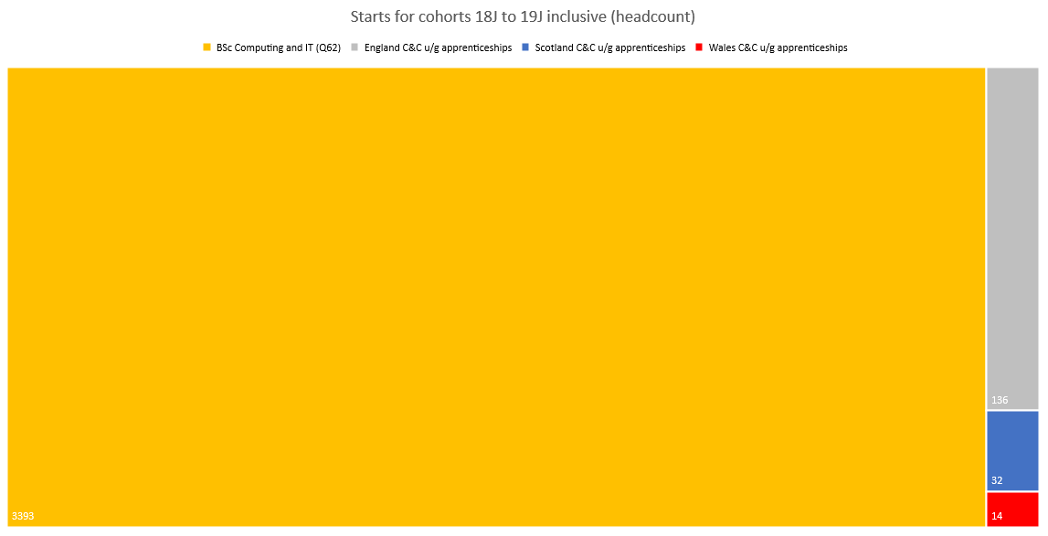
Notes:
The School’s apprenticeship qualifications have low numbers in relation to the School’s largest qualification, Q62 BSc Computing and IT.
Total headcount on the School’s apprenticeships is about 5% of the headcount on Q62.
We should be somewhat cautious about comparison.

Slide 5
Notes:
The gender profile of apprentices is similar to that of students on Q62.
As with Q62, male learners outnumber female learners, but female leaners are more likely to remain in study.
Note that retention is higher for apprenticeships than for Q62 (based on numbers with no study). Scotland is an exception (see next slide).

Slide 6
Notes:
The previous slide hides some differences between nations.
The headcount of apprentices in Wales and Scotland is low: a few extra male or female apprentices in Scotland or Wales will make a big difference to the percentages for those nations.
We do not have the qualification data for Q62 disaggregated by Nation, but see next slide.
R24 Degree Apprenticeship (England) has lowest female participation no R24 cohort has ever recruited higher than Q62 (based on four years of data)
Note that u/g apprentices in Scotland are less likely to remain in study than Q62 students. Scotland requires 120 credits of study per year (England 90, Wales 90, Q62 30-120)

Slide 7
Notes:
Apprentices are much less likely than students on Q62to have declared a disability.
Are employers not recruiting disabled students? Or are apprentices less willing to declare a disability, or is the OU process failing?
The ‘no study’ percentages for apprentices are based on a very small population of apprentices who declared a disability. Too few to be meaningful.

Slide 8
Notes:
All three nations have lower rates of declared disability for apprenticeships than the Q62 average.
Again, won’t comment on ‘no study’ due to very low numbers.

Slide 9
Notes:
White students dominate all qualifications
Apprenticeships have more Asian students than Q62 and retain them better
Black apprentices are less likely to remain in study than other apprentices
Caution about drawing any conclusions based on just 5 Black apprentices and 15 Asian apprentices

Slide 10
Notes:
One academic year (18/19) and one apprenticeship (R24, England) accounts for all the black students in this study.
Aside: OU lags behind sector for Black and Asian participation. OU Computing (Q62) is somewhere between the OU average and sector average.
Aside: across the sector Computing has relatively high Black and Asian participation (circa 9% Black, 18% Asian)

Slide 11
Notes:
Apprenticeships are less likely to come from an area of low SES

Slide 12
Notes:
Percentages do not total 100 due to unknowns. Large number of unknowns in R24 data for 19/20. Figures for R24 for 18/19 show 2% low SES.

Slide 13
Notes:
Q62 is open entry
OU computing apprenticeships have no formal entry qualifications but apprentices are selected by employers
OU computing apprentices are less likely to have low PEQs
Low PEQ apprentices are less likely to stay in study than Q62 students, and appear less likely to stay in study than other apprentices.

Slide 14
Notes:
Of 14 Welsh apprentices in the study, 6 had PEQs lower than A’ level

Slide 15
Tuition support Q62 students vs R24 apprentices
20 students studying Q62 first 90 credits
20 students studying R24 first 90 credits
Module | Salary band | Groups needed | AL salary per group | Total AL salary cost
TM111 | 4 | 1 | 3175 | 3175
TM112 | 4 | 1 | 3175 | 3175
TM129 | 3 | 1 | 2609 | 2609
Total |  |  |  | £8959
Module | Salary band | Groups needed | AL salary per group | Total AL salary cost
TMXY130 | 4 | 1 | 3175 | 3175
TXY122 | 5 | 1 | 3740 | 3740
XTXY122 | 5 | 4 | 3740 | 14960
TMXY112 | 4 | 1 | 3175 | 3175
Total |  |  |  | £25050
Notes:
We invest more than twice the tuition resource into apprentices compared to students on Q62.
Costs are based on 2018 salaries without on-costs and expenses.
This pattern is repeated across each year of study.

Slide 16
Some tentative conclusions
OU computing apprentices are less likely to be of low SES less likely to have low PEQs and less likely to have a declared disability than OU computing students
The gender and ethnic profile of OU computing apprentices appears broadly similar to the gender and ethnic profile of OU computing students. The data suggests some differences, but we don’t have enough data to be confident about these
OU Computing apprentices enjoy a significantly higher amount of tuition support than OU computing students
Note that fee income from apprentices is higher e.g. 360 credits Q62 £18576 vs 360 credit apprenticeship in England £20000 + £5000 on completion

