Slide 1
PROMOTING
Good Mathematical Communication as a key employability and transferable skill in mathematics at Level 1
Andrew Potter, Gerry Golding, Sally Crighton
eSTEeM Conference, online
14:45, 30th April 2020

Slide 2
A Brief History of GMC
The production of MU123, the development of GMC, and where we are now.

Slide 3
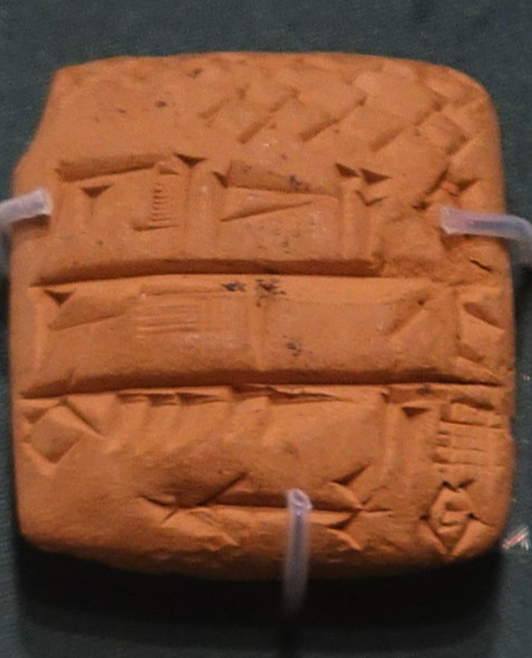
A Brief History of GMC
MU123: from production to present day
What is Good Mathematical Communication (GMC)?
The history behind its development in MU123
Spread of GMC idea across Mathematics & Statistics modules
Importance for students in other Schools across the university
How do we support GMC and assess it?
An early draft of MU123 Unit 1 from the days of production

Slide 4
The GMC Grid
A resource we developed to aid tutors and students in the development of GMC

Slide 5
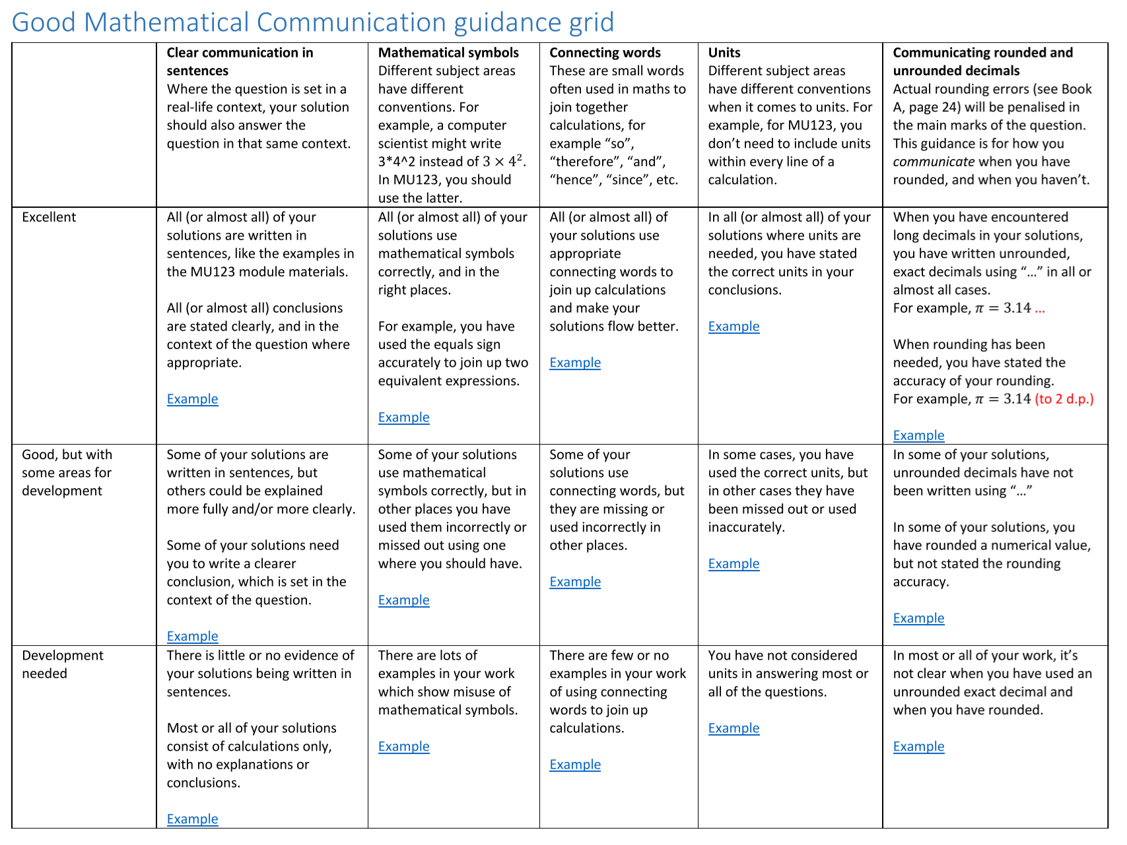
The GMC Grid
A resource to support students and tutors

Slide 6
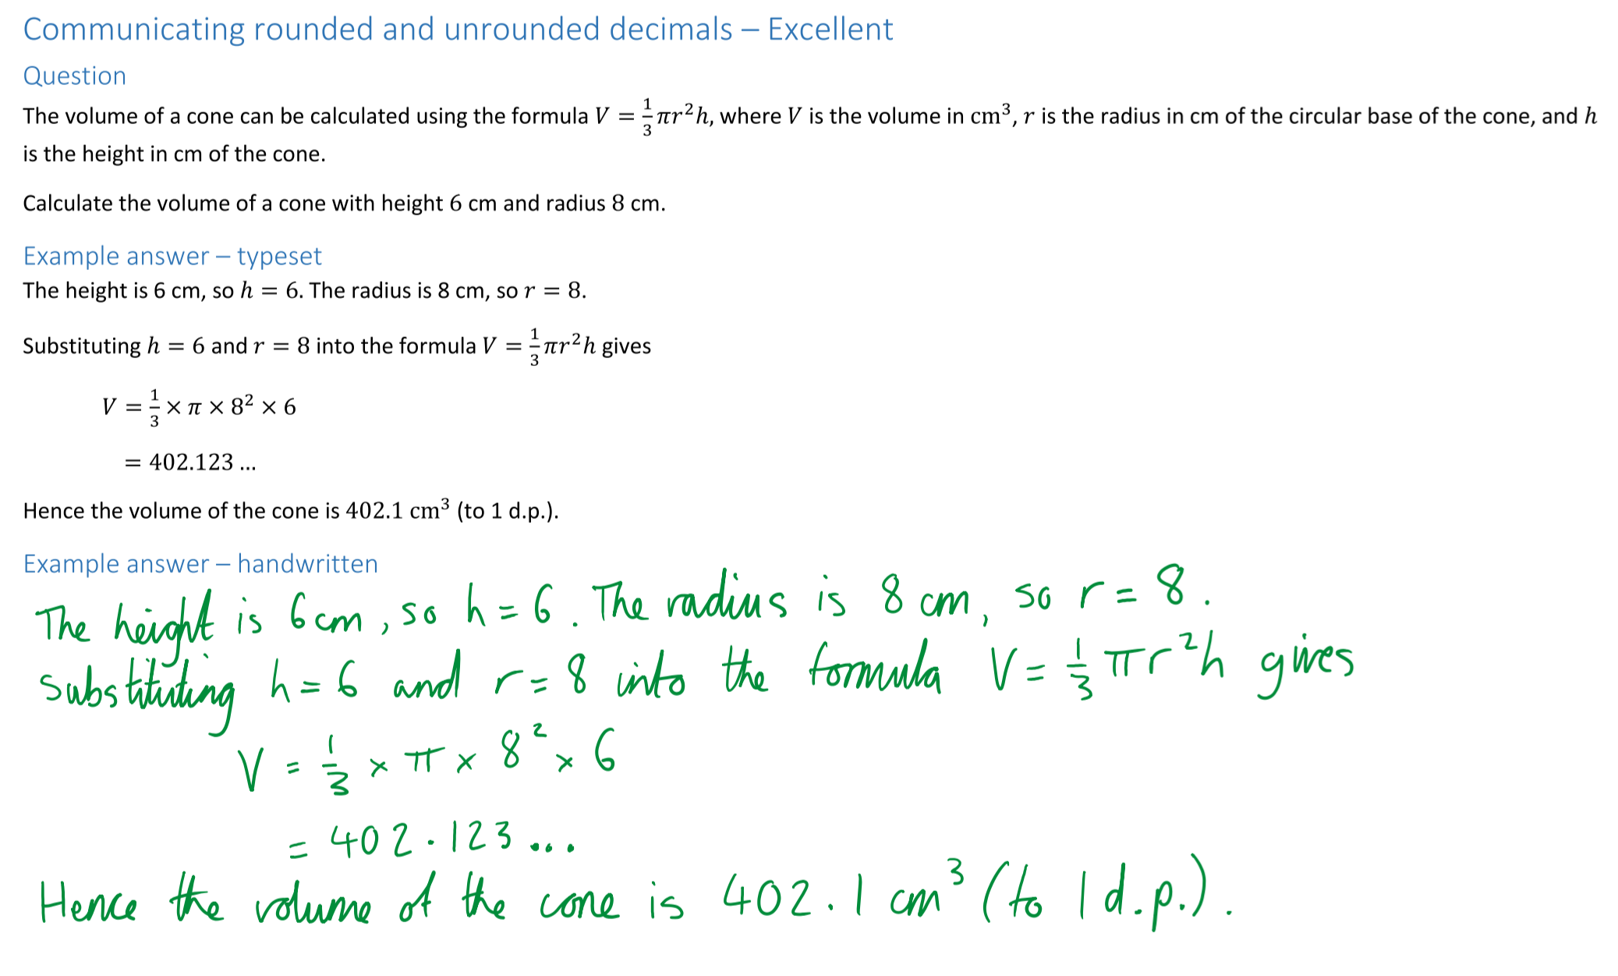
The GMC Grid
Clickable Examples

Slide 7
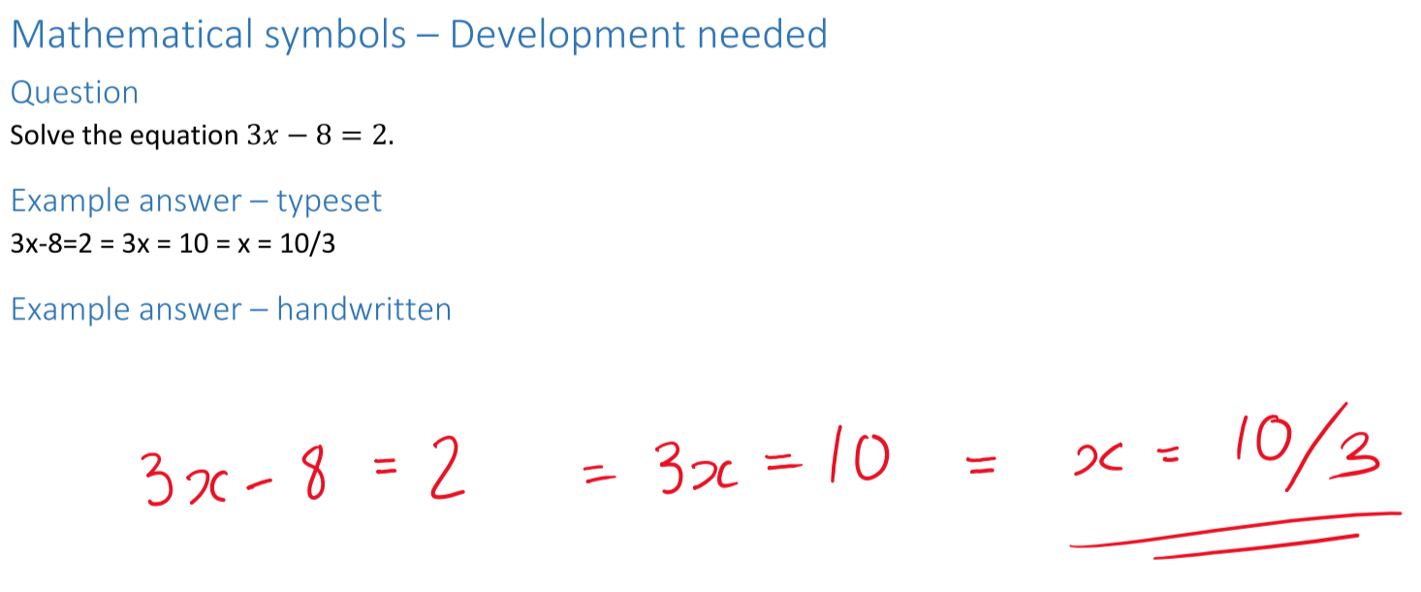
The GMC Grid
Aspects of GMC
Examples given
Clear communication in sentences
Mathematical symbols
Connecting words (“so”, “hence”, “therefore”, etc.)
Units
Communicating rounded and unrounded decimals
Excellent
Good, but with some areas for development
Development needed
Typeset examples
Handwritten examples
An early draft of MU123 Unit 1 from the days of production

Slide 8
Evaluation and Impact
How we are evaluating the grid, and how
this work ties in with employability and cross-School collaboration

Slide 9
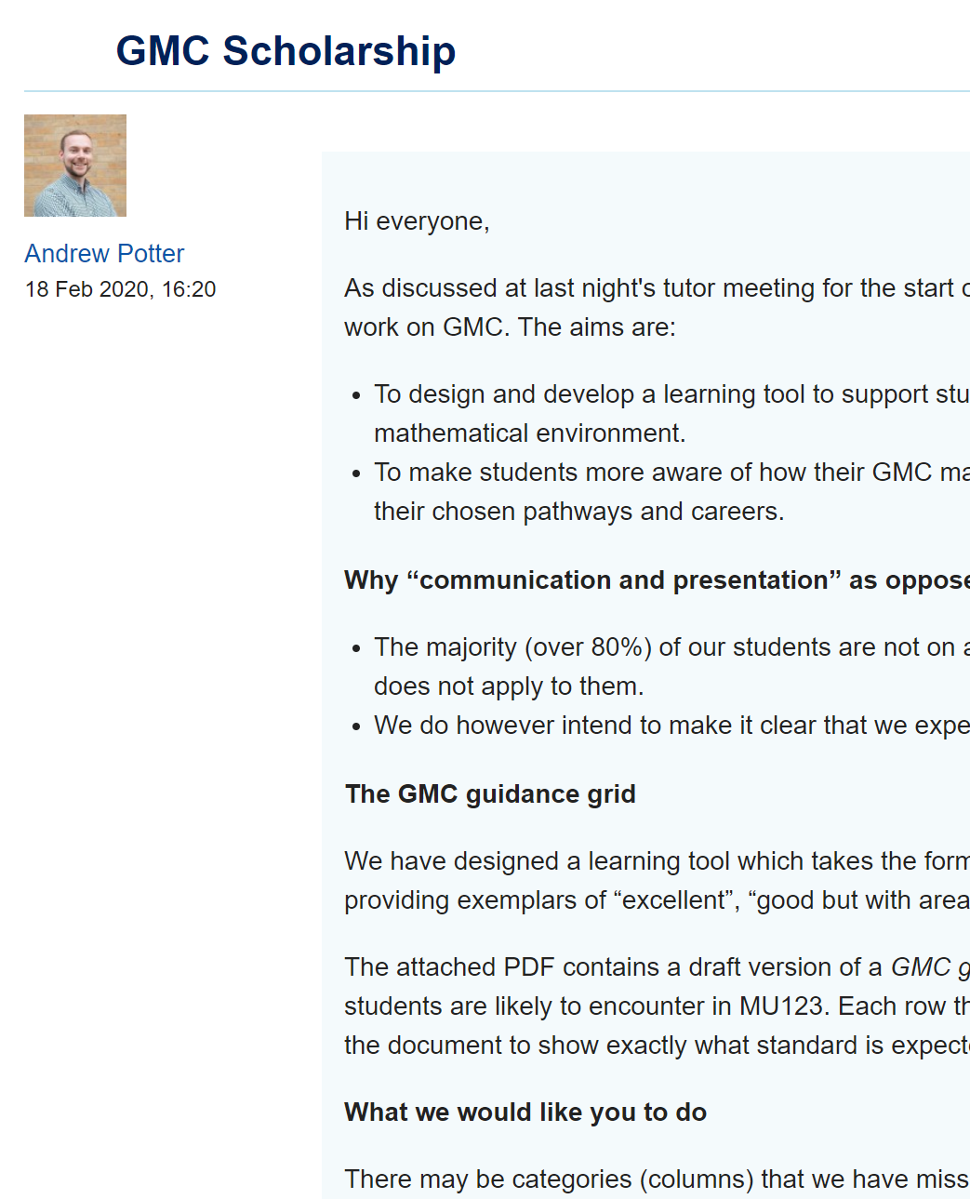
Evaluation and Impact
How are we evaluating the grid?
Introduced in tutor meetings for J-presentation tutors and B-presentation tutors
Posted on MU123 Tutor forum for feedback and suggested improvements
(After redraft) will be posted on MU123 website for students to use and feed back on
An early draft of MU123 Unit 1 from the days of production

Slide 10
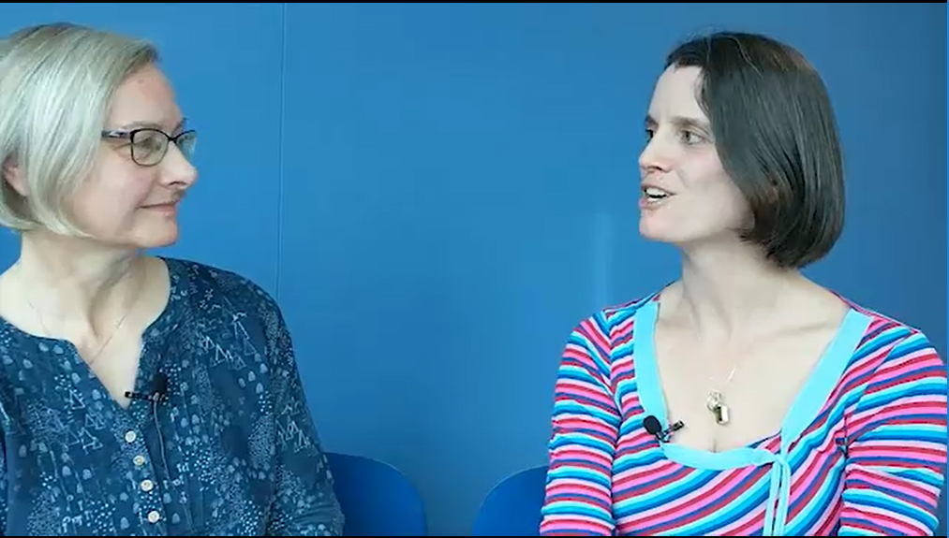
Evaluation and Impact
Working with other Schools
Level 1 Mathematics needs in other Schools
Most of our students will not go on
to study more maths modules
Most students from the School of
Computing & Communication (C&C)
Large percentage from Business & Economics and the Open programme
Many of our tutors are C&C tutors as well – they comment on the difference MU123 makes, especially GMC!
We are working with other disciplines where conventions can differ – but operate a “When in Rome…” policy!
Our tutors and students often comment that being able to communicate and present a structured logical argument is one of the most transferable skills they get from MU123!
By focusing on GMC, we hope to equip MU123 students with a key employability skill

Slide 11
THANK YOU
Questions? Comments? Future directions?

