Slide 1
Jupyter Notebook eSTEeM Project
How Jupyter Notebooks enhance learning and teaching on TM351
Sharon Dawes, Chris Thomson, Stephen Rice & Stephen Bowles

Slide 2
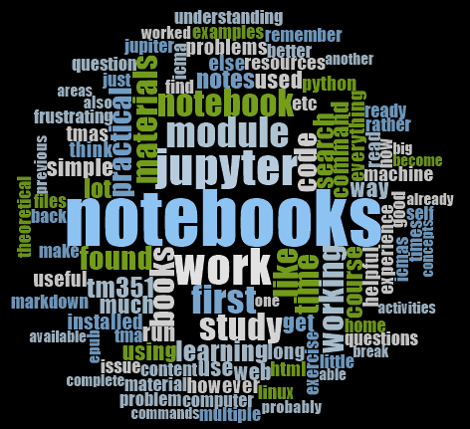

Slide 3
Project Background
What are Jupyter notebooks and how did the project come about?

Slide 4
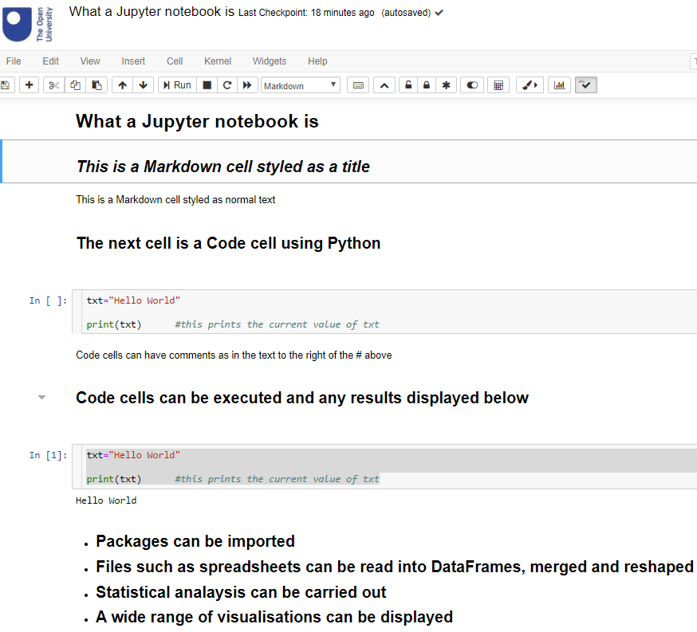
Project Background
What are Jupyter Notebooks?
JSON based
Run in a web browser
Has program code cells
Has Markdown cells
Displays results of running code
Serves as a project log book

Slide 5
Project Background
Background to Project
TM351 use of notebooks in combination with VLE
Rewrite of M269
Various science & maths modules starting to use notebooks
Need to find out how well notebooks support student learning

Slide 6
Research Questions
What we hoped to find out

Slide 7
Research Questions
What we hoped to find out
Does the use of notebooks effectively support students in their studies of the module learning outcomes?
Do notebooks allow the students to integrate theory and practice?
Do students have technological problems in using notebooks?
Does the use of notebooks dictate when and where students are able to study?
Is the use of notebooks restricted by accessibility constraints?

Slide 8
Research Methodology

Slide 9
Research Methodology
Data Gathering
Survey of 301 TM351 students from 3 cohorts
Follow up interviews with 10 students (29 opted-in)
Collect relevant comments from TM351 tutors forum

Slide 10
Research Methodology
Data Analysis
Quantitative analysis carried out using:
  Jupyter Notebooks
    Employing Pandas and Scipy packages
Qualitative analysis carried out using NVivo

Slide 11
Early results

Slide 12
Early Results
Warning – questions are paraphrased on graphs to keep labels readable!

Slide 13
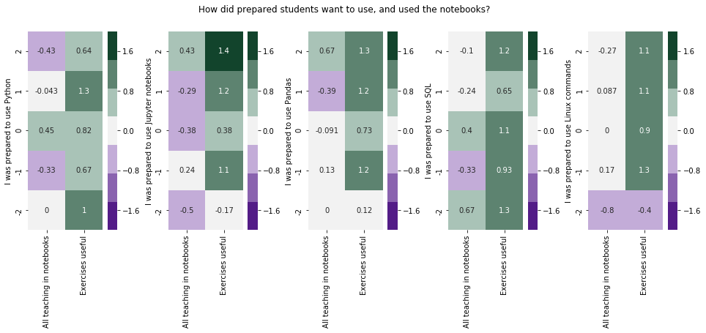
So do students want more in Notebooks?
A mixed picture….
Higher numbers show agreement, lower numbers show disagreement, taken as mean of responses in that bin.
Generally, the less prepared a student felt, the less they found the exercises useful. And the more prepared they felt the more they were interested in having teaching in notebooks, unless they were well prepared to use Python.

Slide 14
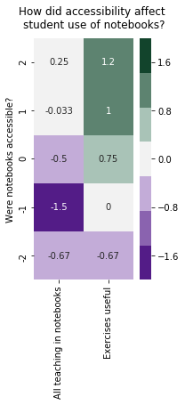
Did Accessibility make a difference?
We saw that students who found the accessibility of notebooks problematic also did not want them used for more teaching, and found the exercises were not useful.
“Books are the optimum study resource for a great many people: indexed and easily searched.“
“There was no guide or appendix for the notebooks. this meant that I had to open up and search through multiple notebooks anytime I needed to find anything.”
“The Jupyter notebooks are a good way to represent small code blocks but for practical activities they are very frustrating to complete simple tasks in and make simple commands on a command line take much longer than normal.”
“It would be immensely helpful to have more, simple questions to work through in Notebook form (not dissimilar to iCMAs) to help embed the volume of techniques in the reading.”
“The Jupyter notebooks have limited formatting capability in comparison to web pages (I have found) so I think the theoretical materials are probably much better presented on web pages rather than Jupyter notebooks.”
“I feel like the notebooks and iCMAs were most useful in terms of learning theoretical concepts in a practical way. However, I found some of them a bit long-winded.”
“I would prefer all theory in the module epub files and just save Jupyter for practicing practical work and assignments. However, after converting the notebooks to html it was quick and easy to search and read them.”
Notes:
It's notable that 6 out of the 55 students responding explicitly mentioned using their own books as a study source

Slide 15
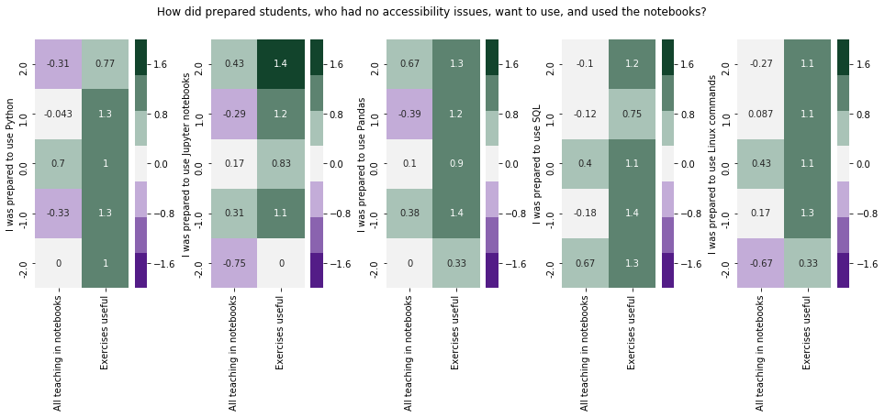
Excluding accessibility issues
However the views of those students who reported problems with accessibility did not affect the overall picture
Notes:
Notably those not prepared to use Linux, who had accessibly concerns, gave more negative responses.

Slide 16
Maybe…
More geeky students who are more comfortable coding and using command lines (etc) find Jupyter notebooks get in the way of “doing the job”
Do these students have problems presenting their work effectively?

Slide 17
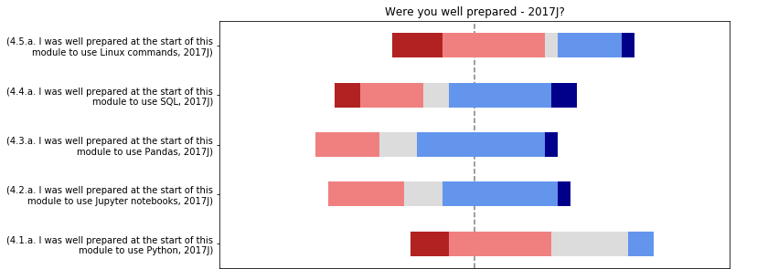
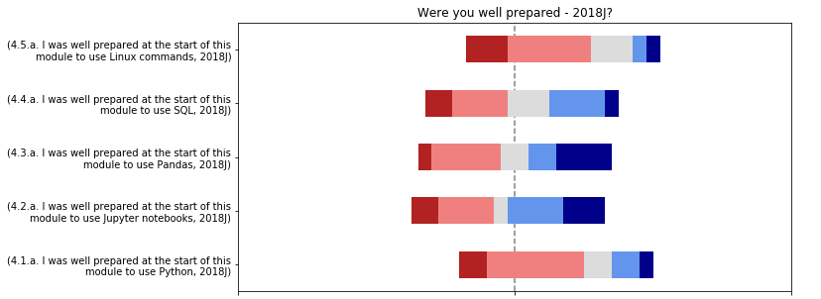
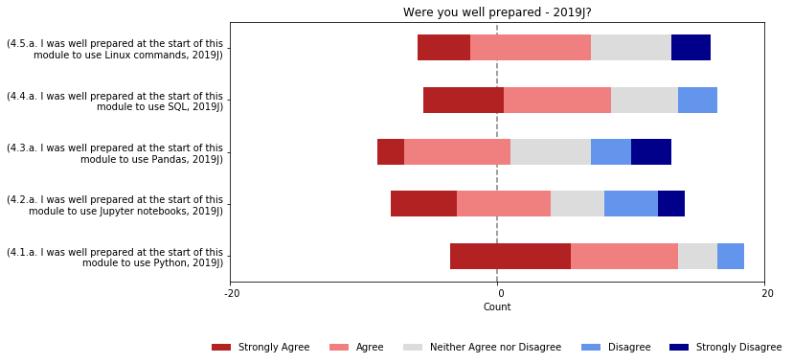
Students becoming more prepared as time goes on
Longer bars means more responses, so compare proportions of answers

Slide 18
Maybe…
Over time the students have become more prepared
Is this due to the module being refined, or the programme?

Slide 19
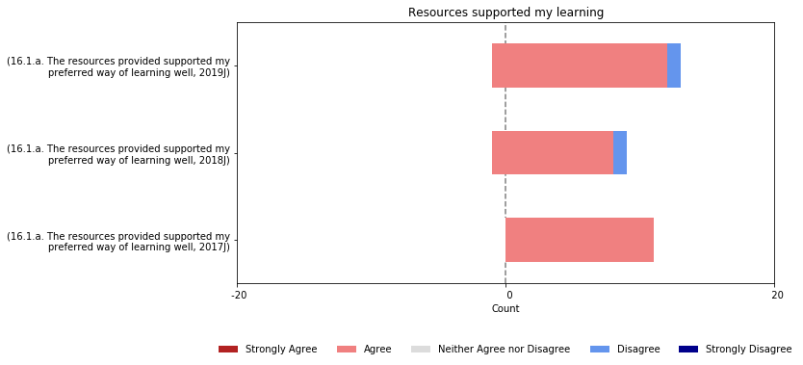
Students found resources supported them
Longer bars means more responses, so compare proportions of answers

Slide 20
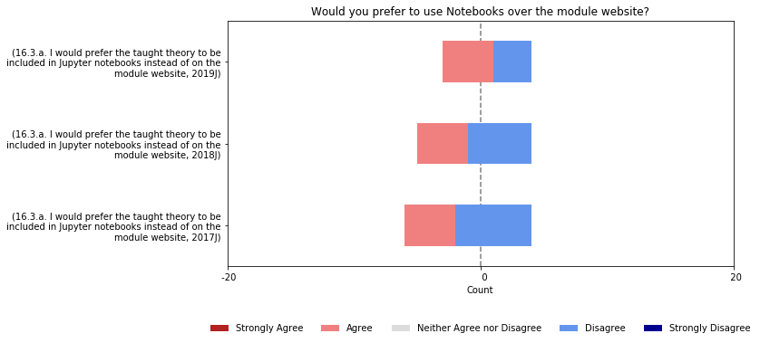
But split evenly over more use of notebooks
Longer bars means more responses, so compare proportions of answers

Slide 21
Maybe…
Students are worried about new things and changes
If notebooks were used for the theory teaching perhaps they would overcome these fears?

Slide 22
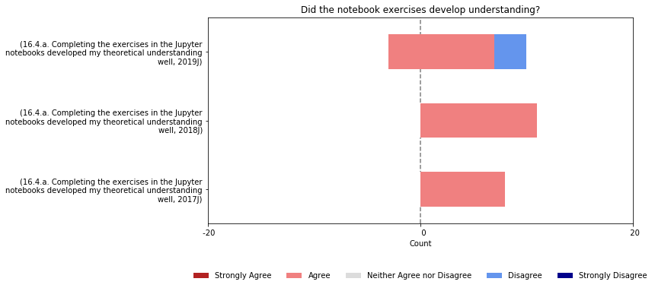
The notebooks were effective

Slide 23
Maybe…
Students part way though studies may lack reflection of effectiveness of techniques
How can we help students recognise learning success?

Slide 24
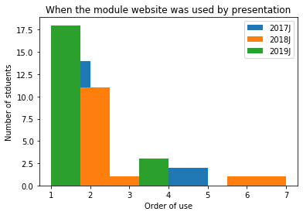
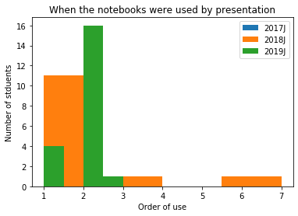
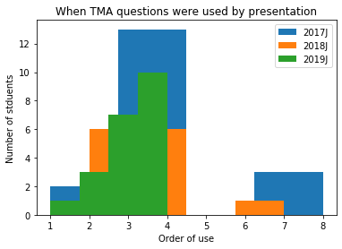
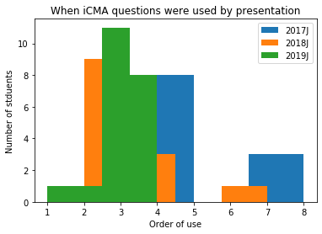
Order of use by study material
The order of use number indicates at what point in the module the student looked at that source, where 1 is the first source looked at and 7 the last. They may have selected more than time to indicate revision of material.

Slide 25
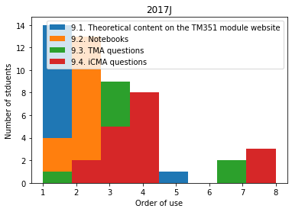
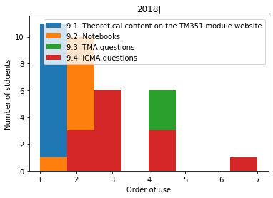
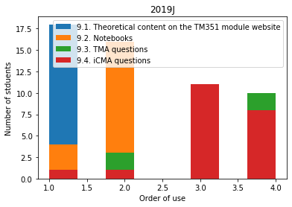
Order of use by presentation
Notes:
This has been checked by t-Test for the combined data
9.3. TMA questions & 9.4. iCMA questions are not independent - the order in which these are studied is not common
For the others, students do study in the same order – there is independence
'9.1. Theoretical content on the TM351 module website', '9.2. Notebooks',
Ttest_indResult(statistic=-2.170069507458466, pvalue=0.03232267780550611)
'9.2. Notebooks', '9.3. TMA questions'
Ttest_indResult(statistic=-7.092945665504736, pvalue=1.7721235488439479e-10)
'9.3. TMA questions', '9.4. iCMA questions'
Ttest_indResult(statistic=-0.1423454141337575, pvalue=0.8870879710477381) ***********
'9.1. Theoretical content on the TM351 module website','9.3. TMA questions',
Ttest_indResult(statistic=-7.885298198474654, pvalue=3.61714656230443e-12)
'9.1. Theoretical content on the TM351 module website', '9.4. iCMA questions'
Ttest_indResult(statistic=-7.7766531043859395, pvalue=6.2045119250486555e-12)
'9.2. Notebooks', '9.4. iCMA questions'
Ttest_indResult(statistic=-6.955128501629876, pvalue=3.445692587062035e-10)

Slide 26
Maybe…
iCMAs have become more important over time, with students focusing on them more
Feedback may be important for learning success?

Slide 27
What next?

Slide 28
What next?
We are currently fleshing out these findings with interviews with respondents.
Then …
Discussion with module teams
  Do additional resources need to be provided
  To help students find content?
  To enable students with accessibility issues to achieving learning outcomes?
  To enable tutors to provide clear feedback distinguishable from students' work?
Further research
M269 introduction of notebooks
TM351 use of cloud based software which could remove technical challenges some students face in running the software

Slide 29
Any Questions?

Slide 30
THANK YOU

