Slide 1

Understanding and mitigating students’ difficulties in undertaking complex practical activities on their computers
Patrick Wong, Helen Donelan and Tony Hirst
School of Computing and Communications

Slide 2
Background
Hands-on practical activities can improve students understanding of technological concepts
The activities provide an opportunity to develop technical skills
Require students to download, install and configure specialised software at their own computers
A daunting task for less technical students
Getting immediate technical support is difficult as they are distance learners
Is virtualisation a solution?
Is cloud-based or local virtualisation more appropriate?

Slide 3
Aims and objectives
Aim: To understand students’ experiences of using virtualisation for their computing practical activities and mitigate the common difficulties they experienced
Objectives:
  To investigate students’ experiences of using virtualisation for their computing practical activities
  To identify the common difficulties they experienced
  To investigate what study support students need
  To gather students’ opinions on cloud-based virtual labs

Slide 4
Methodology
Use the set of practical activities (in total 12 hours on networking and cybersecurity) in TM255: Communication and Information Technologies for this study
Use two Real-Time Student Feedback (RTSF) surveys to gather students experience data
Telephone interviews for more focussed discussions
Quantitative analysis for the RTSF surveys
Qualitative analysis for the telephone interviews

Slide 5
RTSF surveys
First survey: Student experience on downloading, installing and using a specialist software
Second survey: Student experience on using local based virtualisation on a set of more complex practical activities
The participants were from the 18J cohort
512 registered at 25% point
83% male, 17% female
74% are between the age of 21 and 39

Slide 6
RTSF survey 1
133 students responded to the survey (26% response rate)
96% respondents could download and install the specialise software
5% respondents experienced a problem but managed to resolve it.
96% respondents could follow the instructions to complete the two practical activities
67% prefer to use Local version, while only 33% prefer a cloud-based virtual lab.
Mac users expressed more interests in using a virtual lab as there was no Mac version of the software available.

Slide 7
RTSF survey 2
Survey took place at Week 24. 440 student remained registered
88 students responded (20% response rate)
All 88 respondents could download, install the virtualisation software and imported the virtual appliances, but 10 respondents experienced a problem.
All respondents could follow the instructions to complete the practical activities
All respondents agreed virtualisation was an appropriate tool for these practical activities (cybersecurity) and the average score they gave to the activities is 8/10.
66% prefer to use Local version, while only 34% prefer a cloud-based virtual lab.

Slide 8
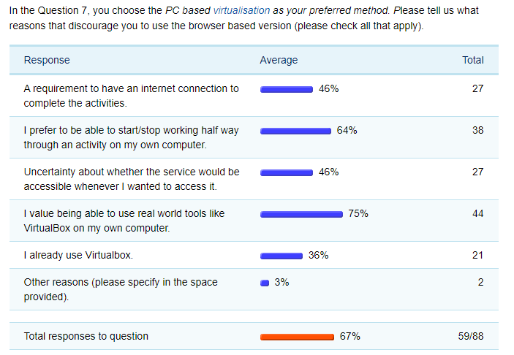
Reasons for choosing local virtualisation

Slide 9
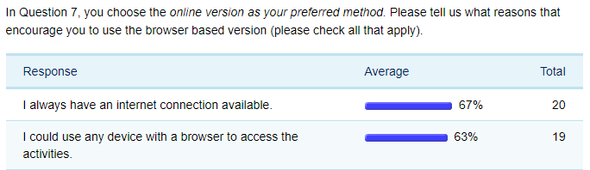
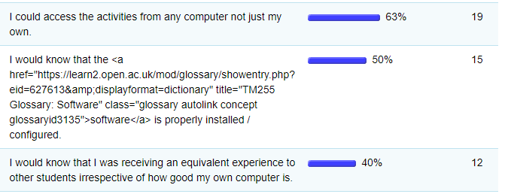
Reasons for choosing cloud-based virtualisation

Slide 10
Telephone interviews
Held after the presentation was finished (mainly in August)
Length: about 30 minutes each
10 students agreed but 9 actually participated
2 female and 8 male (1 didn’t participate)
2 registered disabled, 1 non-UK, most participants achieved Pass 2 or 3.
Age distribution:
  Under 25: 2
  26-35: 5
  36-45: 2
  46-55: 1

Slide 11
Telephone interviews key points
All 9 interviewees agreed the cloud-based option was useful but the option to be able to run the activities on their own machines was also desirable.
The appearance and design should be consistent across all modules.
Equivalent support for MAC users would be appreciated.
Most students could cope with setting up VMs and doing the activities (having previous experience on virtualisation (from TM129) helped).
Forums were the first/quickest/most useful support mechanism
Screencasts/demos would be used by students if produced.

Slide 12
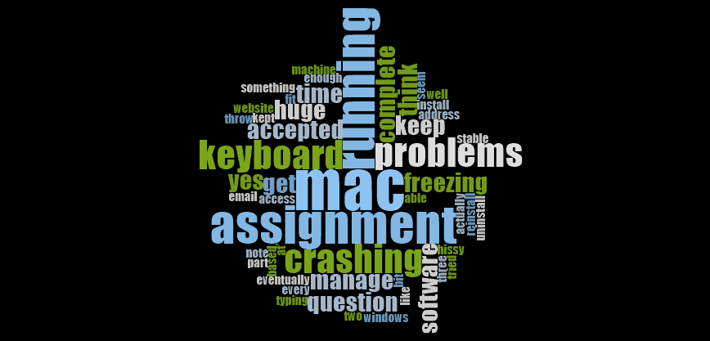
Problem encountered

Slide 13
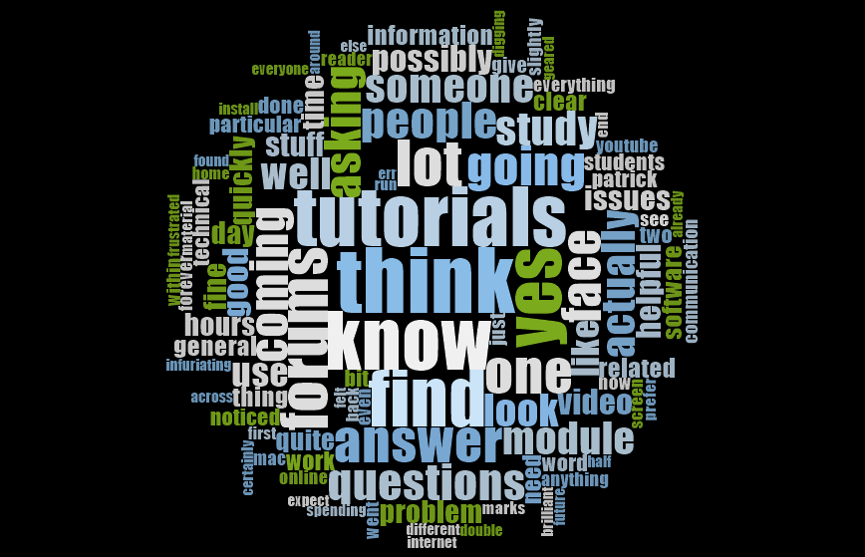
Study support

Slide 14
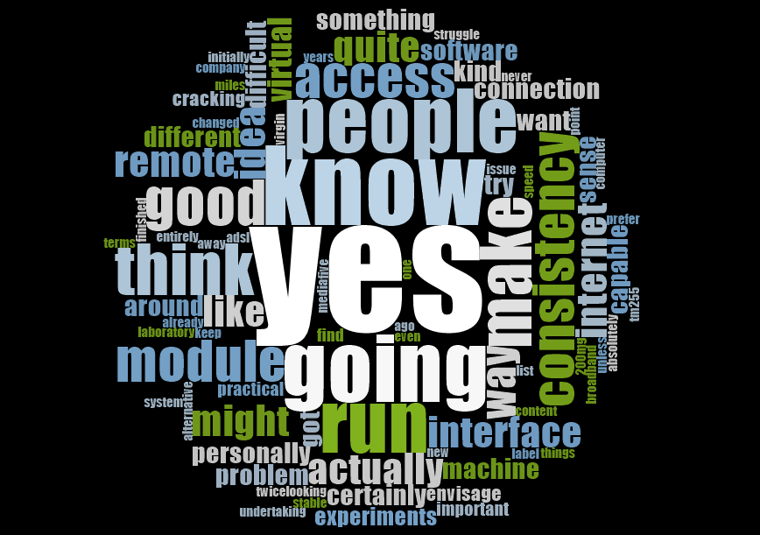
Virtual labs

Slide 15
Concluding remarks
Students like the idea of having virtual labs but also want the option to be able to do the activities on their own computers
The virtual lab would need to provide consistent experience across modules
Many students value the practical skill developed during setting up the labs on their computers
Technical forums (with FAQs) allow students to ask questions and seek answers
A tutorial going through the setup of the labs
Step-by-step guide v Screencasts

Slide 16
Reflection
RTSF surveys – easier to setup and get approved
Telephone interviews can give you wider range and unexpected answers
Should be held soon after the completion of the activities
Don’t underestimate the effort and time needed to get ethical approval
Don’t be too strict about choosing the right distribution of students for interviews
Using a qualitative tool, e.g. Nvivo, to analyse the data?

Slide 17
Questions

