Slide 1

Adeola Adeliyi
Michel Wermelinger
Karen Kear
Jon Rosewell
A Systematic Review of Pair Programming for
Learners of Programming at a Distance
Notes:
Slide needs to be in the 16:9 ratio
The screens are HD with 5760x3240 resolution, so use HIGH QUALITY images

Slide 2
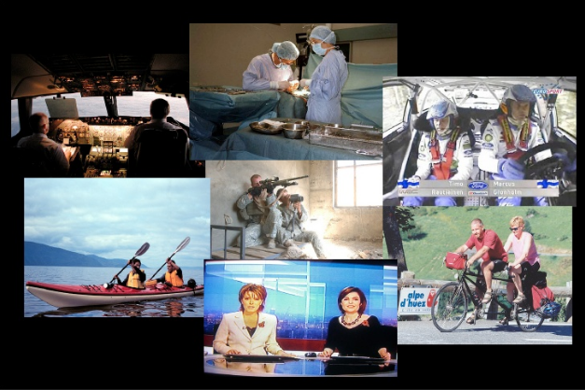
Pair Programming
Pair programming is an extreme programming concept from Agile Software development framework.
Two programmers work side-by-side at one computer, continuously collaborating on the same design, algorithm, code, or test.
It allows two people to produce a higher quality of code than that produced by the summation of their solitary efforts.

Slide 3
Key Principles of Pair Programming
A development workflow can only be considered pair programming if the two programmers work at the same time on the same code base.
Collocation
Communication
For remote collaboration to be Pair Programming
Synchronous Collaboration –
WYSIWIS (What You See Is What I see)
Access to the same repository
Integrated Communication

Slide 4

Systematic Review
Review Questions:
Question 1: In which ways is Remote Pair Programming used in industry and education?
Question 2: Under what conditions does Remote Pair Programming work?
Question 3: What are the main tools that support Remote Pair Programming?

Slide 5
Methodology
Literature Search
Selection of Studies
Quality Assessment
Data Extraction
Synthesis

Slide 6
Initial Results
Remote Pair Programming in Practice found in Literature
 | Negative | Neutral | Positive
Code Quality | (Canfora G. 2005) |  | (Baheti, Gehringer et al. 2002)(Bravo, Duque et al. 2013)(Radermacher and Walia 2011)(Satratzemi, Xinogalos et al. 2018)
Knowledge |  |  | (Baheti, Gehringer et al. 2002)
Productivity |  | (Baheti, Gehringer et al. 2002) | (Canfora G. 2005)
Communication |  |  | (Baheti, Gehringer et al. 2002)
Effort | (Duque and Bravo 2008)

Slide 7
Initial Results
Using Remote Pair Programming for teaching programming
 | Negative | Neutral | Positive
Performance | (Edwards, Stewart et al. 2010) |  | (Hanks 2005), Zacharis 2011), (Satratzemi, Xinogalos et al. 2018)
Grade |  |  | (Hanks 2005)
Motivation |  |  | (Hanks 2005), (Edwards, Stewart et al. 2010)
Confidence |  |  | (Sufian, Abdullah Mohd et al. 2006), (Jackson 2016)
Learning |  |  | (Sufian, Abdullah Mohd et al. 2006)

Slide 8
Initial Results
Tools that support Remote Pair Programming for teaching programming
Tools | Audio Visual | Annotations | Cursor Control | Role Swap
AdobeConnect | x | x
GoToAssist | x | x | x
Stride | x
Skype | x |  |  | x
TeamViewer | x | x | x
USE | x | x | x | x
Zoom | x | x | x

Slide 9
Initial Results
While the Systematic review is still in progress, some gaps in research have already been identified. These are:
Empirical studies involving Remote Pair Programming with industry professionals are limited. Therefore there is not much evidence about many variables relating to Remote Pair Programming in industry.
Remote Pair Programming requires a specific infrastructure and tools. While there are tools that support Remote Pair Programming, existing studies are limited on impact of tools in teaching and learning of Computer Programming at a distance and software development from industry perspective.

Slide 10
Conclusion
Based on the literature, Pair Programming has already proved to be an effective practice for teaching programming. However, only a few studies have explored and sought to analyse the effect of Remote Pair Programming on teaching. There is a good opportunity for more empirical studies in teaching and use in industry.
Specific tools play an important role in order to support the collaboration and coordination. The majority of tools are plugins or adapted to facilitate shared editing and communication with the exception of USE Together. There is an opportunity to investigate the impact of the use of these tools on teaching.
The current OU Remote Pair Programming study will seek to address some of the gaps identified in the research, especially around infrastructure and impact of tools on teaching programming at a distance.

Slide 11
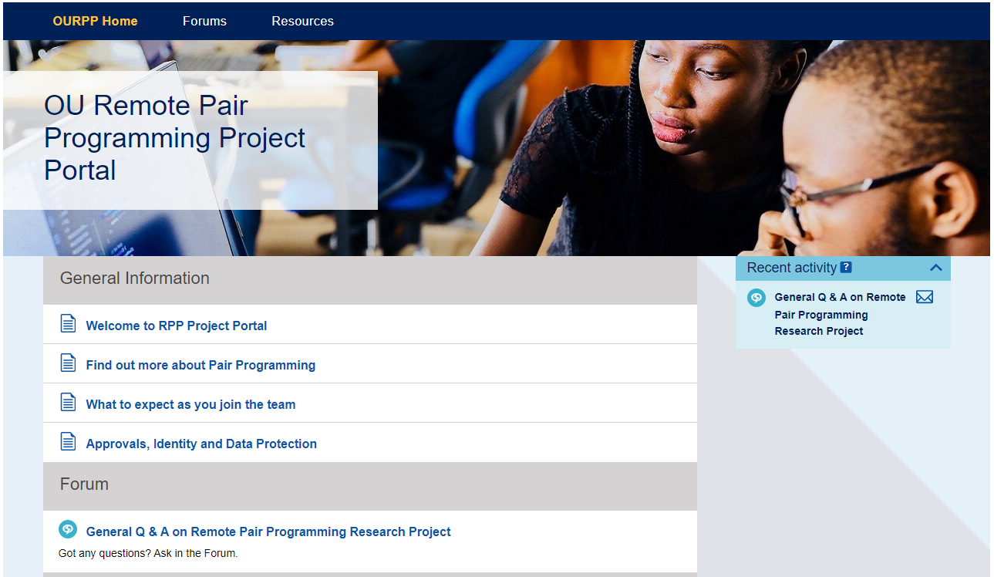

Slide 12
References
Baheti, P., E. Gehringer and D. Stotts (2002). Exploring the efficacy of distributed pair programming. 2418: 208-220.
Bravo, C., R. Duque and J. Gallardo (2013). "A groupware system to support collaborative programming: Design and experiences." The Journal of Systems & Software 86(7): 1759-1771.
Canfora G., C. A., Visaggio C. A. (2005). Empirical study on the productivity of the pair programming, Extreme Programming and Agile Processes in Software Engineering, (6th International Conference, XP 2005), Proceedings (Lecture Notes in Computer Science), Springer-Verlag, Vol. 3556, pages 92-95, 2005. .
Duque, R. and C. Bravo (2008). Analyzing Work Productivity and Program Quality in Collaborative Programming: 270-276.
Edwards, R., J. Stewart and M. Ferati (2010). "Assessing the effectiveness of distributed pair programming for an online informatics curriculum." ACM Inroads 1(1): 48-54.
Hanks, B. (2005). "Student performance in CS1 with distributed pair programming." ACM SIGCSE Bulletin 37(3): 316.
Radermacher, A. and G. Walia (2011). Investigating the effective implementation of pair programming: an empirical investigation: 655-660.
Satratzemi, M., S. Xinogalos, D. Tsompanoudi and L. Karamitopoulos (2018). "Examining Student Performance and Attitudes on Distributed Pair Programming." Sci. Program. 2018.
Sufian, I., Z. Abdullah Mohd and S. Nantha Kumar (2006). "Improving Learning of Programming Through E-Learning by Using Asynchronous Virtual Pair Programming." The Turkish Online Journal of Distance Education 7(3): 162-173.
Zacharis, N. Z. (2011). "Measuring the Effects of Virtual Pair Programming in an Introductory Programming Java Course." IEEE Transactions on Education 54(1): 168-170.

