Slide 1
Accessibility and inclusion in tuition (AccIT)
eSTEeM Conference 29th April 2020
Rachel Slater, Elaine McPherson, Anne Campbell, Patrick Murphy

Slide 2
Housekeeping
We are new to MS Teams too!
Q&A at end, you’re welcome to ask Qs as we go along, please flag in the chat box before speaking
I will ask you a couple of questions during the presentation, please use the chat box to give your answers
Please mute your microphones when not speaking to avoid feedback
Good idea not to share your video until the Q&A
You can switch on captions
Originally scheduled as a one hour workshop, will finish early

Slide 3

Plan for the session
Project aims and project team
What do we mean by accessibility and inclusion?
Methods
Common adjustments
More bespoke adjustments
Challenges
Next steps and get involved!

Slide 4
Project aims and the project team
Four main aims
Develop understanding of accessibility issues in STEM tuition
Raise awareness of these needs amongst STEM staff
Gather examples / cases studies of how STEM tutors adapt their tuition to respond to students’ needs
Share examples / case studies with STEM tutors to help support and improve accessibility in their tuition
Project team
Core team Rachel Slater, Anne Campbell, Elaine McPherson
Advisors Vic Pearson, Jo Buxton, Christine Pearson, Kate Lister,
Gill McMillan, Zoe Clayton
Consultant Patrick Murphy

Slide 5
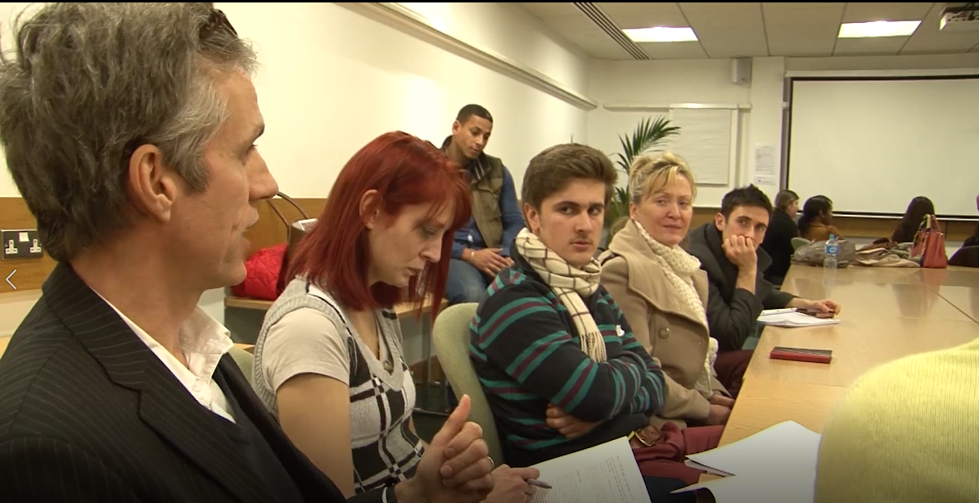
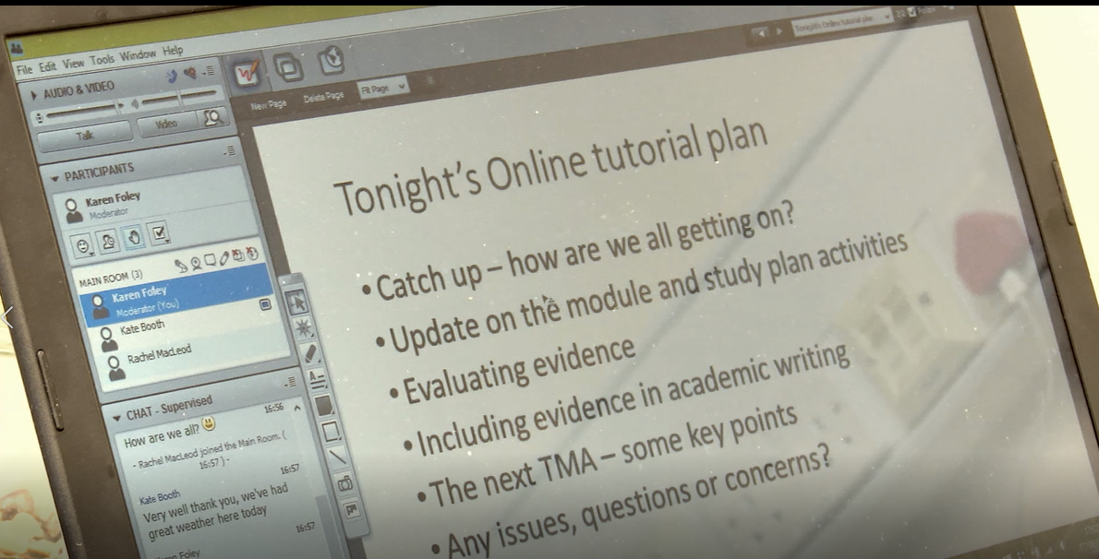
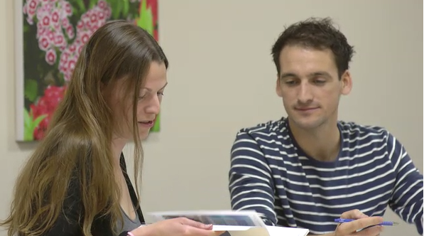
A note on terminology
Accessibility
Disability, long-term health condition, specific learning difficulty (e.g. dyslexia), mental health difficulty, anxiety etc – whether declared or not
Tuition
Any practices within the control of an AL to support their students
Inclusion
Levelling the playing field, enable students to be included and supported alongside other students

Slide 6
How many disabled students at the OU?
More than any other university in Europe
The proportion of students declaring a disability has increased year on year since 2010/11
Question:
What percentage of OU undergraduates registered in January 2020 declared a disability?
Please type a, b, c, or d in the chat box
12%
17%
22%
don’t know

Slide 7
How many disabled students at the OU?
Answer:
What percentage of OU undergraduates registered in January 2020 declared a disability?
c) 22%
Exact answer is 21.6% which represents 28,394 students
https://openuniv.sharepoint.com/sites/units/iet/iet-sega/SitePages/Statistics-on-disabled-students.aspx

Slide 8
How many disabled students at the OU?
Question: What is the most common disability amongst OU students? Type your answer in the chat box
(number of times disclosed, proportion of students)
Mental health issues
(16k times, 57% students)
Fatigue/pain
(7k, 26%)
Specific learning disability
(7k, 25%)

Slide 9
How many disabled students at the OU?
Question: What is the most common disability in STEM?
(number of times disclosed, proportion of students)
Mental health issues
(16k, 57%)
Mental health issues
(3.5k, 40%)
Fatigue/pain
(7.5k, 26%)
Specific learning disability
(1.5k, 18%)
Specific learning disability
(7k, 25%)
Fatigue/pain
(1.5k, 17%)
‘Unseen’
(1.5k, 17%)
https://openuniv.sharepoint.com/sites/units/iet/iet-sega/SitePages/Statistics-on-disabled-students.aspx

Slide 10
Method
MAPP survey (2019)
‘At times, I have adapted my tuition practice to respond to a disabled student's need’
99 responses from STEM ALs, 84% agreed, 71 examples
14 STEM ALs interviewed (phone), interviews transcribed
Tried to prioritise by L1 (but all levels)
Categorised against common themes, bespoke adaptations highlighted
ALs interviewed mostly teach, M, S and TM modules, not representative of STEM
(no Engineering, Environment, Design)

Slide 11
Most common approaches
Adapt the format of documents
  Type face, large font, coloured backgrounds, coloured fonts, feedback in separate document (screen reader users)
Provide materials in advance
  Often presentation slides, can be notes of what will be said
Physical changes to teaching space
  Change of room, room layout, where you & students stand and sit, parking, lift etc
  Field-sites – adapt route, help collect samples
  Online – breakout rooms, webcam, polls

Slide 12
Most common approaches
Provide additional materials, support, time
  Run through before tutorials, ‘how to’ graphs, software, labs
Measures to support anxiety
  OK to be silent, build confidence, focus on key points in feedback
Measures to support hearing impaired students
  Pacing, webcam, reinforce main points in text, ‘ping-pong’ emails
Time management and prioritising
  Must-do & desirable, study chunks, independent learner

Slide 13
More ‘bespoke’ approaches
Tutor led materials
  videos explaining key concepts
  screencasts to explain subscript and superscripts
  ‘how to’ walk throughs – compress files, screenshots, LaTeX and maths notation, drawing graphs, lab work
  examples to explain concepts or carry out calculations in different ways
  use questions in feedback to invite a dialogue
Collaboration, for complex cases work with staff tutor, student support team, disability support team
Study support approach – meeting students’ needs as you see them, whether or not they have disclosed a disability

Slide 14
Challenges
Lets start with ideas from you…
Timing of reasonable adjustments
Non disclosure
The ‘disability flag’ and student profile limited use
Cluster tutorials make it difficult to track needs
What to do when students don’t respond?
Group work
Graphs, diagrams, maths & science symbols and equations
Time management and prioritisation
Student with different needs in the same tutorial
Don’t always feel equipped to support students needs

Slide 15
Key message and next steps
Key messages
Don’t make assumptions, treat all students as individuals and talk to them
Informal conversations and building trust and confidence
Next steps
Looking for more examples of bespoke approaches:
Follow-up with a couple of interviewees
More interviews
AL conference workshop
OUSA Inclusion group

Slide 16
Q & A and get involved!
Any questions?
A couple of questions from us:
Would ‘top tips’ be helpful?
Do you have more bespoke, personalised examples, if so we’d love to hear from you!
Rachel Rachel.slater@open.ac.uk
Anne Anne.campbell@open.ac.uk
Elaine Elaine.mcpherson@open.ac.uk

Slide 17
THANK YOU

