Slide 1
Online Team Investigations in Science:
The student view of online team-working in astrophysics and space science
Mark Jones, Sarah Chyriwsky, Judith Croston, Ulrich Kolb, Susanne Schwenzer and Sheona Urquhart

Slide 2
Cooperative learning in STEM subjects
Why cooperative learning? (small groups working towards a common goal)
In face-to-face context - long recognised (e.g. Springer, Stanne and Donovan, 1999) as leading to improved student outcomes in STEM subject areas.
Cooperative learning mirrors the working approaches used in STEM research and employment – develops team-working skills that are important for employability.
Online cooperative learning activities may have the following characteristics:
Active rather than passive
Authentic (Herrington, Reeves, Oliver, 2010)
Iterative - reflective
Problem-based (PBL, e.g. Raine & Collett, 2003)
Situated in a social context mediated by peer interaction and peer learning

Slide 3
Cooperative learning in a distance learning environment
Challenges to cooperative learning
Student availability for team activities
Interaction through CMC (team formation, communication issues)
Accessibility issues related to types of CMC adopted
Student emotional response (e.g. Robinson, 2013, Hilliard et al., 2020)
Assessment strategies
Educator as a group facilitator

Slide 4
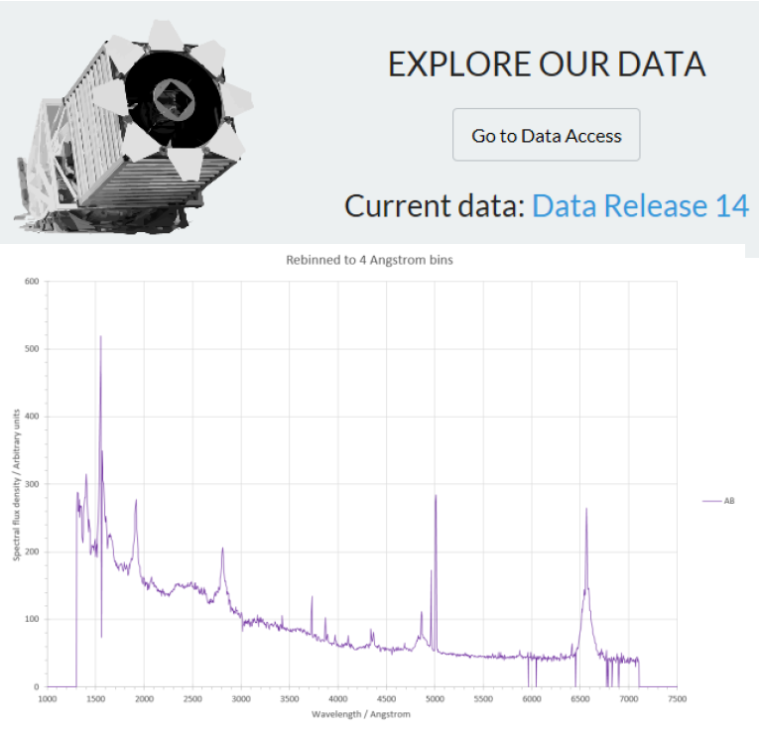
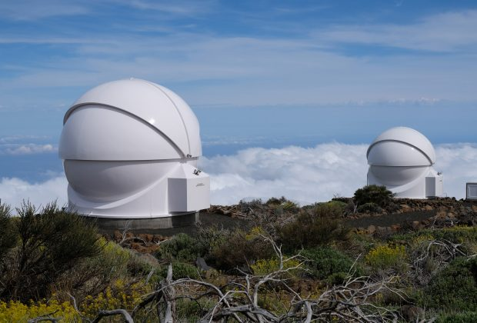
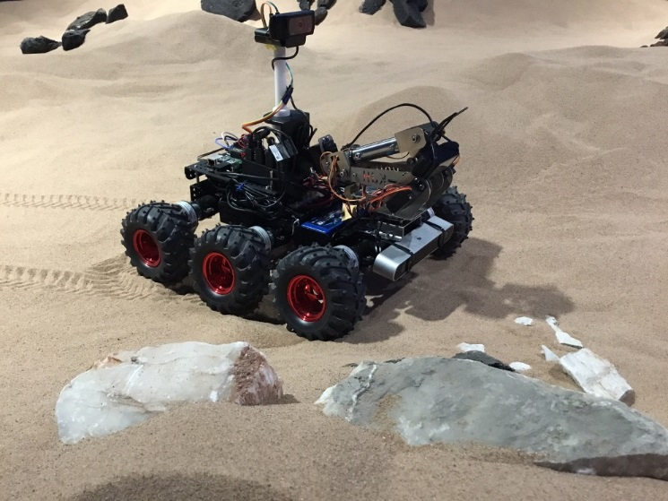
Team investigations in OU physical science modules
Astronomy / Planetary Science
S382 – PIRATE robotic telescope
S382 – SDSS telescope data
S818 – Mars rover simulation
Features
- Advanced u/grad. and taught p/grad.
- Team working
- Synchronous and asynchronous communication tools
- Varied models of assessment
This work
Analysis of student interviews as part of a wider project that also includes forum interactions.

Slide 5
Aims of the project
Through analysis of the synoptic data provided by forum postings and in-depth semi-structured interviews with students, our aim was to study the following aspects of our team projects
Pedagogic design.
Use of online communication tools.
Student engagement and ownership of task.
Peer-learning in a distance environment.
Assessment strategies.
Group dynamics and conflict resolution in an online setting.
Notes:
Highlighted areas will be discussed in this presentation.

Slide 6
Interviews
Structured conversations with volunteer cohort after completion of their group project.
Student perceptions:
    - Before project started,
    - Experience during project,
    Reflecting on whole experience.
14 students interviewed
Module | Project | Number of students
S382 | PIRATE | 3
S382 | SDSS | 5
S818 | Rover | 6
Notes:
These were the themes set out when deciding on the questions in the interviews. As part of the student engagement and ownership theme, we asked whether group work is important.

Slide 7
Interviews – Research questions
RQ1 | What aspects of the project design did the students find particularly helpful? Are there any aspects that could be improved?
RQ2 | What were students’ experiences of peer-learning?
RQ3 | Do students see the assessment task as being appropriate to the work and fair to all?
RQ4 | What value do students see in carrying out team working activities online?
Notes:
Investigated several questions so far.
RQ3 turned out to be too broad a question because it appears that everything influences the team coming together: project design, materials, assessment etc! What does seem to be important, though, is having a particular task to concentrate on. So, for PIRATE the first observing session is a pivotal point, for Rover it’s deciding the first objectives. SDSS is more of a slow burner because there is more preparation activity before students discuss their data.
I’m going to focus on three of these questions:
project design in RQ2
peer-learning in RQ7
value of team work in RQ1

Slide 8
RQ1 : What aspects of the project design did the students find helpful …
having something that guided you … in a structured way … and people to support … That was all really helpful.
I thought it [progress reports] was really useful and it also allowed me to … shape, to decide how I was going to be that day.
Helpful
Scaffolded
Safe
Aligned assessment
Debrief
Authenticity
I kept saying to the wife, I found it difficult to believe that the Rover wasn’t actually on Mars.
It was such an important part for us to see where it was set up …and how close we’d come to hitting the rocks and stuff like that. It was really really a good part of it so, I think it was a really good wrap up.
[The MT] also took ultimate responsibility for decisions …if we made mistakes or we didn’t get things quite right, they would come in and tell us and so we were given a neat set of parameters in which to work.
Notes:
Students generally appreciated that the project was well structured. Students on the Rover project also noted that the lunar practical prepared them well for this project.
Students felt well supported by the tutors and Module Team.
A couple of students mentioned how useful the progress reports were to help them focus on the task and plan the next part. Unfortunately not all the students recognised this opportunity.
Students certainly are engaged with the projects. The debrief of the Rover project is perceived as a fitting end to the project, especially as the assessment focuses on the team-work rather than the science. The debrief is a chance to get feedback on the science and students find this satisfying.
They appreciate the experience is authentic – real science, real collaboration.

Slide 9
RQ1 : What aspects of the project design did the students find helpful …
Helpful
Scaffolded
Safe
Aligned assessment
Debrief
Authenticity
Not helpful
Lack of information at start
Cumbersome nature of the forums
Non-participation
Connectivity issues
it was extremely stressful especially the first couple of days, but again I’m not sure that that worked to its advantage as well, because I was saying how we bonded as a team straight away.
Is there any point in doing it as a group project if it’s just there and you’re just following a book?
Notes:
There are some aspects of the project that students don’t find helpful.
Several students mentioned a lack of information at the start and commented that this is stressful. However, it was also noted that this stress helped team-building and also that at level 3/ masters students shouldn’t expect detail direction.
Communication issues and non-participation of others continues to be a concern. A good internet connection is essential for real-time communication and sharing data files.

Slide 10
RQ2: What were students’ experiences of peer-learning …?
Interviews included two questions:
Did you feel that you learnt something from the interaction you had with your group?
Did you feel that you helped someone else to learn something?
Responses included:
Team-working skills
Using existing skills
Technical help
Discussing science
I do feel like I improve my ability to work with the group, how to phrase things in a diplomatic way and … to motivate people and to … delegate tasks.
I think I helped a bit with the editing side of things and putting the report together and probably time management because I’m pretty good at that.
It’s really nice to talk and, like, actually discuss concepts with people. I think it makes things clearer. I think it’s, like, fun to, like have a project with other people.
Notes:
We asked two questions…
Responses focused very much on team working skills. Possible because the emphasis of the interview was team working, but also possible that they don’t recognise the peer learning taking place.
Students talked about sharing tasks, using existing skills and more technical help. Only a few mentioned learning form discussions (but this is in terms of a nice thing to do, not necessarily learning.

Slide 11
RQ2: What were students’ experiences of peer-learning …?
Responses show what sort of learning takes place in the project:
Students are learning professional skills
Communicating in science
Managing people
Sharing tasks
Time management
Forum analysis shows what students discuss.
I had to have some things explained to me that I didn’t quite understand on the … scientific background and I hope that helped them …because once you explain something to someone it [makes] the ideas more solid in your head.
I’d like to think what I was instrumental in doing was getting everyone to just speak up.
Notes:
From the interviews, we can see what sort of things students are learning.
These are mainly professional skills.
Forum analysis gives a richer picture. As Judith has said, we can see from the forum discussions what students discuss and what they learn from each other.

Slide 12
RQ3: Do students see the assessment task as appropriate and fair?
Assessed skills, not science
Assessment task influences project
Aligned with task
Progress reports prompted reflection
Unease about mark depending on others’ work
… if we were doing the activity and we knew that … the assessment was … how we attained other [science] goals … perhaps we’d have been more performance orientated …and less considerate of our team work.
it would have been nice to have had a technical output from the week as well as a psychological output for me. But .. in terms of … portable skills … I thought the EMA exercise was a good one to have done.
I’m glad I forced myself to do it and actually I found it quite a nice way to summarise … what I’d been doing each week to … make sure I kind of got my head round everything and it was all making sense.
It seemed … fairly easy and straightforward, but … to be able to answer it, to get the points, you would have to demonstrate that … you were learning and you’re problems solving.
you’re writing the group project together and you know that that’s being assessed, when someone isn’t pulling their weight, it’s really frustrating
Notes:
There are two different assessment models used in the three projects in this study. The rover project required students to carry out a self-evaluation exercise. The robotic telescope and SDSS projects required both a group report and set of individual progress reports.
The emphasis on team-work in the assessment influenced students’ attitude to the project.
Progress reports were helpful (to those who did them during the project. In the interviews, when asked about assessment, students focused more on the shared output (wiki, report) and had to be prompted to mention the progress reports and individual tasks.

Slide 13
RQ4: What value do students see in carrying out team working activities online?
I’m struggling to imagine in this day and age, a research role that doesn’t involve you working, in some way, as part of a team.
Employability – authentic and relevant
Stimulated interest
Interaction with other students:
Social aspects
Peer learning
Healthy competition
It was more engaging definitely than just reading about it. … It was just a really good way to learn because I wasn’t really interested in Mars, I have to say, before it started.
It’s just this is how people work. They collaborate. You have to integrate the needs of other people. So, you know, it’s a good real life experience.
“…with Open Uni, because you do everything on your own most of the time, it’s really nice to talk and … actually discuss concepts with people.
it’s slightly out of my comfort zone, but I got more from it than anything else… If you let me have a choice, I wouldn’t do it and then would be really grateful when I was made to.
Notes:
We asked students what value, if any, they saw in online team working activities. The responses were very positive.
Several students recognised that team working and online collaboration was realistic and that they were developing employability skills.
A significant number of students mentioned that it was a more engaging way of learning, less dry than reading books.
Students also value the interaction with other students. Several students mentioned that this is not something that happens very much in distance learning. They valued the social aspects but also having others to discuss science with and helping each other out. Students are conscious that others can be further ahead of them or ‘quicker’ and some commented that the group work kept them ‘on their toes’.
On balance, students go into the team work with some trepidation, but as this quote shows, they find it a positive experience.

Slide 14
Concluding comments
Student experience of online team working is rich and varied
Pedagogic design:
Positive attributes – authenticity, scaffolded, aligned assessment
Problematic – non-participating members, level of briefing, methods of communication
Peer-learning: varied level of self-reflection on peer learning
Assessment:
Focus on skills does change behaviours but is not always popular
Progress logs can be useful scaffolding
Unequal contributions to assessed group work are a source of tension
Value: Our sample generally reported a very positive view of the importance of team working as a professional skill.
Forums provide a synoptic indicator of what students discuss when involved in cooperative project work.
Student experience and perceptions of cooperative work can be probed through interviews.
Developing and running cooperative learning projects is resource intensive – so
we should be clear about their purpose(s) (employability, research skills, authenticity, social interaction, peer learning), and decide what is appropriate within our curriculum,
we should be sensitive to barriers to student participation (design, organisation, assessment)
we should develop future cooperative projects based on our prior experience.

Slide 15
Thank you!
m.h.jones@open.ac.uk

