Slide 1
The role of large informal online workshops to engage and enthuse students studying SDK228 an interdisciplinary level 2 module
Janette Wallace
and
Isabella Henman

Slide 2
Background
Background
SDK228 Science of the mind: investigating mental health – large interdisciplinary module
Students from varying backgrounds including science, health, nursing and psychology backgrounds
Students struggle with different aspects
Student engagement and enjoyment can vary
Traditionally key science skills can be poor, even basic academic skills for science
Extensive tailored guidance is provided but is static
Tutorials are both tutor group and cluster group and tailored to content and direct skills

Slide 3
Workshops
Pilot workshop programme for 18J cohort with 4 module wide workshops
Workshop programme for 19J cohort had 6 timetabled, advertised workshops, with repeats
Linked to module content but not delivering it
Designed to be interactive with polls and breakout rooms
Not recorded or in the LEM
Varying lead speaker of 4(3) and moderator on chat

Slide 4
Workshop titles
Interesting extra on biology
Plagiarism
Positive psychology/How to be happy
Biology in your own words
Essay/critical writing
Dementia care in the 21st century
Run Tuesday evenings and Thursday day time

Slide 5
Analysis
Phase 1
Interaction and attendance assessed by dedicated data collector during workshop
Targeted JISC questionnaire to evaluate impressions after each workshop
Phase 2
Questionnaire to all SDK288 students towards the end of the module
Questionnaire for AL involved in workshops
This presentation looks at results from Phase 1

Slide 6
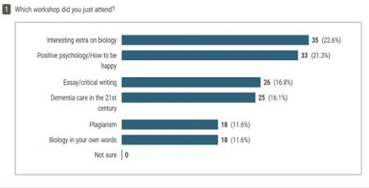
Results Phase 1: Attendance
231 different students attended overall
Highest attendance first (119 students) followed first in January (60 students)
Evening > lunchtime
Some attended all 6 workshops
This was reflected in the responses to the JISC survey (155 respondents)

Slide 7
Results Phase 1: Interaction (data collection)
Breakout sessions within a workshop
  Does not result in students logging off
  Longer duration in breakout sessions appears to give students more time to engage
  Chat main communication in breakouts
  Minimal microphone use even in breakout rooms​
  Polls
  Polls popular​
  Tick polls versus shorter answers results in more participation but
  Overuse of tick Polls results in reduced participation over the duration of the session.
  Activities linked to a poll seem to increase engagement

Slide 8
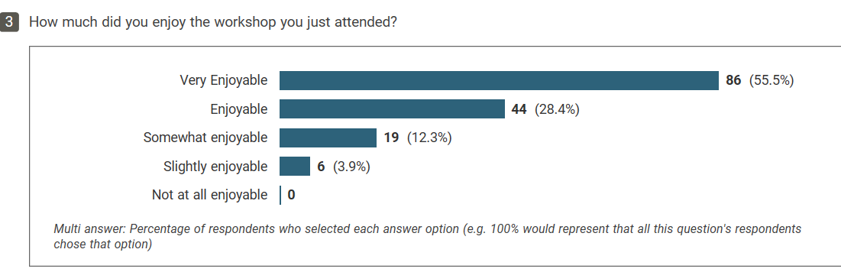
Results Phase 1: Enjoyment
83.9% of those surveyed found the events very enjoyable or enjoyable.
None of those surveyed said they the events were ‘not enjoyable at all’.

Slide 9
Results Phase 1: What did students enjoy?
Interaction with fellow students
Community building
Building relationships with ALs
Interactive style of workshop including polls and breakout rooms (matches data collection)
Content- improved understanding of module material

Slide 10
Quotes: What did students enjoy?
It was interesting, learning new facts, got to interact with others
working with others in the breakout pods
Being able to interact in groups/polls helped retain attention and be more involved
got to interact with others
interacting with others on an idea then bringing all the information together
Very good presenting style from the tutor
Interesting topics that made me think..
Listening to other’s viewpoints
Notes:
Theme
Selected quotes
Interaction with students
Lots of activities with other people
The chat room and hearing other people's personal views in real time.
, got to interact with others
.. interacting with others on an idea then bringing all the information together
Listening to others viewpoints
The interraction with other students
ALs
interactive sessions
very friendly tutors
Friendly, informal atmosphere. Host was very welcoming
Very good presenting style from the tutor
Interactive sessions
Interaction activities
The interactive nature of it! e.g. polls, breakout rooms etc
It was clear, informative and engaging.
Being able to interact in groups/polls helped retain attention and be more involved.
Bitesize, interactive, easy to understand, well paced. Tutors organised, technology worked.
Content
Interesting topics that made me thinking.
information and images relating to relevant topics
Different topics being covered
It was interesting, learning new facts, got to interact with others
The informal nature of the content
The topics were all very interesting.
gaining a greater understanding of the topic
Break out rooms
Using the breakout rooms.
working with others in the breakout pods
Style
plus how light hearted it was.
the flowing of the workshop, how we could interact during and the jovial atmosphere
I liked the informality of it.

Slide 11
Quotes: What did students enjoy?
Lots of activities with other people
I liked the informality of it
interacting with others on an idea then bringing all the information together
It was clear, informative and engaging
Bitesize, interactive, easy to understand, well paced. Tutors organised, technology worked.
Friendly, informal atmosphere
gaining a greater understanding of the topic
Notes:
Theme
Selected quotes
Interaction with students
Lots of activities with other people
The chat room and hearing other people's personal views in real time.
, got to interact with others
.. interacting with others on an idea then bringing all the information together
Listening to others viewpoints
The interraction with other students
ALs
interactive sessions
very friendly tutors
Friendly, informal atmosphere. Host was very welcoming
Very good presenting style from the tutor
Interactive sessions
Interaction activities
The interactive nature of it! e.g. polls, breakout rooms etc
It was clear, informative and engaging.
Being able to interact in groups/polls helped retain attention and be more involved.
Bitesize, interactive, easy to understand, well paced. Tutors organised, technology worked.
Content
Interesting topics that made me thinking.
information and images relating to relevant topics
Different topics being covered
It was interesting, learning new facts, got to interact with others
The informal nature of the content
The topics were all very interesting.
gaining a greater understanding of the topic
Break out rooms
Using the breakout rooms.
working with others in the breakout pods
Style
plus how light hearted it was.
the flowing of the workshop, how we could interact during and the jovial atmosphere
I liked the informality of it.

Slide 12
Results Phase 1: Students did not enjoy
Format of potentially large / busy workshop
Interaction (or lack thereof)
(lack of) links to module material
Time pressures (not long enough)

Slide 13
Quotes - Students did not enjoy
Quotes
The short time scale, felt a bit rushed!
The volume of chats in the pod while trying to concentrate on the main slides.
too much info on the screen at the same time so hard to follow live
The pace is quite fast - lots of information to process in a short space of time
I didn't find the break outs very beneficial. It was nice talking to other students but I didn't feel like I was learning anything
Trying to get others to join in within the breakout rooms
Very quick and brief - relation to course was not clear
Notes:
Theme
Selected quotes
Interaction with students
Lots of activities with other people
The chat room and hearing other people's personal views in real time.
, got to interact with others
.. interacting with others on an idea then bringing all the information together
Listening to others viewpoints
The interraction with other students
ALs
interactive sessions
very friendly tutors
Friendly, informal atmosphere. Host was very welcoming
Very good presenting style from the tutor
Interactive sessions
Interaction activities
The interactive nature of it! e.g. polls, breakout rooms etc
It was clear, informative and engaging.
Being able to interact in groups/polls helped retain attention and be more involved.
Bitesize, interactive, easy to understand, well paced. Tutors organised, technology worked.
Content
Interesting topics that made me thinking.
information and images relating to relevant topics
Different topics being covered
It was interesting, learning new facts, got to interact with others
The informal nature of the content
The topics were all very interesting.
gaining a greater understanding of the topic
Break out rooms
Using the breakout rooms.
working with others in the breakout pods
Style
plus how light hearted it was.
the flowing of the workshop, how we could interact during and the jovial atmosphere
I liked the informality of it.

Slide 14
Results Phase 1: Students took away
Confidence
Improved understanding of module content
Student community

Slide 15
Quotes: Students took away
A lot more confidence in sdk228 and finding it more enjoyable
More confident writing assignments
Knowledge and understanding of writing biology in own words
Made me feel less alone with the studying
Biology not being too scary!
A better understanding of the materials
A better idea of how to approach essay writing critically
Comments from others reflected my own thoughts, whereas before I thought I was the only one
I feel I've been in touch with other students, which is motivating

Slide 16
Results Phase 1: What changes?
57% students said they would not change anything about the workshop.
Those that suggested changes were mostly to suggest improvements to the style of the workshop

Slide 17
Quotes: What changes?
I would like to extend to 90 min
Record them so everyone could access them
I really do get more from actual interaction in both face to face and workshops like this
Make it longer, the presenters are fabulous more interactions with them
Maybe make the breakouts larger than 5 to compensate for some who don't talk
More polls maybe, more interaction
More links to SDK228 material
Notes:
Theme
Selected quotes
Interaction with students
Lots of activities with other people
The chat room and hearing other people's personal views in real time.
, got to interact with others
.. interacting with others on an idea then bringing all the information together
Listening to others viewpoints
The interraction with other students
ALs
interactive sessions
very friendly tutors
Friendly, informal atmosphere. Host was very welcoming
Very good presenting style from the tutor
Interactive sessions
Interaction activities
The interactive nature of it! e.g. polls, breakout rooms etc
It was clear, informative and engaging.
Being able to interact in groups/polls helped retain attention and be more involved.
Bitesize, interactive, easy to understand, well paced. Tutors organised, technology worked.
Content
Interesting topics that made me thinking.
information and images relating to relevant topics
Different topics being covered
It was interesting, learning new facts, got to interact with others
The informal nature of the content
The topics were all very interesting.
gaining a greater understanding of the topic
Break out rooms
Using the breakout rooms.
working with others in the breakout pods
Style
plus how light hearted it was.
the flowing of the workshop, how we could interact during and the jovial atmosphere
I liked the informality of it.

Slide 18
Results Phase 1: Intentions & overall view
93.5% said they would attend the next workshop
Those who didn’t were mainly for time issues or not appreciating the potentially busy workshop format
Notes:
Note that this is only for those who completed the questionnaire e.g. stayed until the end. This may not be a true representation

Slide 19
Quotes: Intentions & overall view
Yes I like tutorials makes me feel like I am part of something bigger not a lone student,
I found it very useful hearing other students perspectives on the subject,
attend most of the workshops as they are very informative
Hosts are knowledgeable and enthusiastic
I sometimes feel isolated while studying at the open university as it is an online university. It is important to have some level of contact with tutors and fellow students.
I always find that I take something away from each tutorial that I attend which hopefully improves my scores
it was very engaging whereas some of the module tutorials are pretty dry
Notes:
Note that this is only for those who completed the questionnaire e.g. stayed until the end. This may not be a true representation

Slide 20
Initial thoughts from Phase 1
Workshop format does encourage interaction
Positive reception overall
Students who recognise the purpose appreciate the community
But more analysis needed and Phase 2 is in progress

Slide 21
Thank you - collaborators
Isabella Henman
Kath Nicol
Leanne Holman
Karen Barnacle
Sinead Eccles
Claire Rostron
Ras Rasul

Slide 22

Thank you: Questions?

