Slide 1
Large-scale game-based activity for delivering experience of communication within teams
Matthew Nelson and David Bowers
9th eSTEeM Annual Conference April 2020
Notes:
An email-exchange based team interaction activity built on a state machine model, devised by David Bowers.
Reminiscent of business simulation games.
Also “choose your own adventure” stories.
Game of “Consequences”

Slide 2
context
Team interaction within an online OU level 2 module
Notes:
First run in 2018
~740 students studying the module:
~390 participated in Activity
Successful, so repeated this year
Two of the main topics of module:
IT service management
Team working

Slide 3
aims
for students to grasp the importance of prompt and effective communication within a functional team
to adopt a game-based approach to lighten the theoretical and practical burden and to promote engagement
learning from experience
Notes:
secondary aim:
relates to the IT service management aspect of the module:
a service and customer-value focus – not just a technical focus.

Slide 4
scenario:
company with IT department and server room in a building with glass walls. The walls spring a leak and the weather is bad …

Slide 5

the cooling they wanted

Slide 6
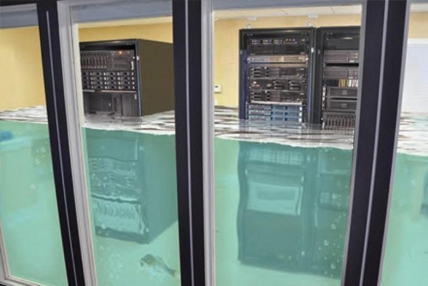
the cooling they want to avoid
Notes:
But the actors don’t know this yet

Slide 7
the actors:
IT manager
building manager
estates manager
server room manager
the service desk

Slide 8
the activity
students sign up to take part
they are each assigned one of the five roles
in teams of five
they receive a message …

Slide 9
Welcome The activity is now running. From tomorrow you will get emails sent every day until the activity ends. When you receive the emails, even if there is no action for you, you can use the link to see actions taken by others and the status of the system.
Click here to visit the Activity
Notes:
Visiting the Activity now:
see the contextual background of the scenario and describes the roles of the actors.
see the starting state of the system.
four key observable states
– of the users
{grumbling, happy, service-less};
- of the building {vulnerable, fixed, failed};
of the file system {failing, secure, dead};
and of the ATL (automated tape library) {out of use, in use, safe, drowned}

Slide 10
most of the emails are “noise”; irrelevant
office “chat”…

Slide 11
Warning After yesterday's incident I feel we need a new policy with regards to what food we bring into the office. You'll be pleased to know that Brian is doing fine, but will be off work for a few days. I will be speaking to the directors to decide a policy. Jennifer Human Resources
Click here to visit the Activity

Slide 12
on all but three days, one member of each team receives a message requiring a response…

Slide 13
F AO : Estates Manager Hi There is a potential risk from a leak on the floor above the server room Building manager Please choose what you want to do.
Organise immediate temporary repair (mastic and sticky tape!)
Close ticket, on the grounds that it's stopped raining, so the leak has stopped
Set up project to write business cases for permanent repair for consideration for next year's budget
Draw on contingency funds to effect immediate permanent repair
Click here to visit the Activity
Notes:
Students not domain experts: so the appropriate response is often quite obvious.
If no response is selected before 0300 the next morning, a default of “no action taken” is recorded.

Slide 14
FAO : All Weather Warning : Autumnal storm with heavy rain and gale-force winds expected today!
Click here to visit the Activity
Notes:
The message on the remaining three days is a weather warning. The aim of the activity becomes clear over time.

Slide 15
clicking to visit the Activity shows the overall state of the system and the responses so far…

Slide 16
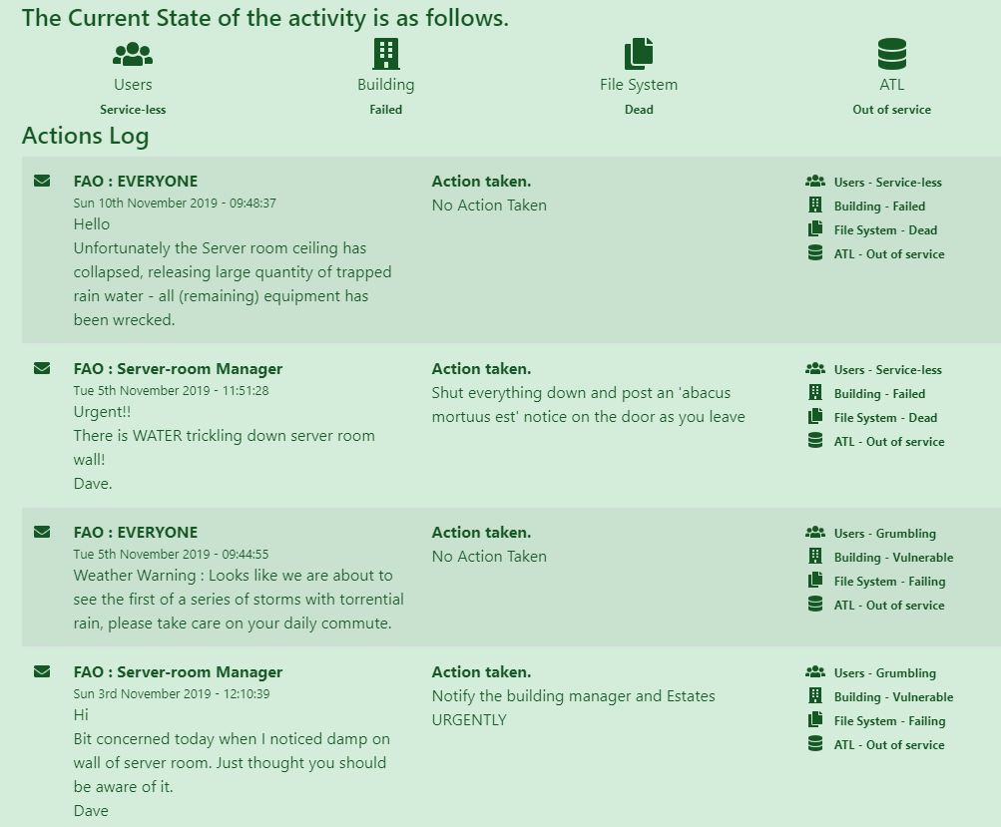
Notes:
Explanation of managerial roles is also shown on this page

Slide 17
experience has shown that the most usual outcome is…

Slide 18
FAO : All Hello Unfortunately the Server room ceiling has collapsed, releasing large quantity of trapped rain water - all (remaining) equipment has been wrecked.
Click here to visit the Activity

Slide 19
But if everyone responds in a sensible, timely way:
the building is fixed
the file system is secure
the ATL is safe
and the users are left happy.
Notes:
Which is a main goal of IT Service Management
The Activity shows students through one path through the state model, only from the perspective of one actor

Slide 20
a simulation of the Activity
runs an entire Activity instantaneously at the click of a button
Notes:
a simulation using the same state model allows multiple executions of the activity, with varying outcomes
multiple executions allows:
overview of role behavior
varying outcomes
better understanding of the issues of communication and perspective
weighted random selections, to nudge things away from the machine room flooding:
better reflect sensible choices that students would have made
adds to realism

Slide 21
evidence of success
assignment question called for reflection on the characters’ perspective: service-focused or technical; and effectiveness of communication
assignment question well answered; many students demonstrated that they had gained the insights intended:
Notes:
The simulation a basis for an assignment question
the assignment question scores compared well with other parts of the module,
including subsequent assessment of both team working theory and
reflection on practical team working activities.
The mean score for the question relating to the activity was 61%, and that for the
remaining questions on the same assignment was 68%.
Very few students scored less than a pass-mark on the one question.

Slide 22
“For organization[s] to work efficiently
each of the areas of responsibility need to communicate,
safe in the knowledge that their communication will not be ignored,
and any appropriate actions will be taken.”
Notes:
We could have told them this. Instead, they experienced it for themselves.

Slide 23
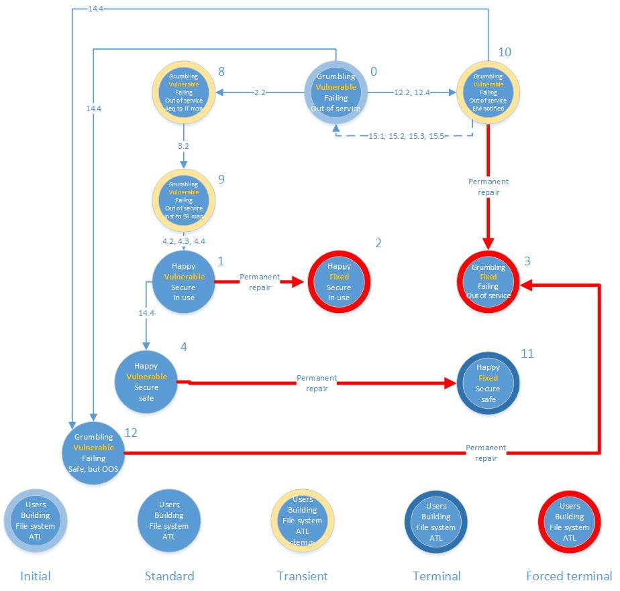
Notes:
An extract from the state machine model that underlies the activity.
This shows paths through different states.
Each state transition is determined by the current state and the input provided by email responses.

Slide 24
further work
exploration of application of Activity in other contexts
survey of student reaction to the Activity, simulation and assignment question
is the Activity an example of gamification?
Is the Activity a game? If so, is this game-based learning?
exploration of gamification effects
Notes:
Study of effect of addition of gameplay elements: competition, leader board, prizes, badges etc.
is moving up a spectrum of gamification intensity a recipe for greater engagement, enjoyment, appreciation, understanding?

Slide 25
thank you!

