Slide 1

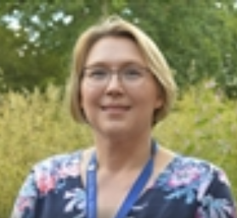

CAN AN ASYNCHRONOUS STUDENT CONFERENCE IN OPEN STUDIO DEVELOP STUDENTS’ CRITICAL EVALUATION SKILLS?
CATHERINE HALLIWELL & JENNY DUCKWORTH

Slide 2
S350 STUDENT CONFERENCE
S350 – ‘Evaluating Contemporary Science’
Approximately 250 students
Takes place over a 2 week period in OpenStudio
Choice of 5 topics: antibiotic resistance, diesel vehicles, nuclear legacy, moons and asteroids, rare earth elements
Comparison of two recent scientific papers
Students upload poster, elevator pitch and key image
Peer feedback given
Major component of TMA03, work developed further for EMA

Slide 3
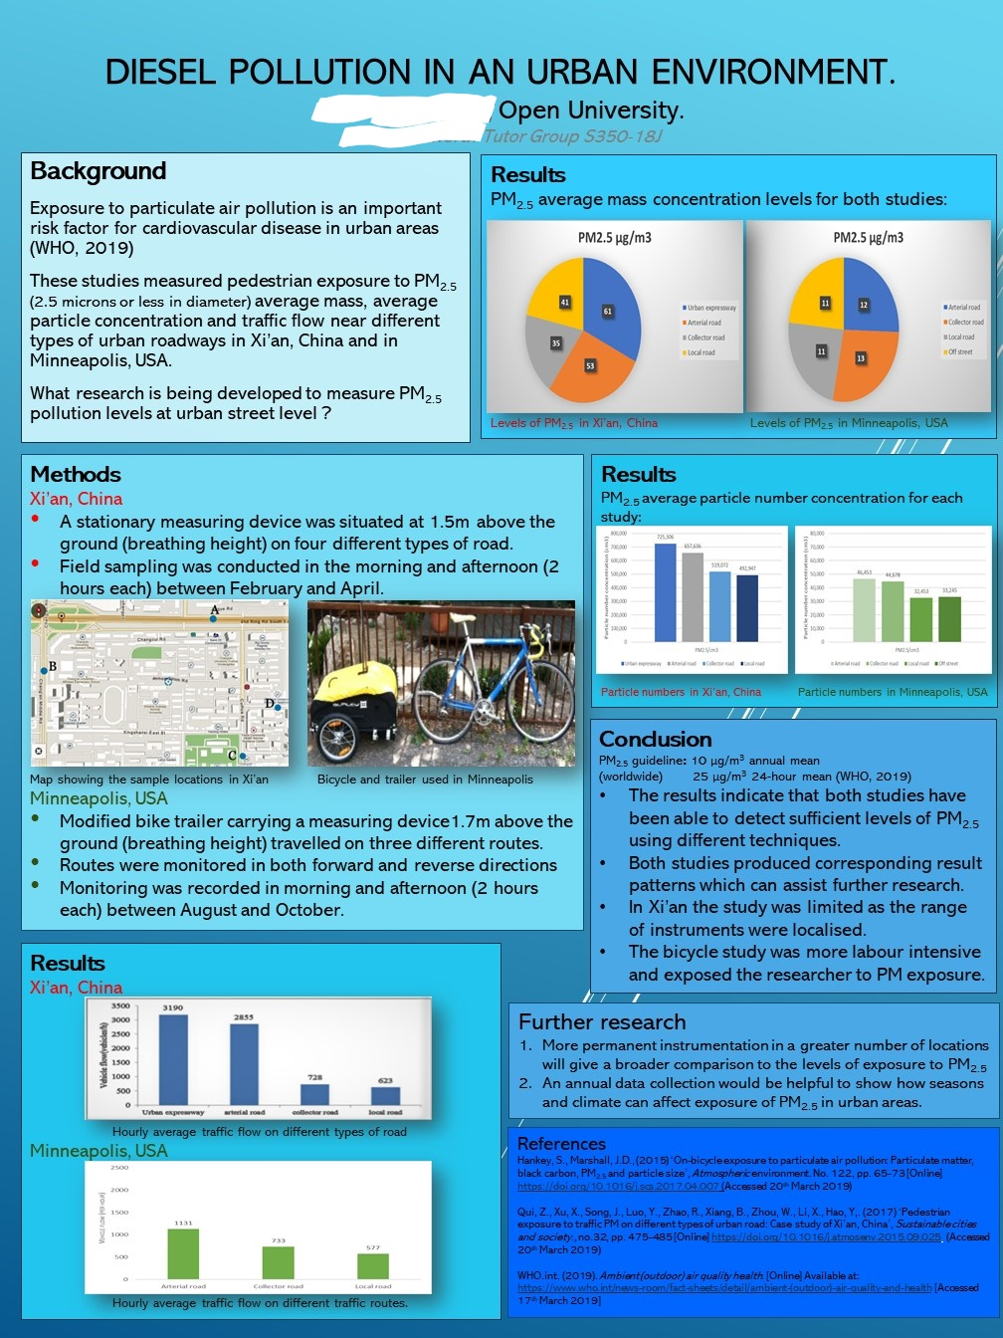
Example poster from the S350 18J Conference

Slide 4
RESEARCH QUESTIONS
Can a student conference using OS lead to a positive impact on module success through supporting a deeper engagement with critical evaluation of contemporary science?
What ‘quick fixes’ can we put in place to help promote student engagement in deeper learning and reflection?

Slide 5
METHODS
100 randomly selected posters from 18J
Checklist of questions including content, ‘quality’ and feedback received
Three measures of scientific ‘quality’:
- Interpretation (results, conclusions, future research)
- Evaluation (quality of each study; comparison of study quality)
- Demonstration of subject knowledge/understanding (through language; use/amendment of figures; contextualisation)
Quality measures used Likert scale from 1 (not attempted/no evidence) to 5 (excellent)
AL focus group discussions

Slide 6
Poster topics and disciplines
Topic
Discipline

Slide 7
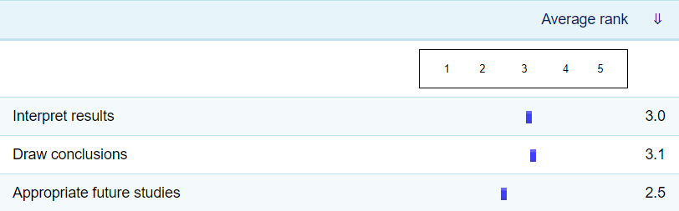
Do posters effectively interpret results, draw conclusions and suggest future research?
“I think the good posters can do a lot with the figures and demonstrate how they interpret the results and that they understand the results by clarifying key findings for students in other disciplines” (AL Focus Group)

Slide 8
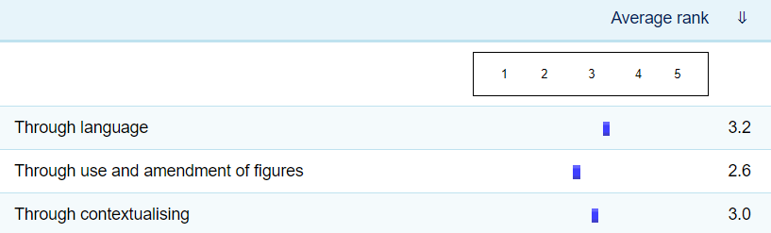
Do posters show a depth of subject knowledge and understanding?
“If they can communicate what the papers are saying in simpler terms, then that shows good understanding. Those papers where they use lots of technical language, to me, demonstrate less understanding” (AL Focus Group)

Slide 9
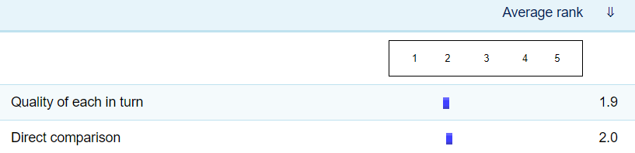
Do posters evaluate the scientific quality of the two studies?
“I think most students provide an effective summary of the methods, but rarely enough critical evaluation” (AL Focus Group)

Slide 10
COMMON FEATURES OF THE ‘BEST’ POSTERS
‘Sensible’ choice of studies that did not differ too much (e.g. same organism with different experimental variables)
Focus on comparison of the two studies
Did their own presentation of results
Clear consideration of study limitations
Proposed ‘sensible’ and specific future research
‘Top tips for S350 posters’ shared with 19J students before 2020 conference

Slide 11
IMPLICATIONS OF FINDINGS SO FAR IN TERMS OF ‘DEEPER’ LEARNING
Some evidence of deeper learning shown but a reluctance to critique
‘You know it when you see it…’
But difficult to assess objectively
Implications for assessment?
Mathieson, S.(2014) 'Student Learning' in Fry, H., Ketteridge, S. and Marshall, S., A Handbook for Teaching and Learning in Higher Education : Enhancing academic practice, Chapter 5 [Online]. Available at: http://open.eblib.com/patron/FullRecord.aspx?p=1770537 (Accessed 24 April 2020)

Slide 12
NEXT STEPS
Focus group with 19J students (June-July 20)
Analysis of 19J posters and comparison with 18J (July-Sept 20)
Further analysis in terms of topic, discipline and module outcome

Slide 13
THANK YOU
Any questions?

