Slide 1
Inclusivity in Pre-Assessment Academic Support
Dr Nicola Swann
Applied & Human Sciences, Kingston University London
Email: nicola.swann@kingston.ac.uk
Twitter: @SwannNicky

Slide 2

Background
The Attainment Gap
In Higher Education institutions, an attainment gap is widely observed between UK domiciled white students and those of UK domiciled black, Asian and minority ethnic (BAME) groups.
According to HESA data, the attainment gap has improved since early reported data in 2003/04 but this has fluctuated and a substantial gap is still evident, with disparity across ethnic groups.
Year | BAME Awarding Gap | Awarding Gap for Black students
2003/04 | 17.2% | 27.6%
2016/17 | 13.6% | 24.1%
2017/18 | 13.2% | 23.4%
2018/19 | 13.4% | 22.6%
(Sources: Equality Challenge Unit, 2013; Advance HE, 2018,2019,2020)

Slide 3
Background
Inclusivity at KU
At Kingston University, attainment is evaluated through a ‘value added’ metric, which highlights differences in attainment between student groups that cannot be explained by entry qualifications or the subject of study.
Strategy
  Improve institutional culture
  Enhance knowledge and skills of staff
  Provide better support for students
KPI targets and course metrics part of the review and planning process
An inclusive curriculum framework is embedded in teaching and learning strategy.
Despite improvements, there is still an attainment gap, whether by the HESA ‘good degrees’ statistic or the VA metric

Slide 4
Background
Inclusivity at KU
The three principles of inclusivity are to:
Create an accessible curriculum
Enable students to see themselves reflected in the curriculum
Equip students with the skills to positively work in a global and diverse environment.
Belonging → Improve induction processes and increase duration
Relationships → Enhance course leader and personal tutor support, particularly during induction and transition
Commuting → Commuter students working group to enhance progression of students who commute for an hour or more each day
Intake qualifications → Enhance institutional process, knowledge and skills of staff to provide better support
Enrichment activities → Mentoring schemes and social tasks and challenges

Slide 5
Ongoing Challenges
Inclusivity in Assessment
It has been highlighted that BAME students in particular can at times struggle with academic language (Open University Annual Report, 2013) - therefore, the use of academic language in documentation must be considered as it can be exclusionary and marginalise students.
Is there sufficient support available to help students engage with academic language and improve their own use of language in assessments?
Is support accessible? It has also been suggested that BAME students may be less likely to access support (Stuart et al., 2011).
Are we providing what students need, with both equality of opportunity and inclusivity?

Slide 6
Study Design
This study aimed to collect preliminary data. Questionnaires were distributed by student partners in the project and were completed by 80 students.
Questions aimed to capture demographic data (course, year group, gender, ethnicity and commuter status) and awareness, experience and preferences of academic support.
A focus group aimed to capture a more comprehensive view of student members’ preferences (McKenna, 2017).
Descriptive statistics and percentages were analysed from the survey and qualitative data was analysed using hierarchical content analysis (Sparkes and Smith, 2014).

Slide 7
Study Population
A total of 80 students (44 female, 36 male) completed the survey, with 47 reporting their ethnicity as white and 33 reporting their ethnicity as black, Asian or minority ethnicities (BAME).
Students were evenly distributed across levels of study.
64% of the BAME students and 60% of the white students reported that they commuted to University, with average journey times of 33mins and 22mins respectively.
Thirty-three percent of BAME students reported a journey time of 60 minutes or more compared to 15% of white students.

Slide 8
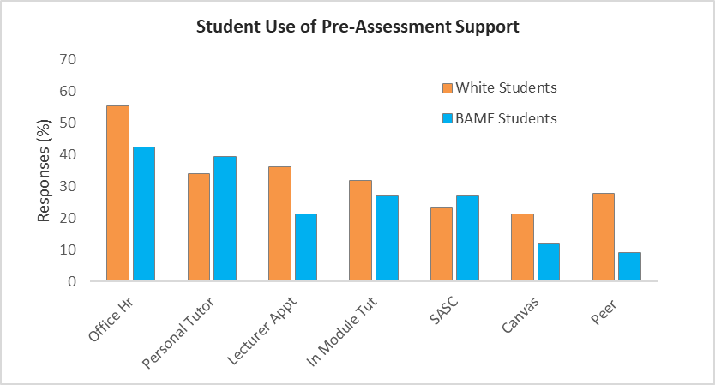
Results
Use of Support
Trends in the data suggest small differences between student groups (Use of office hours - 55% white students: 42% BAME students, Use of staff appointments - 36% white students: 22% BAME students).
Personal Tutors were a popular source of support for all students

Slide 9
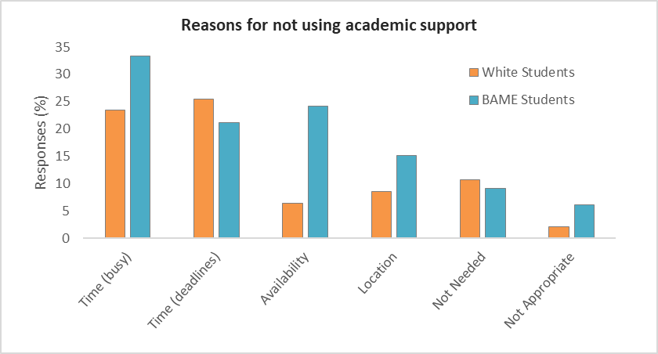
Results
Reasons for not accessing support
The most common responses for both groups were related to time constraints, defined by either being ‘too busy’ (23% white, 33% BAME) or working too close to deadlines (25% white, 21% BAME).
Availability and location were greater concerns for BAME students

Slide 10
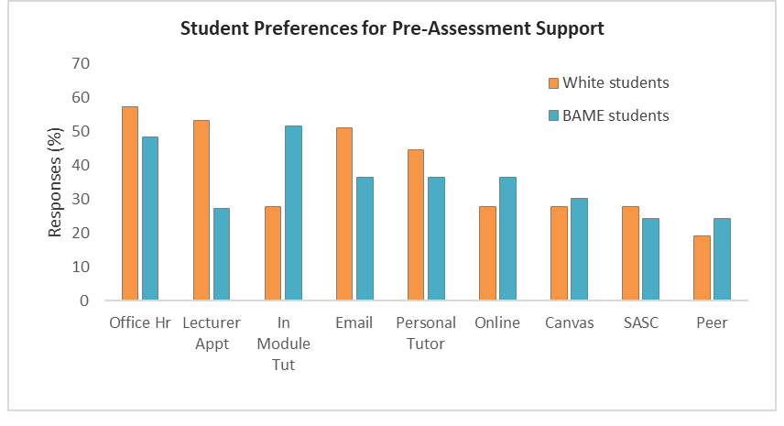
Results
Student Preferences
BAME students’ highest preference was in-module tutorials (52%) compared to white students preferring office hours or appointments (57% and 53% respectively).
*

Slide 11
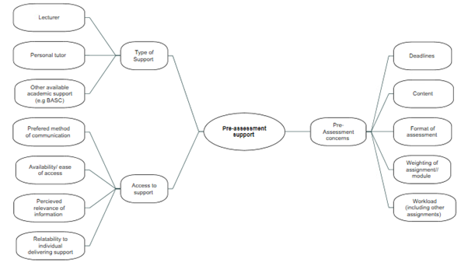
Results
Student Perceptions
*

Slide 12
Discussion
Students were aware of the availability of academic support but reported use of this was low.
Academic staff provided the majority of support, consistent with previous research (Walsh et al., 2009).
Although time constraints were reported as influencing factors by both student groups, availability and location were also indicated more commonly by the BAME students.
Preferences for support leaned towards group support in scheduled sessions for the BAME students and one-to-one support for the white students.
A third of all students reported online academic support as a preference, before this was widely available.
Notes:
Around 1/3 of the number reporting knowing about faculty support had used this compared to over ½ of those who knew about course specific support.
Personal tutors used as a source of academic support by 1/3 of both groups.

Slide 13
Discussion
Academic support should be based on the needs of the students with a focus on equality and inclusivity.
Subject-specific support is perceived to be more important by students than generic support, but students do not always have a good understanding of the support available or required.
Support should be accessible and flexible in order to reduce the barriers to access – online support could go some way to achieving this.
Further research is required to determine the scope of differences between diverse student populations.
  Ongoing projects in academic support and belonging

Slide 14
Conclusion
Efforts to provide academic support need to recognise that a ‘one size fits all’ approach is not appropriate and, far from providing equality, can disproportionately affect certain populations of student.
Collaborative strategies could ensure that academic support is appropriate and relevant to the needs of the students.
Remote working practices could enhance the accessibility of academic support for students but this needs to be carefully balanced with the external demands of both students and academic staff.
Lessons to be learned from adaptations to delivery during the COVID-19 pandemic?

Slide 15
References
AdvanceHE (2020) Equality + Higher Education: students statistical report 2020 [online]. Available at:
https://www.advance-he.ac.uk/knowledge-hub/equality-higher-education-statistical-report-2020
Equality Challenge Unit (2013) Equality in Higher Education: statistical report 2013 Part 2 Students [online]. Available at https://s3.eu-west-2.amazonaws.com/assets.creode.advancehe-document-manager/documents/ecu/equality-in-he-statistical-report-2013-students_1579016961.pdf
McKenna, C. (2017). Hearing student views through focus groups: creating spaces for dialogue. The Education Blog. LSE, online at http://blogs.lse.ac.uk/education/2017/05/09/hearing-student-views-through-focus-groups-creating-spaces-for-dialogue/
Sparkes, A. & Smith, B. (2014). Qualitative research methods in sport, exercise and health: From process to product. London: Routledge.
Stuart, M., Lido, C., and Morgan, J., (2011). Personal stories: how students’ social and cultural life histories interact with the field of higher education. International Journal of Lifelong Education. 30(4) pp. 489–508
The Open University (2013). Equality and Diversity Annual Report 2013 [online]. Available at: http://www.open.ac.uk/equality-diversity/sites/www.open.ac.uk.equality-diversity/files/files/ecms/web-content/Annual-Report-2013-Final.pdf
Walsh, C., Larsen, C., and Parry, D. (2009) Academic tutors at the frontline of student support in a cohort of students succeeding in higher education, Educational Studies, 35:4, 405-424

Slide 16
Any Questions?
Thank you for listening!
Acknowledgements:
Kingston University SADRAS Funding
Contact:
Email: nicola.swann@kingston.ac.uk
Twitter: @SwannNicky

