Slide 1
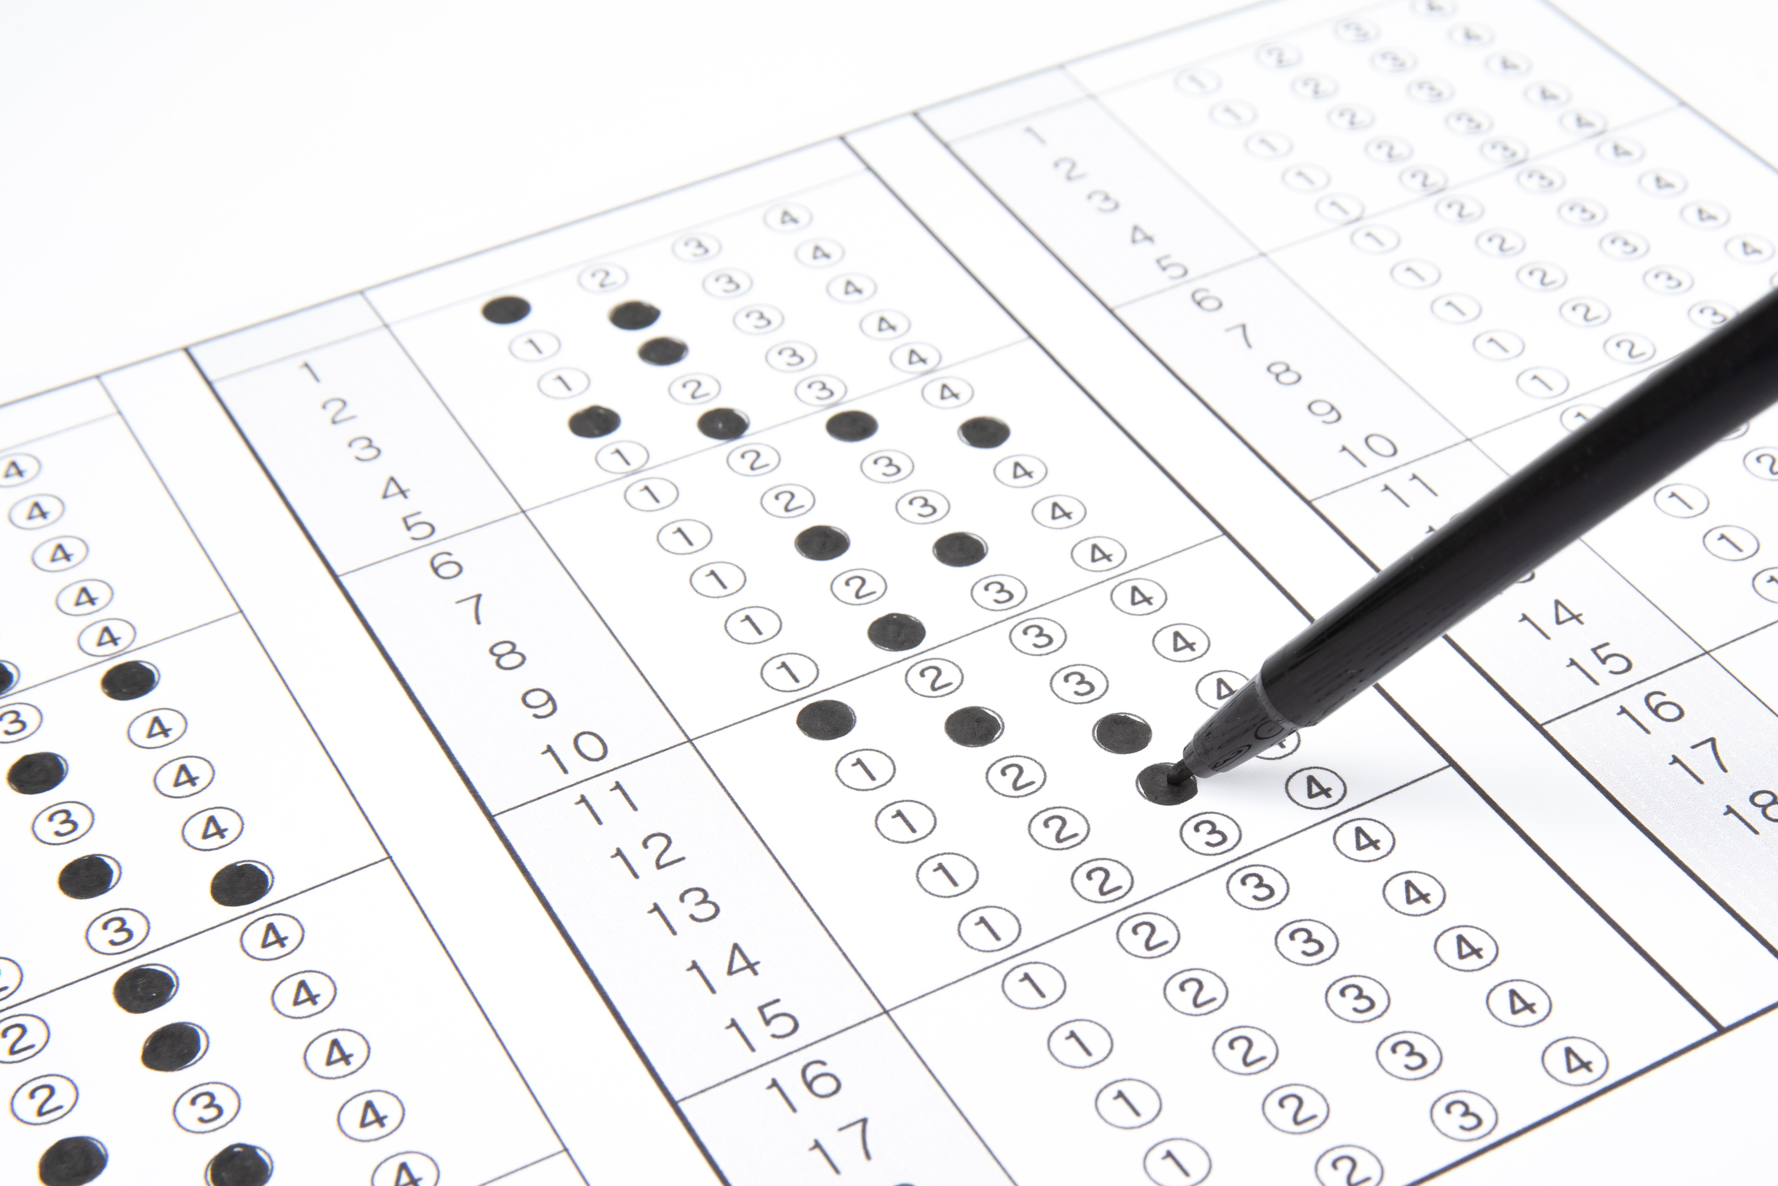

Intro Slide Title 1
Understanding student perceptions & engagement for formative assessment
A study of interactive online quizzes
Jonathan Nylk
Andy Diament

Slide 2
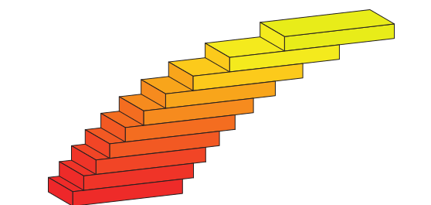





Formative activities are crucial for distance learning
Standing on top of a tower, a man launches a stone at time $t=0$ from a point $15.0$ m above ground level. At the instant of launch, the stone has a speed of $u=5.00$ m s⁻¹ and moves in a direction that makes an angle of ${30}^{∘}$ with the horizontal $x$-axis. At $t=2.00$ s, the stone is still above ground level.
What are the $x$- and $y$-components of the stone’s velocity at time $t=2.00$ s, and what is the stone’s speed at this time?
Enter numbers, correct to 2 significant figures, in the three empty boxes below:
Students engaging with formative activities are more likely to achieve success in summative assessments (Rust, O’Donovan, Price, 2005; Jordan & Butcher, 2010)
Tutor time is valuable but limited
Interactive online quizzes can act as a “tutor at the elbow”, providing immediate feedback (Ross, Jordan, Butcher, 2006)
Variation and randomisation allow reusability for more practice
However, engagement with optional activities can be low
$$u$$
$$v_{x}=$$
m s⁻¹
$${30}^{∘}$$
$$v_{y}=$$
m s⁻¹
$$v=$$
m s⁻¹
How should formative activities be incentivised?
STACK Online assessment

Slide 3
Stage 2 physics (S217) assessment strategy
Physics: from classical to quantum
6 TMAs (5 formative, 1 summative (25%))
1 Exam (summative, 75%)
Additional requirements:
30% threshold in exam
40% threshold in 5 formative TMAs
8 online quizzes (all formative)
1 quiz per TMA, plus a maths revision quiz and another quiz on final topics with no TMA
Quiz engagement is prompted by reflective question in each TMA
Gives a unique opportunity to investigate the effect of indirect, reflective incentivisation
The effect of formative and summative incentivisation can also be studied

Slide 4
Methodology
Quantitative
Qualitative
Learning analytics
Student survey
~1500 student records, 20J – 22J
Quiz engagement analytics
Quiz scores
No. of attempts
Access times
Module outcomes
TMA scores
Exam score
13% response rate of 225 invited (30 responses, 22J)
April 2023 (between TMA05 and 06)
Warmup questions – general enjoyment
Quiz completion and revisiting
Useful types of quiz questions
Reflecting on quizzes in TMAs
Reflecting on feedback in TMAs
What quiz use behaviours are markers for module success?
What motivates students to engage with the quizzes?

Slide 5
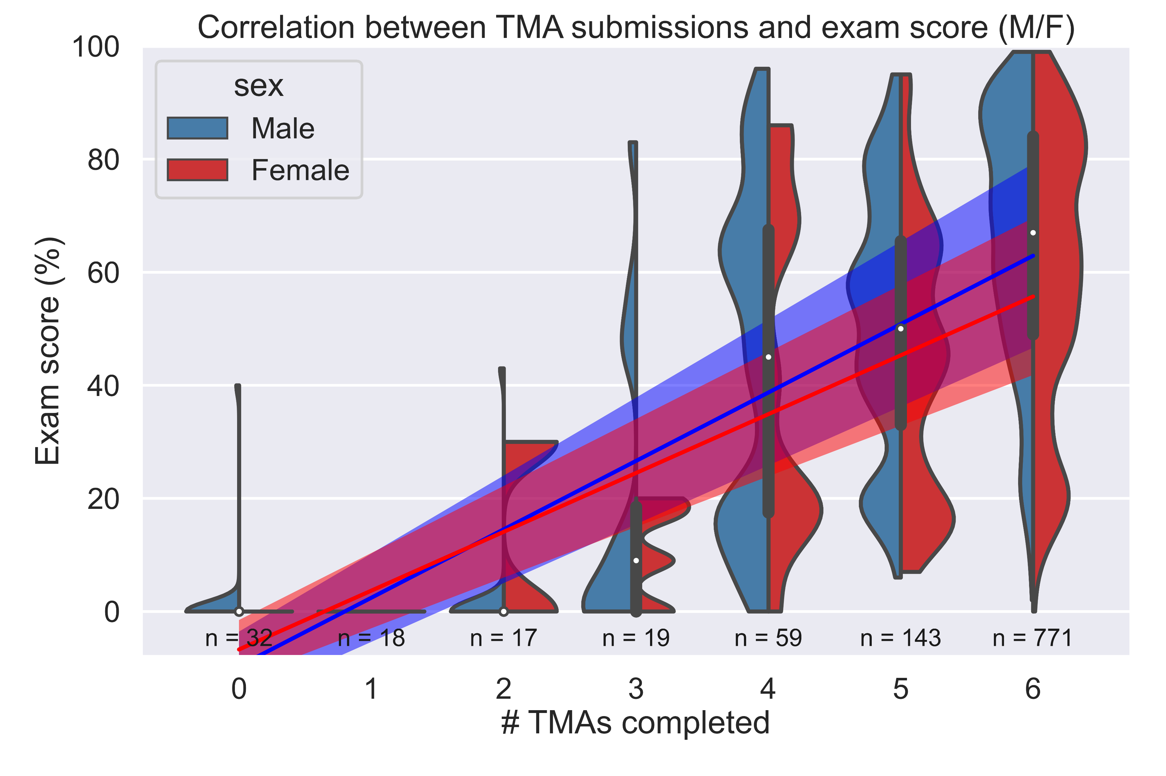
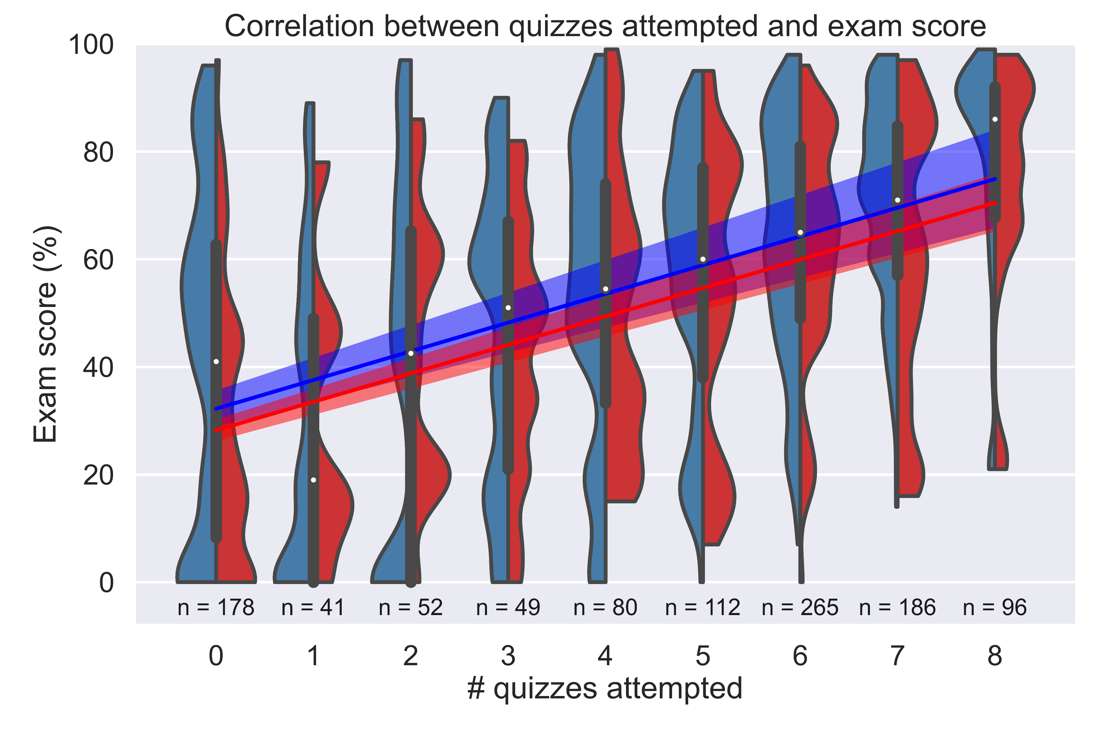
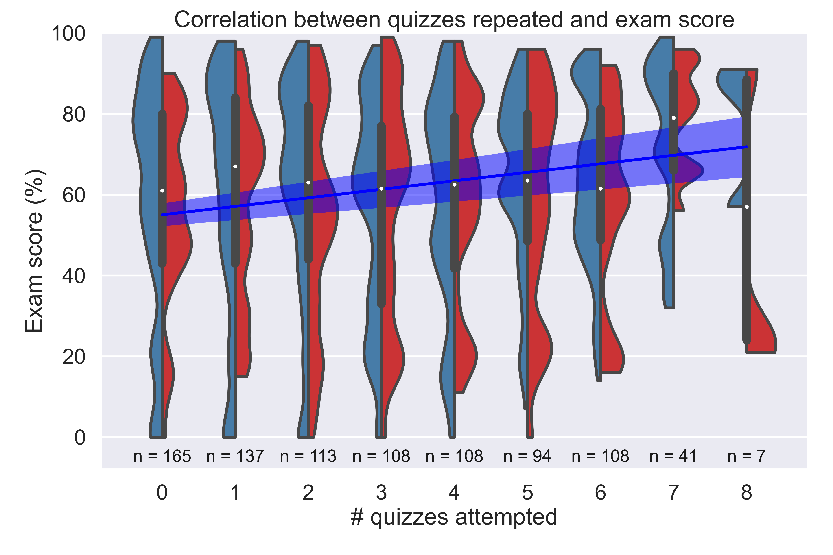
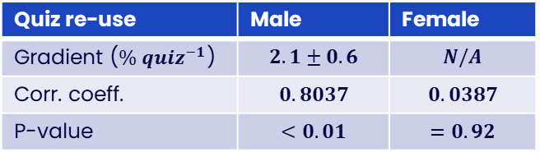
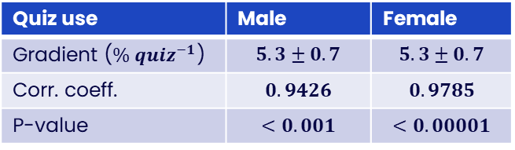
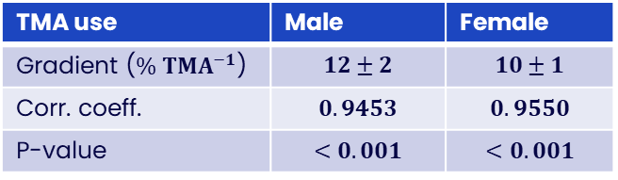
Outcomes are dependent on formative engagement
TMA use | Male | Female
Gradient ($\% TMA^{−1}$) | $$12±2$$ | $$10±1$$
Corr. coeff. | $$0.9453$$ | $$0.9550$$
P-value | $$<0.001$$ | $$<0.001$$
Quiz use | Male | Female
Gradient ($\% {quiz}^{−1}$) | $$5.3±0.7$$ | $$5.3±0.7$$
Corr. coeff. | $$0.9426$$ | $$0.9785$$
P-value | $$<0.001$$ | $$<0.00001$$
Quiz re-use | Male | Female
Gradient ($\% {quiz}^{−1}$) | $$2.1±0.6$$ | $$N/A$$
Corr. coeff. | $$0.8037$$ | $$0.0387$$
P-value | $$<0.01$$ | $$=0.92$$
TMA submissions: indicator for module completion
Quiz engagement: indicator for module success
Quiz re-use shows a strong gender dependence

Slide 6
Prior work on quiz incentivisation
(Agnew, Kerr, Watt, 2021)
Online quizzes in 1st year economics
Findings
Quizzes are short-term assignments (2 days)
Module credit is a strong incentive
1st half of semester: 5 Quizzes each worth 1% module credit
2nd half of semester: Students could choose to:
Receive 1% credit for each of 5 quizzes OR
Receive 5% credit whether they did the quizzes or not
99% of cohort engaged with quizzes when offered 1% credit per quiz
Only 49% of cohort engaged when the credit incentive was removed
Engagement metrics show stronger engagement when credit is offered
Attempted earlier
More repeats
Higher marks

Slide 7
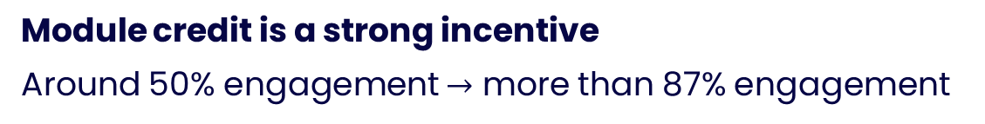
Prior work on quiz incentivisation
(Kibble, 2007)
Online quizzes in medical physiology
Quizzes are short-term assignments (1 week)
4 quizzes over semester
5 assessment models trialled over multiple presentations
Model # | Credit per quiz (%) | Criteria for earning credit | Cohort participation (%)
1 | 0 | - | 52
2 | 0.5 | Login only | 87
3 | 1.0 | Threshold (30%) | 92
4 | 1.0 | Quiz score, best of 2 attempts | 97
5 | 2.0 | Quiz score, best of 2 attempts | 98
Module credit is a strong incentive
Around 50% engagement $→$ more than 87% engagement

Slide 8
Comparison between incentivisation schemes
Engagement
Incentive | Cohort engagement | Reference
No incentive | 52% | Kibble, 2007
No incentive | 49% | Agnew, Kerr, Watt, 2021
1% module grade per quiz | 92-97% | Kibble, 2007
1% module grade per quiz | 99% | Agnew, Kerr, Watt, 2021
Reflective item in TMA | 81% | Nylk, Diament, 2023
Indirect incentivisation through reflection is very effective for engagement, especially considering that it carries no (or very little) module credit

Slide 9
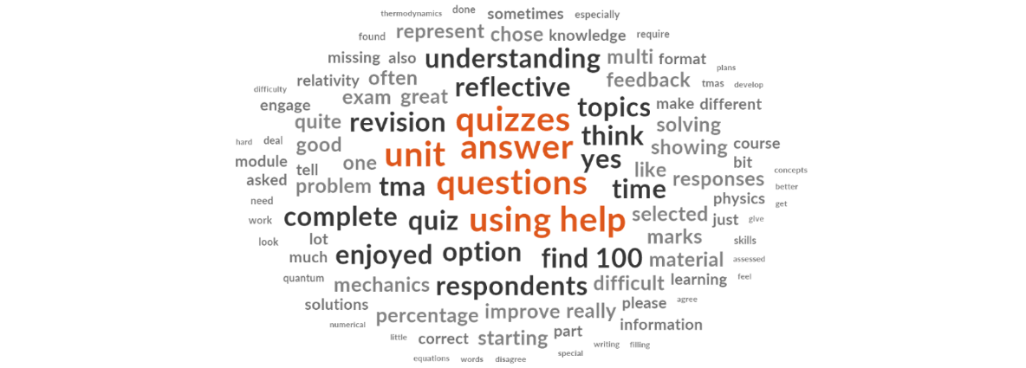
Chapter Title 1
Survey results

Slide 10
Page Title 2
Survey Details
Open between 6th April 2023 and 27th April in 22 J presentation
Between TMA05 and TMA06
Multiple choices, Likert scales, free responses
30 replies – 13% of cohort invited to participate (225) and 9% of registered students (350)
Warmup – general enjoyment
Quiz completion and revisiting
Useful quiz questions
Reflecting on quizzes in TMAs
Reflecting on feedback in TMAs
Notes:
Warm ups indicated students enjoy the module a great deal and favourite topic is quantum physics, least fave is gases/thermodynamic
Though surveyed students appear to score better, difference is not significant, z= 0.24 for both measures, p(survey mean > population mean) = 0.41

Slide 11
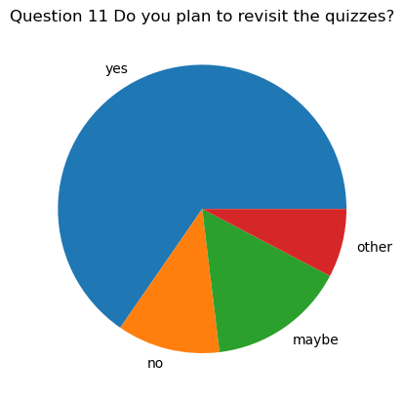
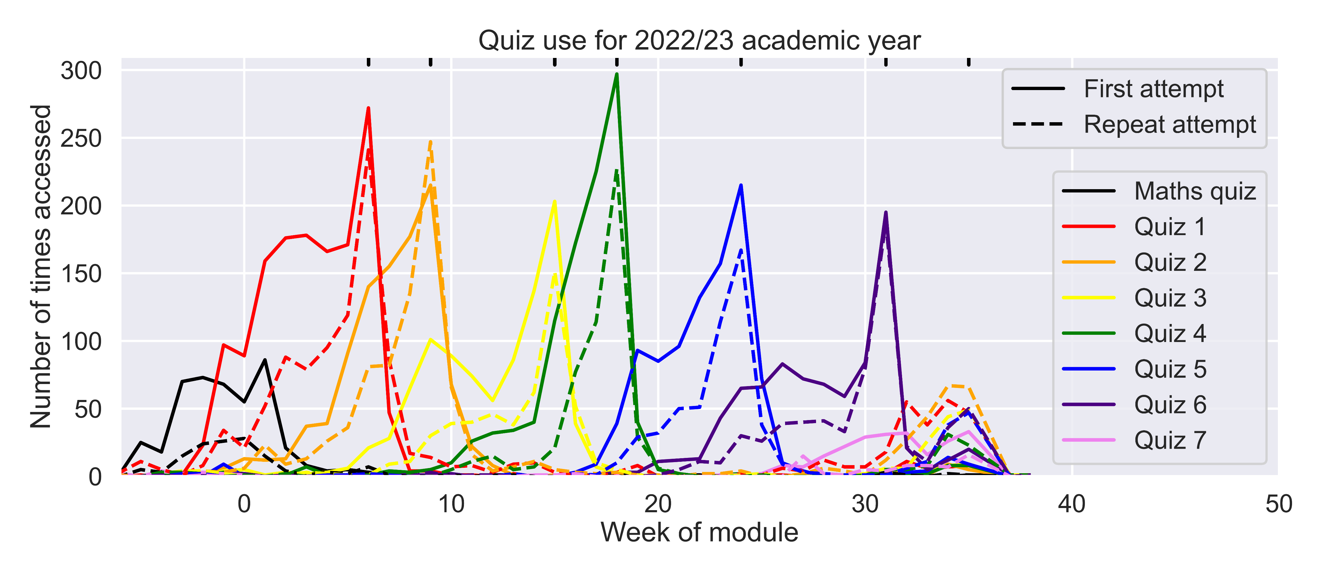
Revisiting Quizzes
Most students intended to revisit the quizzes
A lot of revisiting occurred within the module: students returned to individual questions over multi-week span of quiz
Revision was given as the main reason for revisiting
In reality, significant use in revision period, around 15% of attempts compared to previous use

Slide 12
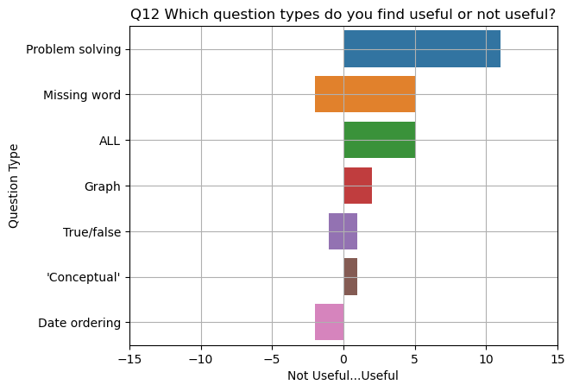
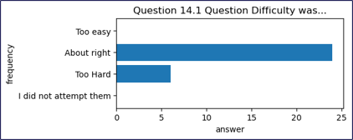
Pie Chart 5
Questions – types and difficulty
Question types
Date Ordering is putting discoveries in time order
Anecdotally, students more likely to mention True/False as useful in TMA feedback
Difficulty
About right or on the hard side
Not considered easy or trivial

Slide 13
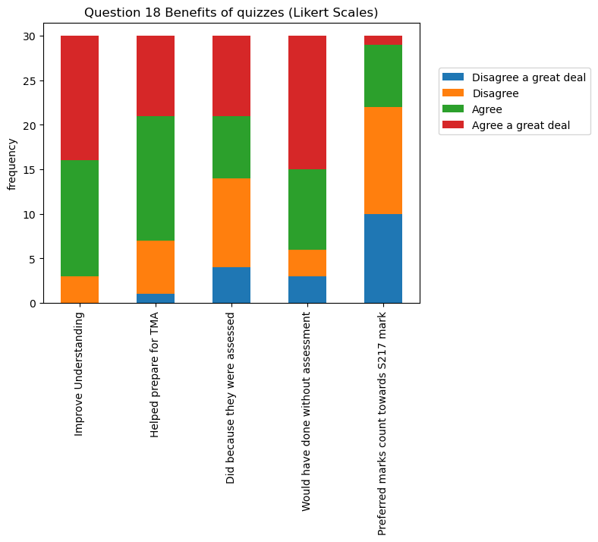
Benefits of quizzes
Agreement ranked
Strongest agreement
Quizzes improve understanding
Would have done quizzes even if no marks given in TMAs
Quizzes help TMA preparation
Did quizzes just because they were assessed (50% agree, 50% disagree)
Weakest agreement
Should be part of TMA final mark

Slide 14
Reflective TMA Questions
First question in each TMA for prominence
2 marks for evidence of doing the relevant quiz
4 marks for reflection on the quiz
4 marks for reflection of TMA feedback (TMA02 onwards)
Counts towards OES in TMA04 – ‘straightforward’ marks
Some found them useful ​
They help me reassure myself and reflect on skills I gain.​
I suspect their value will come later when I have to list what I know and or skills I've developed doing tis (sic) module.​
helped me to understand how the quizzes improved my skills.​
Some found them less useful.​
I find reflective questions totally useless and a complete waste of time.​
For me it doesn't help my skills/knowledge​
Personally, they did very little to improve my skills. I only answered them to get the grade.

Slide 15
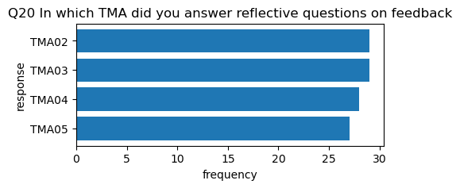
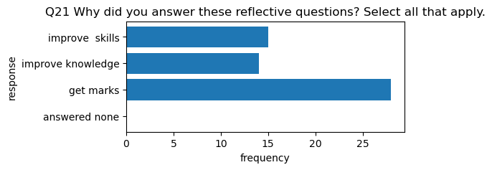
Reflecting on TMA feedback
Mixed answers
“Mainly improving my mathematics, layouts of answers and other small details. I don't think it improved my knowledge of physics as a subject though”
“I picked up marks the next time round thanks to the reflection”
“My answer to Q1c was often a lie to get the marks”
“forced me to properly engage with the feedback on my TMAs and also reminded me to apply it in the TMA I was actually working on”

Slide 16
Survey takeaways
Quizzes are widely used by students
Quizzes are useful for improving understanding and TMA preparation
Quizzes can be time consuming and difficult to interpret what is required
Students do not want (these) quizzes to contribute to overall mark
Many students see value in reflecting on tutor feedback – directs them to apply feedback in TMA they are working on
BUT
Some students see no value in reflection and give reflect 'flippantly' to get marks

Slide 17
Conclusions
Strong relationships between quiz use, TMA submissions and exam performance
TMAs are an indicator of passing the module
Quiz use is an indicator of how good a pass
Quizzes are useful for improving understanding and TMA preparation
Students do not want (these) quizzes to contribute to overall mark
Many students see value in reflecting on tutor feedback – directs them to apply feedback in TMA they are working on

Slide 18
An update
Stage 2 physics (S217) assessment strategy
Physics: from classical to quantum
6 TMAs (5 formative, 1 summative (25%))
1 Exam (summative, 75%)
Additional requirements:
30% threshold in exam
40% threshold in 5 formative TMAs
New for 24J: Move to single-component assessment
6 TMAs (5 summative (5 x 5% = 25%), 1 summative (15%))
1 Exam (summative, 60%)
Additional requirements:
30% threshold in exam
8 online quizzes (all formative)
1 quiz per TMA, plus a maths revision quiz and another quiz on final topics with no TMA
Quiz engagement is prompted by reflective question in each TMA

Slide 19
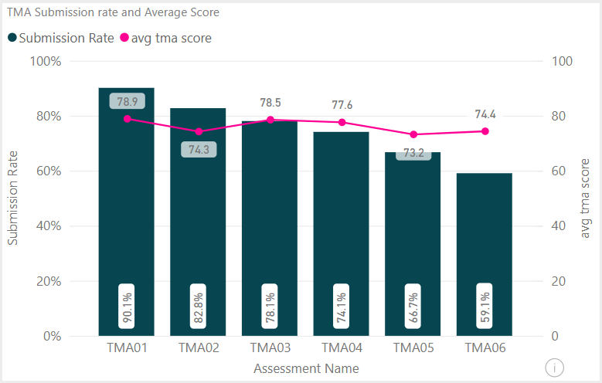
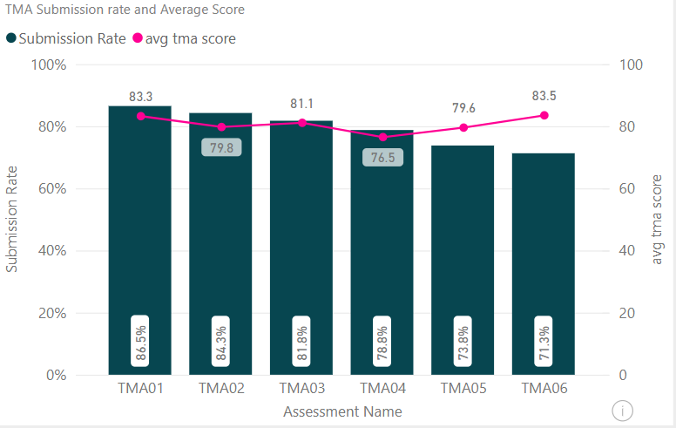
New assessment strategy for 24J
TMA submission rate
23J
24J

Slide 20
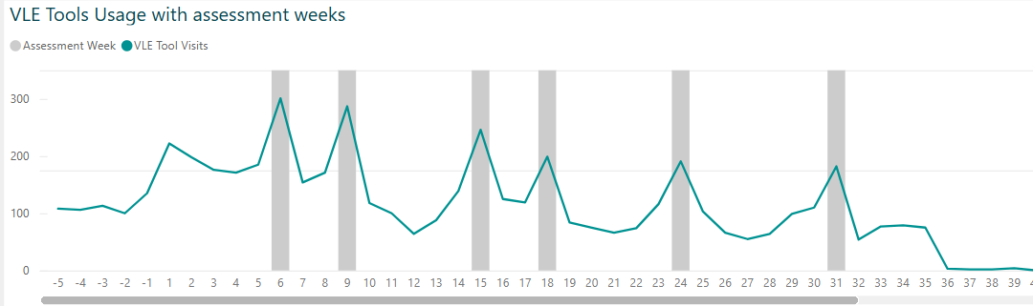
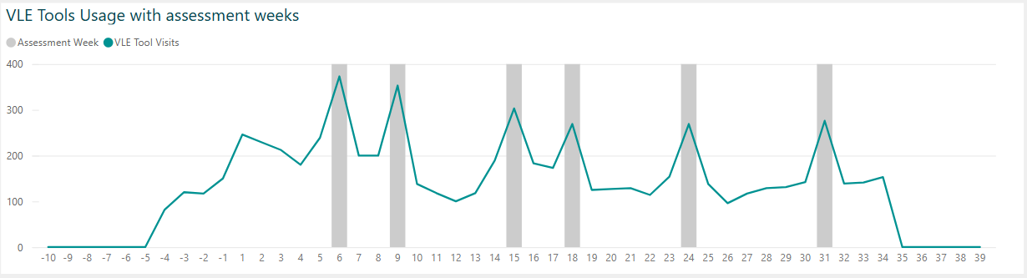
New assessment strategy for 24J
Quiz usage
Quiz 1: Formative
Quiz 4: Summative (25%)
23J
75%
50%
Quiz 1: Summative (5%)
Quiz 4: Summative (15%)
24J
75%
24J
23J
50%

Slide 21
Informing S227 Core Physics
Replacing S217 in 25J
Retaining, repurposing, expanding quizzes
Quizzes will be formative
More quizzes, more specialism – better for selecting questions to reinforce topics
Reflective questions on quiz use – earn TMA marks
Broader reflective questions - maths, use of Python, Are You Ready for S227?
Assessment – 5 x TMAs @10% Each + Exam @50% - closer to S217 2024J Strategy

Slide 22
References
Agnew, S., Kerr, J. & Watt, R. (2021), ‘The effect on student behaviour and achievement of removing incentives to complete online formative assessments’, Australasian Journal of Educational Technology, 37(4), pp. 173–185.
Jordan, S. & Butcher, P.G. (2010), ‘Using e-assessment to support distance learners of science’, in The GIREP-EPEC & PHEC 2009 International Conference, 17-21 Aug 2009, Leicester, UK.
Kibble, J. (2007), ‘Use of unsupervised online quizzes as formative assessment in a medical physiology course: effects of incentives on student participation and performance’, Advances in Physiology Education 31(3), pp. 253–260.
Ross, S., Jordan, S. & Butcher, P. (2006), ‘Online instantaneous and targeted feedback for remote learners’, Innovative assessment in Higher Education, pp. 123–131.
Rust, C., O’Donovan, B. & Price, M. (2005), ‘A social constructivist assessment process model: how the research literature shows us this could be best practice’, Assessment & Evaluation in Higher Education, 30(3), pp. 231–240.

Slide 23
Slide Title 30
Thank you

Slide 24
Slide Title 31

Slide 25
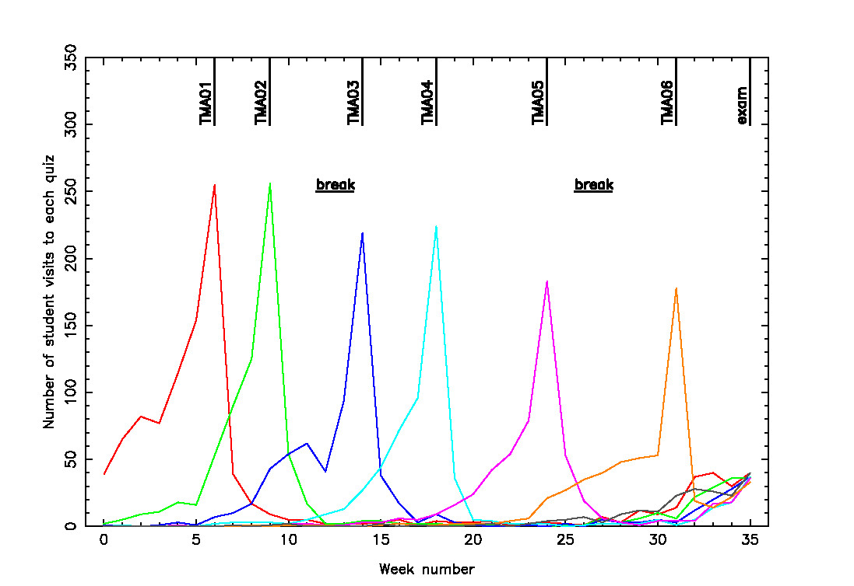
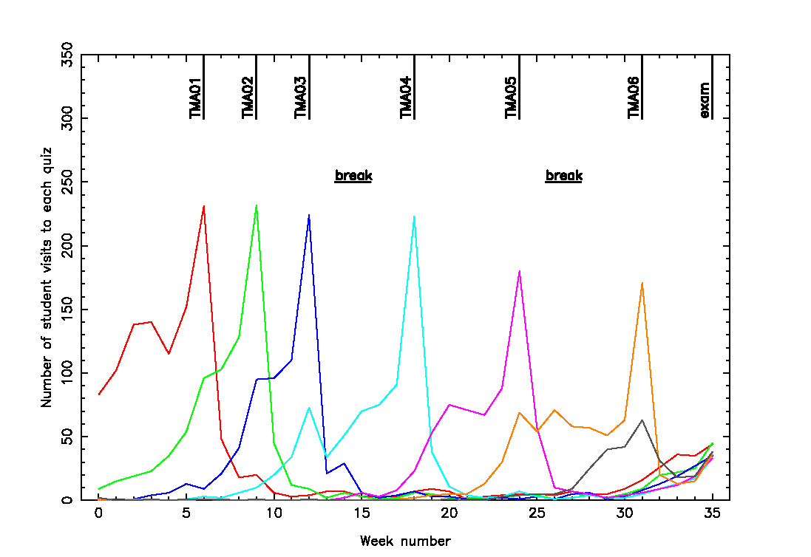
Prior work on S217 quizzes - Norton, 2016
Assessment analytics of student engagement with, and performance on, S217 online quizzes
15J
16J
Increasing visibility/signposting of quizzes in module materials and TMAs improved early engagement

Slide 26
81% of students attempt at least 1 quiz.
57% of students repeat at least 1 quiz.
68% of quiz attempts are repeat attempts.
When do students attempt quizzes?
Students still largely attempt quizzes when prompted by TMA deadlines

Slide 27
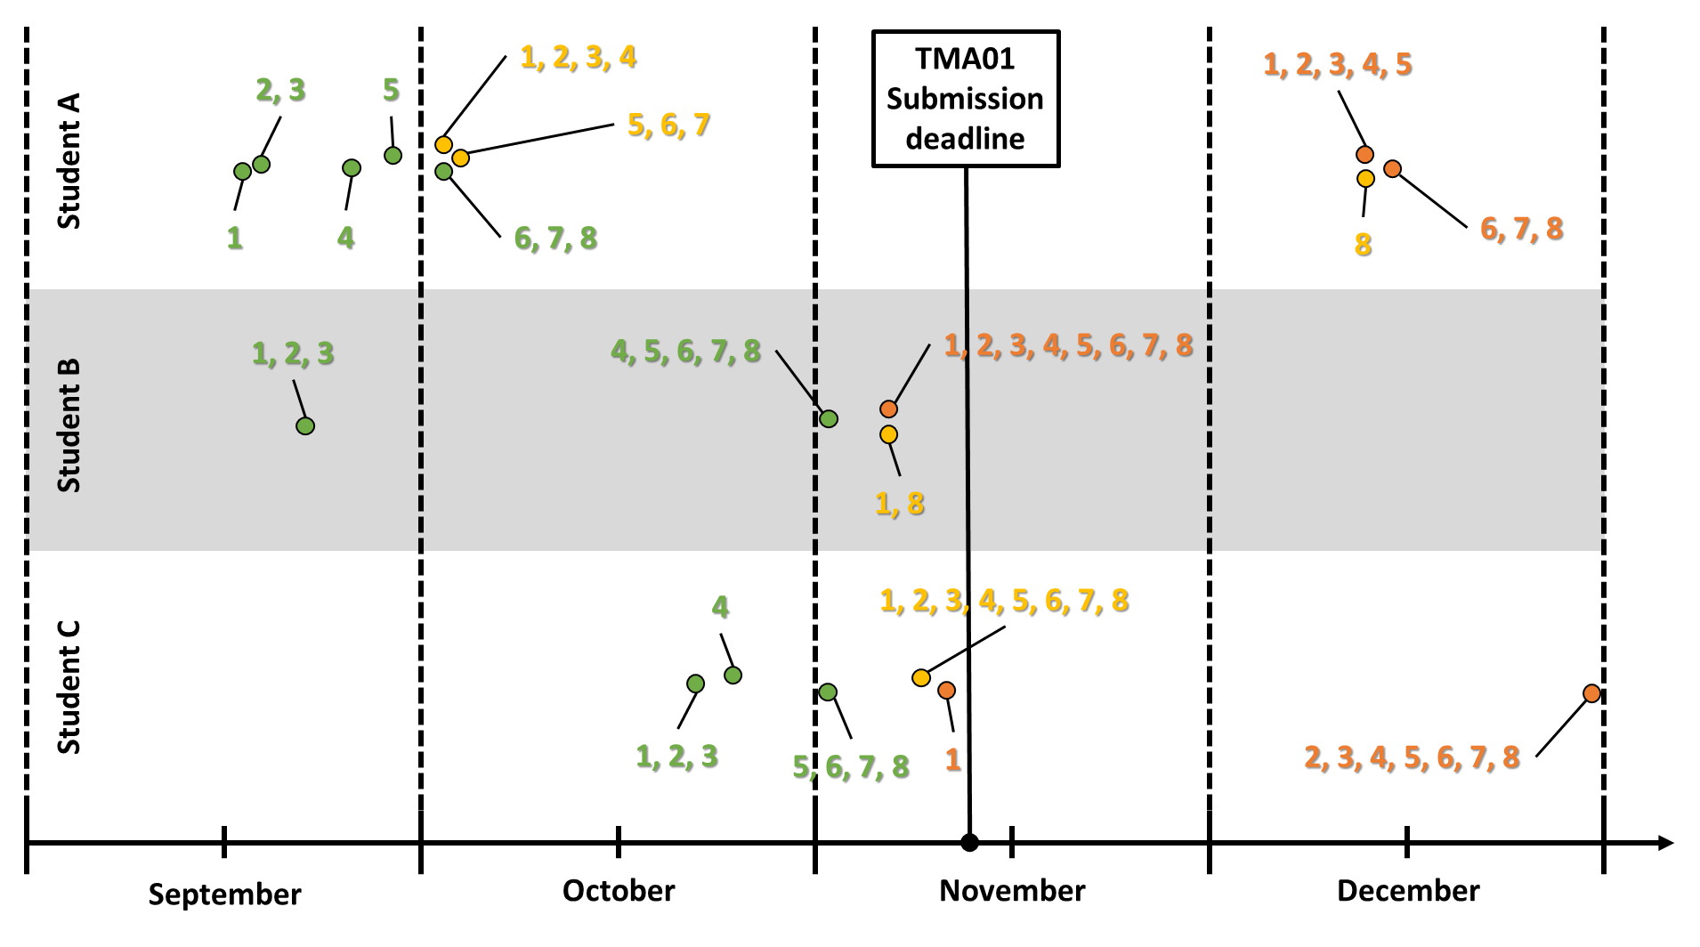
Student use behaviours are complex
Quiz 1
1st attempt
2nd attempt
3rd attempt

Slide 28
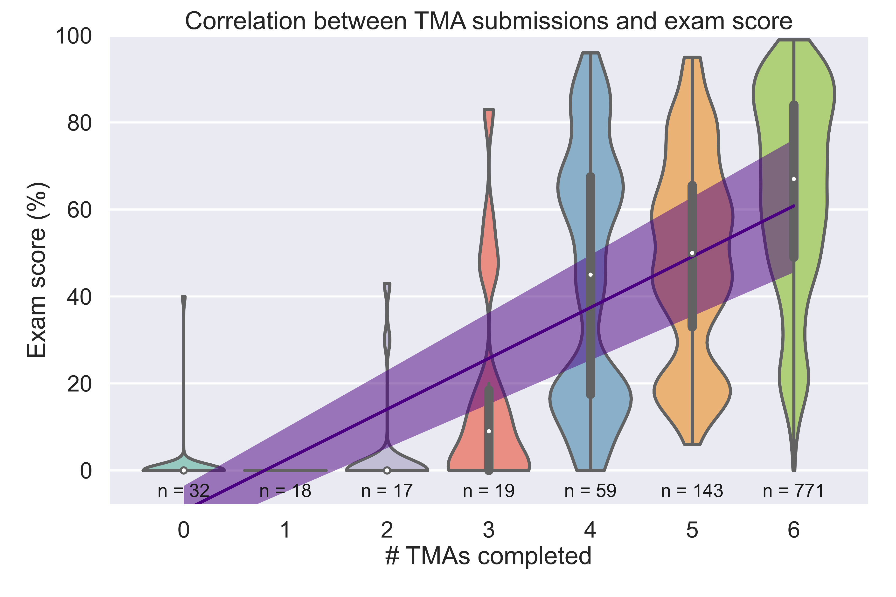
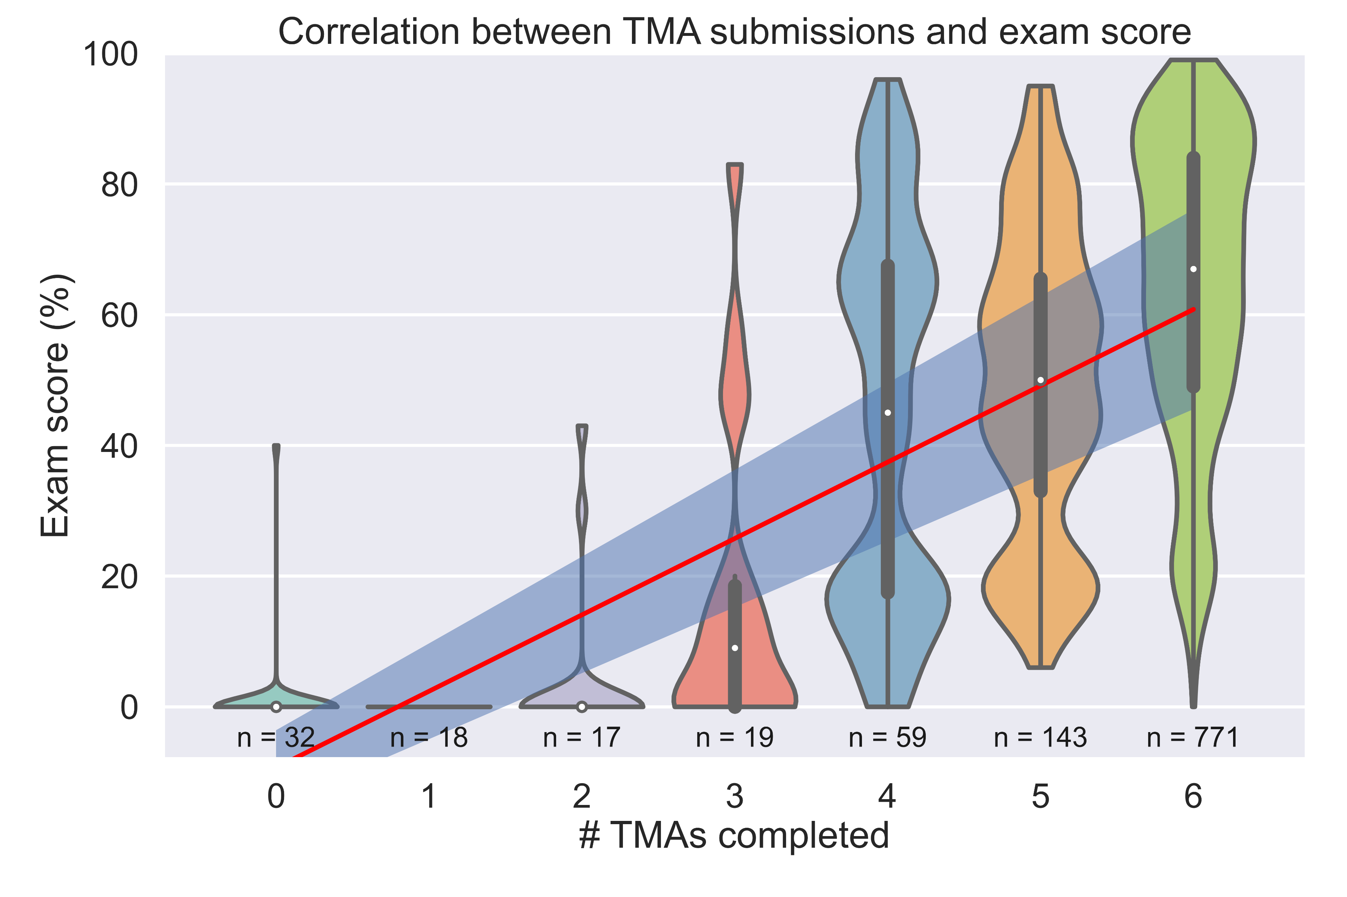
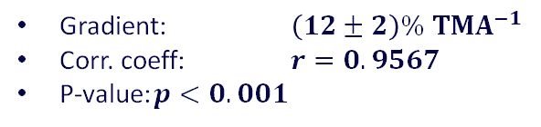
TMA submission is strongly linked with module success
Gradient: $\left(12±2\right)\% TMA^{−1}$
Corr. coeff: $r=0.9567$
P-value: $p<0.001$
Exam score has a strong dependency on number of TMA submissions
Possibly an artefact of TMA threshold requirement?
Some tutors suggested ‘strategically’ dropping the final TMA if a student was struggling

Slide 29
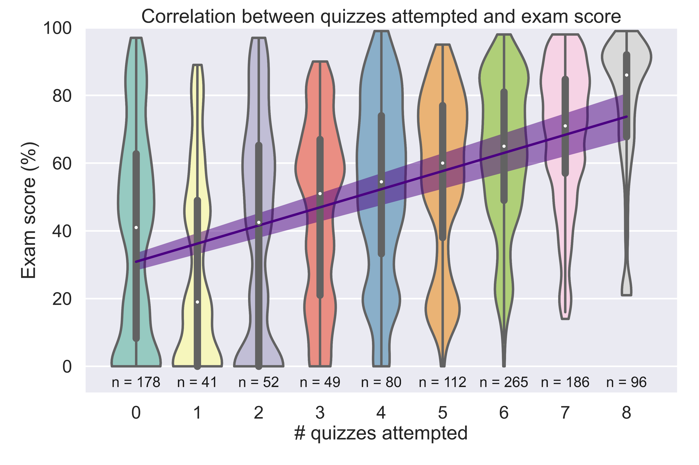
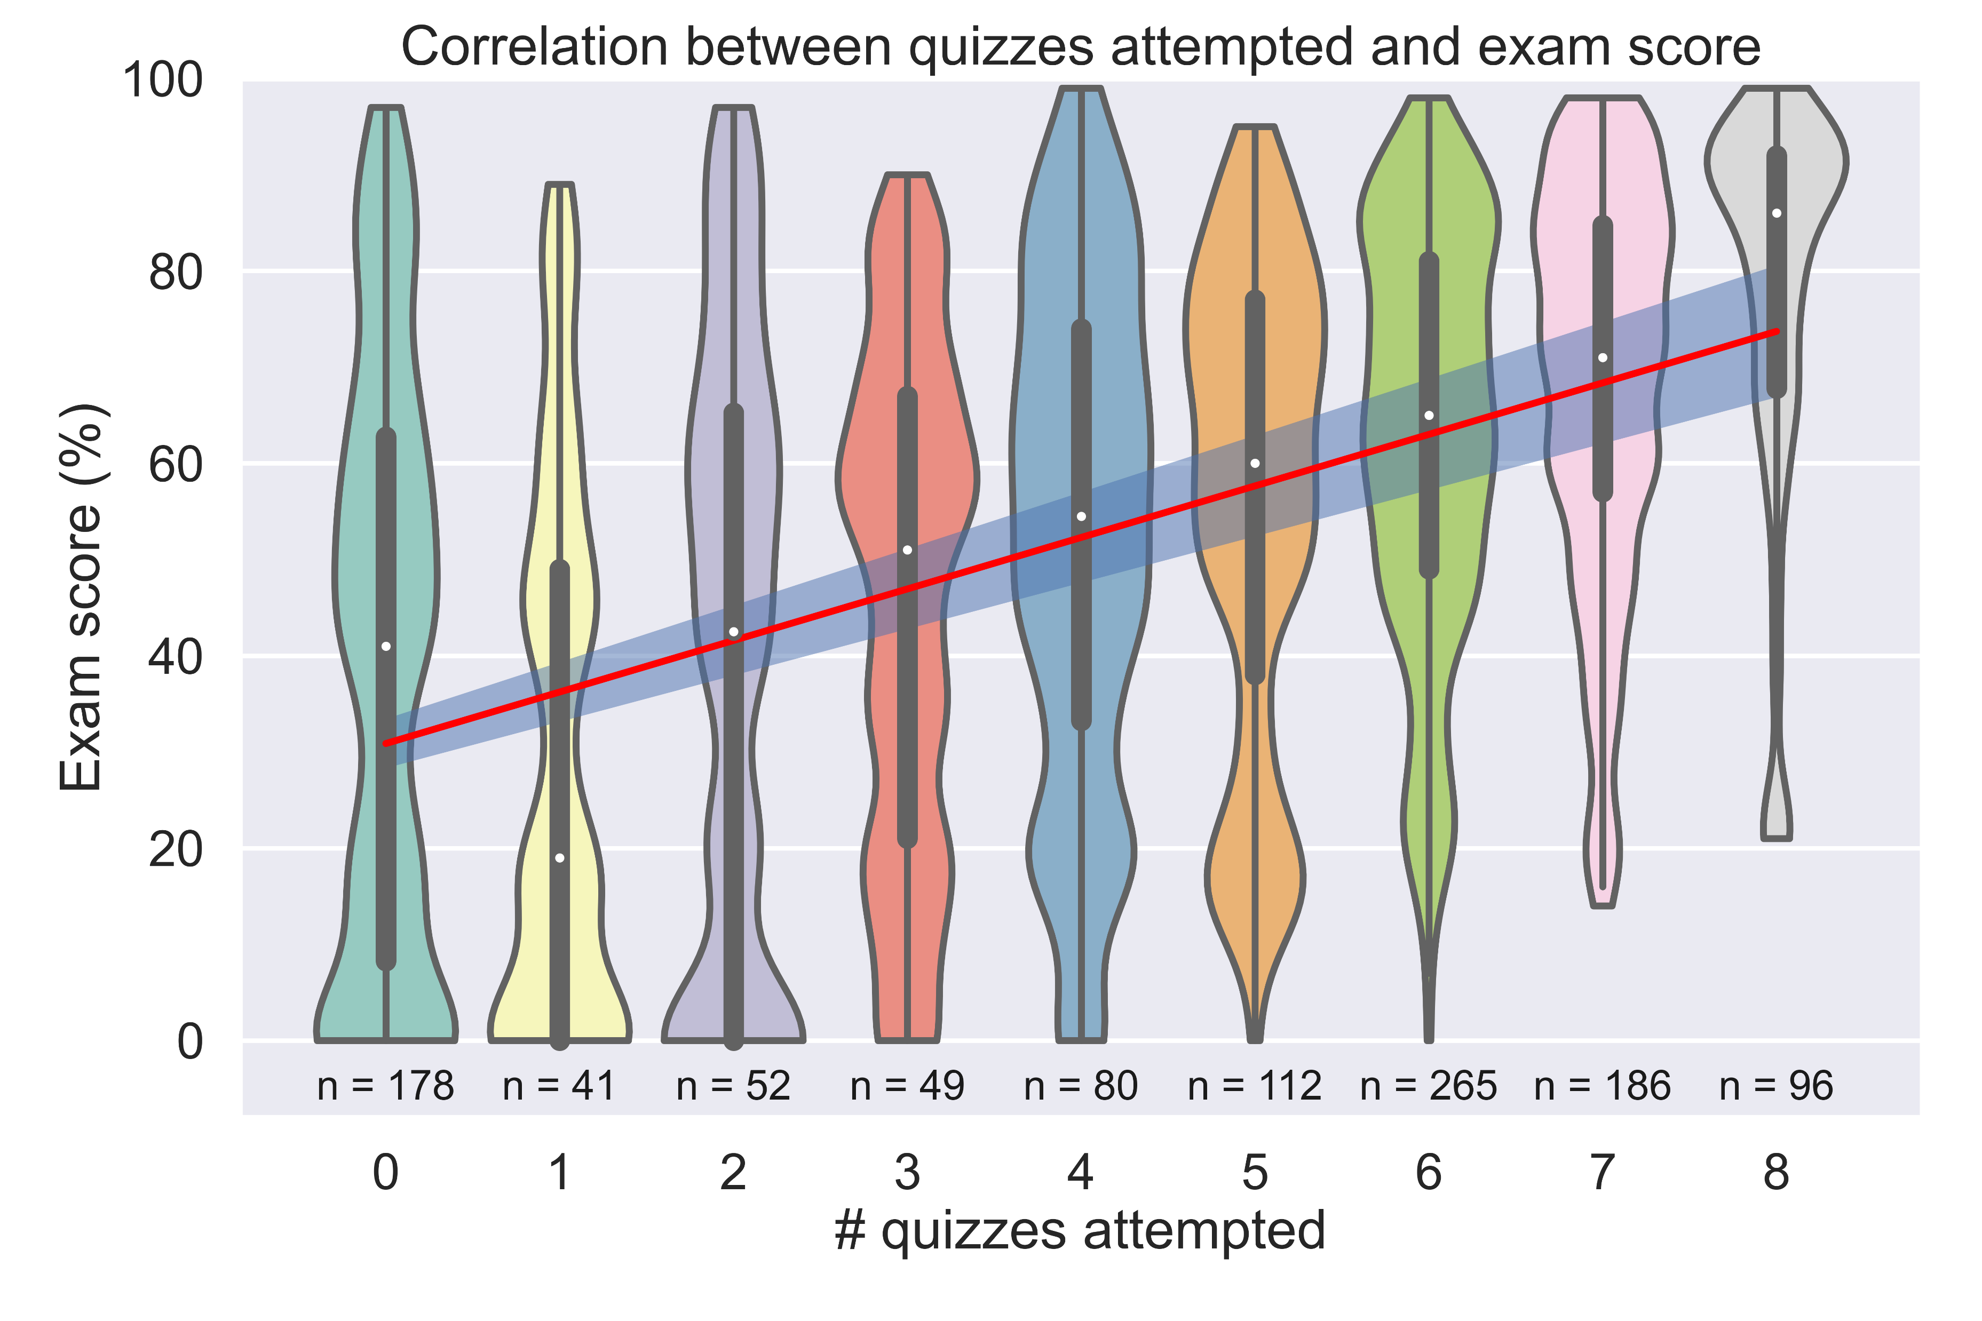
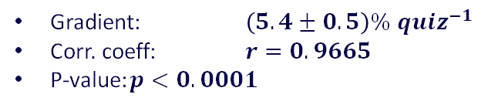
Quiz use is strongly linked with module success
Gradient: $\left(5.4±0.5\right)\% {quiz}^{−1}$
Corr. coeff: $r=0.9665$
P-value: $p<0.0001$
Most students engage with 6 quizzes (linked with TMAs)
No quiz engagement is also a large group
The difference between fully engaging with the quizzes and not, is the difference between achieving a distinction and barely scraping a pass in the exam

Slide 30
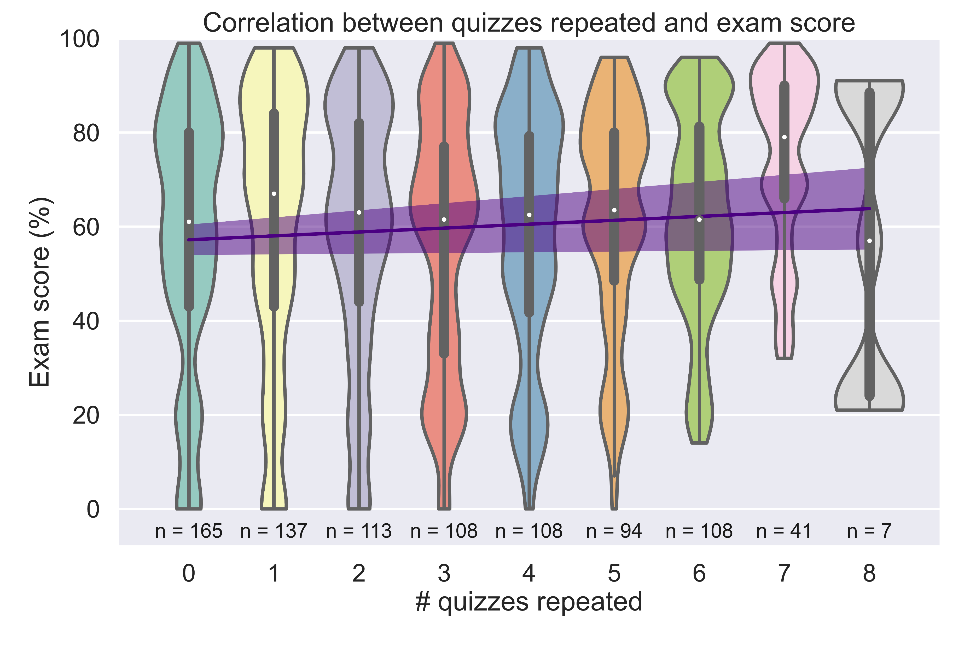
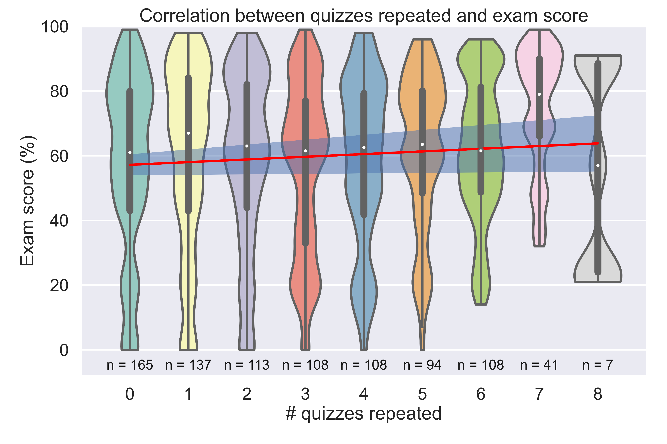
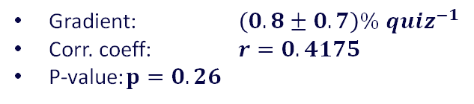
Quiz reuse is not linked with module success
Gradient: $\left(0.8±0.7\right)\% {quiz}^{−1}$
Corr. coeff: $r=0.4175$
P-value: $p=0.26$
Students are fairly evenly distributed between repeating 0 – 6 quizzes
Quiz reuse shows no apparent trend
Or does it?

Slide 31
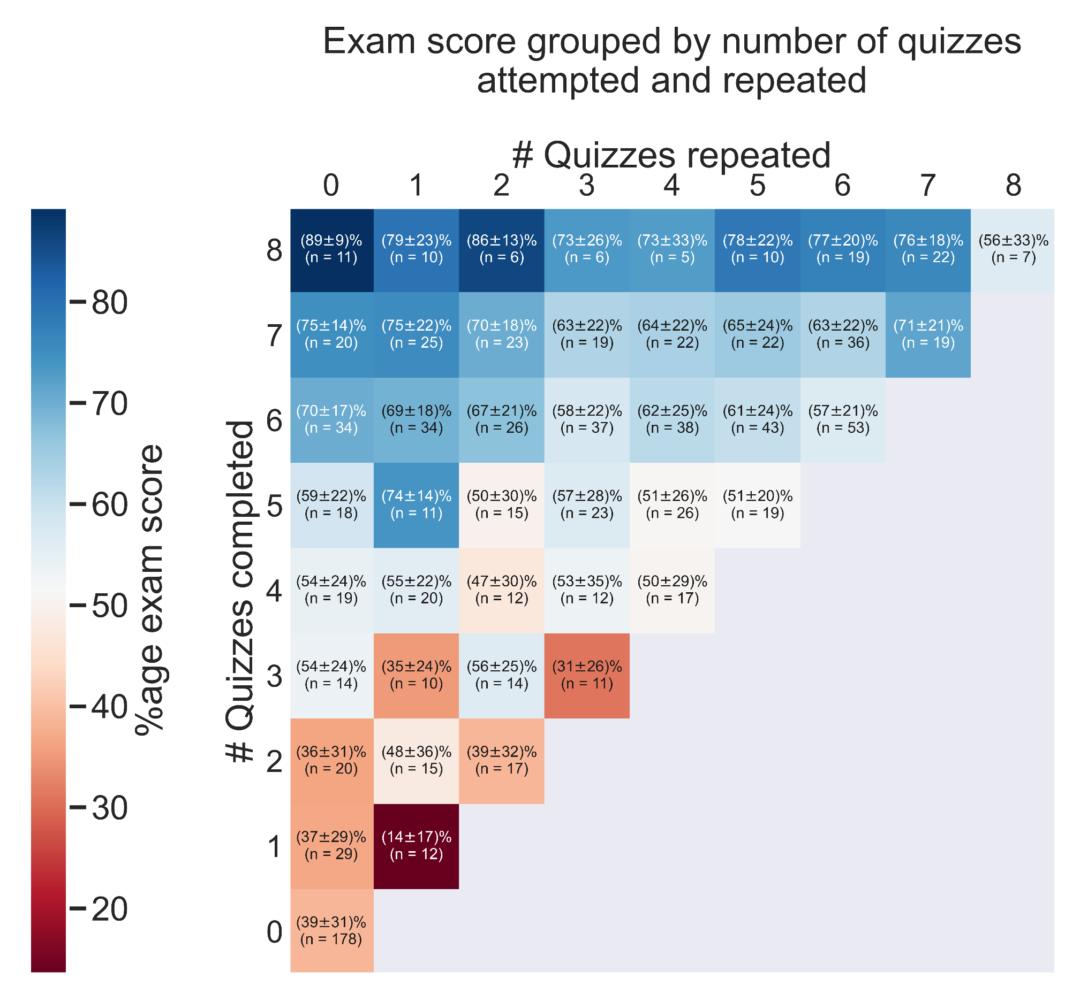
Intersectional analysis of use and reuse

Slide 32
Word cloud – all text in survey

Slide 33
Characterising the survey cohort
n=30 | TMA01 score | TMA02 score | TMA03 score | TMA04 score | TMA05 score | TMA06 score | All TMAs | Exam score
Mean | 80.2 | 81.7 | 85.1 | 84.2 | 81.2 | 82.6 | 80.4 | 66.7
σ | 20.9 | 18.7 | 13.3 | 19.2 | 15.5 | 17.0 | 19.3 | 23.1
min | 0 | 20 | 42 | 0 | 35 | 25 | 0 | 19
max | 98 | 100 | 98 | 100 | 99 | 100 | 100 | 99
For overall cohort
Mean TMA score = 75 .3 ± 21.3
Mean Exam score = 60.1 ± 27.4

Slide 34
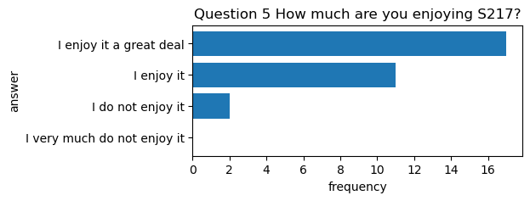
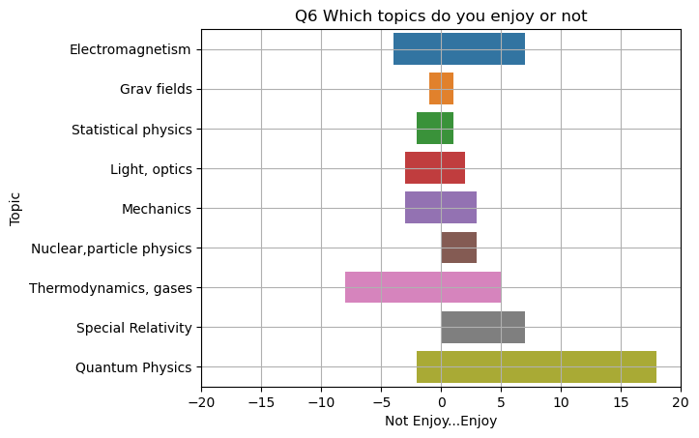
Pie Chart 1
Warm up Questions
Nearly all students were enjoying the module
Some subjects are preferred more than others
Quantum physics most popular
Thermodynamics/gases least popular

Slide 35
81% of students attempt at least 1 quiz.
57% of students repeat at least 1 quiz.
68% of quiz attempts are repeat attempts.
When do students attempt quizzes?
Students still largely attempt quizzes when prompted by TMA deadlines

Slide 36
Other feedback from free-form answers
Quizzes were often viewed as time consuming
Format is dated (Conversion to Moodle Stack format in progress)
Worked examples were very useful, but hard to go back to a worked example once left
Opposition to these quizzes in OES
Variants (3 versions of each question were welcome for repeated practice)

Slide 37
Reflection on quizzes
Some found them useful
They help me reassure myself and reflect on skills I gain.
I suspect their value will come later when I have to list what I know and or skills i've developed doing tis (sic) module.
helped me to understand how the quizzes improved my skills.
Some found them less useful.
I find reflective questions totally useless and a complete waste of time.
For me it doesn't help my skills/knowledge
Personally, they did very little to improve my skills. I only answered them to get the grade.
Notes:
Other feedback
Quizzes were often viewed as time consuming
Format is dated (Conversion to Moodle Stack format in progress)
Worked examples were very useful, but hard to go back to a worked example once left
Opposition to these quizzes in OES
Variants (3 versions of each question were welcome for repeated practice)

