Slide 1

Pair marking: Working together
Nigel Gibson
Computing & Communication

Slide 2
I’m going to tell you a story…
How we work/The idea
The origins of the work and how we came up with the idea for the project
The project
What we did
The findings
Something of what we’ve learned
x

Slide 3
Page Title 4
Context
You need to know this to make some sense of what I’m going to cover
Where I refer to “we” I mean Kate Sim and I
I’m going to describe a way of working that we adopted more than a dozen years ago
We carried out the eSTEeM project together
x

Slide 4
Page Title 4
Our practice
Once upon a time, there was TU100 (2011 – 2017)
Very detailed tutor notes and a very, very busy Tech Help forum to run (we were co-moderators on the student-facing forums)
How to survive?
What we did:
  Reduced the tutor notes to a marking document
  Shared this in a Dropbox folder
  Added our own comments as we marked
  Used each other’s comments
  Carried comments forward between presentations
The result:
  Saved us time
  We learnt from each other
We are now working on TM111 (2017 – now)

Slide 5
Page Title 4
Let’s think about marking
Or the feedback element at least
Feedback is where tutors offer 1-2-1 teaching to students
  It’s the only place that this happens
  It’s individual
Script feedback can fall into one of three categories:
  Standard – Comments for issues that arise on TMAs regardless of the question; “Do not include the question”.
  Question specific – These comments relate to a particular variant of a question and might be used on a number of scripts.
  One-offs – comments which are specific to this student.
We share comments that fall into the first two categories, comments in the third category have no possibility of reuse

Slide 6
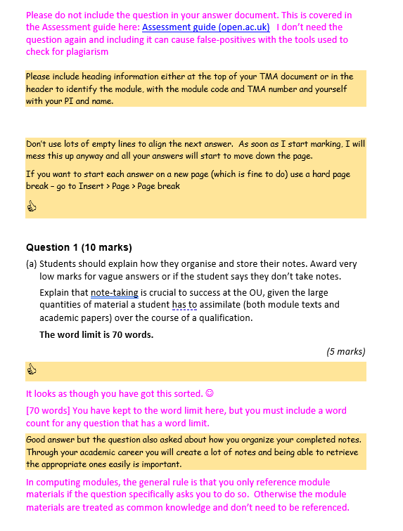
Page Title 4
Our practice
We retain our formatting
What it looks like
This is an active document – we add to it as we work
Before we start marking one of us will take the current marking guide and copy over comments from previous MGs
We include PT3 comments and a framework
I use a thumbs-up rather than a tick (Kate uses a smiley face)

Slide 7
Page Title 4
The idea
Would this work for others?
Reports from ALs about marking taking too long
  This might be because the marking guide isn’t well written! (I write one of the marking guides…)
  Poor training for new tutors?
Possible uses in
  Mentoring
  Supporting colleagues

Slide 8
Page Title 4
The project – at the start
What we did and got others to do
Recruited and briefed participants
No new tutors but a range of experience
  Five had 0 – 5 years
  Two had 11 – 20 years
  Five had + 20 years
Eleven of twelve reused comments between scripts, none had shared comments with peers
Shotgun marriages: we organised the pairs
Initial questionnaires before they started
Set up shared areas and populated them
  A cut down copy of the tutor notes for each TMA
  Added a few selected rollover comments

Slide 9
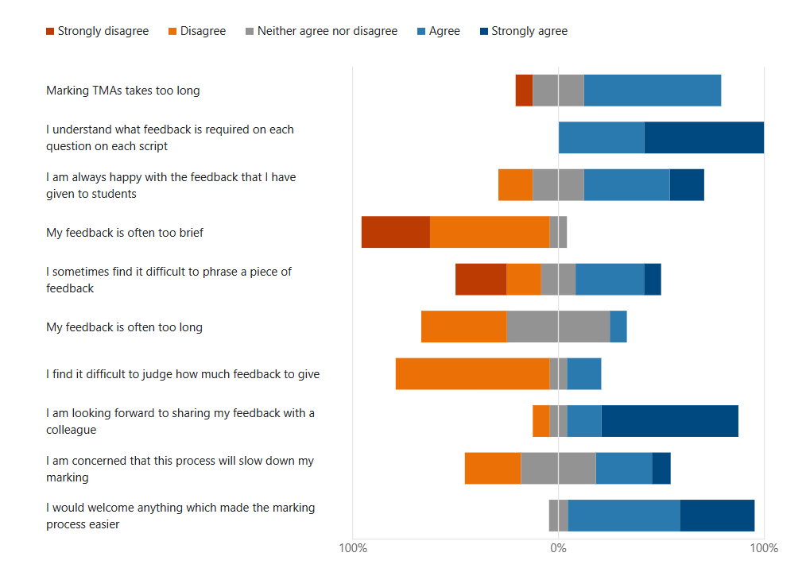
Page Title 4
The project – at the start
From the anonymous questionnaire at the start of the project

Slide 10
Page Title 4
The project
The project ran for the duration of one presentation of TM111
Three TMAs
Participants had access to a forum for discussions but most stuck with email to communicate with their partner

Slide 11

Afterwards

Slide 12
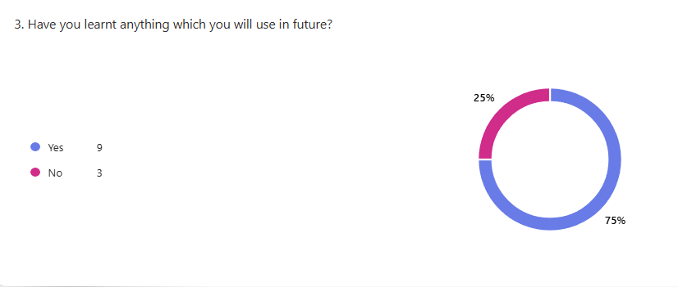
Page Title 4
The project – at the end
Results

Slide 13
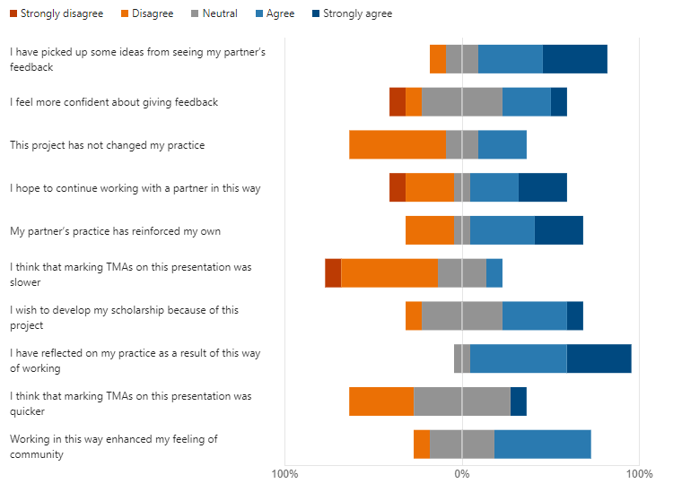
Page Title 4
Some findings
This is from the anonymous questionnaire at the end of the project
We used some of these responses as seed questions for the focus groups

Slide 14
Page Title 4
More findings
Comments from participants – from questionnaires
Seeing other tutor’s comments which I can adapt helped me to consider alternative ways to give feedback while retaining my own tutor 'voice’
I probably won't change *how* I work but I am likely to change aspects of style
It is a great way of adding to my own list of standard feedback with insights from a partner who may see the student's work differently from me
Finding a marking partner that is like minded but who also thinks differently is important. How do we seek out these potential collaborators?
I might try to be a little less verbose in my feedback
Will continue to work with XXXX in future to pool our comments and speed up the process of preparing feedback
More ways to say things to students
Look to continue working in pairs

Slide 15
Page Title 4
Other stuff
Random thoughts
Some participants found the “seed” comments useful – voice, “freedom” to change their style
Benefits accrue over multiple presentations (also reduces the possible disbenefits of not marking at the same time)
It can be “intimate”; showing a peer how you work
  It requires trust
  Non-judgemental
  Open communication
It isn’t about homogenisation - we don’t always agree

Slide 16
Page Title 4
What happened next
After the project finished
“Organised” sharing of comments
  On a module with a large number of new tutors
  Set up a forum for sharing comments
  Limited take-up
  Too public?
Mentor/mentee
  Positive impact
  Helps the mentee to understand the module

Slide 17
Page Title 4
Recommendations
Things that I think we’ve learnt
It works better if pairings grow organically (rather than speed-dating)
Make colleagues aware of this kind of peer-working
Create an environment where it is encouraged but not imposed
Suggest it to mentors

Slide 18
Any questions?
nigel.gibson@open.ac.uk
Notes:
kate.sim@open.ac.uk
nigel.gibson@open.ac.uk

