Slide 1

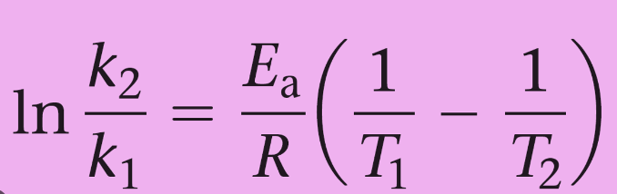


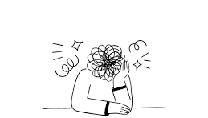

Mathematics support in LHCS
Nicola McIntyre, Eleanor Crabb, Cath Brown
Background
Maths is used in almost all LHCS modules
Many students are anxious about maths.
Students have varying existing levels of competence so however good in-module support is, it’s not tailored
Students often need to revisit “earlier” maths concepts
Students may feel embarrassed about their maths skills and be reluctant to seek help
What are we going to produce?
Short videos, each explaining a single key concept
Sets of practice questions for each video
Workshop sessions, allowing for peer and AL support
Bookable “drop in” clinics
Curated links to existing resources
Available to all LHCS students; located on science study site
How will we evaluate it?
Student questionnaires
Student interviews
Potentially performance on mathematical components of modules

