Slide 1
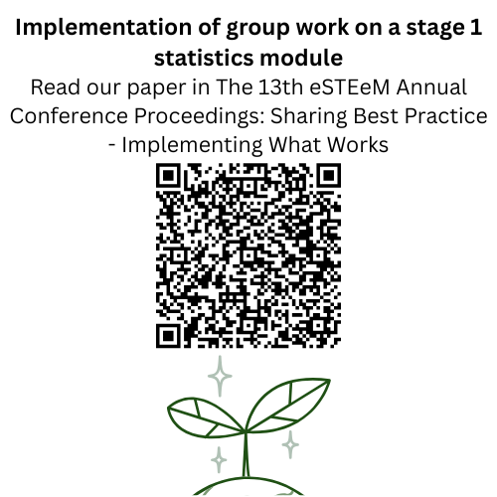
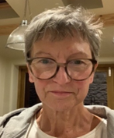
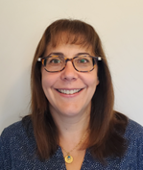


Intro Slide Title 1
Is group work
"a necessary evil"?
The 14th eSTEeM Annual Conference: Innovations in Impact
Ruth Neal and Kellee Patterson
School of Mathematics and Statistics
Thursday 1st May 2025
10:30 – 11:15
A necessary evil for work or study I hated it
Initial student perspective about group work

Slide 2

Slide Title 8
Project aim
To assess the suitability and impact of introducing group work on a level 1 statistics module.
What do we define as group work?
We define ‘group work’ as collaboration and cooperatively working with others to complete a task or project.
Why group work?
Increase collaboration and cooperation between students
Key employability skills
Context of situation is important in statistics, and this is often understood better through discussion
If we are truly preparing statistics students for applying statistics in the workplace then statistics education should resemble statistics practice; including data awareness, basic concepts and interpretation (Rumsey 2002) and cooperation, communication and teamwork (Roseth et al., 2017).
References
Roseth, C. J., Garfield, J. B., & Ben-Zvi, D. (2008) Collaboration in Learning and Teaching Statistics. Journal of Statistics Education, 16(1).
Rumsey, D. J. (2002) Statistical literacy as a goal for introductory statistics courses. Journal of Statistics Education, 10(3).
Notes:
RN

Slide 3
Slide Title 8
Workshop aim
To understand student experience of being asked to work in groups
Workshop plan
Introduction (5 minutes)
Undertake a task in groups (10 minutes)
Report back on task (10 minutes)
Repeat task in groups (5 minutes)
Discussion (10 minutes)
Feedback (5 minute)
Notes:
KP

Slide 4
Group work experience
Aim is for you to experience some of what the students go through when asked to work in groups to complete tasks
This is what our students experienced, and we are trying to replicate this here:
Put in groups to complete task for which we believe you have the skills
Complete task over a time period through collaboration and discussion
Formulate conclusion/solution
Give feedback
Notes:
RN

Slide 5

You will have 10 minutes to work together on the task, then return here
Three group work task options
Choose a task
Great British Bake Off
House of Games
Race Across the World
Click the 'Rooms' app icon in the Teams meeting toolbar options and then choose the room link for the session you would like to join.
This room and this meeting will automatically be put 'on hold'.
When you leave the breakout room to return, be sure to 'Leave room' not 'Leave meeting'!
Notes:
KP

Slide 6
How was your group work experience?
Discussion
Did you complete the task?
Did you have the required skills/instructions/information?
How did you work as a group?
Notes:
RN

Slide 7
Slide Title 12
Our students' experience
Project findings
Not enough instructions/guidance/prompts – no role allocation
Everyone did not contribute – perhaps because task not compulsory
Perhaps guided discussions on exercises on a tutor group forum. That may be included for a very small number of marks in tmas.
A group tutorial where aims of the task could be discussed and roles assigned.
Tackling tasks ‘freely’ is not how we teach students
We give them 'neat' problems for which they don't need to think more widely
More scaffolding is needed before letting them loose on group work
Purpose – should count for something e.g. grades, skills development
Notes:
KP

Slide 8
You will have 5 minutes to work together on the task, then return here
Three group work task options
Choose a task
Great British Bake Off
House of Games
Race Across the World
You do not have to go to the same room as first time
Click the 'Rooms' app icon in the Teams meeting toolbar options and then choose the room link for the session you would like to join.
This room and this meeting will automatically be put 'on hold'.
When you leave the breakout room to return, be sure to 'Leave room' not 'Leave meeting'!
Notes:
RN

Slide 9
Slide Title 27
How was your group work experience second time around?
Discussion
Notes:
KP

Slide 10
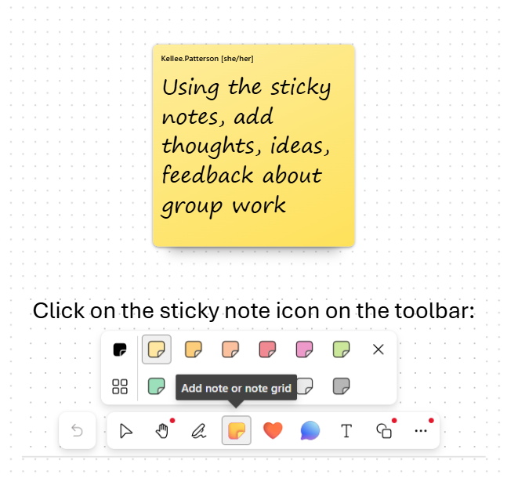
Slide Title 23
Feedback/Advice
Group work feedback whiteboard
Based on your experience, what advice would you give us for helping develop students' group work skills?
Notes:
RN

Slide 11
Slide Title 30
Thank you
Ruth Neal - ruth.neal@open.ac.uk
Kellee Patterson – kellee.patterson@open.ac.uk
​

