Slide 1
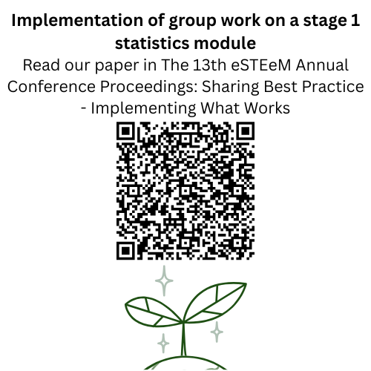
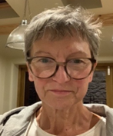


Intro Slide Title 1
M&S Scholarship session - Incorporating asynchronous group work into M140
Ruth Neal and Kellee Patterson
School of Mathematics and Statistics (M&S)
Thursday 15th May 2025

Slide 2
Slide Title 6
Assessment and feedback on the introduction of group work on a level 1 statistics module (M140)
AIM To assess the suitability and impact of introducing group work on a level 1 statistics module.
PURPOSE To increase the employability content of the module by enabling and encouraging students to work in small groups to discuss their statistical results.
It is generally considered that group work affords invaluable opportunities for students to develop their collaborative skills and this, in turn, is a key employability skill. However, students do not always recognise the importance of group work (Evans et al, 2020). It is also noted that opportunities for group work via the current online tutorial provision may be few and far between, with facilitation of it being varied. (Butler et al, 2018).
METHODS Two JISC surveys, one before the group work activity and one after, assessing the students’ previous experience and how students found this activity.
We aim to learn from this experience before rolling this out to all students on the module.
01
Notes:
Ruth
A number of our students are studying data science and in this line of work will need the skills of working with large data sets as well as communicating and collaborating with others. Therefore we wanted to introduce something that would help enable our students take the first step towards developing these skills.
Also, maths and stats students are generally not the most well developed when it comes to working with others since maths is traditionally seen as a somewhat independent pursuit!

Slide 3
What is our project?
We define ‘group work’ as collaboration and cooperatively working with others to complete a task or project.
Set up in 2023 to introduce a group work aspect into M140, Introducing statistics.
The aim is for students to collaborate and communicate in online forums and gain some useful skills that could help them in the workplace.
The addition of employability skills into the curriculum is seen as something which employers are looking for.
These collaborative and discussion skills should also prove useful in the stage 2 statistics modules where they will be further developed.
Notes:
Kellee

Slide 4
Why incorporate group work?
Using interactive styles of learning such as group work has been shown to lead to better student understanding of course content through developing ‘meaning’ rather than simply ‘reproducing’ taught material (Macbean et al, 2001).
Collaboration via online forums is a valued student experience (Smith, 2014) and students consider discussion with others useful in helping solve practical problems (Macbean et al, 2001).
Notes:
Ruth

Slide 5
Slide Title 15
Module progression
Pre-module
Module start
Mid-module
Module end
Post-module
June 24
M140 Introductory statistics 23J
May 24
Nov 23 – Mar 24
Oct 23
Sept 23
Group work element here
Notes:
Kellee – overview of module and where group work sits within the course
Pre-module – prep for project, SRPP, JISC surveys, AL time/EOI
Module start – intro at welcome tutorial, forum posts and news items, initial group work survey
Mid-module – invitations to group work, tutor training
Post-module – final survey and feedback from tutors

Slide 6
How do you think students felt about group work before it took place?
Notes:
Ruth – initial survey question we asked students “Use three individual words, separated by commas, to describe how you are feeling about taking part in the online group work on this module?”
(Kellee set up Poll – question for word cloud - How do you think students felt about group work before it took place?)

Slide 7
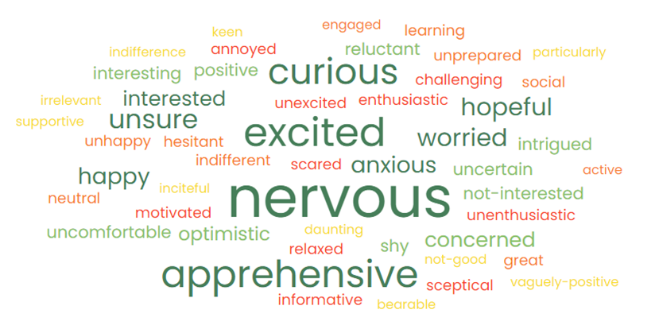
How did students feel about the group work before it took place?
Notes:
Kellee

Slide 8
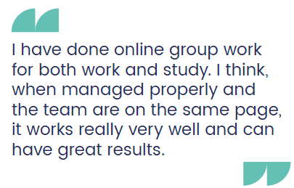

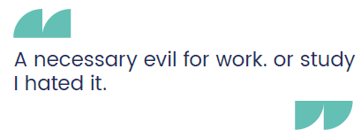
Student quotes (before)
If students had experienced online group previously, we asked, how did you feel about this online group work?
Notes:
Ruth

Slide 9
Initial Survey
17% (119) of the 683 students invited responded to the initial survey.
Notes:
Kellee
The first survey was sent to students to gain feedback about group work experience and to let them know this group work was happening later in the presentation.
From the survey we found that students considered communication, success as a group and meeting project deadlines important aspects of group work, as well as collaboration.
Other aspects not included here because not deemed as important by the students were understanding individual roles within the group and use of technology for collaboration.

Slide 10
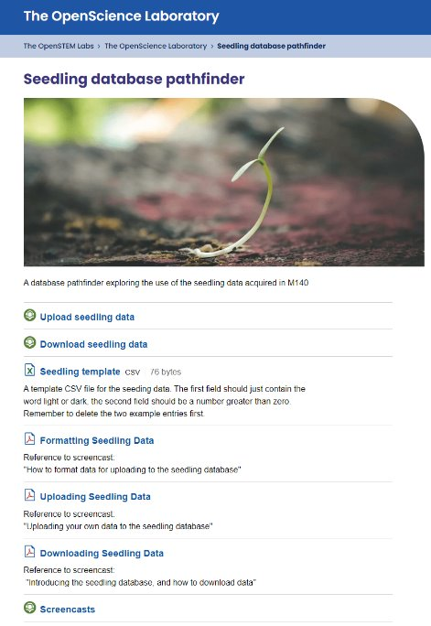
The group work
Students are encouraged to conduct an experiment as part of the final assignment, TMA04. Students grow some seedlings in different light conditions and measure the root length.
This data is then uploaded into a combined database. We ask the students to download this data and then investigate the full database using the software Minitab.
Students can produce plots and data summaries and analyse these as a group.
The aim is for the students to produce a summary report.
Notes:
Ruth

Slide 11
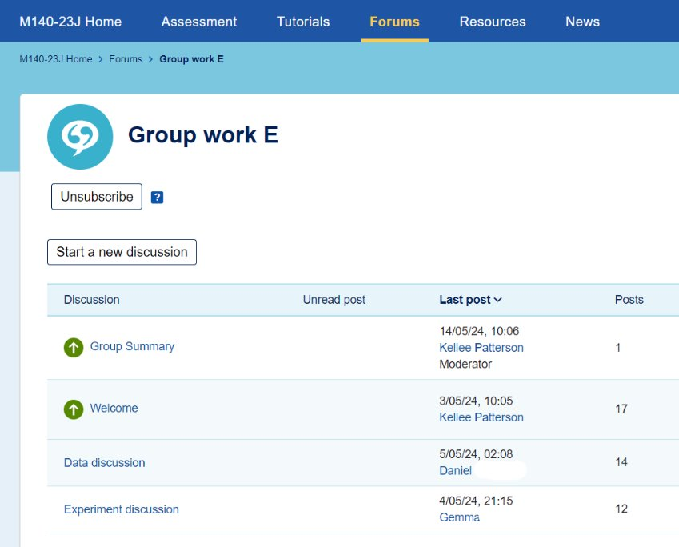
What happened in 23J?
We publicised the group work activity from the start of the module, emailing students, posting on the forum and adding news items.
In the first presentation, approximately 60 students volunteered for the group work activity. This took place over a two week period.
We split these student volunteers into 5 groups and asked them to introduce themselves and talk about the experiment, how this had gone and what problems they had encountered.
We then wanted the students to investigate the combined database and analyse the data using techniques learnt on the module.
Notes:
Kellee

Slide 12
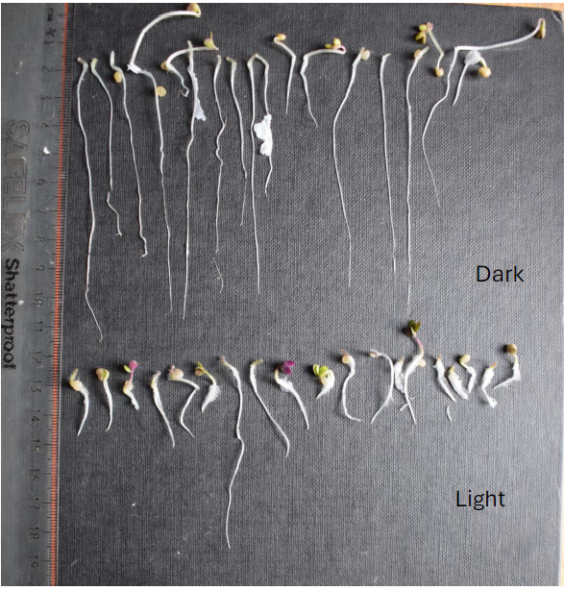
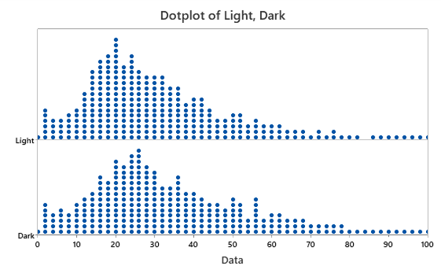
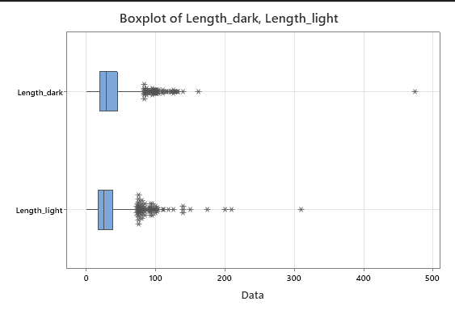
What went well in the group work discussion?
What did not go so well in the group work discussion?
The students were enthusiastic about discussing the experiment and suggesting improvements, mostly after the assignment due date had passed. The students mainly reported their issues with growing the seeds.
The students were supportive of one another.
Downloading and reporting the data was less successful. Students had difficulty downloading the data and were then reluctant to suggest useful or appropriate data investigation methods.
Despite volunteering, a number of the students did not engage at all in the group discussion.
Image of the seedling root measurement supplied by student A
A dotplot produced by student B
A boxplot produced by student C
Notes:
Ruth
Comment from tutor: ‘Overall the group work went reasonably well and 8 out of the 13 students who signed up for the project posted on the forum. The main difficulty was in getting students to initiate anything – without quite precise prompts there was very little activity. ’
Initially we were not sure if students were even going to be willing to be involved, let alone contribute!

Slide 13
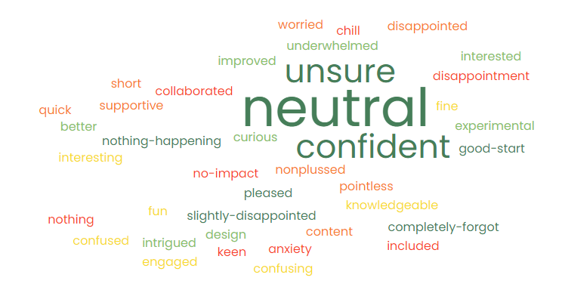
How did students feel about the group work after it took place?
Notes:
Kellee
Final survey – sent to all 61 students who agreed to take part in the group work activity, though not all had participated. 33 responses.
Use three words to describe how you felt after taking part in the online group work on this module

Slide 14
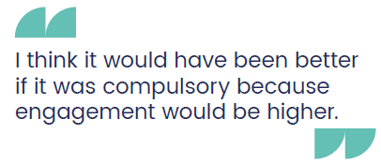


Student quotes (after)
State one thing that would have enhanced the group work.
Notes:
Ruth

Slide 15
Final survey
54% (33) of those who participated in the group work responded to the final survey.
Of these 64% (21) had participated in the group work.
Notes:
Kellee
Final survey – sent to all 61 students who agreed to take part in the group work activity, though not all had participated.

Slide 16
Final survey versus initial survey
Notes:
Kellee
We would like the greens in the final results to match more closely the greens in the initial results - there is clearly work still to do here.
Final survey is a much smaller sample, ~21 verses 119 in initial survey

Slide 17
Slide Title 6
End of year 1, what did we do next?
More direction
We made the instructions for students (and tutors) clearer, setting deadlines and giving the students specific tasks.
We have created a set of prompts for tutors to use with students and a timeline to guide the group work discussions more closely.
Make it count!
As students indicated that they may be more enthusiastic if the group work was to count towards the module assessment, we have allocated marks for this work in two places in TMA04.
Notes:
Ruth – based on student feedback we made these changes

Slide 18
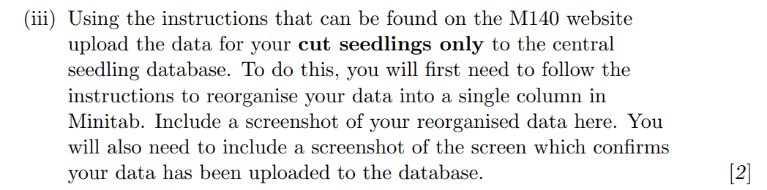
Included in TMA04 24J and 25B
For those students that do the seedling experiment -uploading their data to the shared database
(2 marks)
NOTE: Students who do not complete the seedling experiment have an alternative question, so they are not disadvantaged.
Notes:
Kellee

Slide 19
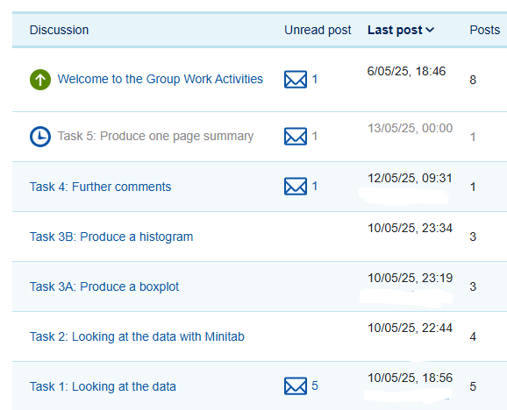
24J, did things go better?
For the second presentation, we included detailed instructions for students to follow. We asked the tutors to post the prompts every few days.
For two of the groups this is going well, students have posted comments and have attempted to follow the instructions.
For one group, students raced ahead and produced plots when they were asked to just look at the data. This has made it difficult to bring the student group back on schedule.
When students go to the final task and miss out the intermediate steps, it can make it difficult for the other students to contribute.
Notes:
Ruth
Currently in the group work phase now!
Less groups.
Also being done on the B presentation this year.

Slide 20
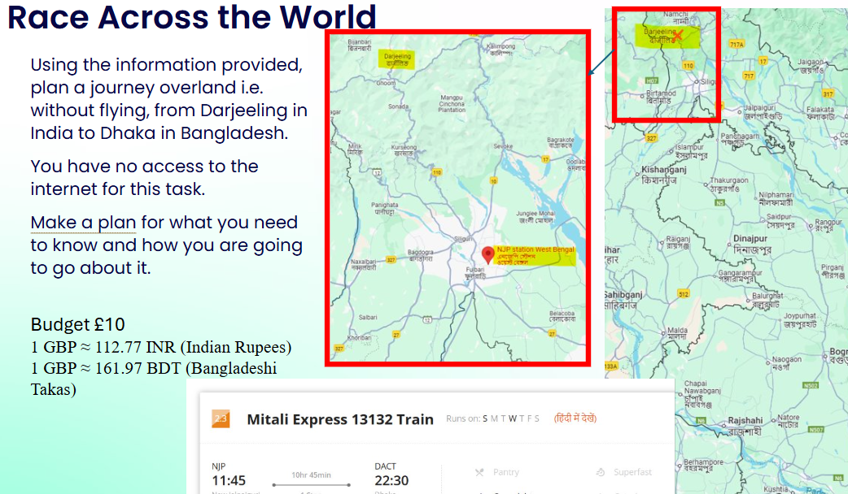
Esteem conference workshop – May 25
To gain further feedback for future development, we created a workshop for the recent eSTEeM conference.
In this session we asked participants to work in groups to tackle an activity with limited instructions.
We wanted these participants to experience group work as our students had.
Task with no definitive ‘answer’
Notes:
Kellee

Slide 21
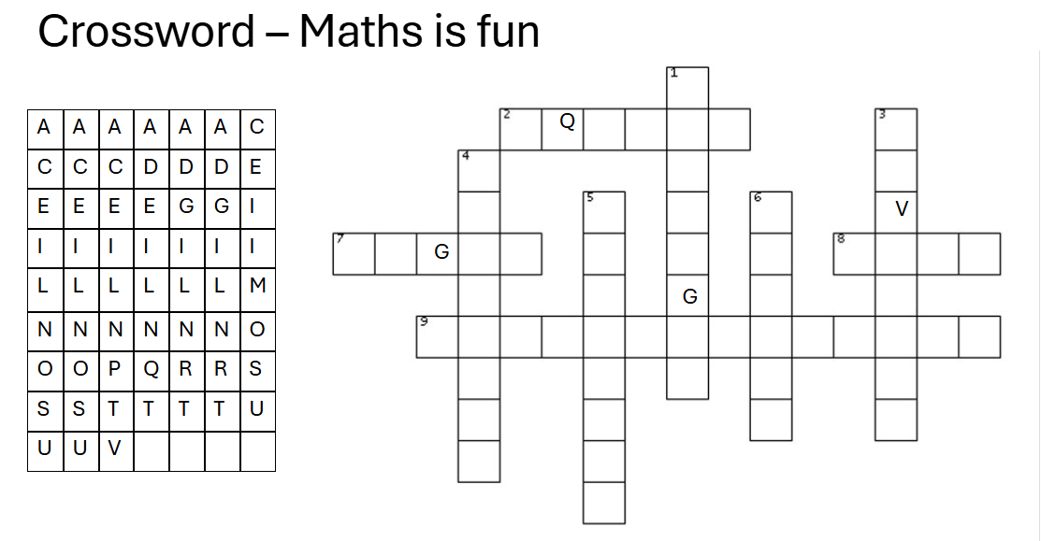
Task with minimal instructions
The participants experienced similar issues to our students.
These included:
Not being able to use the technology
Some participants dominating, doing all the activity without involving others and allowing them to find their way
Finding the task confusing and needing clearer instructions and clear rules
Task with a definitive ‘answer’, but limited instructions.
Notes:
Ruth

Slide 22
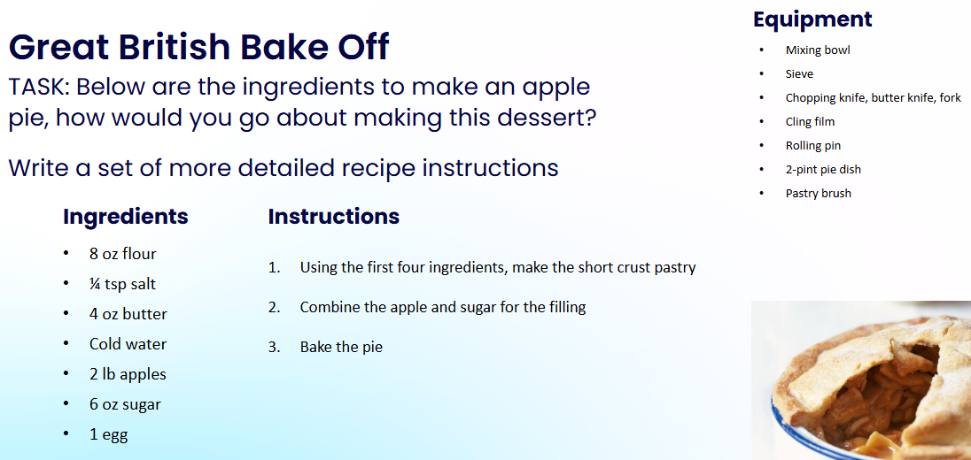
Task with more detailed instructions
Here, again, there were issues.
Some participants worked on their own and completed tasks without communicating with other participants.
Giving more instructions meant working as a group did not necessarily happen, since some participants now found no need to communicate and work together to solve the problem.
The task needs to be guided enough to allow participants to know what they are doing but not so guided that there is not enough challenge thereby negating the need for group problem solving
Task with clear instructions
Notes:
Kellee

Slide 23
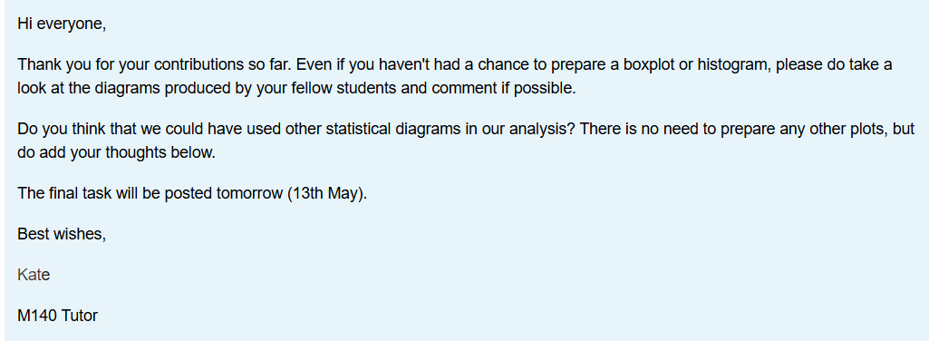
Feedback from current group work
More detailed instructions help guide tutors and students.
Timing the release of each task seems to work better than putting all the tasks up at the beginning.
Some students still go ahead and do the final task before attempting the initial ones.
Despite tutor efforts (see below), once a student has posted their results, others are reluctant to contribute.
Notes:
Ruth

Slide 24
The way forward?
For the next presentations (25J and 26B), there will be a further student activity in TMA04 that asks students to look at the shared dataset and write a short summary of their findings (see next slide).
We intend to put a group work activity into the final assessment, this will be students working in their tutor groups, looking at the combined dataset and doing some analyses.
Notes:
Ruth
Again, we will survey our current students and use this to inform our future plans
If you have suggestions/ideas/feedback, please let us know

Slide 25
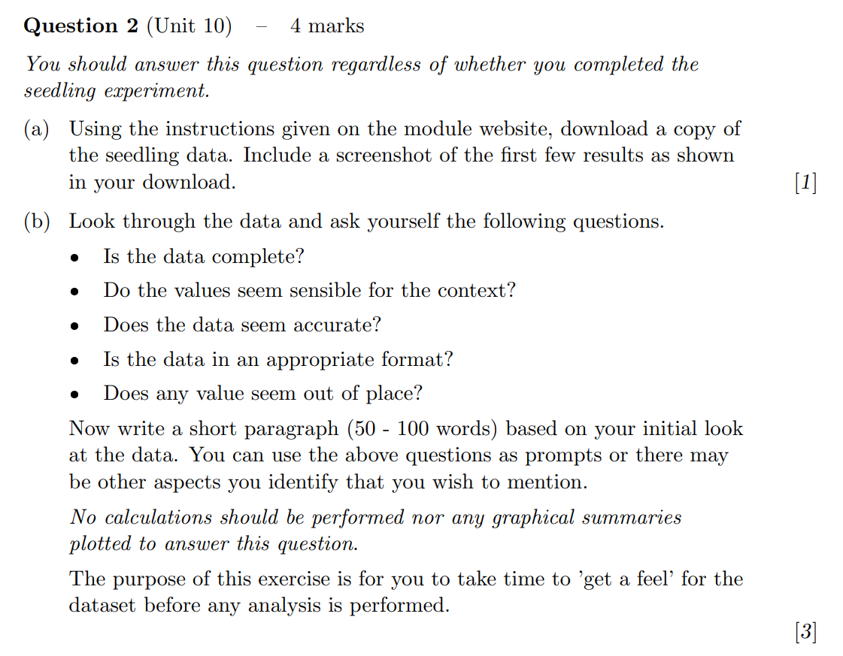
Included in TMA04 25J and 26B
For all students to complete by accessing the shared database – ‘getting a feel’ for the data
(4 marks)
Notes:
Kellee

Slide 26
Next steps?
We intend to investigate the current use of tutor group forums across the module in 24J.
We intend to ask tutors to post at key points in the module presentation and encourage students to respond in 25J.
The aim is to get all tutors familiar with using their tutor group forums in 25J.
Group work will be rolled out to the whole module as part of the assessment changes that will be implemented for 26J.
Notes:
Ruth

Slide 27
Slide Title 30
Thank you
Any questions?
Ruth Neal ruth.neal@open.ac.uk
Kellee Patterson kellee.patterson@open.ac.uk
​

Slide 28
References
Butler, D., Cook, L., and Haley-Mirnar, V., 2018. Achieving student centred facilitation in online synchronous tutorials. eSTEeM project.
Evans, S., Graham, W., and Malik, M., 2020. Strategies to support students and tutors with online collaborative projects: an action research project. eSTEeM project.
Macbean, J., Graham, T. and Sangwin, C. (2001) Group work reluctance in maths education. LTSN Maths, Stats And OR Network, Birmingham, UK pp. 24-25.
Smith, D. (2014) Collaborative Online Forums in the Social Sciences: Participation, Value and the Student Experience. eSTEeM project.
Notes:
Kellee

