Slide 1
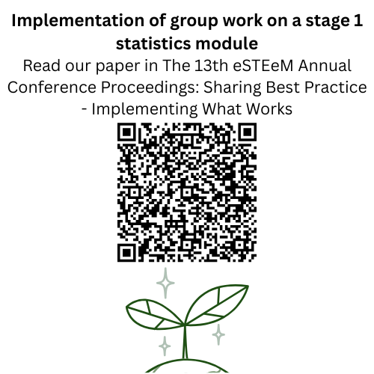



Intro Slide Title 1
M&S Scholarship session - Incorporating asynchronous group work into M140
Ruth Neal and Kellee Patterson
School of Mathematics and Statistics
September 2025

Slide 2
Slide Title 6
Assessment and feedback on the introduction of group work on an Open University first year statistics module (M140)
AIM To assess the suitability and impact of introducing group work on a first year statistics module.
PURPOSE To increase the employability content of the module by enabling and encouraging students to work in small groups to discuss their statistical results.
It is generally considered that group work affords invaluable opportunities for students to develop their collaborative skills and this, in turn, is a key employability skill. However, students do not always recognise the importance of group work (Evans et al, 2020). It is also noted that opportunities for group work via the current online tutorial provision may be few and far between, with facilitation of it being varied. (Butler et al, 2018).
METHODS Two JISC surveys, one before the group work activity and one after, assessing the students’ previous experience and how students found this activity.
We aim to learn from this experience before rolling this out to all students on the module.
01
Notes:
A number of our students are studying data science and in this line of work will need the skills of working with large data sets as well as communicating and collaborating with others. Therefore we wanted to introduce something that would help enable our students take the first step towards developing these skills.
Also, maths and stats students are generally not the most well developed when it comes to working with others since maths is traditionally seen as a somewhat independent pursuit!

Slide 3
What is our project?
We define ‘group work’ as collaboration and cooperatively working with others to complete a task or project.
Set up in 2023, Phase 1 was to introduce a group work aspect into the first year module Introducing statistics (M140).
The aim was for students to collaborate and communicate in online forums and gain some useful skills to help them in the workplace.
The addition of employability skills into the curriculum is seen as something which employers are looking for.
These collaborative and discussion skills should also prove useful in the stage 2 statistics modules where they will be further developed.
Notes:
Kellee

Slide 4
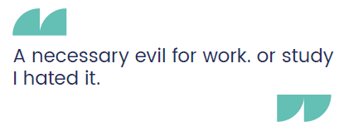
Why incorporate group work?
Using interactive styles of learning such as group work has been shown to lead to better student understanding of course content through developing ‘meaning’ rather than simply ‘reproducing’ taught material (Macbean et al, 2001).
Collaboration via online forums is a valued student experience (Smith, 2014) and students consider discussion with others useful in helping solve practical problems (Macbean et al, 2001).
Student quote regarding previous group work experience

Slide 5
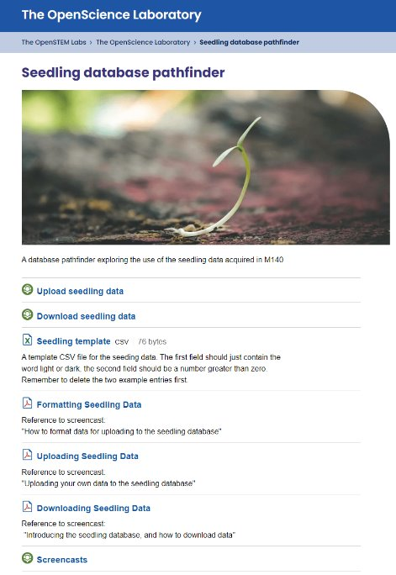
The group work
Students are encouraged to conduct an experiment as part of the final assignment. Students grow some seedlings in different light conditions and measure the root length.
This data is then uploaded into a combined database. We ask the students to download this data and then investigate the full database using the software Minitab.
Students can produce plots and data summaries and analyse these as a group.
The aim is for the students to produce a summary report.

Slide 6
Phase 1, final survey versus initial survey
Notes:
We would like the greens in the final results to match more closely the greens in the initial results - there is clearly work still to do here.
Final survey is a much smaller sample, ~21 verses 119 in initial survey

Slide 7
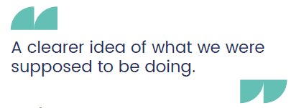
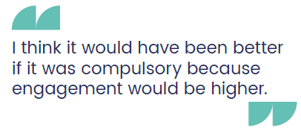
Slide Title 6
Phase 2, what we did next
More direction
We made the instructions for students (and tutors) clearer, setting deadlines and giving the students specific tasks.
We created a set of prompts for tutors to use with students and a timeline to guide the group work discussions more closely.
Make it count!
As students indicated that they may be more enthusiastic if the group work was to count towards the module assessment, we have allocated marks for this work in two places in the final assessment.
Student quotes regarding future development of the group work
Notes:
based on student feedback we made these changes

Slide 8
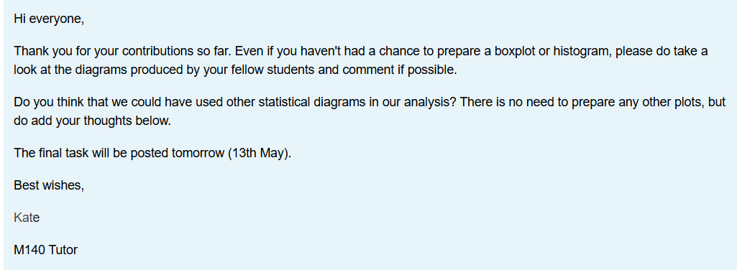
Feedback for Phase 2
More detailed instructions help guide tutors and students.
Timing the release of each task seems to work better than putting all the tasks up at the beginning.
Some students still go ahead and do the final task before attempting the initial ones.
Despite tutor efforts (see below), once a student has posted their results, others are reluctant to contribute.
Notes:
For two of the groups the prompts went well, students posted comments and attempted to follow the instructions.
For one group, students raced ahead and produced plots when they were asked to just look at the data. This made it difficult to bring the student group back on schedule.
When students go to the final task and miss out the intermediate steps, it can make it difficult for the other students to contribute

Slide 9
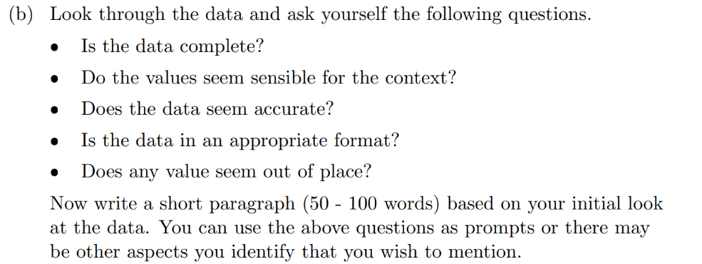
The way forward
For the next presentations, there will be a student activity in the final assessment asking students to look at the shared dataset and write a short summary of their findings.
Notes:
Again, we will survey our current students and use this to inform our future plans
If you have suggestions/ideas/feedback, please let us know

Slide 10
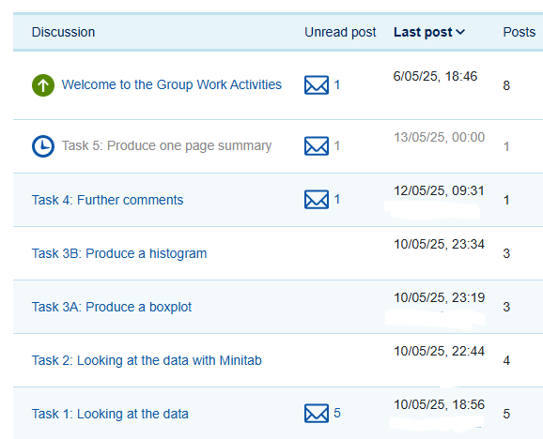
Next steps for 2025/26
Investigate the current use of online tutor group forums across the module.
Ask tutors to post at key points in the module presentation and encourage students to respond.
The aim is to get all tutors familiar with interacting with their tutor group via online forums in preparation for the future group work activities.
Notes:
Two-way communication

Slide 11

Next steps, Phase 3
Roll out the group work to the whole module as part of the assessment for 2026/27.
This will involve students working with the shared database in their tutor group forums and tutors monitoring the discussion.
We hope that the student groups will communicate and collaborate to produce a combined statistical report.
We need to consider accessibility requirements and provide an alternative activity.

Slide 12
Slide Title 30
Thank you
Any questions?
Ruth Neal ruth.neal@open.ac.uk
Kellee Patterson kellee.patterson@open.ac.uk
​

Slide 13
References
Butler, D., Cook, L., and Haley-Mirnar, V., 2018. Achieving student centred facilitation in online synchronous tutorials. eSTEeM project.
Evans, S., Graham, W., and Malik, M., 2020. Strategies to support students and tutors with online collaborative projects: an action research project. eSTEeM project.
Macbean, J., Graham, T. and Sangwin, C. (2001) Group work reluctance in maths education. LTSN Maths, Stats And OR Network, Birmingham, UK pp. 24-25.
Smith, D. (2014) Collaborative Online Forums in the Social Sciences: Participation, Value and the Student Experience. eSTEeM project.
Notes:
Kellee

