Slide 1

Leaky pipeline or untapped potential? An investigation into the motivations and aspirations of female engineering students at the Open University.
Carol Morris, Sally Organ and Moira Dunworth
8th eSTEeM Annual Conference
8 May 2019
Carol Morris and Sally Organ

Slide 2

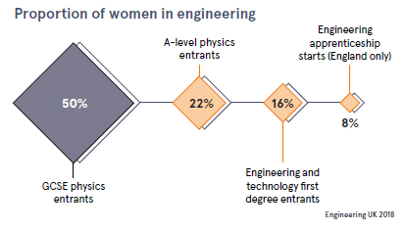
The leaky pipeline – classic view
(women only)
Assumes a linear progression through education
Encourages initiatives that attempt to either
  increase throughput or
  improve conditions to encourage those who make it to stay

Slide 3
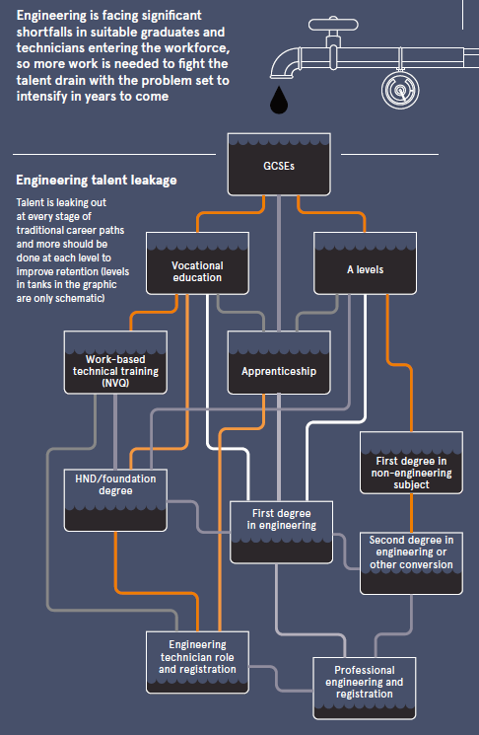
The leaky pipeline – another view (all)
John Perkins / Dept for Business, Innovation and Skills 2013, from ‘Future of Engineering’ Raconteur.net 2018
More options are recognised, but the basic message is the same:
‘Talent is leaking out at every stage of traditional career paths and more should be done at each level to improve retention’
Where do female engineering students at the OU fit in?
What can we do to attract more people – and especially women - into engineering?

Slide 4
What did we know about our female engineering students before the study?
Account for ~10% of undergraduate engineering students
Mostly in 25 – 40 age group
~ One third qualified to first degree level or above
~ One quarter have no formal quals or < two A levels
Anecdotally
Not working in an engineering role, although majority working full-time
Concerned that they cannot relate to existing curriculum
Concerned about gaining industrial experience

Slide 5
What we did
Pilot survey to 190 first year engineering students in November 2017
18 female respondents
10 male respondents
14.8% response rate
Main survey to 800 engineering undergraduate students January 2018
60 female respondents
54 male respondents
14.3% response rate
Individual interviews with 17 students (12 female, 5 male) August 2018

Slide 6
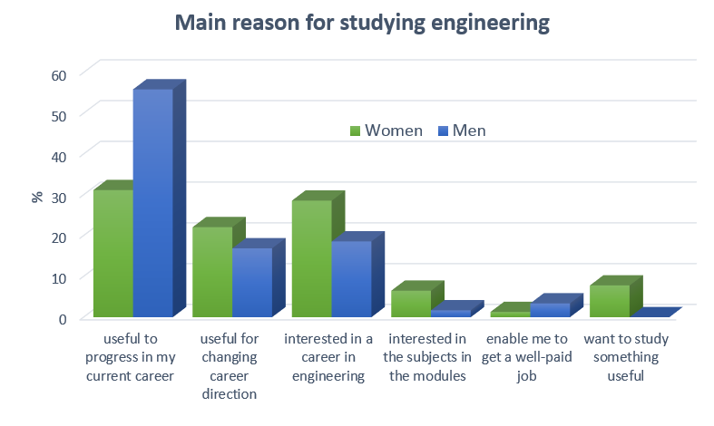
Key survey results - work and study
Women
71% work full-time
10% work part-time
19% work in engineering
23% work in STEM
44% have never worked in engineering
Men
84% work full-time
4% work part-time
58% work in engineering
12% work in STEM
17% have never worked in engineering

Slide 7
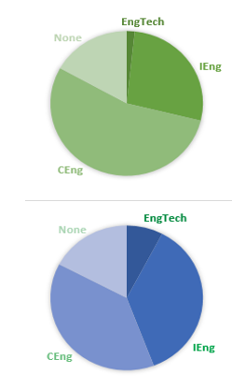
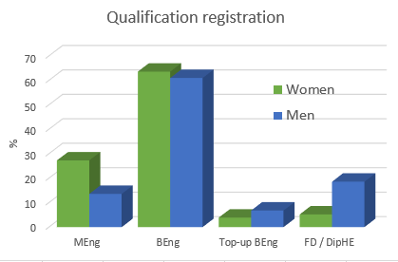
Male students are most likely to be studying to progress a career in engineering
Female students are more likely to be looking for a new or different career
Female students appear to be aiming higher

Slide 8
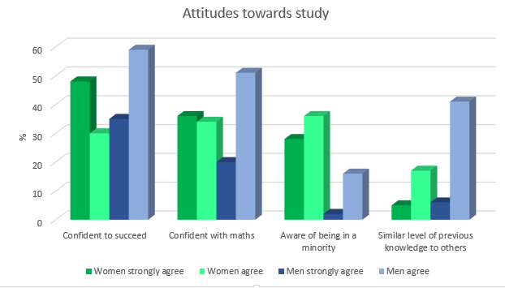
Key survey results –Attitudes and encouragement
Other questions covering ‘keeping up with other people’ and ‘working with others’ showed little difference between genders.

Slide 9
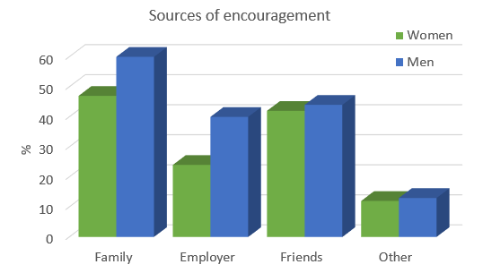
Confidence levels are generally high
64% of female students (and 17% of male) are aware of being in a minority
Female students feel they do not have a similar level of previous knowledge
Differences in levels of encouragement are small

Slide 10
Individual interviews (12 female, 5 male)
Common to both genders:
Studying to enhance career prospects, usually alongside personal interest
Demands of their work schedule present the biggest challenge, the amount of online material can be a problem
Found the module material interesting and relevant, enjoyed the content of the modules, good support from tutors. Motivation increased by studying.
Maths often gets a special mention – either positive or negative. Possible gender differences in attitude warrant further study.
Family support - male students more likely from partner, female students from their wider family, often their mother.
All respondents who work or worked in engineering settings reported having witnessed, or been subject to, discriminatory behaviour. Most of this was sexism and overt.

Slide 11
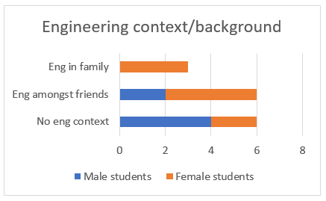
Individual interviews - female specific
Lack of information about engineering as a career option at school and afterwards:
  several reported barriers at school level
  want more contact with women in engineering, to explore options
More likely to have had a previous connection with engineering.
Funding changes allowing loans for STEM second degree have been helpful.
Negative attitudes or disinterest from work colleagues or managers: several students reported experiencing mocking or incredulity about their degree choice.
Women with children are very aware of the barriers they will face when they graduate and start to work in an engineering setting.

Slide 12
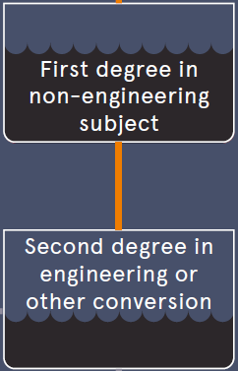
Back to the pipeline….
So where do female OU students fit in?
a bit of this?
a lot of this
and
a new pool of potential engineers from outside the pipeline

Slide 13
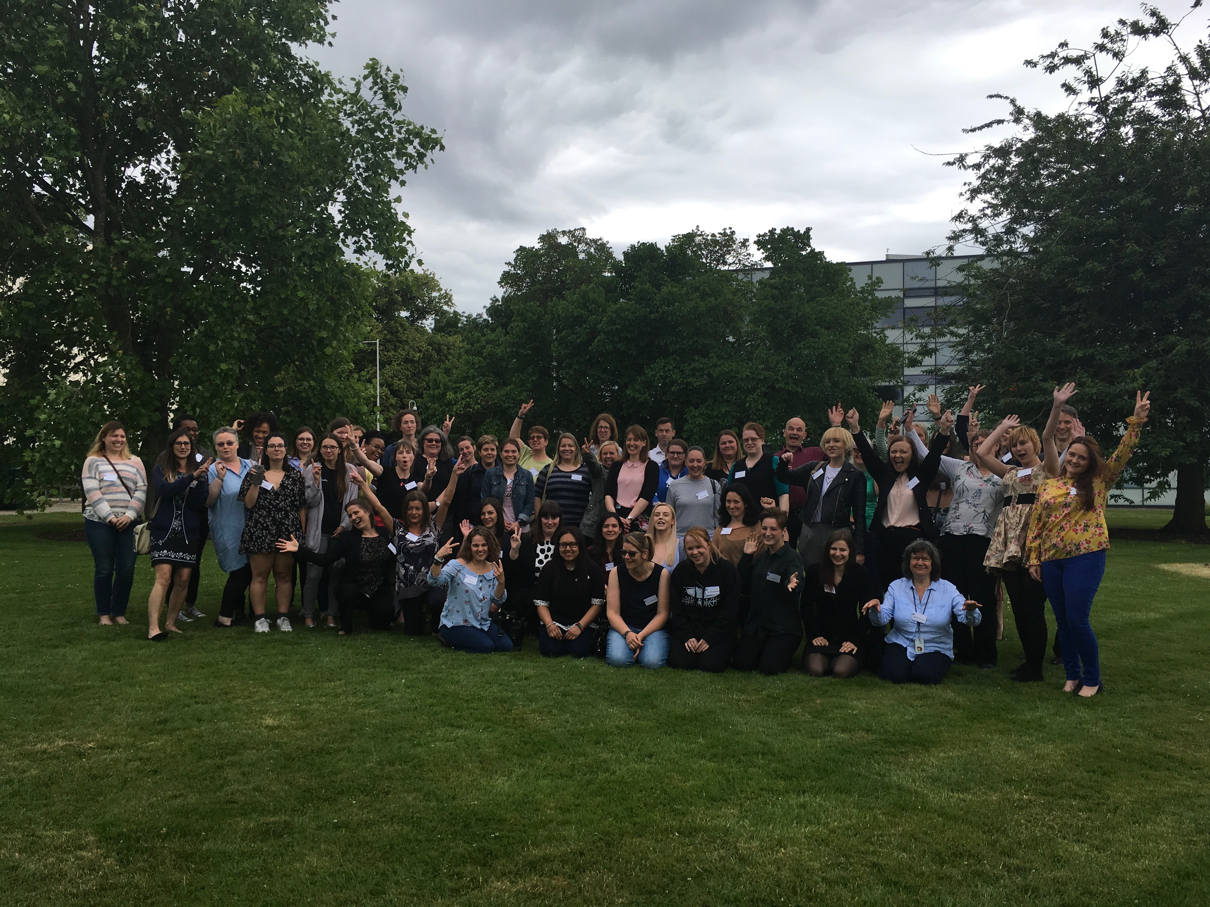
What have we done so far?
Community building to reduce isolation
  Annual conference for female engineering students
  Bursaries for WES student conference
  Women in Engineering discussion forum
  Women in Engineering prospectus page
  RAEng Visiting Professor for ‘Transforming Engineering Culture’ Jan Peters
Ongoing curriculum renewal
  Choosing images and case studies to reflect a broad view of engineering and a diverse engineering workforce
  Being careful not to assume prior knowledge and experience
  Keeping a balance of print and online material
  Teaching maths in an engineering context
Staffing
  improved gender balance in teaching staff to provide female role models

Slide 14
Next steps
Work with marketing to attract more mature female entrants to engineering at the Open University
Work with employers to enable career changers to gain engineering work experience
Continued curriculum renewal and monitoring

Slide 15
THANK YOU carol.morris@open.ac.uk sally.organ@open.ac.uk with thanks to Moira Dunworth for the interviews

Slide 16
  There's an assumption I am there socially rather than working, even with tools in my hand that can be the case. (AF39)
  I did witness one of the training supervisors - well, he was the mechanical lecturer I suppose - turn round to one of the girls and say engineering is no place for a woman. (AM13)
  I always found before that jobs I did well would not be recognised as much and men doing less or same got promotions….. there are men less assertive placed higher for much less than the nine years I’ve been working for companies. (AF05)
  You're expected a lot to do note-taking, minute-taking and it takes a long time for men to take your opinion on board …..(AF05)
  One of our squadron changed gender. I have got no problem with that, but everyone else did and there were comments about it….. (AM01)
  They would always go to my male colleague without talking to me. (CF05)

Slide 17
… obviously there is a high proportion of mothers and, as a mother myself, I know that I’m going to find getting into the industry tough. Because I can only work part time until my children are older and I can see that as being a hell of a barrier to push past, for an employer to see past… (BF04)
There were no concessions and hours were so long that I sent my child off early at 7 and returned at 8 to afford to work. When I return after this break I assume I will be on a lower wage or position than I was before even though I spent the whole time studying. I will have to sacrifice a lot in my career to raise children even with a partner. There were no people there who understood enough about being a sole parent as it was mainly male-dominated much of which were (all that I knew) not single parents. (AF05)

