Slide 1

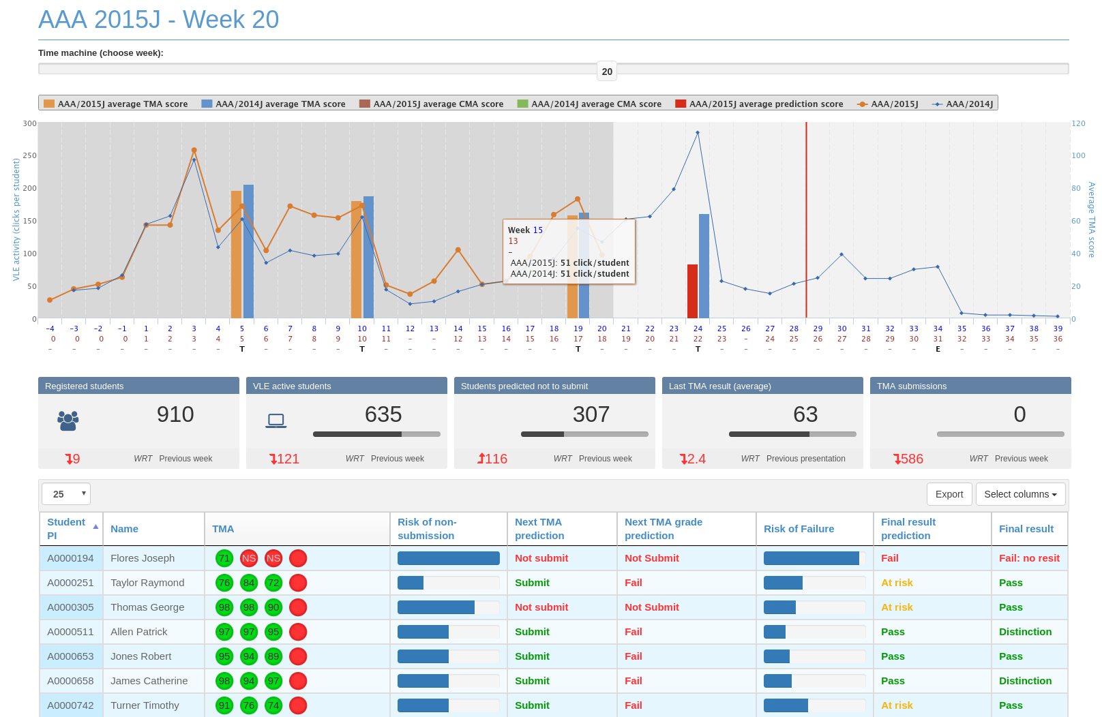


Understanding the Degree Attainment Gap of BAME Students
by means of Quantitative and Qualitative Data Analytics
Martin Hlosta, Tracie Farrell, Vaclav Bayer, Venetia Brown, Miriam Fernandez
Research Hypothesis: When learning analytics are applied to learn student patterns and identify students at risk, data is not disaggregated by demographic groups. Therefore, the learning and behavioural patterns of ethnic minorities may not be given the same relevance as those of the majority demographic (White students).
Objective: understand the behavioural, success, failure and learning pattern divergences between students designated as BAME and students from other backgrounds at the OU.
Collect data from The OU’s online learning environments (via OUAnalyse) and disaggregate it by ethnicity.
Conduct large-scale quantitative data analyses to uncover divergences in the learning, behavioural, failing and success patterns of BAME vs. non-BAME students
Conduct qualitative data analysis, via focus groups, with students and practitioners to better understand the potential root causes behind the previously identified patterns
Propose a set of targeted intervention strategies, based on the previously learned patterns, to provide more effective support to students
Disseminate the work done and the results acquired throughout the entire project to relevant stakeholders within the university
Ethical clearance / Student and staff recruitment and participation

