Slide 1

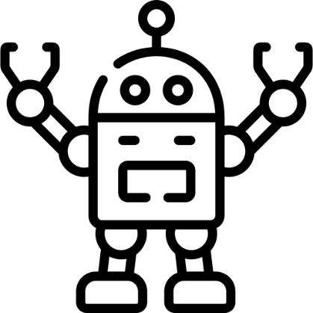

Using AI isn’t always cheating: can we tell the difference?
Mike Richards, Kevin Waugh, Daniel Gooch, Mark Slaymaker
AI is more than just ChatGPT – it’s already embedded in the tools students use to create their work.
Will honest students using modern tools to create their assessment be flagged as potential cheats?
The University already uses AI detection tools as part of its academic conduct processes to identify potential cheating or misuse of new technologies.
The creators of these tools say they are reliable and fair…
…but is that necessarily the case?
Or should we stop relying on AI detection software?
We will take existing student submissions known not to have been written using AI tools.
Each of them will then be altered using a range of free AI tools that can: spell-check, rephrase, correct grammar, summarise, and restructure the text.
The edited documents will then be re-analysed using the University’s AI-detection software.
Is there a point where the involvement of AI triggers the detector?
Or are even the smallest changes obvious?

