Slide 1
Investigating how to enhance the idea generation process for academic projects by engineering students
Martin Braun, Ian Bates, Keith Carter, Joanne Holford and Katherine Kirk
eSTEeM Seminar Series: Scholarship Showcase
19 October 2022

Slide 2

01
Background
02
Creative process
Expertise
Creative skills
03
Ideation toolkit
04
What we found

Slide 3
Background
Section 1

Slide 4
Background
Final year projects
OU business model
  ALs
  No active research portfolio
  ➔ Students need to come up with project idea, method, plan etc
Student proposed
Continuum
Staff
proposed

Slide 5
Creative process
Section 2

Slide 6
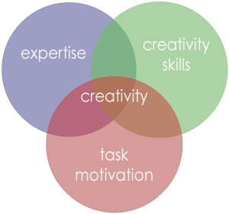
Creative process
Adapted from Amabile (1998)
Notes:
Motivation: Internal vs external (Want to finish my degree)
Schnittmenge: Intersection

Slide 7
Expertise
Most of the time students
study subject related material
Are final year students subject experts?
Litzinger et al (2011):
10,000 h to develop subject expertise
UG degree about 3,600 h
Knight & Botting (2016):
Lack deep subject knowledge to identify
research question
Notes:
A

Slide 8
Creative skills
Other modules teach subject specific
knowledge and skills
Project module needs to support
creative thinking skills
T452: Constructivist
Minimal guidance instruction (MGI)
Not much support in identifying projects
List of previous titles
Something that interests you
Short description of possible topic areas
Kirscher et al (2006): MGI does not work
Hmelo-Silver et al (2007): MGI needs sufficient scaffolding

Slide 9
Ideation toolkit
Section 3

Slide 10
Sources of inspiration
Literature review
  Many ideation tools: Intuitive and directed methods (White et al, 2012)
  Mainly for engineering design students
  Other engineering students are trained to focus on technical aspects of design solutions rather than on exploring the design space (Sintoris et al, 2018)
OU project modules
  Undergraduate FYP modules
    Different approaches for different modules
    Engineering: Title of previous projects, seven sort topic guidance
  Engineering MSc project modules
    Brainstorming for personal use
    Mapping tools

Slide 11
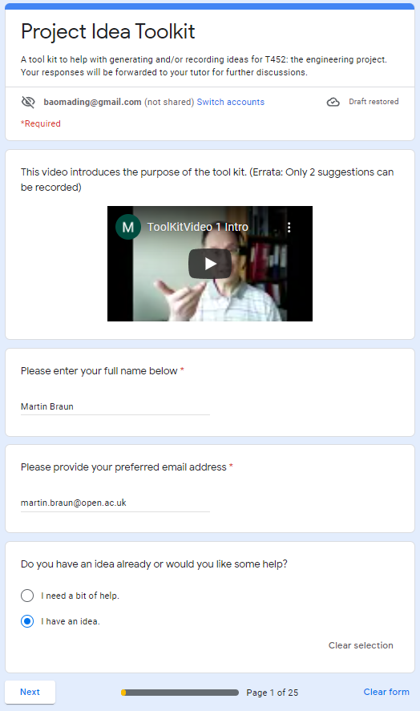
First section: Choose idea or not
Run workshop
to introduce toolkit
Notes:
https://docs.google.com/forms/d/e/1FAIpQLScFIHhIbOOEETFWxpHLKaw9I8ds85_Btw5allcJTmqWgAAq2w/viewform

Slide 12
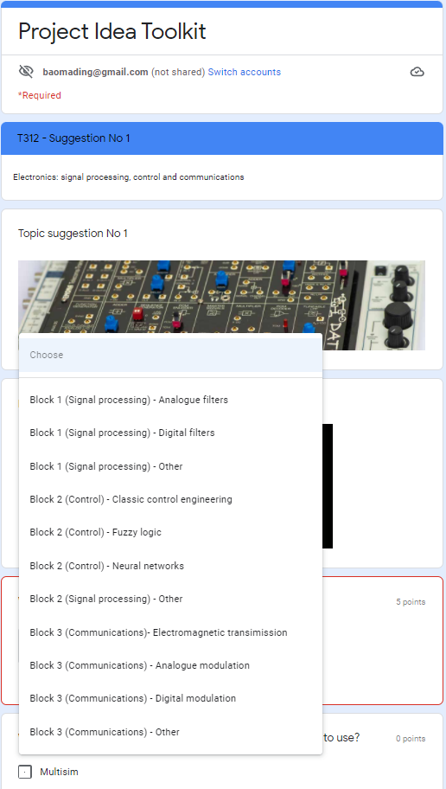
Have idea ➔ Suggestion form

Slide 13
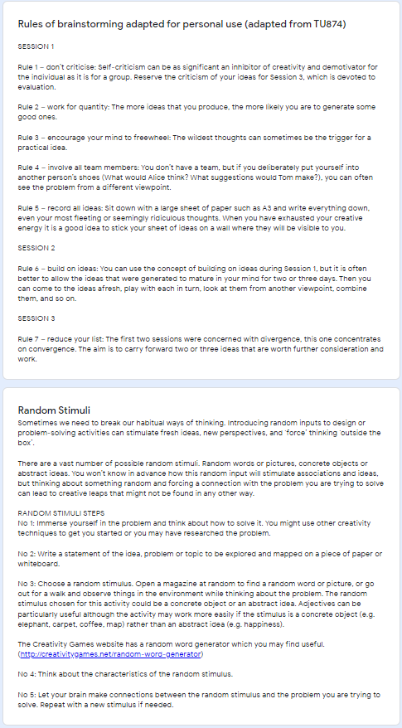
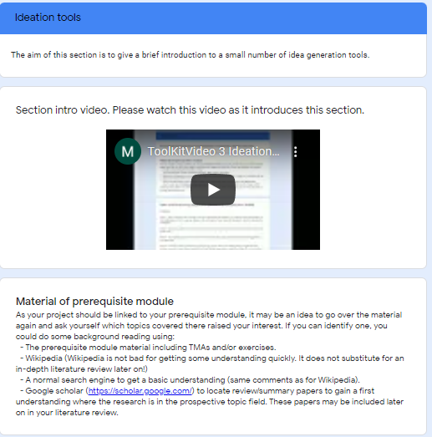
No idea ➔ Ideation section

Slide 14
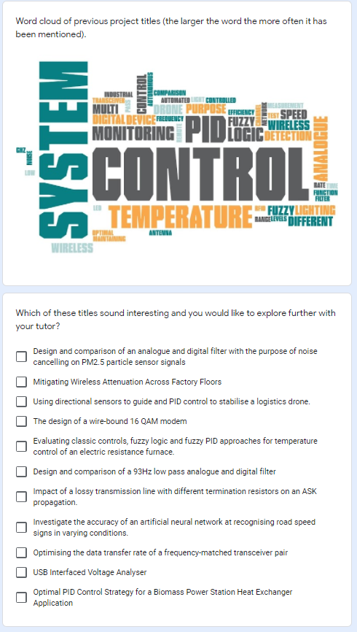
Sample of previous project titles

Slide 15
What we found
Section 4

Slide 16
Studying student ideation
Impact of workshop (Entry/exit polls)
8 students and five T452 tutors
Questionnaire after workshop
8 students
Interviews with students after proposal feedback received
3 students (also discussion with tutors)

Slide 17
What we found
Workshop/questionnaire:
Only one student had a clear idea
Concerned about level of project idea
Discussion of ideation tools helped develop project ideas
Interviews:
Students benefited from facilitated workshop
Other in same boat, explanation of ideation tools
Students found most of the toolkit useful
Both parts useful, usability needs improving
➔ Project modules need to develop creative skills
➔ Clear guidance to appropriate level

Slide 18
THANK YOU

