Slide 1
Online Team Investigations in Science (OTIS) – Work in progress
Mark Jones, Susanne Schwenzer, Ulrich Kolb, Judith Croston, Sheona Urquhart and Sarah Chyriwsky

Slide 2
OTIS
Team investigations in OU modules
Astronomy / Planetary Science
S382 – PIRATE robotic telescope
S382 – SDSS telescope data
S818 – Mars rover simulation
Features
Advanced undergraduate / taught postgraduate
Team working projects
Use synchronous as well as asynchronous communication tools
Varied models of assessment
Why this study?
Anecdotally, these team working investigations seem to be enjoyable and effective.
We want a more scholarly analysis so we can understand these teaching activities in depth.

Slide 3
OTIS
Cooperative learning in STEM subjects
Why adopt cooperative learning? (small groups working towards a common goal)
In face-to-face context, has long been recognised (e.g. Springer, Stanne and Donovan, 1999) as leading to improved student outcomes (in terms of assessment) in STEM subject areas.
Cooperative learning mirrors the collaborative working approaches used in STEM research and employment – develops skills of team-working
Challenges to cooperative learning in the distance learning environment
Interactions through CMC
Accessibility issues related to types of CMC adopted
Student availability
Student attitudes to cooperative learning

Slide 4
OTIS
Themes in understanding online cooperative learning
Online cooperative learning
Examples of cooperative working in the online environment: computing (Minocha and Thomas, 2007), psychology (Robinson, 2013).
The mode of communication is clearly a very important factor, but it is far from being the whole story.
Pedagogic design
Student engagement and ownership of task
Peer-learning
Role of assessment
Group dynamics
Gender differences in participation

Slide 5
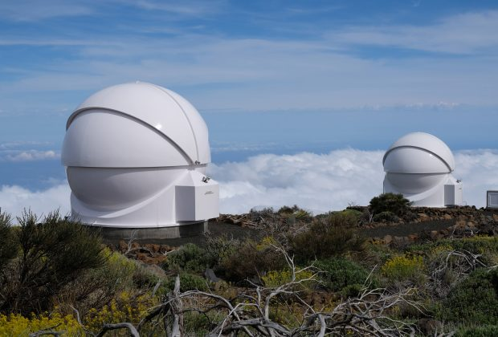
OTIS
S382 – PIRATE robotic telescope
Level-3 module ‘Astrophysics’
Astronomical observation and data reduction addresses practical skills development.
Rationale for team approach:
efficient use of facilities
project tasks can be sub-divided between a group
peer-learning
Task: To make new observations of a candidate variable star over a sufficient length of time that the nature of the variability can be determined.
Duration: 9 study weeks
Group size: 6 to 10 students
Assessment:
50% on a group report (written as a wiki)
50% on individual progress report (compiled weekly)

Slide 6
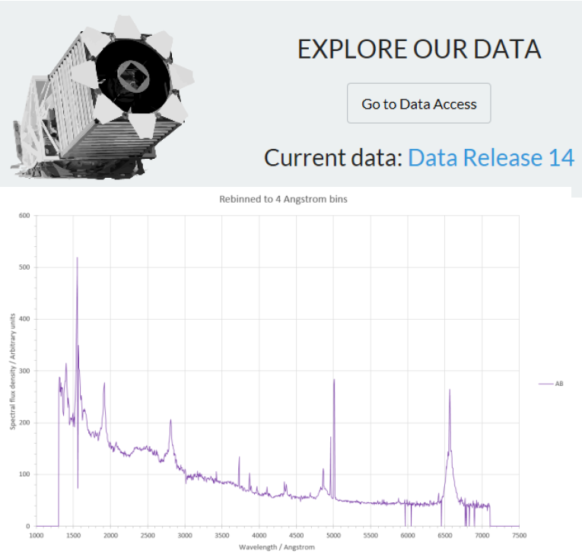
OTIS
S382 – SDSS research database
Level-3 module ‘Astrophysics’
Astronomical data analysis addresses practical skills development. (Trend in astronomy is for increased use of automated surveys.)
Rationale for team approach:
project tasks can be sub-divided between a group
peer-learning
Task: The Sloan Digital Sky Survey contains optical spectra of many quasars. Students are asked to create a composite spectrum (extending into the ultraviolet) of quasars and assess whether this composite can be considered representative of quasars in general.
Duration: 9 study weeks (5 weeks in team working)
Group size: 6 to 10 students
Assessment:
50% on a group report (written as a wiki)
50% on individual progress report (compiled weekly)

Slide 7
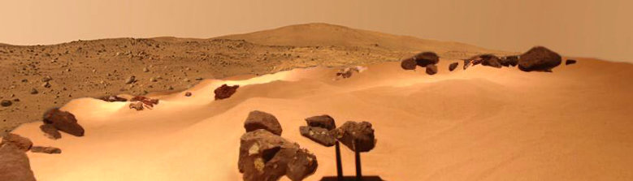
OTIS
S818 Mars rover simulation
Taught postgraduate module in space science
The Mars rover mission simulation develops skills in online team-working that are needed for space operations.
Rationale for team approach:
Space mission operations require a team approach to ensure that the science goals are achieved based on analysis of science/engineering data and subject to engineering constraints.
Peer learning
Self-reflection on performance in team
Task: Explore a simulated Martian environment to search for geological signatures of the presence of water in the past. Rover has cameras and (simulated) analytical instruments.
Duration: 1 study week
Group size: 10-15 students
Assessment:
Self-reflection exercise (20% of the EMA)

Slide 8
OTIS
Methods and data
Two approaches:
Synoptic analysis of online communications (forums, wiki)
in-depth interviews with a sample of students
The synoptic approach should allow us to analyse trends of behaviour and identify factors and themes that require deeper study.
The interviews will probe student perceptions and will allow in-depth questioning: this will be especially useful for eliciting views that students are unlikely to share in the team setting.
Cohorts in study – student numbers
S382-16J: 72 (PIRATE), 92 (SDSS)
S382-17J: 47 (PIRATE), 93 (SDSS)
S818-17B: 51
S818-18B: about 50
We will characterise the cohorts by gender balance.
We will also use posting data to characterise the degree of activity taking place in project forums.

Slide 9
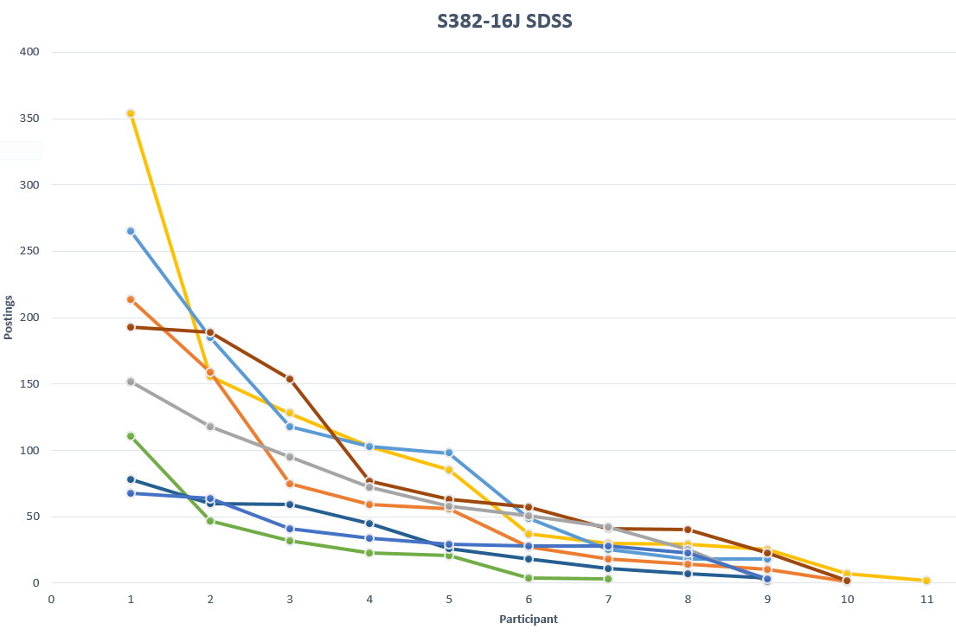
OTIS
Posting activity - example

Slide 10
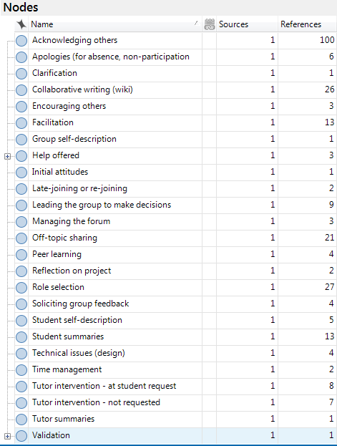
OTIS
Synoptic data
Accessible sources of data:
Forum discussions (all modules)
Report wikis (S382 only)
The forum data will be analysed qualitatively by theme.
Preliminary inspection of data suggests that this is useful for drawing out information related to
student engagement
group dynamics (forming, sustaining)
peer learning
Example (preliminary inspection) – shows a lot of activity related to peer acknowledgement and team self-organisation

Slide 11
OTIS
Structured conversations
With a small sample (six) from each project: (sample selection to be representative where possible)
In-depth discussion to explore all themes, but in particular to draw out information that is not usually disclosed online.
Example questions/prompts
Were there aspects of the way in which the activity was structured that were problematic or could be improved? [Pedagogic design]
Can you tell me how you felt about the assessment task (or tasks) that related to this activity?
[Assessment strategies]
Overall, how would you describe the experience of working on a group project? [Student engagement, general]
Do you think it is important for students to engage in this type of group activity? [Student engagement].
Analysis
Qualitative thematic analysis of transcripts

Slide 12
OTIS
Concluding comments
A deeper understanding of team working investigations is important for the development of similar teaching tasks across STEM, but also more generally across the University.
The findings of the studies should contribute to the professional practice of staff that are planning, designing or running similar activities.
This study will be of interest to the wider HE community in terms of its analysis of student engagement, and application to employability in an increasingly online world.
We also anticipate that the project could have higher-level implications for the University’s approach to collaborative online learning.
“Thanks Chris and to everyone else who's been so active this last week getting the wiki finished on time. The final report is just amazing! Incredible to read what we've acheived as a group over the last 10 weeks.”

Slide 13
m.h.jones@open.ac.uk

