Slide 1

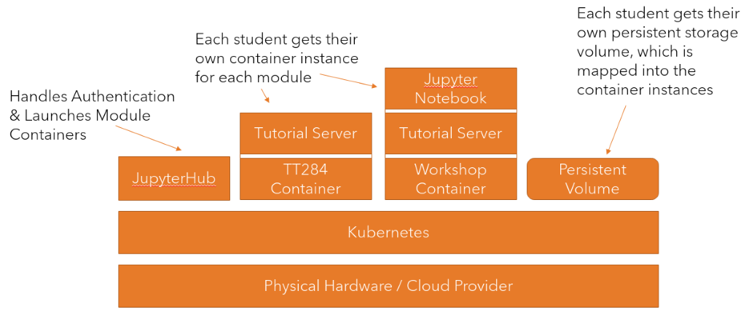

Modern Container-based Learning Interface and Delivery Infrastructure (MCLIDI)
Mark Hall, Soraya Kouadri Mostéfaoui
Project Aims
- Deploy and evaluate a modern container-based learning interface and delivery infrastructure, focussing on supporting:
* Neurodiverse students
* Students with disabilities (vision and motor-skill impairments)
* Dyslexic students.
Objectives
- Understand technologies and requirements for students with disabilities and neurodiversities
- Develop the new learning interface and delivery infrastructure for TT284-21J
- Gather feedback from students and ALs, as well as automatic monitoring of their interactions with the system
- Analyse the students’ and ALs’ feedback together with the collected analytics data
Outputs
- Improved student learning experience
- Better student satisfaction, and improved retention,
- An understanding of the cost impacts of this approach.

