Slide 1
Drop-in tutorials to support assessment
Presenter: Maria Townsend and Emma Champion
Project team: Maria Townend, Emma Champion and Wendy Berndt

Slide 2
Plan for today
Introduction to the project
Tutorial organisation
Evidence collected
Main findings – student and tutor experience
Impacts to date
Thoughts for the future
Time for questions

Slide 3
Project aims and anticipated outcomes
Aims
  Assessing the value to students of online drop-in tutorials to support assessment
  Understanding student behaviour and how they experienced drop-in tutorials
  Appreciating the tutor experience of running drop-in tutorials
Anticipated outcomes
  Increased student confidence with assessment
  Inform future tuition strategies
  Guide for tutors on running drop-ins to support assessment

Slide 4
Context
Online tutorials are generally tutor-led, including a mix of presentation and activities
Still reluctance from some students to actively participate in tutorials
Butler et al. (2018) concluded module tuition strategies could include:
‘A greater variety of types of well signposted, small group tutorials, clearly defined in terms of expectations of active student participation, including drop in support, clinic, problem solving, skills focused sessions, assessment focused sessions.’
Anecdotal evidence from informal inclusion of drop-in tutorials indicated that students had found them useful.
Our project:
Included online drop-in tutorials for students to ask questions about each TMA on U116 (20J)

Slide 5
Tutorial organisation
Careful wording of tuition strategy to set student expectations.
Tutorial name: TMA01: Drop-in with your questions.
Tutorial student description: This is a less formal online tutorial for you to ask questions to aid your understanding of the requirements of TMA01. It will not be recorded.
Cluster tutorials
Experienced U116 ALs recruited to run the tutorials – two ALs per cluster
One drop-in tutorial per TMA, except TMA01 (two events)
Tutorial window – 10 days before the TMA cut-off date
Not recorded
No formal presentation
AL briefing at module start

Slide 6
Evidence
Students
Two student surveys – December 2020 and May 2021
One student-led focus group April 2021
TMA confidence poll in tutorials
Drop-in tutorial attendance data
Achievement on module
Tutors
Reflections after each tutorial

Slide 7
Main findings – students
23% of U116 students attended at least one drop-in tutorial
The majority of students:
arrived at the start and stayed until the end (not a drop-in?)
used the chat box to ask questions
Most students reported:
listening to other questions/answers was useful
the drop-ins had helped them to complete the TMA (76% and 84%)
an increased confidence with TMAs (94% and 96%)
likely to attend in future (90% and 84%)
found the drop-ins a useful complement to the other tutorials (90% and 88%)

Slide 8
Main findings - students
Some students:
Had no questions but attended to listen to other questions/answers
A very few students:
Had a question but were not confident enough to ask it

Slide 9
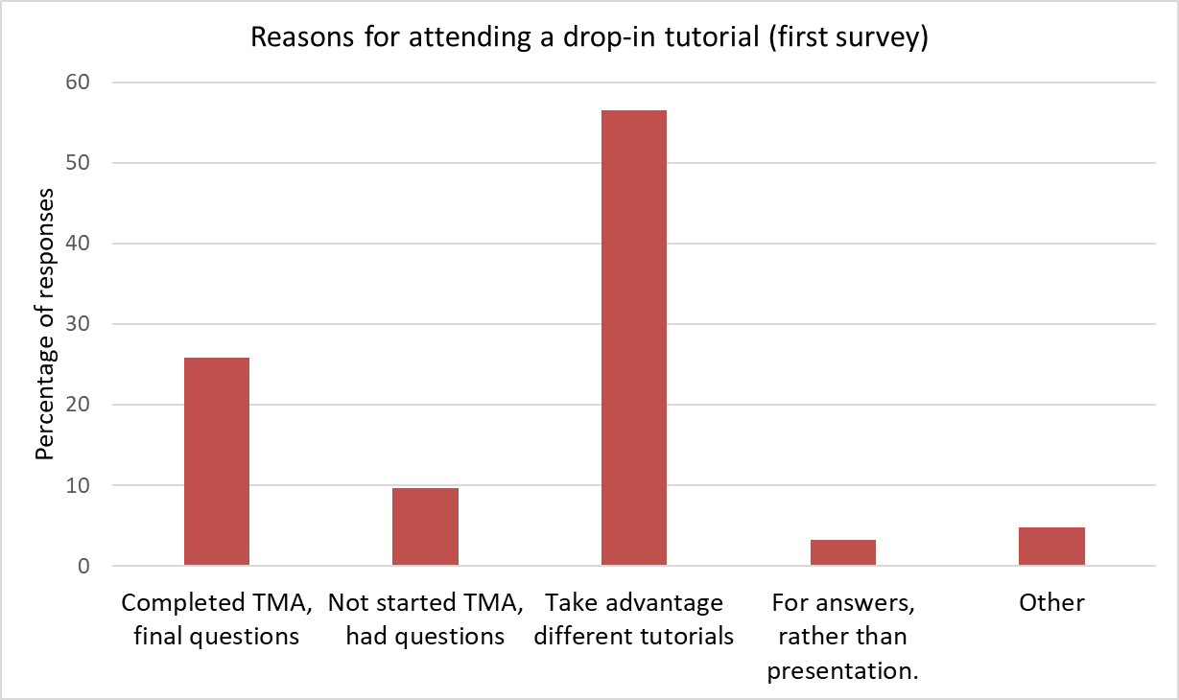
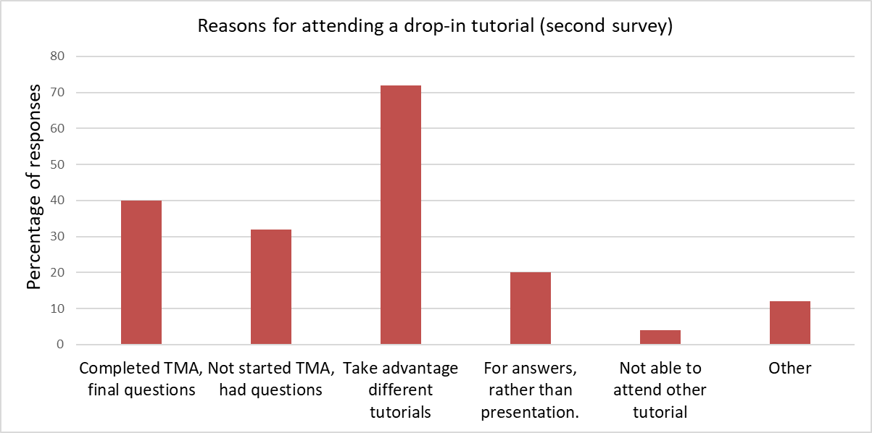
Reasons for attending a drop-in
Both surveys - top three reasons:
To take advantage of the different tutorials available to students
Had completed the TMA but had some final questions
Had not started the TMA and had some questions.

Slide 10
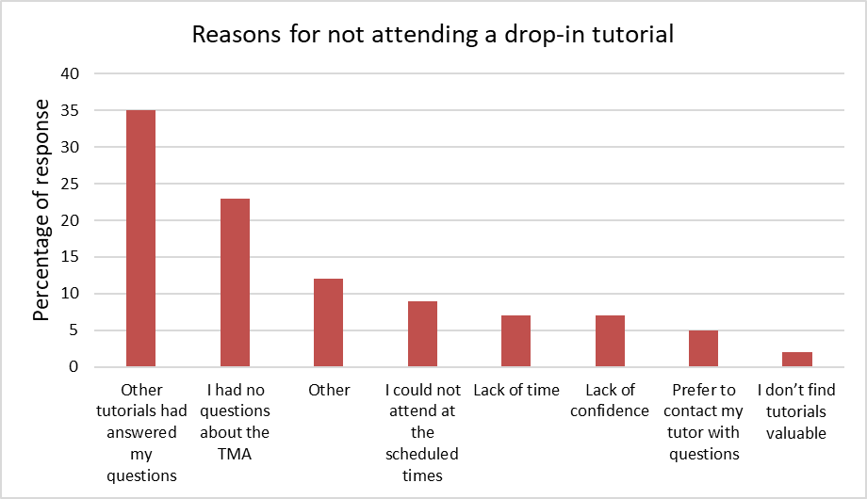
Reason for not attending a drop-in tutorial (first survey only)

Slide 11
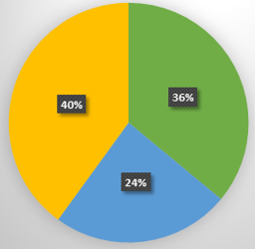
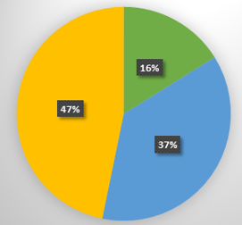
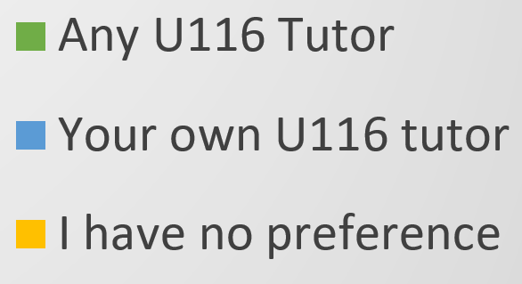
Student tutor preference
First survey (Dec 2020)
Second survey (May 2021)
Most students did not have a preference for their own tutor to run the drop-in tutorial

Slide 12
Tutor experience
Tutors felt the combination of standard and drop-in tutorials was valuable
Tutors enjoyed running the drop-ins
Helpful to have the TMA questions presented on slides
Challenges
  Silence
  Rush of questions in the chat
Reflections from tutors also backed-up some of the reported student experience

Slide 13
Tutor tips
Before tutorial:
Remind students beforehand of the tutorial purpose
Slides with the TMA questions
Prepare examples for questions relating to maths or chemistry.
During tutorial:
Remind students are free to leave after asking their question
Be prepared for a rush of questions at start. To manage:
Invite questions about each TMA question in turn
Ask students to re-ask questions if missed
Try not to fill silences – leave space for students to ask questions
Have prompts ready relating to common queries
Ask students to be specific about TMA questions they are referring to
Be ready to share module resources if appropriate (via screen share).

Slide 14
Impacts to date
Students attending drop-in tutorials in 20J about 3 percentage points higher on Overall Module Score and EMA score
Drop-ins to support assessment included in U116 tuition strategy & two other School of Engineering & Innovation modules (L2 & L3)
One module is using them outside of the tuition strategy
Guide for running drop-ins produced

Slide 15
In the words of the students
Useful as the free structure was refreshing
It is the best hour I spend each month since I have been with the OU
It was like a bonus session
It is reassuring when you hear other people have similar questions.
Drop-in tutorials act as an emergency back-up to standard tutorials
Helpful, confidence building, insightful

Slide 16
In the words of the tutors
I confess I was a little doubtful at the outset… But it seems the lack of any formal tutor presentation changes the way students approach the tutorial – a switch from relatively passive consumption to much more active co-production
Lots of questions and peer-to-peer support in the chat box
Students were initially very quiet and hesitant in coming forward with questions, though once I provided some structure student questions began to flow naturally (I simply read through each of the TMA questions and asked them how they felt…)
Students starting answering each other’s questions……showed they were paying attention to each other

Slide 17
Final thoughts
Students have other means of asking questions (other tutorials, contacting tutor directly, forums) but they still attended the drop-ins and found them valuable.
Would drop-ins not related to assessment be as well attended?
Most students weren’t using these as drop-ins – so should they have an alternative name? Does it matter?
How could online drop-ins translate to modules with more use of specialist notation?

Slide 18
Thank you & Questions

