Slide 1


Closing the awarding gap – listening to Black science students
Louise MacBrayne, School of Life, Health & Chemical Sciences
Jennie Bellamy, School of Environment, Earth & Ecosystem Sciences
Angela Richards, School of Life, Health & Chemical Sciences
Elaine McPherson, School of Environment, Earth & Ecosystem Sciences

Slide 2
Contents
Project Background
Research Questions
Research Aims
Research Methodology
Intersectionality Study
Statistical Testing
Focus groups and interviews
Impact and Recommendations
3
4
5
6
7
12
14
18

Slide 3
Project Background
S112 Science, Concepts and Practice is an interdisciplinary level one Science module with a typical cohort of around 1800 students and is compulsory in 16 STEM qualifications (including BSc single honours) and optional in 23 further qualifications.
Preliminary data (17J – 19J) for S112 suggested that there was an awarding gap for Black students vs White students on S112 when looking at module pass rate, despite comparable completion rates, most notably in the 19J presentation, where the gap was the highest noted to date at 32%.

Slide 4
Research Questions
1
What are the needs of Black students in S112 and possible barriers to their study?
2
What could be influencing the experience and outcomes for Black students in S112?

Slide 5
Research Aims
1
To develop understanding of issues faced by Black students throughout S112 module presentation, including a focus on the revision period leading up to and including the exam.
2
To raise awareness of these issues amongst STEM staff including module tutors, student support staff, and module teams.
3
To consider how S112 tutors could adapt their tuition practice to respond to Black students’ needs throughout the module presentation as well as to support exam preparation and practice.
4
To consider module wide interventions (including module material modification and changes to assessment strategy and tuition) to support and improve Black student experience and success on S112.

Slide 6
Research Methodology
Intersectionality Study
To investigate whether S112 Black students face a double disadvantage (17J – 21J)
Ethnicity and Index of Multiple Deprivation (IMD)
Ethnicity and gender
Ethnicity and parents in Higher Education (‘first in family’)
Statistical Testing
A statistical significance test (Mann Whitney U) was undertaken to determine whether there was a statistically significant difference between
17J-21J Black students’ and White students’ average module scores
17J-21J Black students’ and White students’ first-time pass rates
17J-21J Black students’ and White students’ completion rates
Focus Group and Semi Structured Interviews
Online focus group (December 2021) with a culturally appropriate facilitator
1:1 semi structured interviews (January 2023)

Slide 7
Research Methodology
Intersectionality Study
To investigate whether S112 Black students face a double disadvantage (17J – 21J)
Ethnicity and Index of Multiple Deprivation (IMD)
Ethnicity and gender
Ethnicity and parents in Higher Education (‘first in family’)
Statistical Testing
A statistical significance test (Mann Whitney U) was undertaken to determine whether there was a statistically significant difference between
17J-21J Black students’ and White students’ average module scores
17J-21J Black students’ and White students’ first-time pass rates
17J-21J Black students’ and White students’ completion rates
Focus Group and Semi Structured Interviews
Online focus group (December 2021) with a culturally appropriate facilitator
1:1 semi structured interviews (January 2023)

Slide 8
Intersectional Study
Data for students at the following three intersections were analysed:
Ethnicity and Index of Multiple Deprivation (IMD) where IMD1 is the most deprived 20% of UK postcodes and IMD5 is the least deprived 20% of UK postcodes
Ethnicity and gender (M/F, currently inadequate data for other genders)
Ethnicity and parents in Higher Education (‘first in family’)

Slide 9
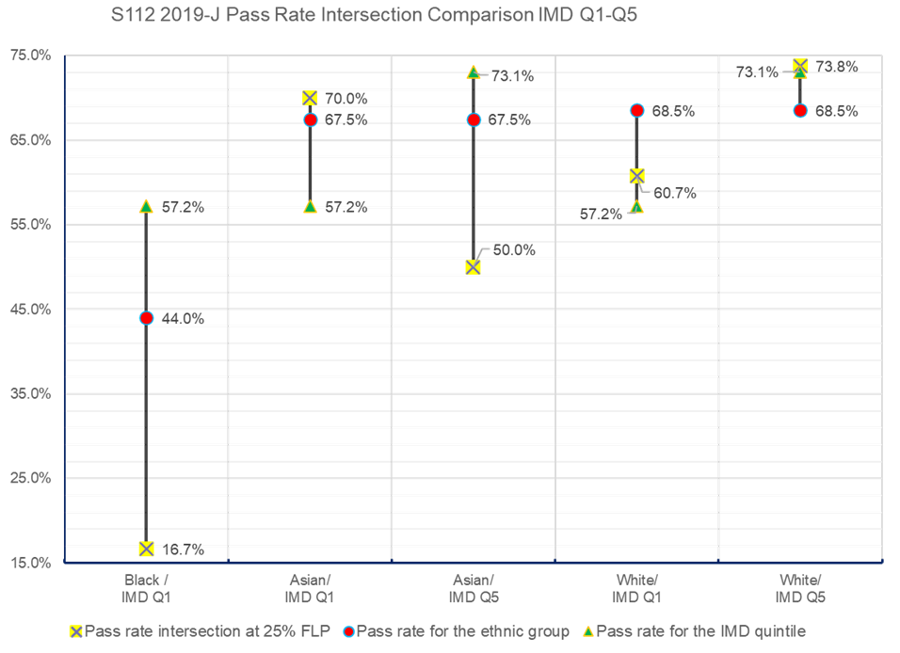
Pass rates by ethnicity and IMD status
Pass rate comparison for students of different ethnicities and their IMD status for the 19J presentation of S112. A consistent double disadvantage was found for Black students in IMD1 postcodes

Slide 10
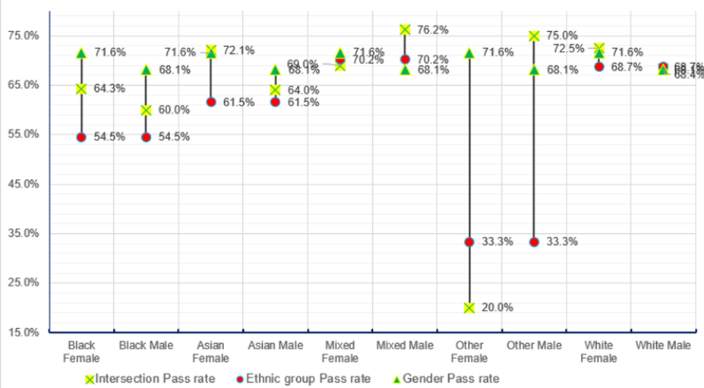
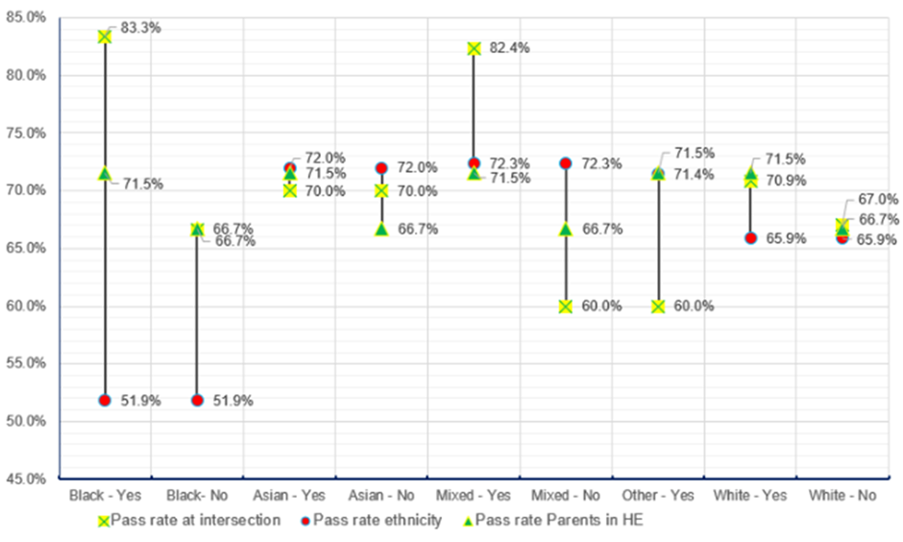
Pass rate by ethnicity vs gender and ethnicity vs first in family
Pass rate comparison for students of different ethnicities and gender e.g. for the 20J presentation of S112 (left) and for students of different ethnicities and their ‘first in family’ status e.g. for the 21J presentation (right). No consistent double disadvantages were found.

Slide 11
Research Methodology
Intersectionality Study
To investigate whether S112 Black students face a double disadvantage (17J – 21J)
Ethnicity and Index of Multiple Deprivation (IMD)
Ethnicity and gender
Ethnicity and parents in Higher Education (‘first in family’)
Statistical Testing
A statistical significance test (Mann Whitney U) was undertaken to determine whether there was a statistically significant difference between
17J-21J Black students’ and White students’ average module scores
17J-21J Black students’ and White students’ first-time pass rates
17J-21J Black students’ and White students’ completion rates
Focus Group and Semi Structured Interviews
Online focus group (December 2021) with a culturally appropriate facilitator
1:1 semi structured interviews (January 2023)

Slide 12
Statistical Significance Tests
Mann Whitney U tests were undertaken to look for significant differences between Black students and White students in module outcomes.
The results confirmed our impressions that Black students complete S112 at a similar rate to White students but are less likely to pass first time and less likely to be awarded a high score.
Average Module Score
Statistically significant difference
First-time pass rate
Statistically significant difference
Completion rate
No statistically significant difference

Slide 13
Research Methodology
Intersectionality Study
To investigate whether S112 Black students face a double disadvantage (17J – 21J)
Ethnicity and Index of Multiple Deprivation (IMD)
Ethnicity and gender
Ethnicity and parents in Higher Education (‘first in family’)
Statistical Testing
A statistical significance test (Mann Whitney U) was undertaken to determine whether there was a statistically significant difference between
17J-21J Black students’ and White students’ average module scores
17J-21J Black students’ and White students’ first-time pass rates
17J-21J Black students’ and White students’ completion rates
Focus Group and Semi Structured Interviews
Online focus group (December 2021) with a culturally appropriate facilitator
1:1 semi structured interviews (January 2023)

Slide 14
Focus Groups & Semi structured interviews
Focus Groups
Interviews
19
36
No. of students invited
No. of students invited
10.5%
5.6%
2
2
No. of students in focus group (Dec ‘21).
No. of students interviewed (Jan ‘23).
Themes identified:
Representation
Sense of Belonging
Student costs
Motivations for study
Being time poor
Students also identified the importance of a culturally appropriate focus group facilitator/interviewer
“If you had received this invitation from a white lecturer, do you think you would have still engaged in this process? “

Slide 15
Focus Groups & Semi structured interviews
Themes
Representation
Sense of Belonging
Student costs
Motivations for study
Being time poor
“I’m in my last year of environmental science and not one of the modules has taught me about a black environmental scientist”
“If there are no Black people in the curriculum where else am I going to look?”
” it's not for Black people it's for white”
“We clearly do not feel represented in any of the curriculum, and that’s including in S112”
“I’ve just learned about White scientists, which is good but it’s not equal”
“Every exam that I attended I was the only Black person there”
“To have a [Black] partner to study with, that would be nice’”

Slide 16
Focus Groups & Semi structured interviews
Themes
Representation
Sense of Belonging
Student costs
Motivations for study
Being time poor
” When you don’t have time to really study as much as you would like to, you are basically whizzing through everything”
“The experiment it assumed that you had certain things in your house, it assumed that you had a freezer and a fridge, it assumed that, you know, you had everything in your house and they don’t support you”
” Times are hard, and you are trying to salvage whatever”
“Knowing that you have somebody similar to you doing the same thing, it is a big motivation”
“Having to give an alternative option for the experiment was like us asking for too much”
“I need to do what’s best for my children, and show them that they can achieve – no matter who they are or – we are Black, yes, and there are things that seem to be directed at us so we have to kick through to make sure we get what we want done, and we have to, you know, go to extreme levels”
“I just wanted to better myself and come out and be able to obtain a career in the Sciences”

Slide 17
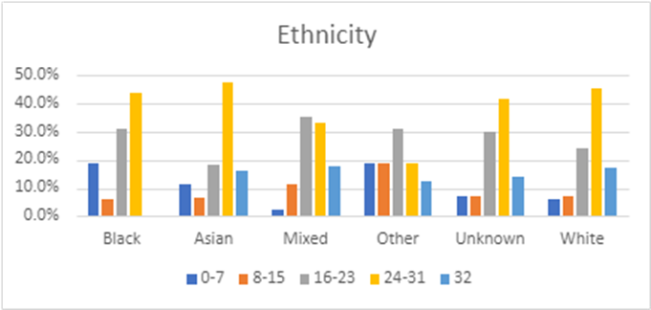
Student cost theme: Analysis of TMA scores
Scores (out of 32) by ethnicity for a TMA01 question based on the write-up of a collaborative 'kitchen experiment’, requiring access to a fridge and/or a freezer
vertical scale - % of students achieving each score band, horizontal scale – score bands by ethnicity
Analysis of TMA scores by question revealed that Black students are less likely to score well on the question assessing the home experiment in comparison to other ethnicities

Slide 18
Impact
Impact on Teaching and Learning
S112 was included in a pilot run of the Inclusive Curriculum Tool in August 2022
S112 content was updated to replace images of White scientists with scientists representing a more diverse ethnicity (and gender), together with a greater emphasis on global representation
Production of a new video to show the set up and results from the topic 2 kitchen experiment, assessed in TMA01, for which many Black students had previously shown a low question score. This video also enabled Black students to see a Black OU scientist performing science thereby helping to address the lack of representation in module materials

Slide 19
Impact
Other Impact
In 21J, it was decided to allow all students direct access to the online alternative resources for any home experiment, thereby removing the requirement for students to have to request permission to use alternative resources and the possible stigma/embarrassment associated with this
The theme of student financial deprivation identified in our focus group has resulted in the setting up of a further eSTEeM project to explore the impact of the cost of home experiments on student learning in both S111 and S112

Slide 20
Impact
Impact on Awarding Gaps
Whilst the awarding gap does appear to have reduced on S112 overall, the confounding effect of the pandemic makes causality difficult to attribute.
The awarding gap for S112 for Black vs White students has remained at a consistent level since 20J.
Faculty level awarding gaps for Black vs White students have increased since 19J, however the awarding gap on S112 has decreased and is now below that of the Faculty, although remains higher than the Institutional level.
It is hoped that longer term recommendations from this project will continue to improve Black student success on S112 and beyond.
Academic Year | Institution | STEM | S112
19-20 | 10% | 13.4% | 24.5%
20-21 | 11.4% | 17.4% | 14.2%
21-22 | 11.9% | 18.5% | 14.1%

Slide 21
Recommendations
The project makes the following recommendations:
Build a sense of Belonging: enable Black students to find each other
Reverse a lack of representation: Include Global South researchers and their work in module content
No additional costs of Study: alternative online study materials made available to all students
Listen to students: anonymous feedback tool similar to ‘Report and Support’
Increased awareness of students residing in IMD1 postcodes: Consider use of an IMD Q1 flag (similar to the “carer” flag)

Slide 22
Any Questions?
Link to eSTEeM project page:
Black student experience and attainment on S112: improving a level 1 STEM module | eSTEeM (open.ac.uk)

Slide 24
Questions you might have in mind
…or aspects we as a team are wondering
Can you say a bit more about challenges you had with recruitment and how you overcame them?
What if there are only European or North American resources available? How is it then possible to include Global South researchers and their work in module content?
How can we get the views of Black students and enable them to feel comfortable to share their voice when there are negative aspects?

