Slide 1

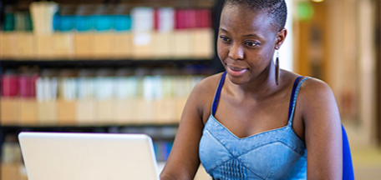
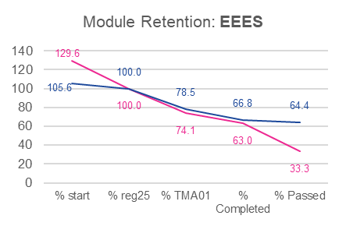

Black student experience and attainment on S112: improving a level 1 STEM module
Louise MacBrayne, Jennie Bellamy
Data (for 2015-18) produced by the Strategic Analytics Team, seems to indicate that pass rates for black students in EEES have previously been low despite completion rates closer to the rest of the cohort.
Registrations for black students in EEES are low and currently the majority are studying S112. Pass rates for black students (pink line) were approximately half that of the non-BAME students (blue line).
Preliminary data collected for S112 suggests that there is an awarding gap for black students on S112 when looking at module pass rate
Planned Research Methodology
The project will start by gathering and analysing S112 data around black students and will focus on the student journey:
TMA and exam scores across presentations, and other factors including study intensity, concurrent/ previous modules, credit transfer, employment status, caring responsibility, PEQ, socio-economic status.
Student-led focus groups will focus on identifying issues faced by black students on S112, including a focus on the revision period leading up to and including the exam.
.
At this preliminary stage the project has two overarching research questions:
What are the needs of black students in S112 and barriers in S112 to their study?
What reasons could be influencing the exam performance of black students in S112?
It is anticipated than longer-term outcomes will include developed understanding of the needs of minority students and more inclusive tuition practice.
It is hoped that this will provide a positive impact on students’ experiences and success including fostering a greater sense of belonging for the minority student demographic.

