Slide 1
Online Team Investigations in Science (OTIS) – Analysis of student interactions in team-working projects
Mark Jones, Sarah Chyriwsky, Judith Croston, Ulrich Kolb, Susanne Schwenzer and Sheona Urquhart

Slide 2
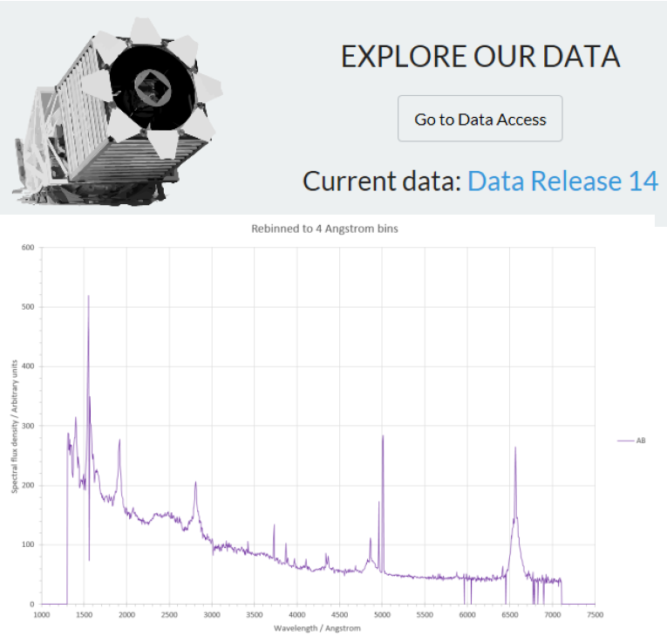
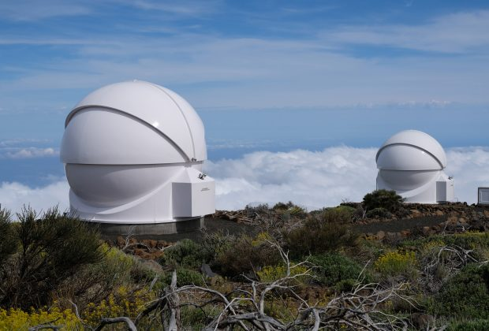
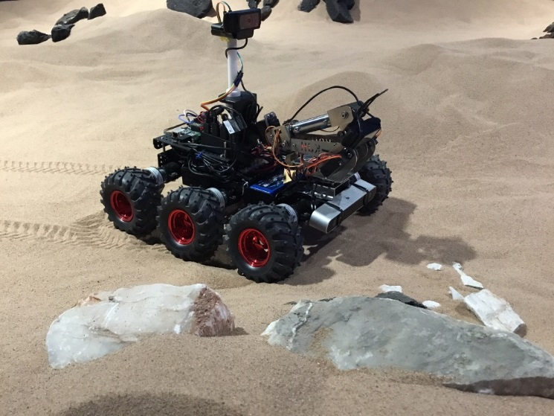
OTIS
Team investigations in OU physical science modules
Astronomy / Planetary Science
S382 – PIRATE robotic telescope
S382 – SDSS telescope data
S818 – Mars rover simulation
Features
- Advanced u/grad. and taught p/grad.
- Team working
- Synchronous and asynchronous communication tools
- Varied models of assessment
This work
Analysis of forum interactions as part of a wider project that also includes student interviews.

Slide 3
OTIS
Summary of projects – key differences
Project | Level | Duration | Comms | Assessment
PIRATE | U/grad | 9 weeks | Forums & synchronous (obs.) | Group report wiki, Individual progress
SDSS | U/grad | 5 weeks (9 weeks total) | Forum & synchronous (3+) | Group report wiki, Individual progress
ROVER | P/grad | 7 days | Forums & synchronous (daily) | Self-reflection exercise

Slide 4
OTIS
Forum data analysis
Sample
We restrict analysis to 3 forums for each project – i.e. 9 in total.
86 students involved in these 9 projects
4,187 forum posts included in analysis
Method
Thematic analysis using NVivo.
Manually coded (2 people, cross check by initial coding).
All content coded by theme (and by participant).
Item of coding – whole or part of forum posting that is linked to a theme.
After initial investigation, themes organised into a hierarchical structure.
Type | Students | Posts
PIRATE | 6 | 516
 | 7 | 259
 | 7 | 326
SDSS | 9 | 247
 | 10 | 567
 | 7 | 577
ROVER | 11 | 489
 | 16 | 371
 | 13 | 697
Notes:
(Each project forum is a few hundred pages). Hierarchical structure allows a view across the entire project – i.e. what the students discussing as a whole and important but infrequent detail.

Slide 5
OTIS
Top-level themes
Learning and development
Project management
Teaching support
Group building and social
Feelings
Notes:
Process – initially used a set of themes based on reading of transcripts and areas of interest.

Slide 6
OTIS
Hierarchical organisation of themes - example
Learning and development
Acknowledgement of mistakes
Peer learning
Writing process
Mention of existing skills...
Reflection on learning
Notes:
Isn’t time to describe the entire framework – 53 nodes in total. This just shows the next level down from “Learning and Development”

Slide 7
OTIS
Research questions based on the thematic analysis
Variation by project
1a. Does the distribution between themes differ between different projects?
1b. If, so can any insights be obtained as to why these differences arise?
Variation by gender
2a. Does the thematic distribution vary by gender?
2b. Is the contribution from female and male students similar?
Notes:
Variation by project – links to design of project and should provide insight about how to improve design/assessment
Gender differences – we need to know whether student gender plays has an effect in this mode of working.

Slide 8
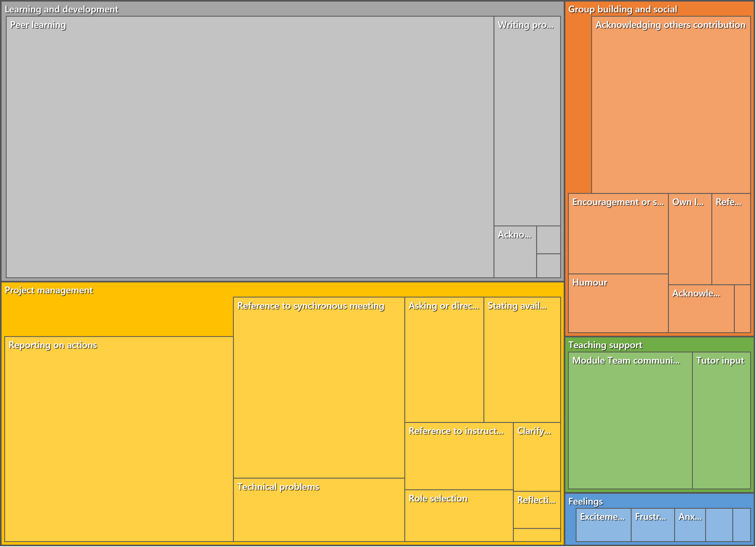
RQ1a
All projects
Area shows fraction of coded items by theme
Notes:
Mean values for all projects

Slide 9
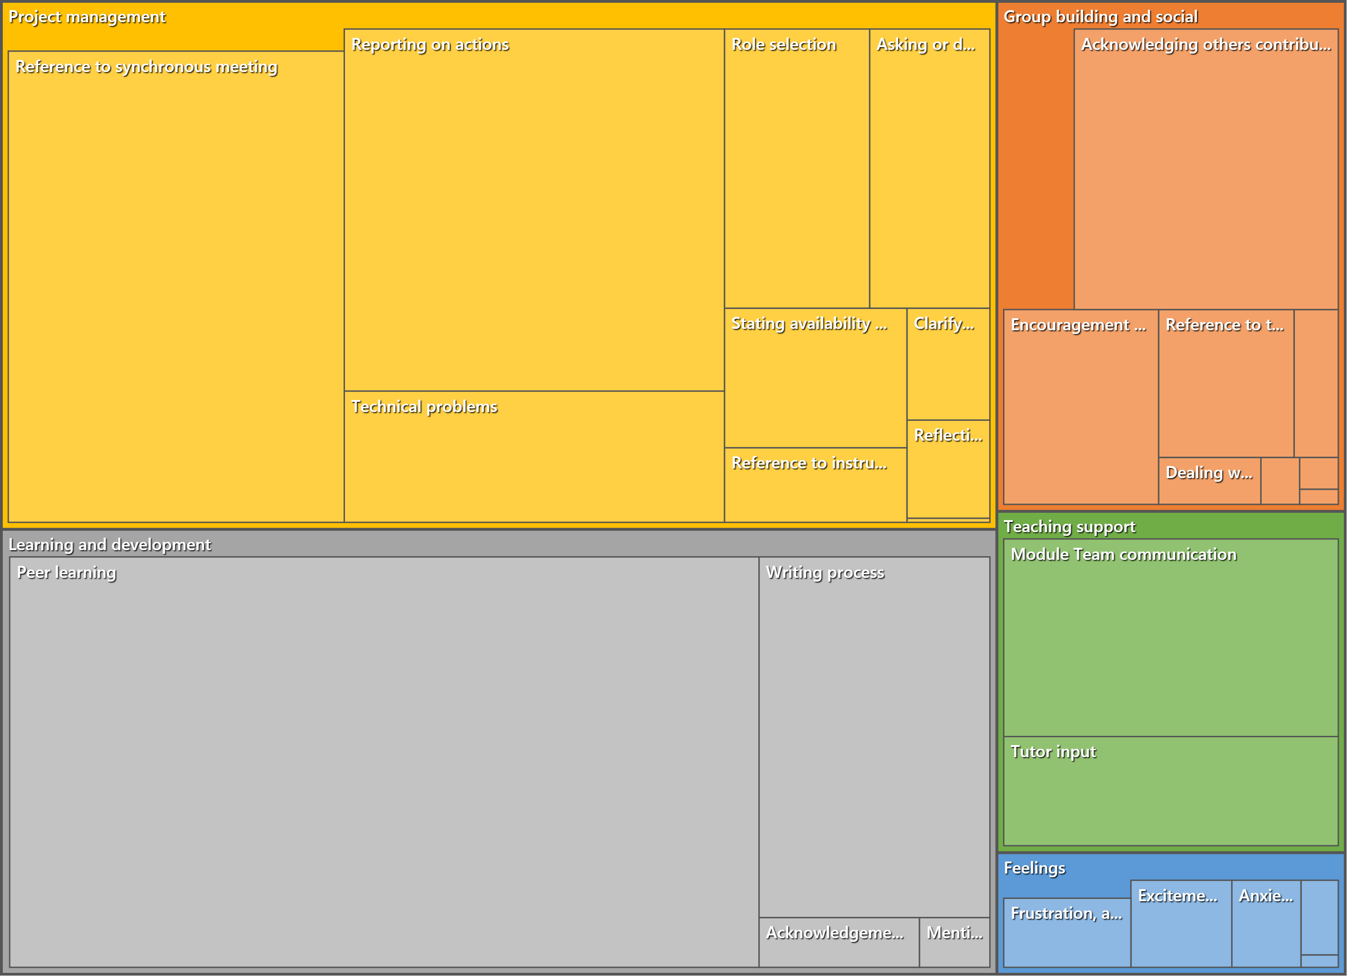
RQ1a
PIRATE
Notes:
Project management is slightly more than learning and development – due to nature of the project. Substantial teaching support – (practical work, so need night duty astronomer etc). More expression of feelings than other projects.

Slide 10
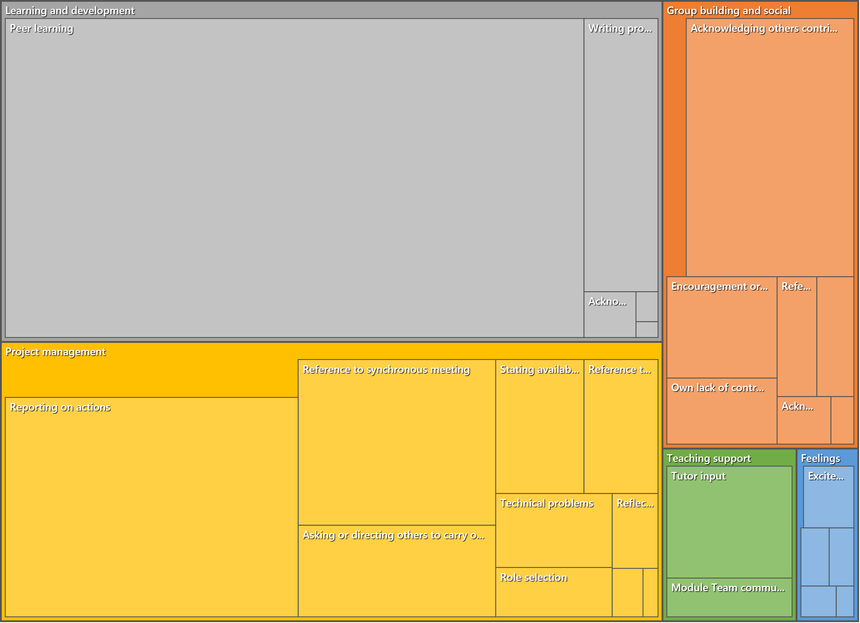
RQ1a
SDSS
Notes:
Balance shifted more to Learning and Development than Project Management – project is more straightforward than PIRATE. Group building and social is high. Teaching support is low – due to design of this project.

Slide 11
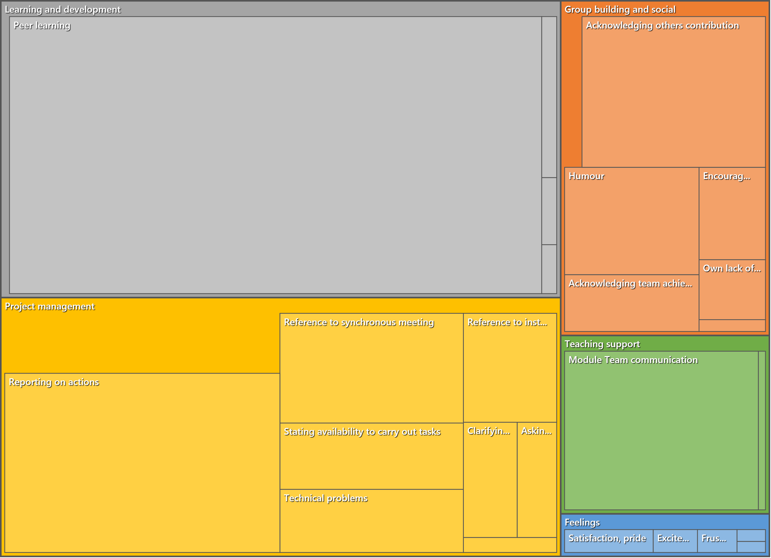
RQ1a
ROVER
Notes:
Learning and development and project management similar to SDSS. High group building and teaching support.

Slide 12
OTIS
RQ1a Top-level differences between projects
The total number of student contributed references in this sample:
SDSS – 2120
PIRATE – 1734
ROVER - 1768
Analysis based on student contributions only and expressed as a percentage of the total number of references.
 | SDSS | PIRATE | ROVER
2 : Feelings | 2.08% | 3.63% | 2.26%
8 : Group building and social | 16.84% | 15.11% | 17.87%
18 : Learning and development | 44.76% | 37.43% | 42.59%
32 : Project management | 36.32% | 43.83% | 37.27%
Notes:
Numerical data from previous slides – but now EXCLUDING teaching support – just the student input.
There is lot of information in the entire coding. As an example, just look at Feelings.

Slide 13
OTIS
RQ1b Example sub-level differences between projects
The total number of student contributed references in this sample:
SDSS – 2120
PIRATE – 1734
ROVER - 1768
Analysis based on student contributions only and expressed as a percentage of the total number of references.
 | SDSS | PIRATE | ROVER
2 : Feelings | 2.08% | 3.63% | 2.26%
3 : Anxiety | 0.42% | 0.75% | 0.17%
4 : Confusion | 0.28% | 0.35% | 0.17%
5 : Excitement, enthusiasm | 0.80% | 1.10% | 0.51%
6 : Frustration, anger | 0.38% | 1.10% | 0.45%
7 : Satisfaction, pride | 0.14% | 0.06% | 1.02%
8 : Group building and social | 16.84% | 15.11% | 17.87%
18 : Learning and development | 44.76% | 37.43% | 42.59%
32 : Project management | 36.32% | 43.83% | 37.27%
Notes:
Highlight that PIRATE prompts more expression of feelings than other projects. These are both positive & negative – may be because of excitement at using a real telescope but also the pressures associated with that.

Slide 14
OTIS
RQ2a. Does the thematic distribution vary by gender?
Notes:
Distributions are similar. Key difference is female students engaged more in group building and social.

Slide 15
OTIS
RQ2b Is the contribution from female and male students similar?
When contributions are broken down by female/male, the raw table is as shown.
However, the ratio of female to male students is 23:63 or 27%:73%
Since the ratio of overall postings is 38%:62% it is evident that the female students made a greater contribution.
 | FEMALE | MALE
2 : Feelings | 1.14% | 1.48%
8 : Group building and social | 7.08% | 9.60%
18 : Learning and development | 15.00% | 26.79%
32 : Project management | 14.83% | 24.09%
Total | 38.04% | 61.96%

Slide 16
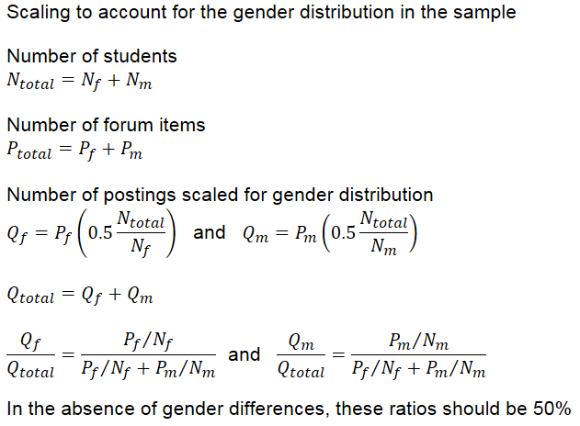
OTIS
RQ2b – accounting for the gender distribution in the sample
 | FEMALE | MALE
2 : Feelings | 68% | 32%
8 : Group building and social | 67% | 33%
18 : Learning and development | 61% | 39%
32 : Project management | 63% | 37%
Total | 63% | 37%
Notes:
Key point is that there female students contributed substantially more to the forums. This raises further questions: are the female students carrying out a disproportionate amount of the work? (Remember that forum is only part of the workload)

Slide 17
OTIS
Summary
Similarities and differences between projects
In these projects forum discussions, student communication appears to be distributed approximately as follows: ~40% learning, ~40% planning, ~15% group building, <3% expression of feelings.
The hierarchical approach allows areas of difference to be identified. E.g. PIRATE project seems to prompt expression of feelings.
Gender effects
In terms of the high-level themes – gender distributions are similar, although some evidence of more “group building / social“ from female students.
Major difference is contribution to overall forum content – when scaled for the gender ratio in the sample, female students seem to be making a significantly larger contribution.
Next steps
Using these data: in-depth look at e.g. peer-learning, especially using qualitative data.
Can also look at individual behaviours (such as dominance) and group dynamic.
Understanding of the student experience will be probed from interviews (14 students).
Notes:
Caveat – this is an early analysis!

Slide 18
m.h.jones@open.ac.uk

Slide 19
OTIS
Gender distribution by project
Notes:
In case asked about this.

Slide 20
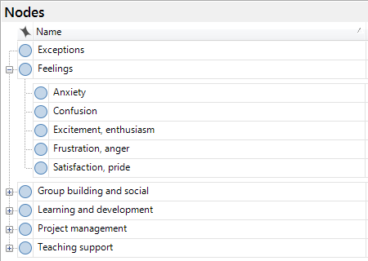
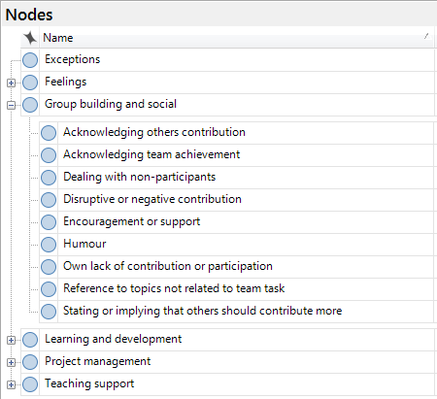
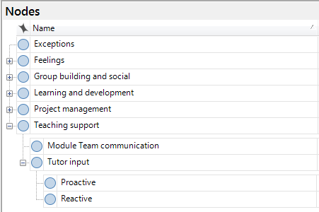
OTIS
Nodes
Notes:
In case asked about this.

Slide 21
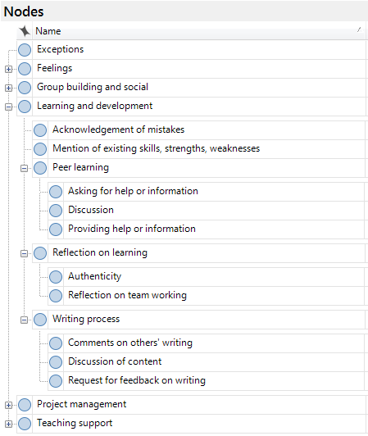
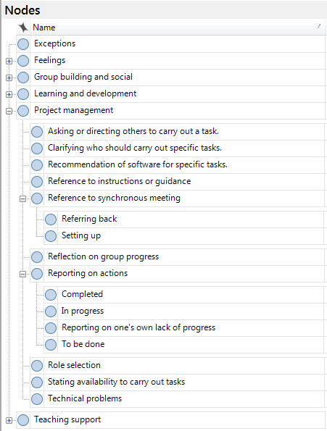
OTIS
Nodes
Notes:
In case asked about this.

