Slide 1

Mental wellbeing in distance learning: exploring barriers and solutions
Kate Lister

Slide 2

Welcome
What do you think are the main challenges for students’ mental wellbeing in STEM:
Curriculum
Tuition
Assessment?
Post your thoughts in the chat.

Slide 3


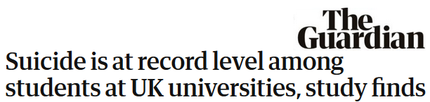
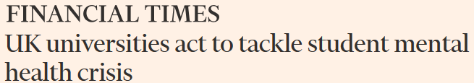

Slide 4
Mental health in HE
Research has shown that students with mental health difficulties are:
Less likely to complete a course or module (Richardson, 2015)
Less likely to continue after the first year (Baker, 2017; Office for Students)
Less likely to attain higher grades (Eisenberg et al, 2009; Office for Students)
More likely to experience long term consequences, e.g. future employment, earning potential and overall health (Eisenberg et al, 2007, Office for Students)
We also know:
University culture can trigger mental health issues (Tinklin et al, 2005; Markoulakis and Kirsh, 2013; Ribeiro et al, 2018)
Mental health declarations are increasing (sector average increase from 1.4 per cent in 2012-13 to 3.5 per cent in 2017-18)
Progression
Completion
Attainment
Employment

Slide 5
OU context: disability disclosure figures

Slide 6
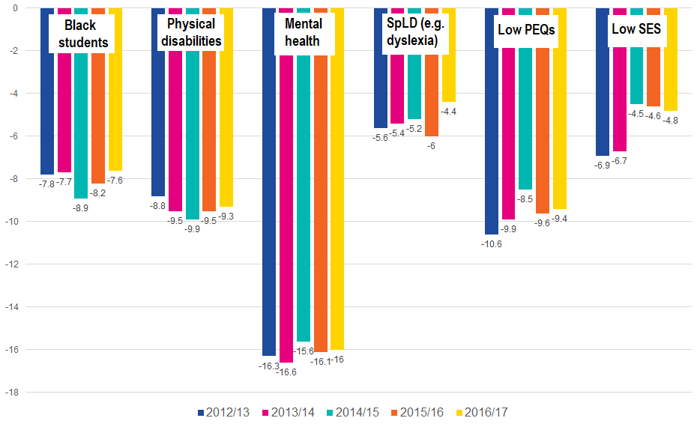
OU context: module completion gaps for APP reporting

Slide 7
What can we do about this?
Support
Support students with mental health needs in a timely way
Be proactive in promoting wellbeing and anticipating mental health triggers or issues
Empower students to build skills and strategies to overcome adversity, build resilience, manage their mental wellbeing and celebrate their achievements
Accept that HE needs to change, and work to understand how by learning about diverse student experiences and journeys
Adapt our modules, tuition, curricula and learning environments to reduce barriers, expand enablers and create solutions
Pre-empt
Empower
Learn
Adapt

Slide 8
Project: Towards embedding mental wellbeing in the curriculum
RQ1: What barriers and enablers to mental wellbeing do students experience in distance learning?
RQ2: What solutions do students and staff perceive would reduce these barriers?
RQ3: How can these solutions be embedded in distance learning?

Slide 9
Project stages
Stage 1: Interviews
16 x students told their stories; 5 x tutors told student stories of barriers and enablers.
These were turned into vignettes to represent diverse journeys and issues.
Stage 2: Focus group events
116 staff and students analysed the vignettes, identified barriers, and worked together to create ideas for projects and interventions to address them.
Stage 3: Project pilots
7 projects and interventions are being piloted and evaluated
Stage 4: Survey
Barriers and interventions from stages 1 and 2 were substantiated by surveying a larger population of students

Slide 10
Stage 1 analysis
Barriers/Enablers
Study-related
Systems
Curriculum
Tuition
Assessment
Environmental
Skills-related
Social skills
Self-management
Study skills
People
Life
Spaces
Using NVivo, barriers and enablers were categorised using the following model:

Slide 11
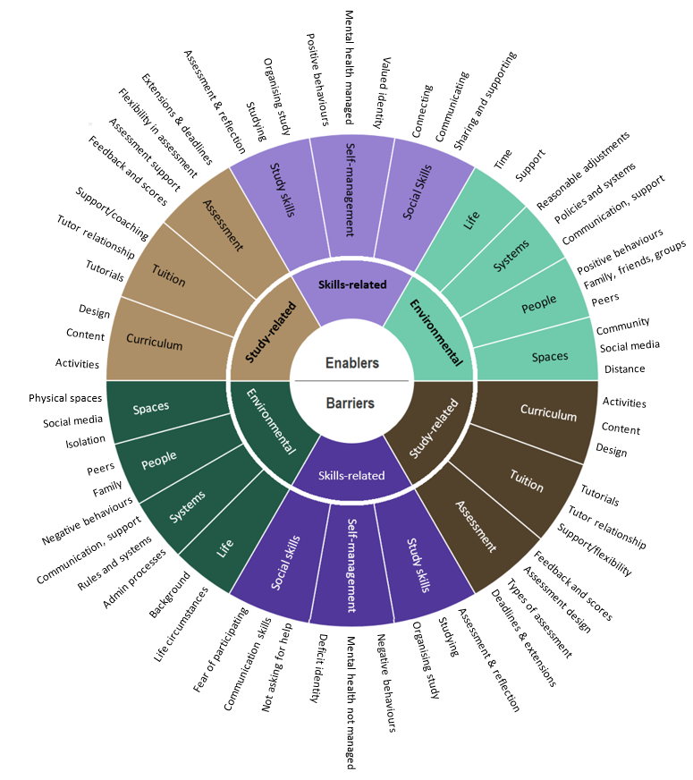
Stage 1 findings
Many themes appeared as both barriers and enablers, meaning that a factor can be a barrier or an enabler, depending how it is designed and how the person experiences it.
The model is therefore represented as a taxonomy

Slide 12
Discussion
How does this taxonomy compare to your perceptions of barriers to mental wellbeing in the curriculum, tuition and assessment?
Which area do you think presents the greatest barriers and enablers?
Post your thoughts in the chat.

Slide 13
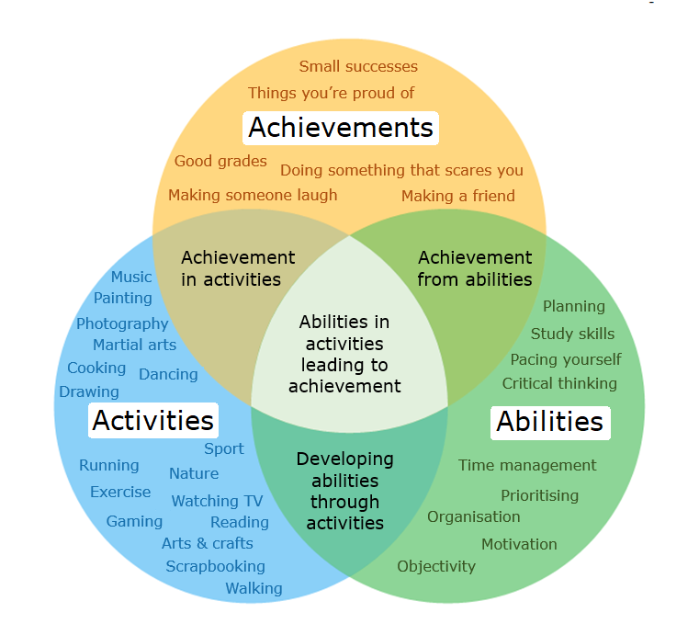
AAA model for tuition
Students also shared strategies that helped them manage wellbeing
Enjoyable learning activities (escapism)
Opportunity to log and reflect on achievements, tutors helping them recognise these
Abilities and skills to manage their learning and their wellbeing

Slide 14
Project stages
Stage 1: Interviews
16 x students told their stories; 5 x tutors told student stories of barriers and enablers.
These were turned into vignettes to represent diverse journeys and issues.
Stage 2: Focus group events
116 staff and students analysed the vignettes, identified barriers, and worked together to create ideas for projects and interventions to address them.
Stage 3: Project pilots
7 projects and interventions are being piloted and evaluated
Stage 4: Survey
Barriers and interventions from stages 1 and 2 were substantiated by surveying a larger population of students

Slide 15
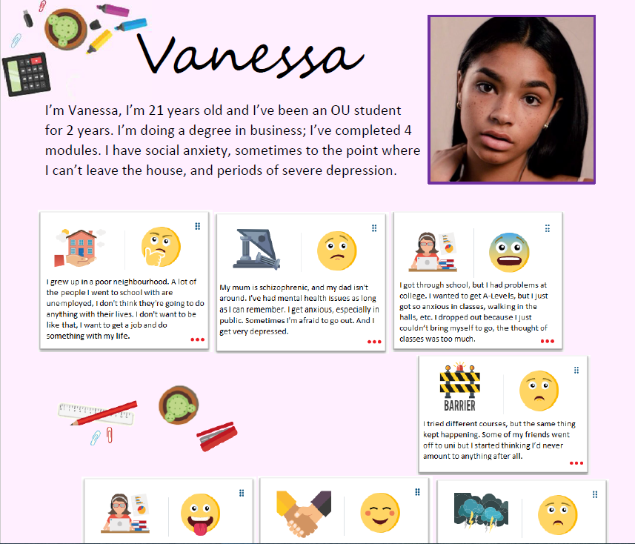
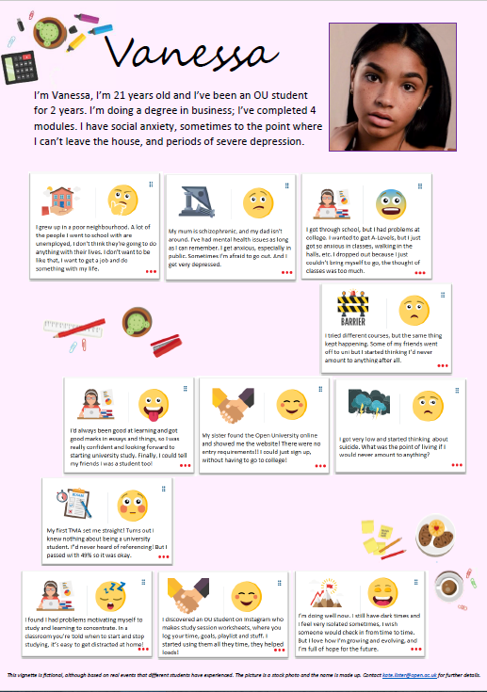

Slide 16
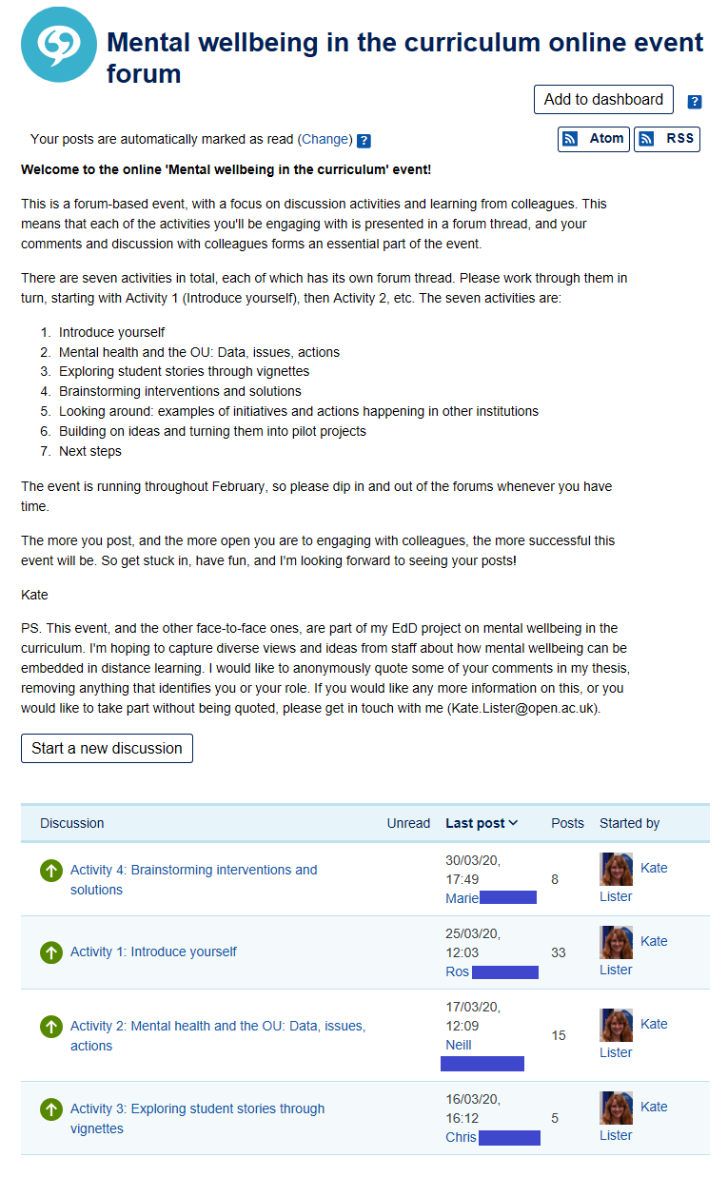
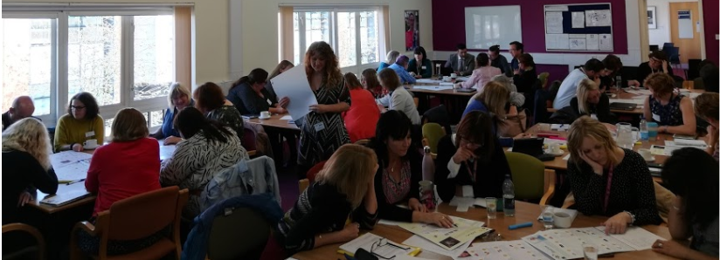
Focus groups
3 events: MK, Scotland and online (affected by strikes and Covid-19)
9 students and 107 staff from diverse roles (teaching, support, learning design, WAS, careers, library…)
Group, individual and group interaction data captured

Slide 17
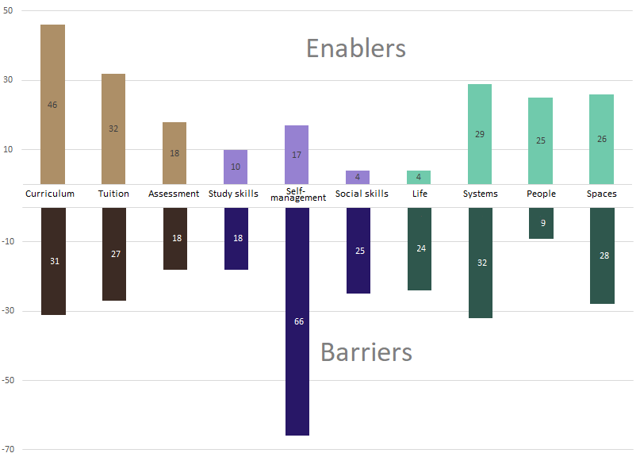
Stage 2 findings:
Barriers & enablers
Focus group data revealed 340 references to barriers and 226 references to enablers. These mapped to the same categories and themes, supporting the taxonomy model

Slide 18
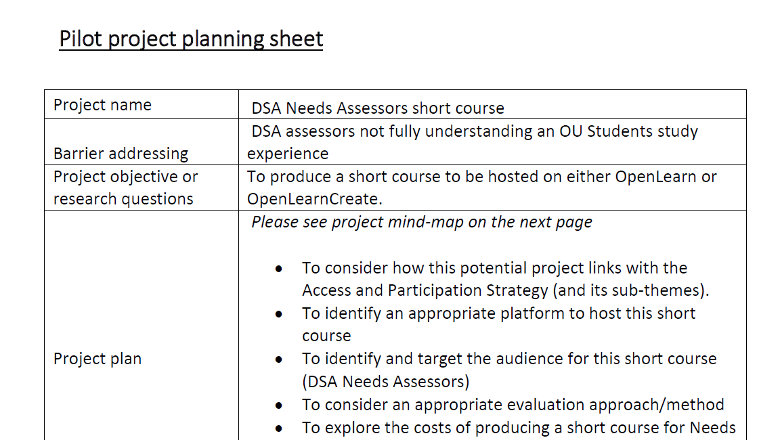
Stage 2 findings:
Solutions
Focus group data also revealed 91 references to solutions, which were turned into 16 project ideas.
6 for environmental barriers
5 for skills-related barriers
5 for study related barriers

Slide 19
Project stages
Stage 1: Interviews
16 x students told their stories; 5 x tutors told student stories of barriers and enablers.
These were turned into vignettes to represent diverse journeys and issues.
Stage 2: Focus group events
116 staff and students analysed the vignettes, identified barriers, and worked together to create ideas for projects and interventions to address them.
Stage 3: Project pilots
7 projects and interventions are being piloted and evaluated
Stage 4: Survey
Barriers and interventions from stages 1 and 2 were substantiated by surveying a larger population of students

Slide 20
Stage 3: pilot projects
Seven of the 16 pilotable interventions are in progress:
Staff training: a micro-credential on embedding wellbeing in the curriculum (HZFM883)
Learning Design: a model for embedding wellbeing in module production
Student resources: ‘Your wellbeing’, discipline-specific wellbeing guidance on subject sites
Tutorials: a self assessment tool for tutors, auditing wellbeing in tutorial materials
Student study support: Emotional resilience guides for studying distressing topics
University systems: a BOC for DSA needs assessors to better support OU students
Transitions: a wellbeing strategy for the Careers team, with events and resources
Reflective interviews with project leads took place following a facilitated practitioner research approach.

Slide 21
Project stages
Stage 1: Interviews
16 x students told their stories; 5 x tutors told student stories of barriers and enablers.
These were turned into vignettes to represent diverse journeys and issues.
Stage 2: Focus group events
116 staff and students analysed the vignettes, identified barriers, and worked together to create ideas for projects and interventions to address them.
Stage 3: Project pilots
7 projects and interventions are being piloted and evaluated
Stage 4: Survey
Barriers and interventions from stages 1 and 2 were substantiated by surveying a larger population of students

Slide 22
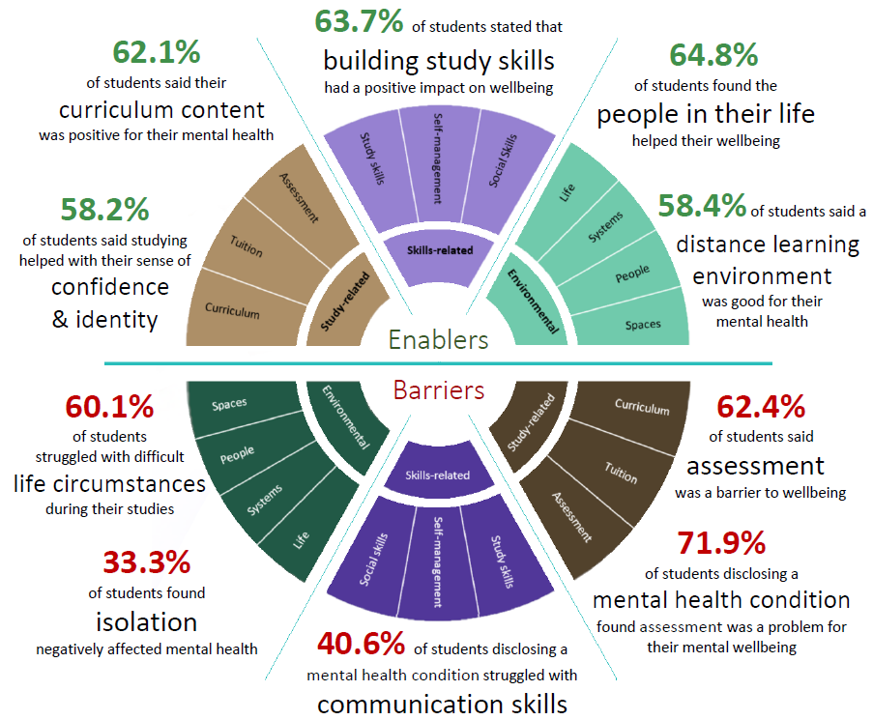
Student survey
584 students (11.7% response rate)
340 student with disclosed MH conditions
244 students without

Slide 23
Barriers

Slide 24
Enablers

Slide 25
Welcome
So, assessment is the greatest barrier, while study skills, module content and tuition are clear enablers.
What can we do to make assessment less of a barrier for students in STEM?

Slide 26
Existing solutions (ranked by positivity)
Free courses and resources on improving study skills
Free OpenLearn courses with information about a study area
Library resources and events to help with referencing skills
Careers guidance and support, including career counselling
Student Hub Live sessions on study skills
OU advice for friends and family on how they can support students
OU help with computing and technology
Advice from Student Support on choosing (or changing) degree pathway
The OU Students Association peer support programme
Free courses on managing finances or other life skills
OU advice and support with low scores, failing or retaking an assignment
Disabled Student Allowance (DSA) mentoring, software or other support
TogetherAll (formerly Big White Wall), an online platform to support mental health
OU Students Association groups or student-run Facebook groups

Slide 27

Further info
If you’d like to learn more about the project, visit the project website
To try out the Our Journey tool, visit https://ourjourney.ac.uk/
For more the AAA model of wellbeing, watch my TEDx talk.
For professional development, go to our micro-credential.
For white papers, see this Advance HE report
or the Student Minds charter
Thank you

