Slide 1

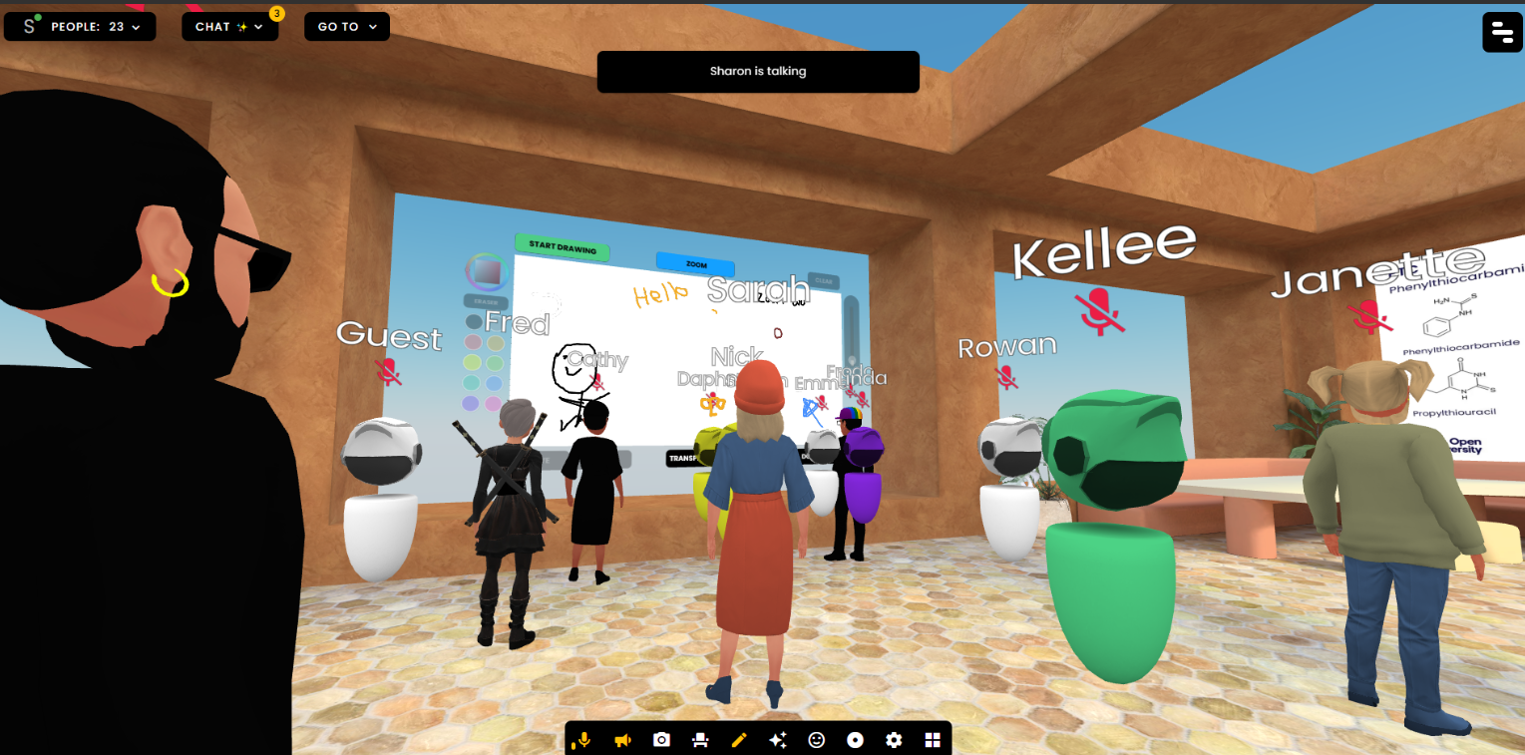
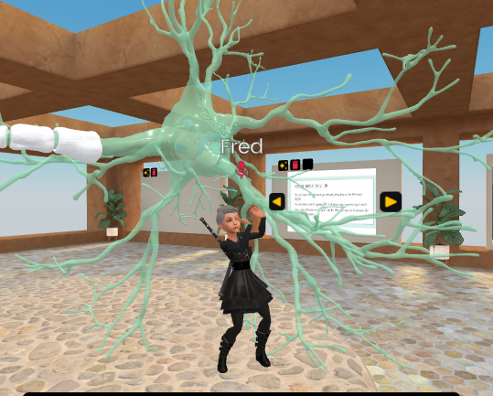

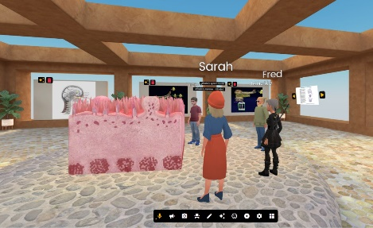

Facilitating and evaluating the use of virtual reality tutorials within the school of Life, Health and Chemical Sciences.
Lucy Anderson, Janette Wallace,
Sarah Daniell & Trevor Collins
We have previously shown that VR tutorials at level 2:
Increase student community,
Increase student interaction,
Increase motivation
Here we propose to:
Introduce and evaluate VR tutorials to level 3 (ongoing) and level 1 to establish whether there are consistent benefits across the curriculum pathway
Produce resources to help module teams introduce & and evaluate VR tutorials as part of their student support strategy.
Develop resources for ALs running VR tutorials.
Support module teams and ALs in conducting FrameVR tutorials

