Slide 1

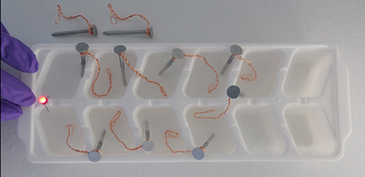
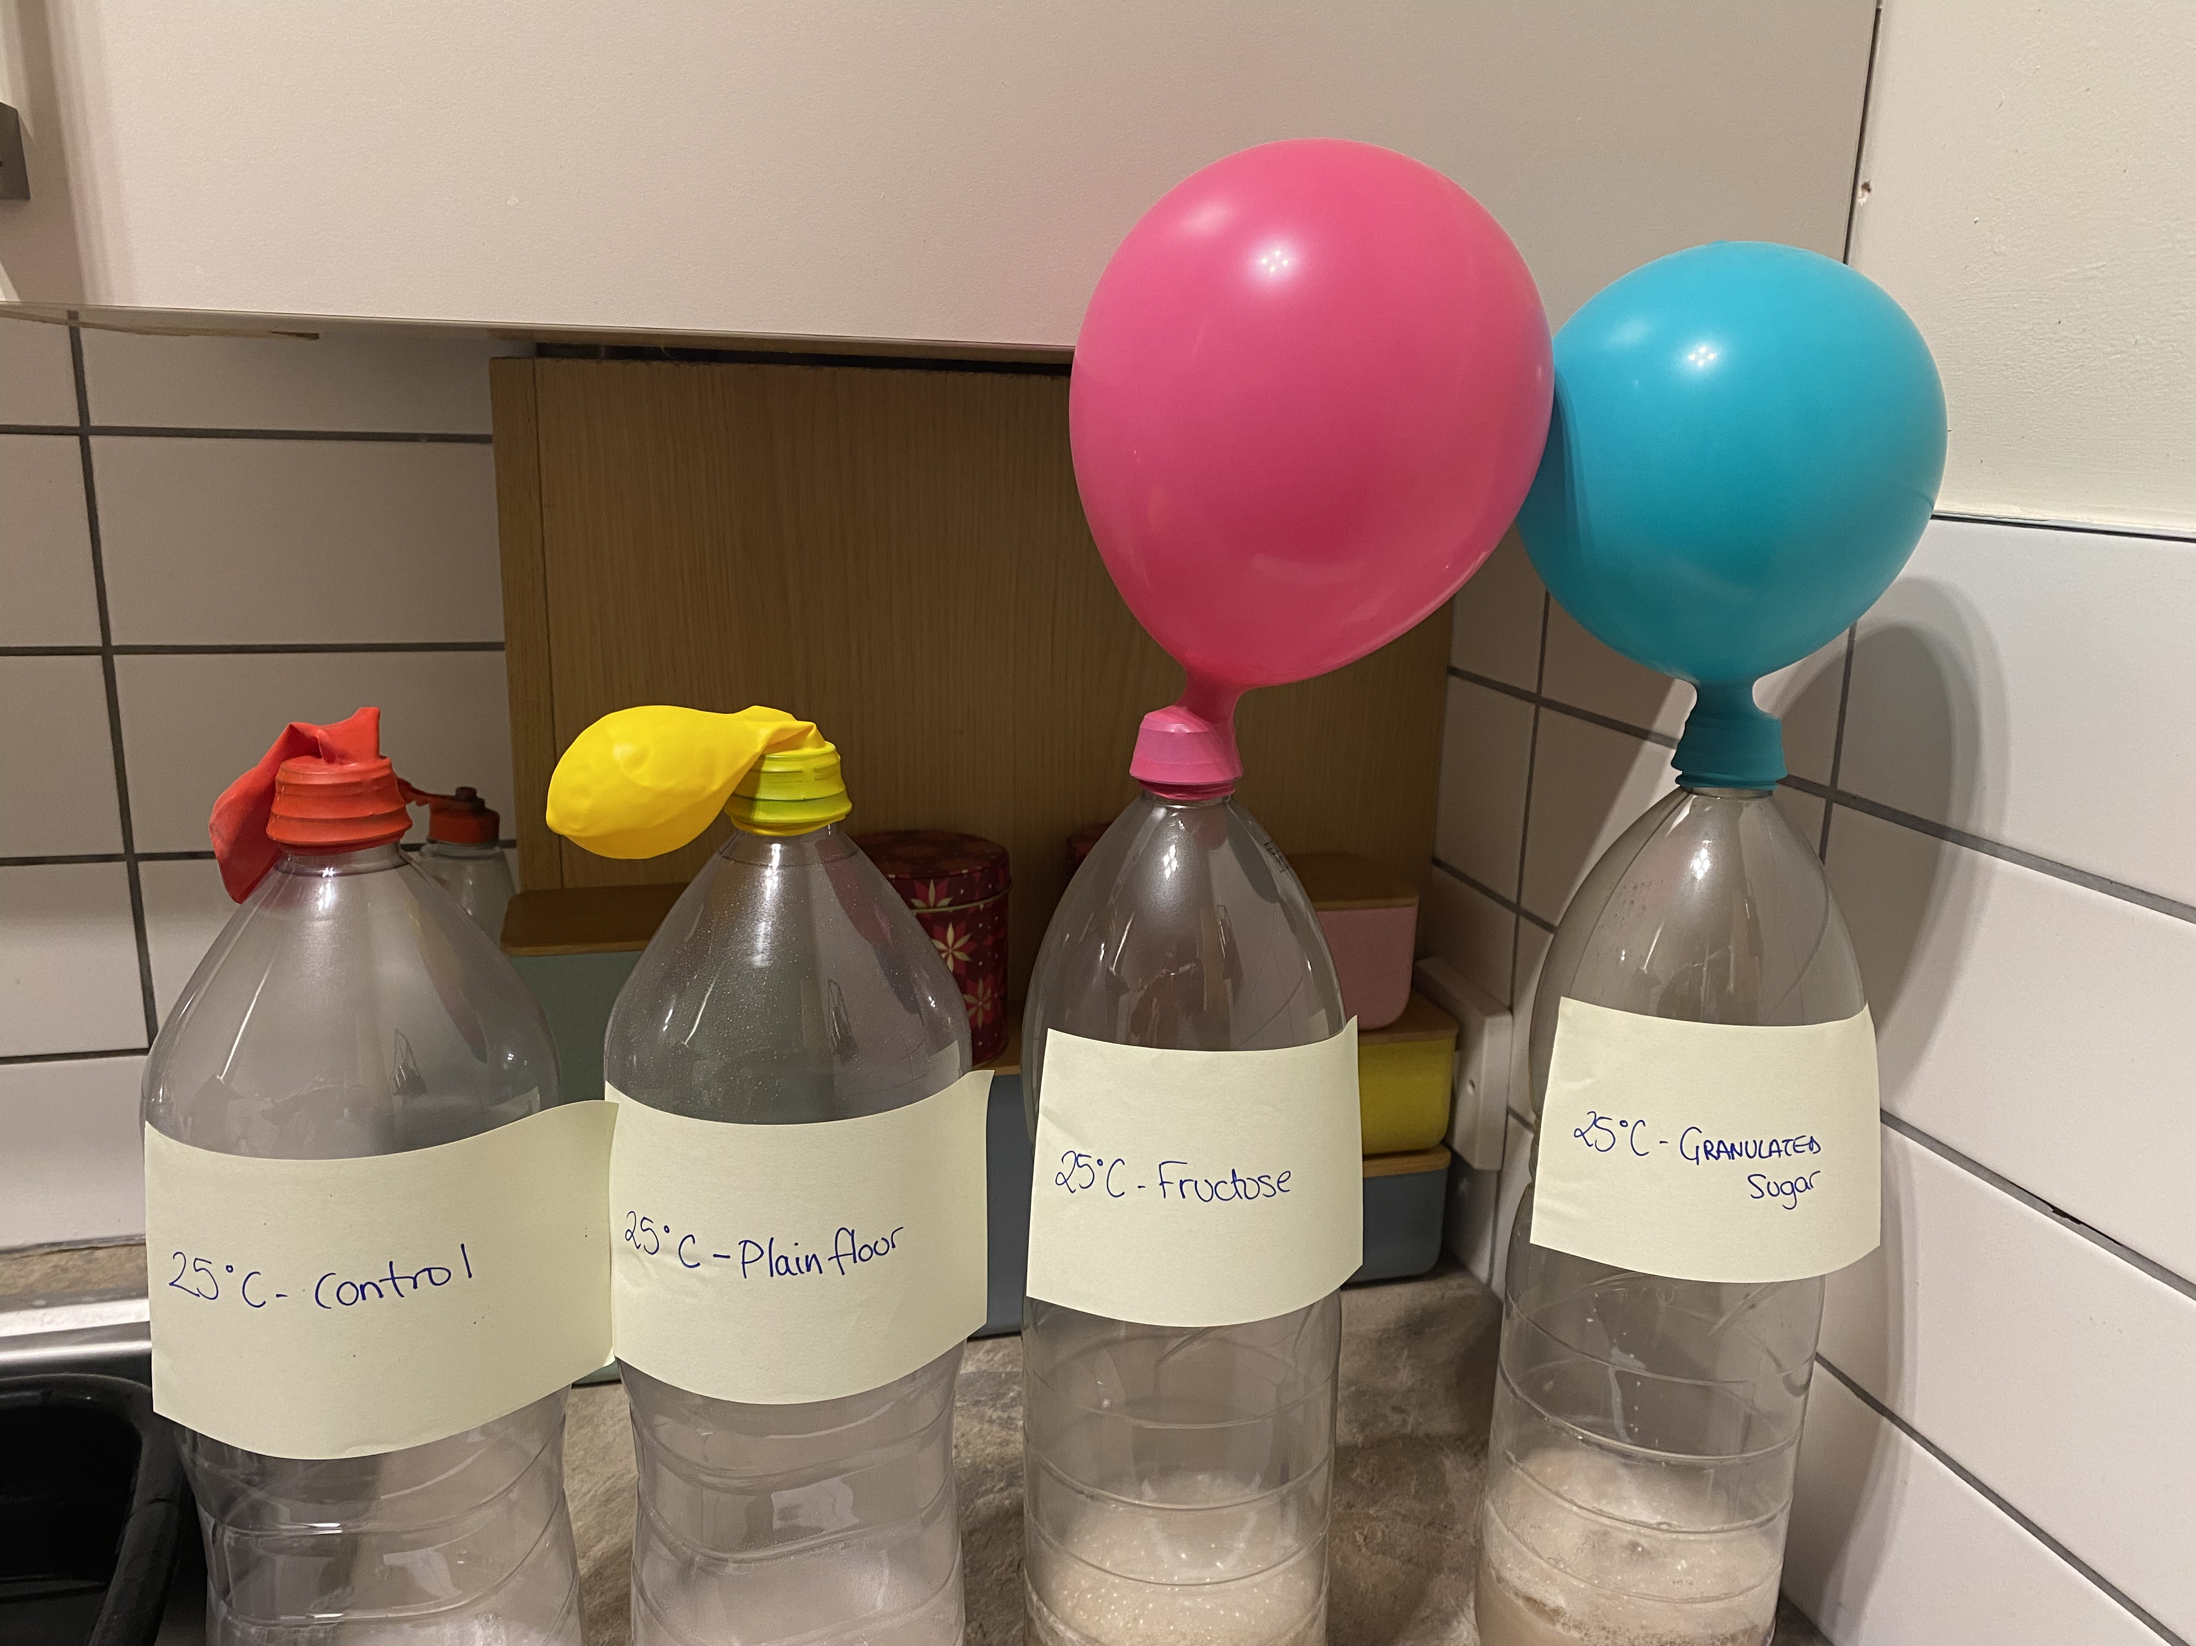
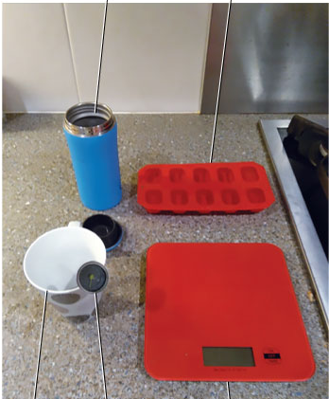

Is the cost of home experiments a potential barrier to learning? Experiences from two level one science modules
Louise MacBrayne, Eleanor Crabb, Zoë Chapman
Practical work in the form of home experiments has always formed an integral part of the science curriculum. The move, however, from printed materials to online delivery has been accompanied by a change in the way students are supported in home experiments.
The current level one curriculum (S111 and S112), compulsory in several science qualifications, has the expectation that students will be able to purchase, and have ready access to equipment needed to perform experiments at home, contributing to core module content and assessment. Some of this equipment is relatively costly and may not be easily accessible to some students.
Preliminary data collected from a focus group for a previous S112 eSTEeM project suggests that the cost associated with home experiments could be a potential barrier to learning but also student success as many of these experiments contribute to assessment.
“the experiment it assumed that you had certain things in your house…it assumed that you had everything in your house and they don’t support you”
Planned Research Methodology
The initial data collection phase will focus on student surveys, exploring student experience and outcomes of home experiments and whether the requirement for purchasing equipment adversely affected the achievement of relevant learning outcomes.
Later phases of the project will consider adjustments, to include development of one video resource, equivalent to a home experiment within S112, enabling students to collect their own data by a means other than a home experiment, thereby achieving the same learning outcomes, but without the potential stigma associated with having to admit to not having the financial means to purchase equipment.
Key outputs include information on issues faced by financially impoverished students on low incomes studying S111 and/or S112.
It is hoped that longer-term outcomes will inform approaches for incorporating fully accessible and inclusive practical work within new module design.
.
At this preliminary stage the project has two overarching research questions:
Are financially impoverished students being disadvantaged by the requirement to purchase additional equipment needed for home experiments in core level one science modules?
Is the requirement to purchase equipment for home experiments a barrier to achieving the learning outcomes associated with practical work?

