Slide 1
Learning in an online studio
Georgina Holden, Nicole Lotz
School of Engineering and Innovation
The Open University UK

Slide 2
The Context of The Open University UK
Founded in 1969
The UK’s biggest distance learning university teaching around 38% of part-time undergraduates
Has taught more than 2 million students, around 170,000 each year
Validates other institutions
Completely open entry
Diverse range of students of all ages, backgrounds and physical abilities
Originally dubbed the “University of the Air”, now delivering by print and digitally
Multi-media teaching materials created by teams of academics
Notes:
Some facts and figures about the OU.
One of our greatest delights and biggest challenges is completely open entry, students come with wide range of academic backgrounds
Used to be TV and radio, then Video and audio cassettes, then CDs and DVDs, now mostly print and online
Being a module team member at the OU means creating multi-media teaching resources, text, audio, video, interactive exercises and so on

Slide 3
Design teaching at the OU
Integral since the first course in 1971
Around 800 students start the Level 1 design thinking module each year
Around 300 students register for the Design and Innovation BA/BSc each year
Nearly half and half male/female with ages between 18 and 60 years old most between 25 and 40.
Materials created by design academics, grading and tutoring by associate lecturers
Long history of multi-media use, now all non-print delivered digitally
Taught in 60 credit modules
Notes:
Facts and figures about design teaching at the OU
Has been taught since the beginning of the OU – first course presented in 1971
Around 800 students sign up for U101 each year, 300 of these register for the BA/BSc D&I
Nearly fifty fifty male female, wide age range though majority between 25 and 40
Design is taught through three, 60 credit modules

Slide 4
Design teaching delivery
Two completely online, 60 point modules
Print materials supported by VLE sites and tools
Assignments submitted and marked online

Slide 5
Challenges of teaching design at a distance
Through digital interfaces
How to emulate the learning experience of the studio
  to facilitate skills development
  to encourage interaction and co-operation with peers
  to share design work and outcomes
  to build a community of learners
How to engage students asynchronously
Notes:
The challenge of teaching design at a distance has shifted as digital delivery has become more commonplace,
Level 1 and level 3 modules are both delivered online
However, going digital also offered opportunities, previously students worked on design projects in isolation, seen only by their tutor, going digital enabled us to think about bringing the studio experience into distance learning.
So, the challenge was how to replicate the learning experience of a studio, to develop skills, encourage peer interaction, share work and build a community of learners
With the caveat that engagement needed to work asynchronously as students study when it suits them

Slide 6
Virtual Learning Environment Tools
At the OU
Forums, for text based discussion
Online conference rooms, for tutorials, presentations and synchronous collaboration
OpenDesignStudio, a purpose built, Moodle integrated VLE tool for sharing images and files of all types
Notes:
In the OU, like everyone else we already used VLE tools to aid learning
Forums are well used for text based discussion
And Online conference rooms are used for tutorials, presentations and some synchronous collaboration
The new tool that we developed was ODS. This was originally a development of a tool created for a photography module which was based on the Flickr API, it has been through many iterations to arrive at the point where it is now a fully integrated VLE tool.

Slide 7
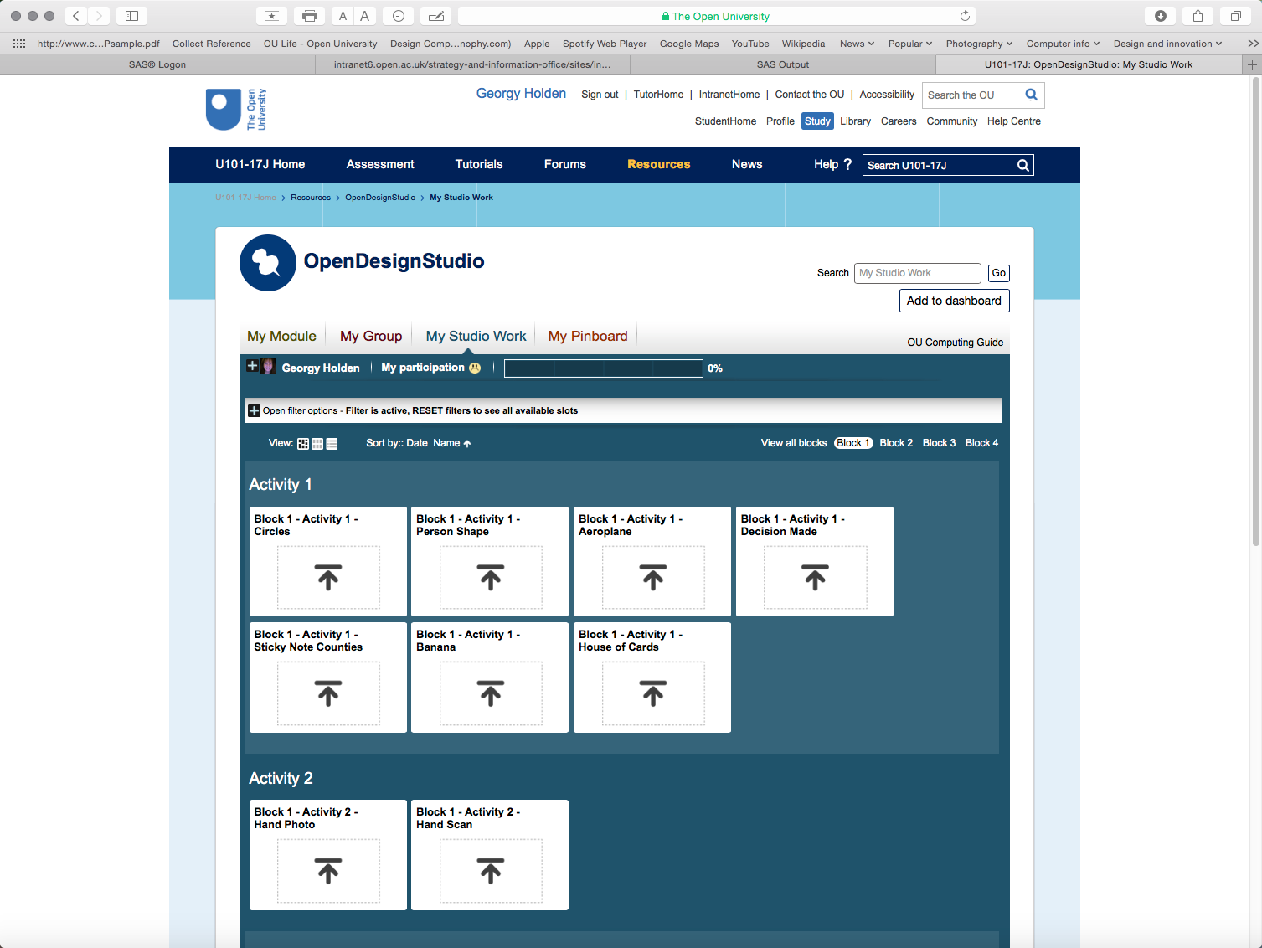
Notes:
This is the blank space a year one student will encounter in the studio. There are slots for posting the work done for activities which are in the teaching materials. In subsequent years the interface has fewer pre-named slots and more for sets of project work.
These slots are configurable by the module team, the number of slots and their titling and also the media they will accept are determined in accordance to the need of the module. ODS is now being used across the university by about 20 different modules who have configured it to meet the needs of their disciplines.

Slide 8
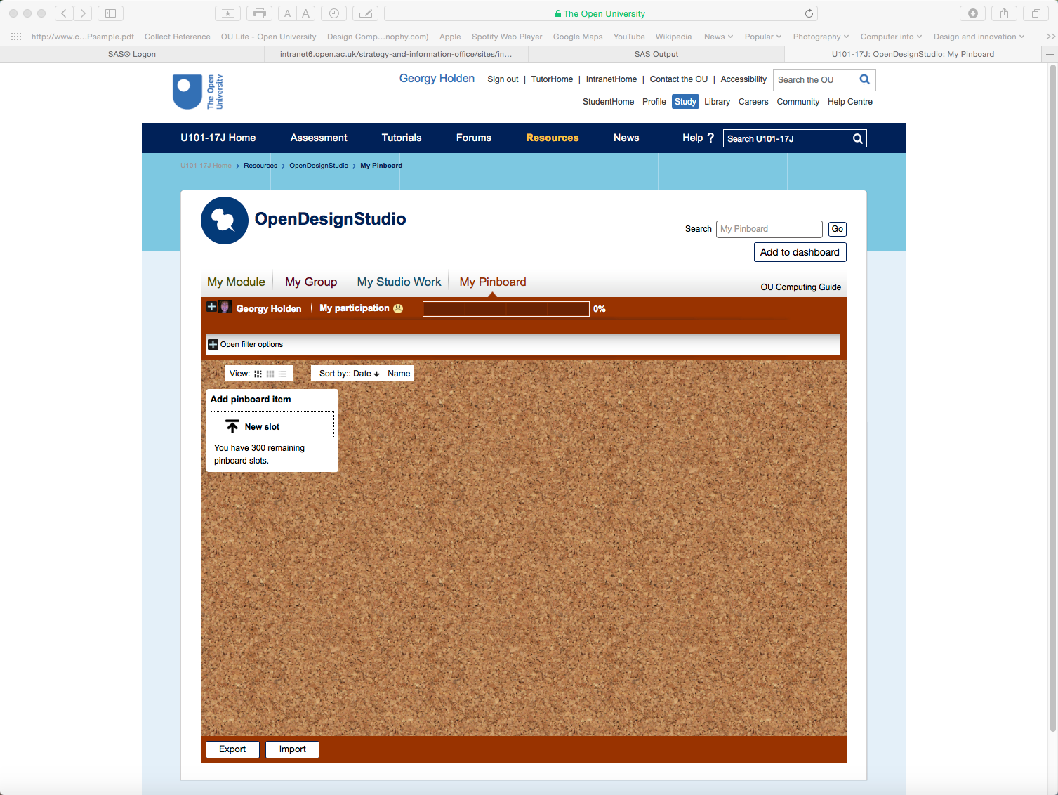
Notes:
This is an individual student pinboard, students can post anything they like on it just as they might on a pinboard in a studio. This is unique to the design modules (as far as we know)

Slide 9
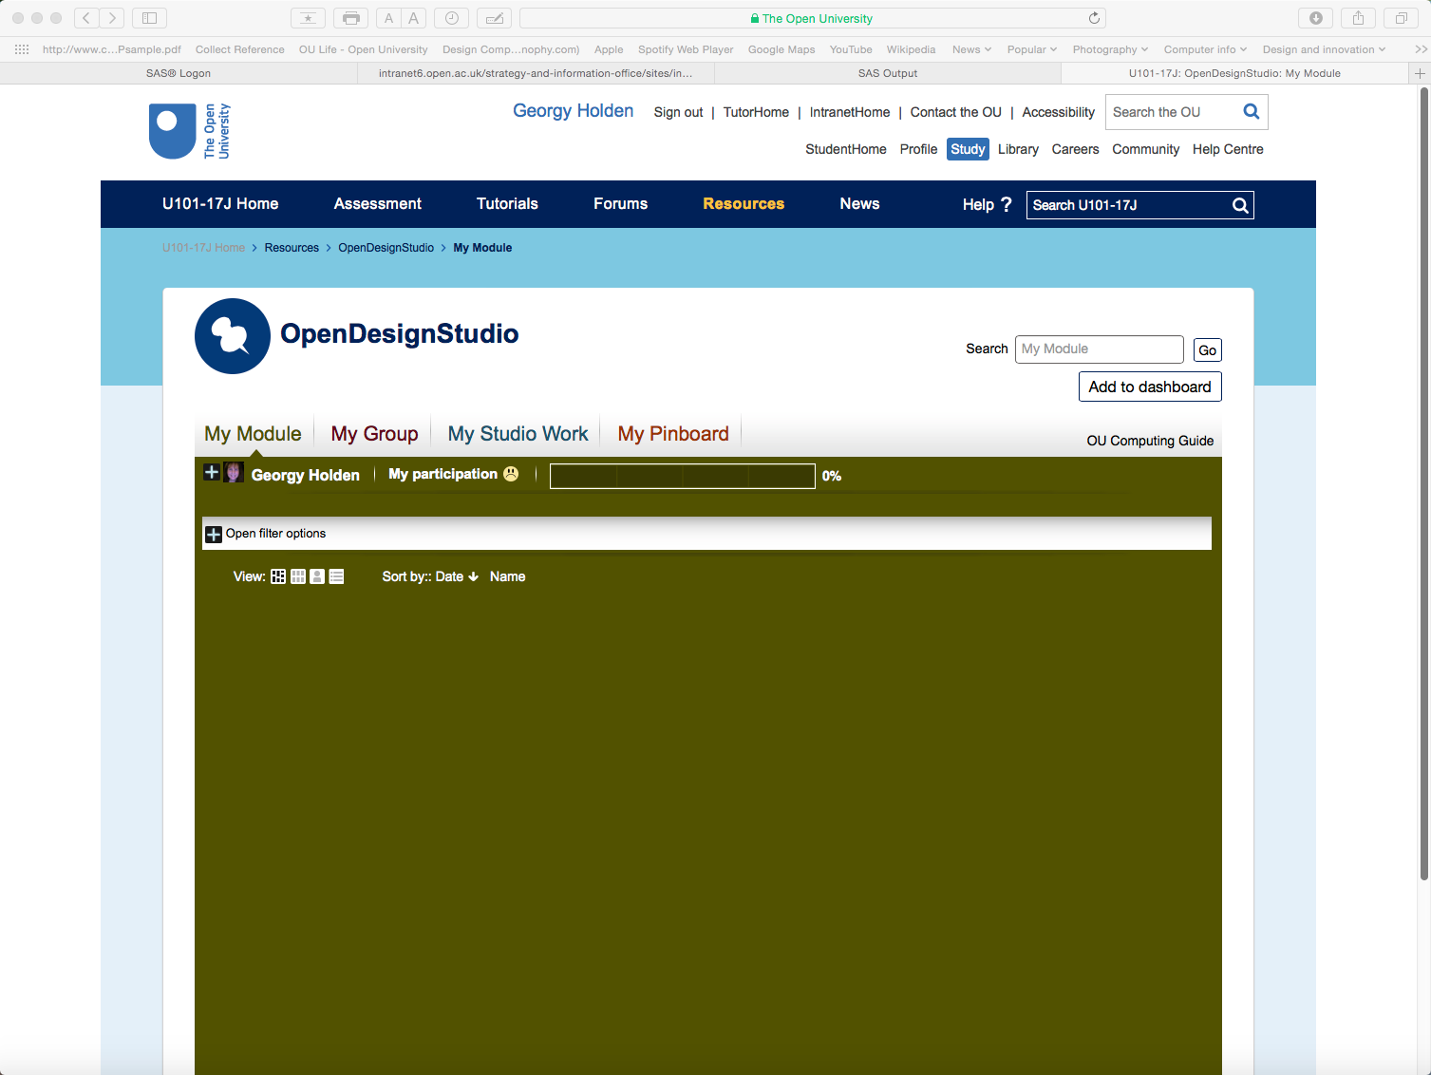
Notes:
This blank space will be populated by all of the work posted by all of the students across the module

Slide 10
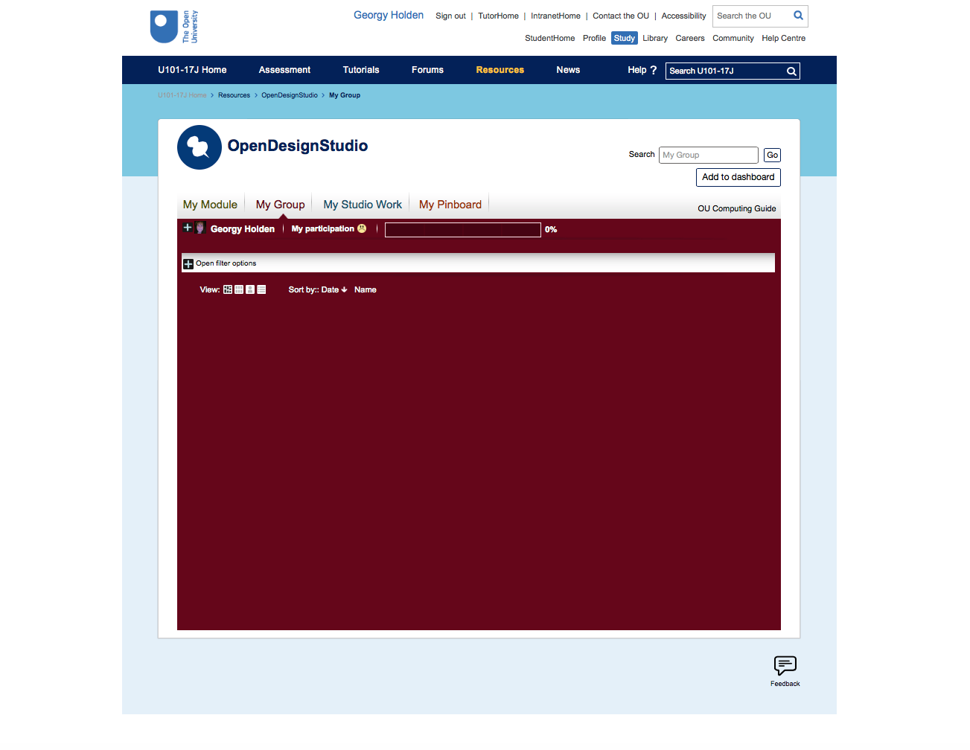
Notes:
This blank space will pull in all of the work from a particular tutor group to give a ‘home group’ identity to students

Slide 11
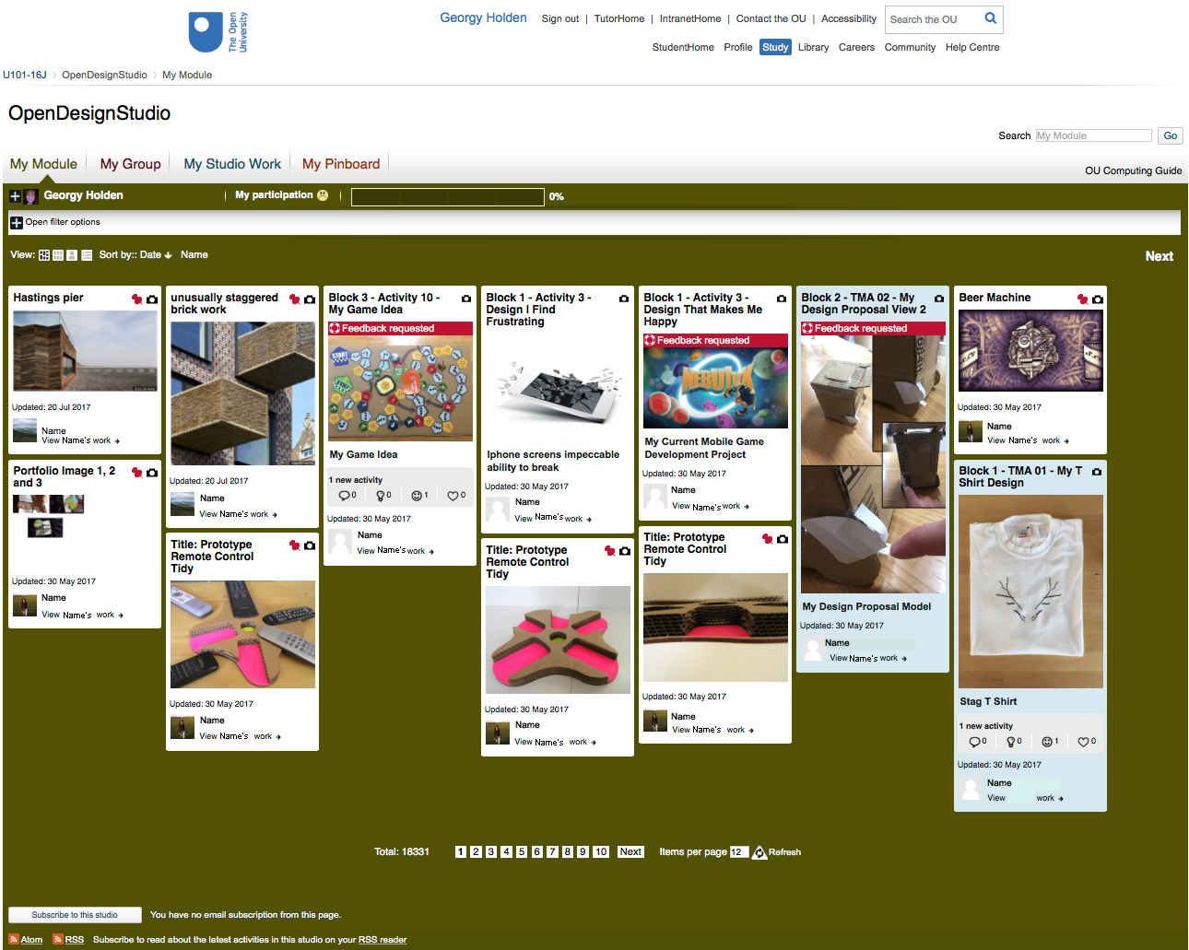
Notes:
So this is how the module space looks when it is populated. As you can see at the bottom of the screen, overall there are over 18000 posts from this module cohort (about 550 students).
As you can see there is a wide variety of postings from things that have been put on a student’s pinboard (see the little red pin) both inspirations and work in progress, and pictures of designs with requests for feedback.

Slide 12
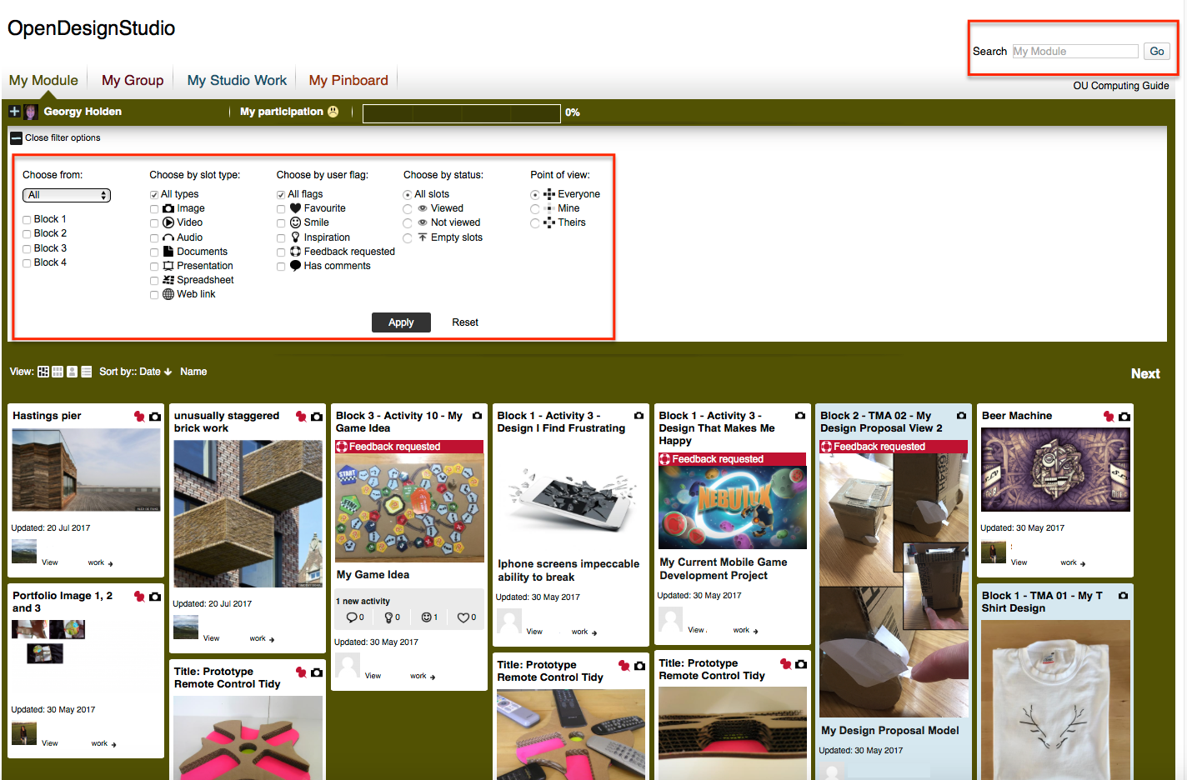
Notes:
It is possible to filter and search the content to find work in different ways, for example looking for all examples of work by a particular student, or looking for projects with a similar theme or to look for posts where feedback is requested.

Slide 13
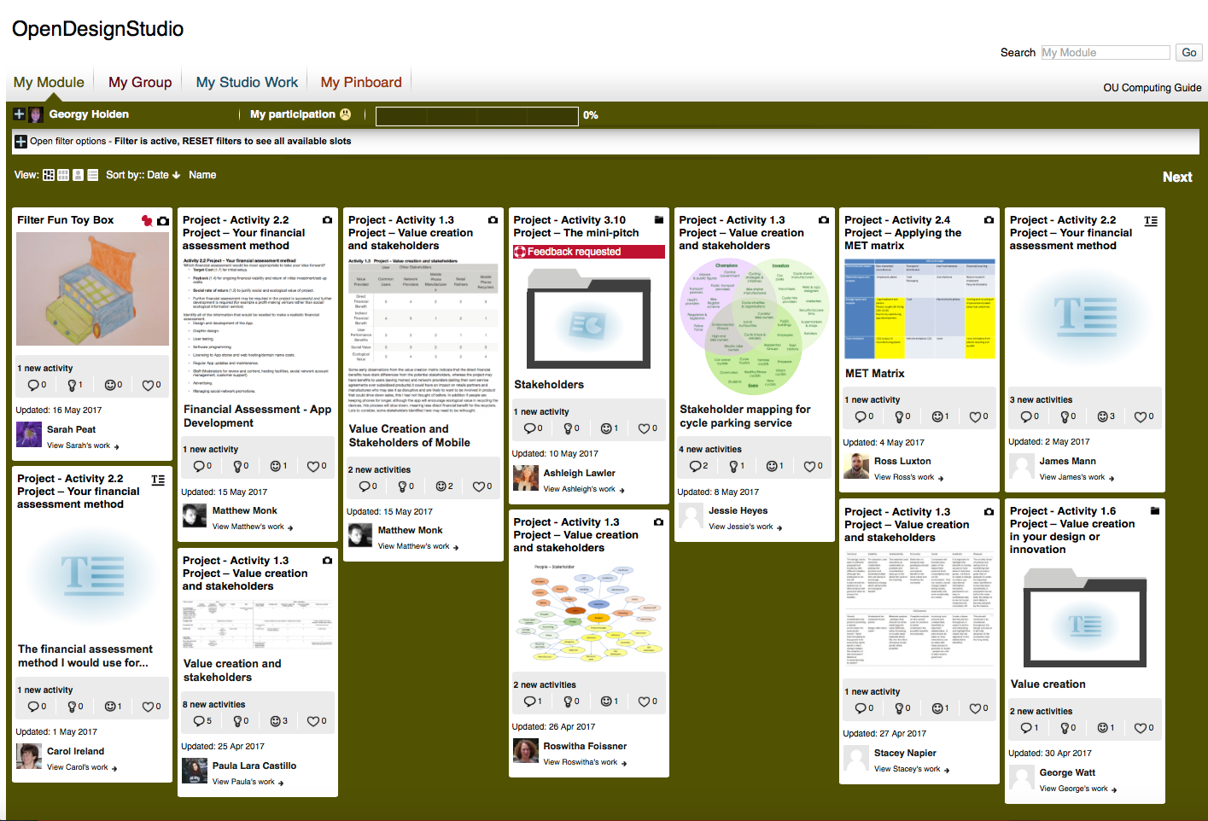
Notes:
This shot from the Level 3 design module shows how, in that module, there is posting of other media, with fewer images as students respond to activities such as considering value creation and stakeholders. Clicking on the non-images downloads the item to the viewer’s computer – ideally we would like it to open in a new window, that is on our wish list.

Slide 14
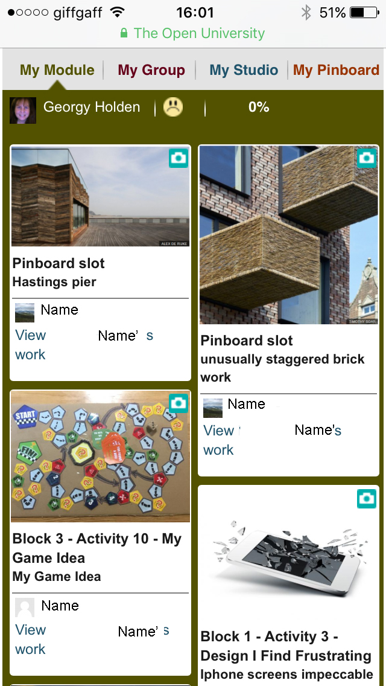
Notes:
Mobile view

Slide 15
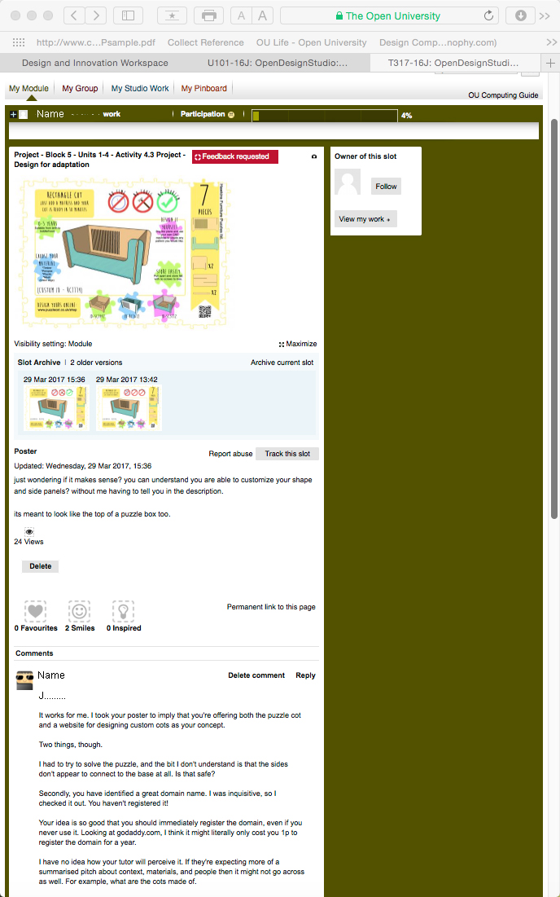
Notes:
Commenting on a third year project. Note the option to give quick feedback, favourite, smiley, or inspiration. Also show previous iterations of the post.

Slide 16
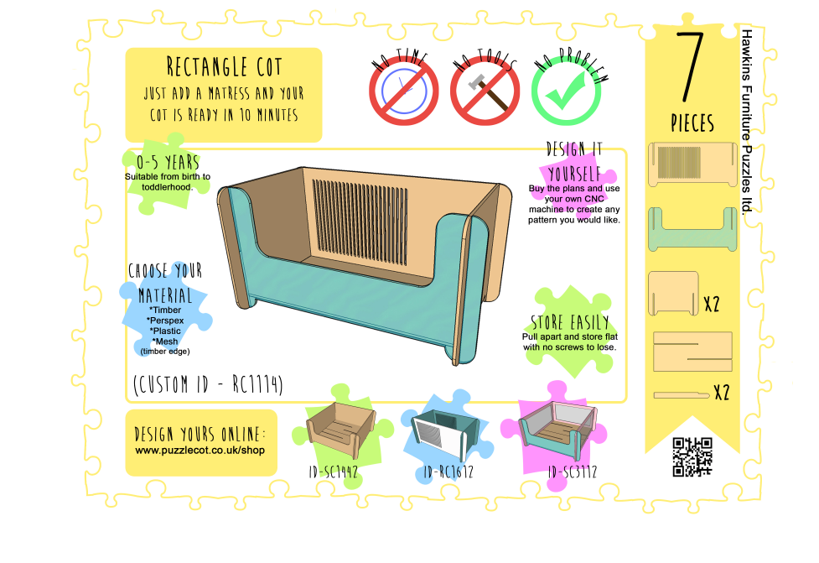
Notes:
Expanded view from a post so greater detail can be seen

Slide 17
What do students think about the OpenDesignStudio?
Are we making progress; a scholarship project sponsored by eSTeEM
Quantitative and qualitative research to understand how students use ODS across the Design qualification and whether it helps them to progress in their studies
This talk focuses on the findings of eleven semi-structured interviews carried out with students who had used ODS, most for more than one module.
Notes:
ODS has been used since 2012 with several iterations, myself and two colleagues, wanted to understand exactly what it contributes to design learning at the OU.
We embarked on a scholarship project sponsored by the OU centre for STEM pedagogy – ESTEEM
The project used a number of approaches, both quantitative and qualitative to look at the affect on student learning
This talk focuses on 11 semi-structured interviews with students, initially we looked at students who had used ODS across the D&I degree but we broadened this out to include students who had studied design as part of other qualifications too.

Slide 18
Fundamental premises of ODS
A space for peer critique
Open to tutors but not expected of them
Self-moderated
A place to build and test portfolio work
Notes:
When ODS was first mooted we say saw it primarily as a place for peer critique, accessible to tutors but they were not expected to use it as part of their tutorial duties (not enough time or money allocated for that).
The studio would be self-moderated, with the ability to flag any concerns for MT action
Above all we saw it as a place to build a portfolio and test out that work with the community of learners.

Slide 19
How we thought ODS would be used
The learning design intentions
Regular posting of activities week by week
Tutor group space as a base for exploring the wider module posts
Integral part of the learning experience
Used by tutors to oversee student progress
A record of comments, suggestions and developments to aid reflection and embed ideas and practice
Increased richness of perspective and improved cultural understanding from peer exchanges
Holden G, Garner S (2009)
Notes:
Each design module has activities built in on a weekly basis to encourage use of ODS
Tutors are encouraged to create a ‘safe haven’ for students to step out from
Use of the studio is seen as integral to the learning experience
The interface shows tutors how much students have posted to ODS
The interface was seen to have value as a record of comments and suggestions
Interaction with peers was hoped to encourage changes in perspective and understanding

Slide 20
How ODS was actually used
The learning design intentions
Regular posting of activities week by week
  By a few, but many post sporadically
Tutor group space as a base for exploring the wider module posts
  Successful in year 1 less so in subsequent years
Integral part of the learning experience
  True in year 1 but less so in subsequent years
Used by tutors to oversee student progress
  Mostly in year 1
A record of comments, suggestions and developments to aid reflection and embed ideas and practice
  Successful record
Increased richness of perspective and improved cultural understanding from peer exchanges
  Improves understanding of different perspectives
Notes:
Students study patterns are more erratic that our ‘model’ student, some do post week by week, but many more post sporadically.
The tutor group space is very successful in year 1 but less so in subsequent years, this is most likely due to a drop off in posting at higher levels leading to tutor group spaces feeling somewhat empty
At year 1 we have successfully integrated use of ODS into the learning experience. At higher levels, although regular posting to ODS is encouraged it Is viewed as optional and only done by the very keen
Tutors can see the amount of engagement and this aids interventions
ODS does help students to keep a record of the work they have done and the comments received
Seeing different perspectives and better cultural understanding seems to have been successful

Slide 21
Key themes emerging from interviews
Ease of use of the interface
Commenting concerns
Giving and receiving feedback
Interaction with others
Skills developed through use
The value of using ODS
Notes:
Analysis of the interviews identified 6 key themes that occurred in the responses these were
Discussion around ease of use of the interface
Discussion around commenting on others work
Specific points about giving and receiving requested feedback
Points about interaction with peers
Identification of skills developed
And general comments on the value of using ODS

Slide 22
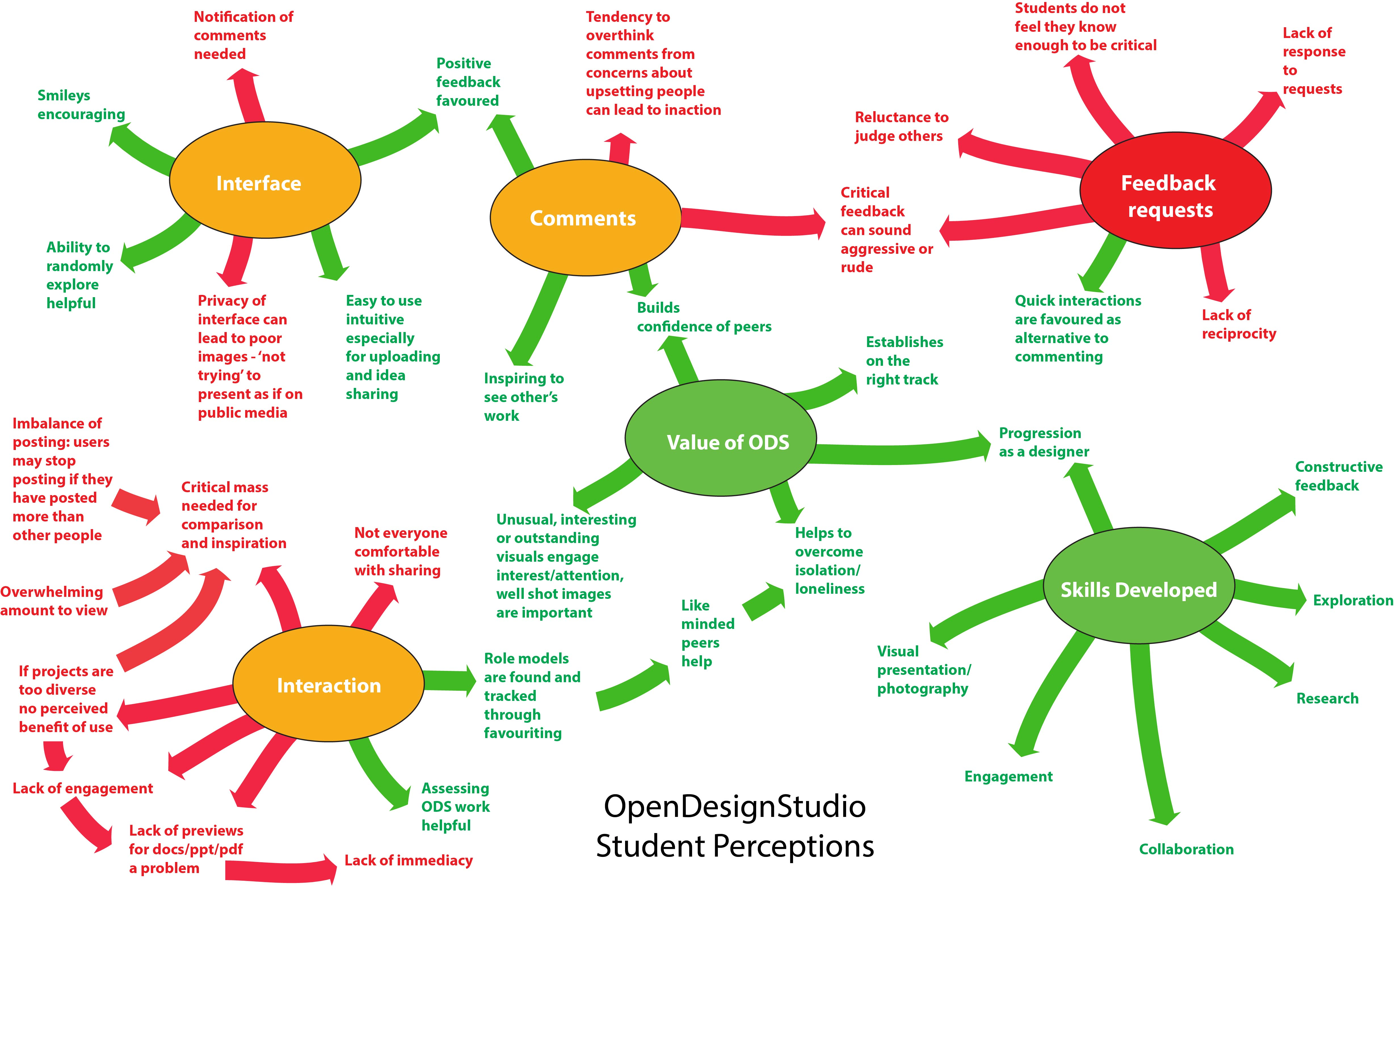
Notes:
This map summarises the positive and negative points made around each of these themes. It is colour coded to show mostly positive feedback (green), mostly negative feedback (red), and mixed feedback (orange).

Slide 23
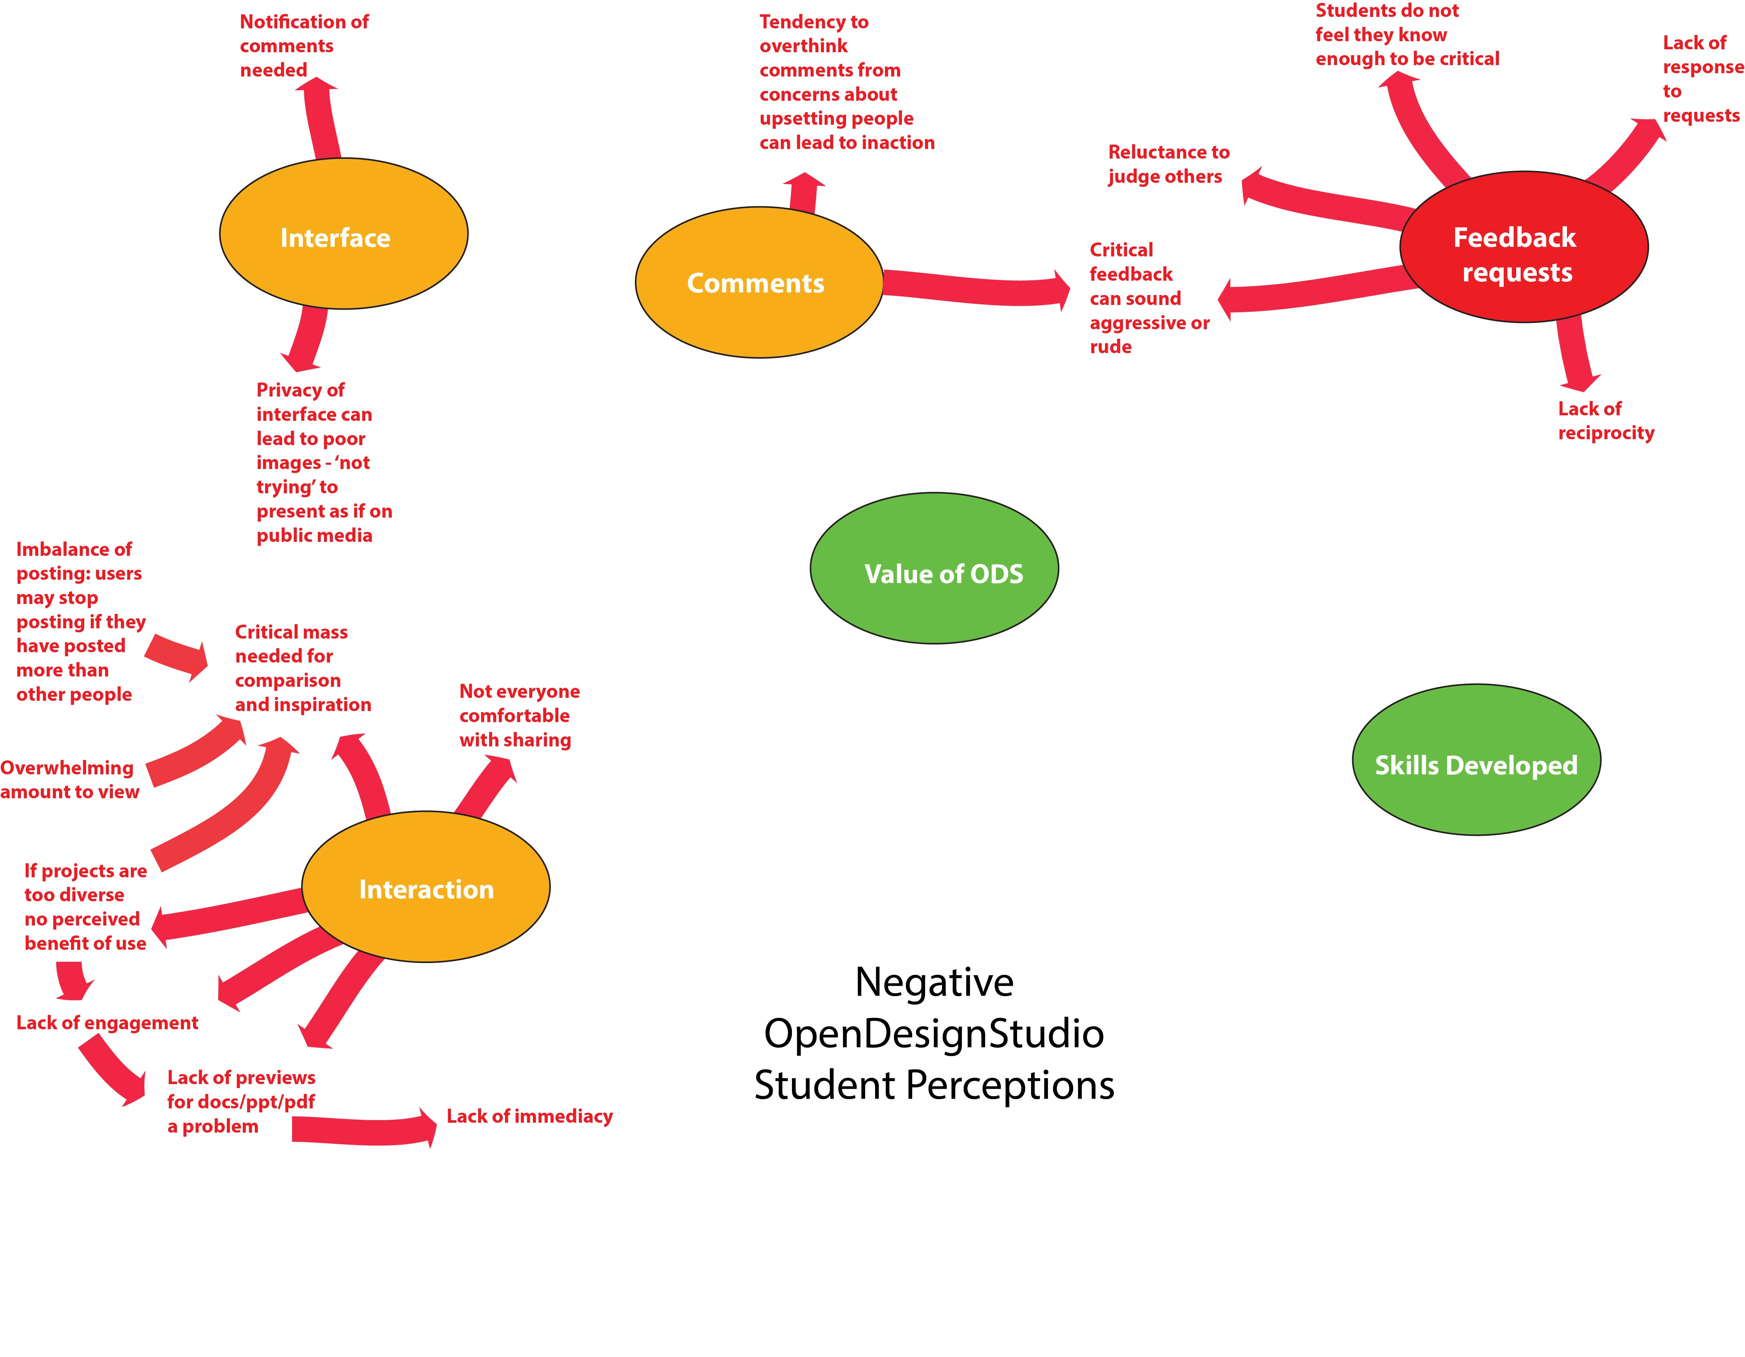
Notes:
Negatives:
A fine balance between an overwhelming amount to view and critical mass
Higher levels have open projects which some students do not find useful as there is no direct comparison
Also at higher levels greater use of interface to post documents without visual preview a barrier (like having to flick through someone’s folder)
Some students don’t like sharing (autism, concern for confidentiality etc)
Users want to see others posting a similar amount and stop if there is imbalance
Around the feedback request feature most negative concerns are around students’ reluctance to judge and criticise others which can lead to inaction meaning lower response rate to requests and less reciprocity. Others report critical feedback as sounding aggressive and are put off from interaction.
On the interface, some students were critical of poorly taken images, which may be linked to the private nature of the space (though may not), the interface does not currently notify of new comments on your posts which is a feature people have come to expect from social media platforms.

Slide 24
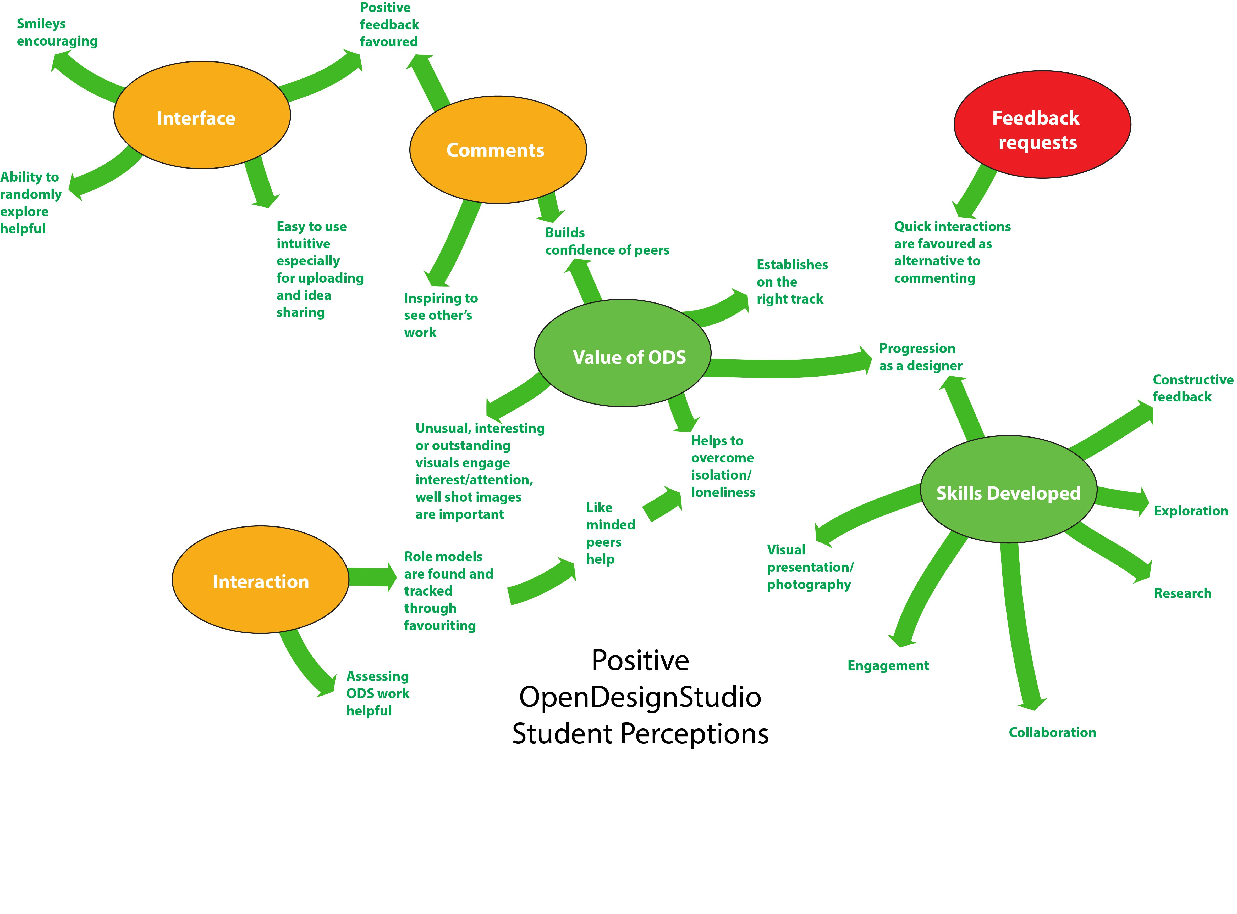
Notes:
On the positive side
Interface generally liked, seen as intuitive for uploading and sharing ideas,
Like being able to randomly explore posts
A smiley feature which rewards progress at filling slots with a smiley face is liked by students who are motivated by stickers
Positive feedback is encouraged by the interface, students favour quick interaction features like favouriting, smileys or inspiration to having to construct comments.
Students see their peer comments as confidence building and inspiring
Students report skills development in
Giving constructive feedback
Exploration and research
Collaboration
Engagement with others
Visual presentation
and progression as a designer
Overall benefits are seen as
Overcoming isolation and loneliness – finding like minded peers and role models through interactions on the interface aids this
Helping students to compare their work with others and see that they are on the right track
Students comment that unusual, interesting or outstanding visuals are the hooks that engage attention
Where ODS work contribute to assessment this is seen as a helpful incentive to post work

Slide 25
What students say
Average user NB
“For me, as not very confident, it was important to share and extend my ideas . It was a broad approach. I was surprised often what the variety was in how people had interpreted the task”
“Nearly all posts were photos, it is a skill in itself trying to get across the point you want to get across in the image that you make. It was very useful to bear in mind what responses different colours or fonts elicited”
“As time went on I became less scared of uploading something and what the response would be, you can think harder about something when you get critical feedback.”
“Probably overthought every single thing that I wrote to make sure that it would make sense and that I was not offending people.”
“Very good bit of software, it helps you engage with lots of other people at the same time without having to travel anywhere and it’s easy to use"

Slide 26
What students say
Enthusiast FS
“Because you were all working on the same task and looking at others interpretations it made you realize you had to be open and just look and not judge. You learn to see the good points in others approaches and how to build on it in your own work.”
“I think that the interaction in U101 (Year 1) was brilliant but decreasing levels of interaction at higher levels affected my own interaction and enjoyment. There are areas that could be worked in higher levels where interaction could be increased.”
“It gave an element of community, a place where all us newbies could rock up and share our wares and not be embarrassed (well maybe the first time)’. Distance learning is hard so the more opportunity you have to interact with people the easier your journey will be”

Slide 27
What students say
“Super Commenter” TC
“It is important to give constructive feedback, to look for the positivity in someone’s work and to look for something else, I will never be negative but I will try to give suggestions for improvement.”
“Skills learnt? Time management, you can see how you should be progressing with your project. ….. It has helped me to present my work in a more aesthetic way, there are some images that have been snapped or taken in poor lighting but it has inspired me to use Photoshop and improve my images which emphasizes what I have learnt “
“Really liked sharing, we can all learn from the block (course) materials but design is about being inspired by other people’s work. That sharing aspect of the community, that vision, is a golden goal. However it can disintegrate if people do not participate fully.”
“The interface is easy to use, I am not particularly tech savvy. The layout is good too, aesthetically pleasing.”

Slide 28
What we have learnt
Using ODS is key to building community for new students
Barriers to overcome are lack of confidence with sharing and commenting
Where tutors engage with ODS too the value is magnified
Lack of response to feedback requests can lead to students becoming disheartened with ODS
Students use ODS much less as they progress to levels 2 and 3 though the reasons are different, Level 2 may be because of a lack of critical mass on a smaller module (200+ students), Level 3 because a large number of students coming into the module from other disciplines with no knowledge of studio work.
Notes:
ODS is the key to building community, visual communication is powerful and immediate way of engaging with and getting a sense of others
However, to get full benefit requires students to take the plunge and feel confident enough to share and comment, we try to enable this with module materials about how to comment successfully but it remains a barrier for some
If tutors engage with ODS then students perceive it as having greater value, however, there are some students, we have dubbed ‘super commenters’ who play a very active part in the community and encourage continuing engagement
Lack of response to feedback requests is an issue, should we remove this facility or find a way to enable students to feel more confident about responding?
ODS is a good interface for those starting out but is less well used as they progress up the levels. This seems to be in part to do with the way in which it is integrated into the modules, in part to do with the tutors who are less familiar with the interface, and in part to do with students becoming more strategic learners, only doing things which are assessed. At level 3 the module also has a large number of students coming in from other disciplines who are unused to studio work.

Slide 29
How we would like to develop ODS in the future
Design academic dreams
A studio space that spans the whole course and not separate modules
Ability to publicly share the portfolio outside of the OU using ODS
Notifications of interactions such as comments
Greater integration of ODS with teaching and assessment
Use of ODS as the jumping off point for all other interactions, online tuition, teaching materials and resources – ODS would become the teaching hub.

