Slide 1

Intro Slide Title 2
Enabling students’ wellbeing in distance design education
Nicole Lotz and Muriel Sippel
E&I STEM
18 October 2023

Slide 2
Slide Title 9
Pass and awarding gaps in Design project modules
Aims of eSTEeM project
Focus on
Gain a deeper understanding of the specific issues experienced by Design students with mental health disabilities throughout their study.
Develop recommendations that could inform the learning design of modules in production and positive interventions in presentations to reduce the awarding gap and facilitate progression.
Intersecting factors:
Discipline (knowledge and skills, coursework, assessment),
Personal circumstances (work and family, caring commitments, life events),
Support received during their studies from OU and elsewhere

Slide 3
Inclusion, mental health, wellbeing and project work
Wellbeing
social perspective of mental health ‘holds society accountable for change’ (Lister 2022, p13).
design and delivery of distance learning enables or creates barriers to wellbeing for distance learners.
changing the systems rather than making change as the individual’s sole responsibility
educators and institutions can actively support students’ wellbeing
Project assessments
design project assignments can be considered high stakes.
takes up a large part of a course, and it involves the individual deeply
threaten wellbeing by heightening consciousness and anxiety of failure (Jones et al. 2020, 441).
design projects are often ill-defined and become more complex at higher levels of study.
heightened uncertainty and stress offer additional challenges to learners with mental health challenges
But creative projects can improve mental wellbeing too!

Slide 4
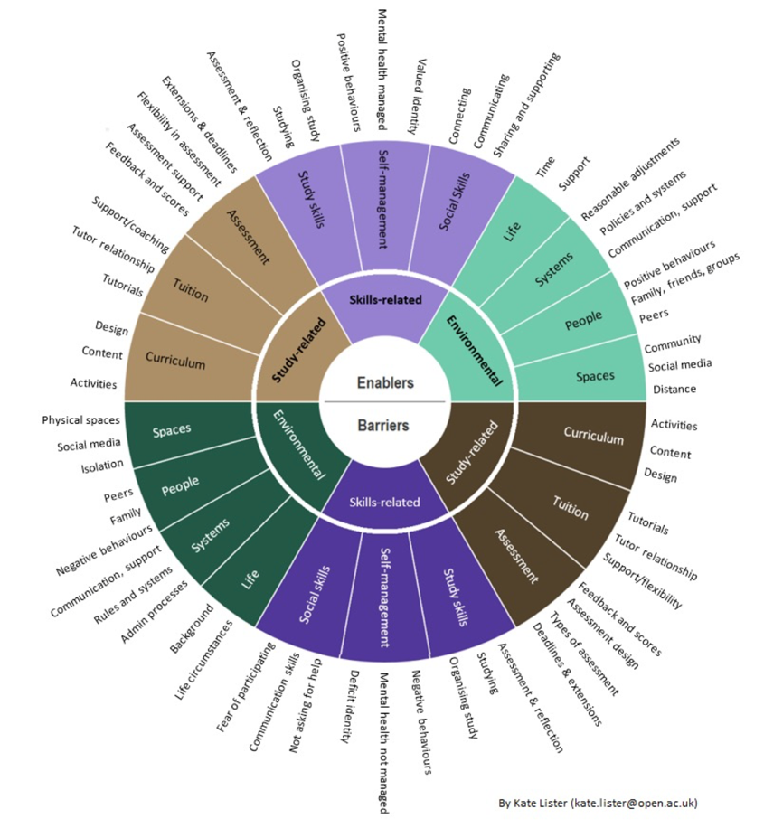
Slide Title 22
Barriers and Enablers
to wellbeing by Kate Lister
Informed interview protocol and analysis
Social model of disability: barriers and enablers to participation, success, and wellbeing
Deemphasises the dominant personal deficit perspective.
Thematic qualitative data analysis that revealed :
  ‘tensions’ - conflicts between student experiences and the requirements of the design and delivery of learning
  Students reported how tensions were resolved to move a barrier to an enabler

Slide 5
Approach
Experiential, qualitative, and longitudinal over 4-5 months
4 passionate interviewers, working each with 2 students from one module (levels 1-3)
Aim to build a conversational, trusting relationship, but not as a tutor, more like a friend with a good listening ear!
2 online interviews, an experience sample and a diary study (using instant messenger)
Student selection: aim for diversity
  Prev. high and low achieving
  Mix of gender and background (e.g. age, ethnicity)
  Low sample size at higher levels challenging
Recruited 7 students who stayed with us, except for one who dropped out earlier

Slide 6

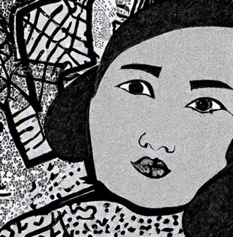

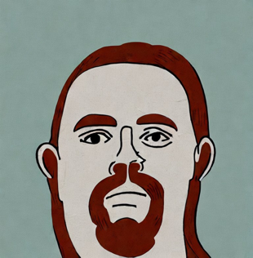
Slide Title 15
Our participants levels 2-3
I am originally from the Philippines. I study the second level module Design Essentials. I have been recently diagnosed with a Personality Disorder. I also experience Anxiety and Depression.
Anna
Isobel
I am a carer for my partner, so I don’t work, but I volunteer a lot. I have Bipolar Disorder. I study the third level module Design Innovation.
I work as engineer. I study the second level module Design Essentials. I have phases of Depression, Anxiety and OCD.
Harry

Slide 7




Slide Title 15
Our participants level 1
Zoe
I am a D&T technician at school and want to become a teacher. I am about to get married. I have Anxiety. I just started Design Thinking.
Charlotte
I live with my parents. I have an Eating Disorder, Anxiety and Depression. I love to draw. I study Design Thinking.
Jake
I lost my job due to COVID and live with my mum. I have chronic pain and suffer episodes of strong Depression.
Ben
I live with my partner. I have had PTSD, OCD, Anxiety and ED for a long time. I am a creative person. I love the level 1 module.

Slide 8
Slide Title 13
Tensions related to:
Study
Openness of design project assignments and the fear of misinterpretation
Delayed but more valuable tutor feedback and immediacy of others’ feedback *
Support for wellbeing and during design project work
Skills
Working towards deadlines and adjusting study rhythms
Independence and social learning
Following the flow of creativity and knowing when to stop or move on *
Environment
Study environments for practical and creative work

Slide 9

Delayed but more valuable tutor feedback and immediacy of others’ feedback
Barriers
Resolutions
Waiting for tutor feedback for days
Not wanting to email every time a small question pops up
Peers or family no subject experts
Vicious cycle of worrying and overthinking starts
Do something else while waiting for a reply
A day to reply to an email query
Option of phone call
Instant feedback from family and friends
But consult multiple sources (family/friends and peers) for clarification
Set up a study buddy or small instant message study group
“I would say I get a lot of support from my wife, … I will always read my TMAs to her and ask her if they make sense, like she might not necessarily understand the kind of technicalities, like the technical stuff behind it, but she’ll be like, oh my god that sounds really good, or, you know, she will pick up times when there is a spelling mistake.” (Anna)

Slide 10
Following the flow of creativity and knowing when to stop or move on
Barriers
Resolution
Following a creative flow is satisfying and creates positive emotions
Develop passion for and attachment to project
But students overwork
Overdrive can lead to obsessive loops when students no longer know when to stop designing
Negative impact includes breaking study and life routine, sleep disturbance, a messy desk, or loss of daily self-care routines, such as exercise
Break down assignments into smaller chunks with shorter creative flow phases
Get ideas out of their heads onto ‘paper’ or another medium
Use assignment template to capture any ideas or relevant information in it, sort and edit later
Use frequent project-evaluations to facilitate moving on
Use recommended study time to determine when a project result is good enough
Use family and friends to monitor time spent

Slide 11
Further student suggestions for support (*embedded)
Assessment feedback and tuition
Curriculum design
Open-themed projects to embed the individual interests into the project *
Soft deadlines and flexible submission formats *
Choice to involve friends or family in collaborative learning tasks instead of peers *
Frequent and timely formative feedback
Instant chat (tutor group or peer group possibly with MHFA AL)
Audio or video instructions and feedback (tone of voice!) *
Ahead and behind tutorials
Proactive tuition offer (don’t dare to speak up)
Wellbeing activities combined with subject curriculum and embedded in VLE tools
Discuss study routines and spaces that facilitate wellbeing *
Discuss over-criticality, that it can sometimes inhibit decision making, or how to overcome it
Teach quick evaluations after fast paste creative activities to instil good habits
Glossary *
Study planner: show theory or activity focus, show workload

Slide 12
Recommendations: Curriculum / Learning Design
Process
Personas / Stories
Build empathy of marginalised students’ experiences with module team
Prototype / Test
Evaluate applicability of resolutions with a wider student population
Co-design
Feedback sessions with students and work closely with interns

Slide 13
Recommendations: Curriculum / Learning Design
Content
Projects
Themed to address marginalisation, broken in smaller chunks, discursive, formative feedback focus or soft deadlines (milestones)
Curriculum
Integrate mental health and wellbeing support throughout materials
Collaboration
Offer students options to work with others, if not peers then friends and family, people they are more familiar with to give a more secure feeling.

Slide 14
Recommendations: Tuition
Email
Encourage contact and respond to emails as soon as you can (preferred to forum and phone or AC), simple language, stop overthinking
Relationship
Referring a student is not always the right approach, students do value specialist support from their module tutor
Discursive
Different interpretation of assessment feedback – beyond black and white, but more balanced reflective responses
Empathy
Takes more time to build relationship, being flexible, balance with tutor wellbeing, tutor training and development of AL role

Slide 15
Impact
Internal
External
Inclusive curriculum (focus on assessment)
Well attended presentations and workshops to eSTEeM and WELS.
Revised U101 (L1) assessment and tuition strategy
BDes / T190 Formative feedback focus
Frequent project reviews, in addition to other tuition events
Wellbeing focus throughout materials
Professional practice
PhD (Muriel)
AHE, DRS conference presentations
External bid AHRC rated 5* but not funded
Journal paper

Slide 16
References
Barnes, C. (1996) Theories of disability and the origins of the oppression of disabled people in western society. In Bartin, L. (ed) Disability and Society, Longham: London
Boden, M. (2003) The Creative Mind: Myths and Mechanisms, London: Routledge.
Csikszentmihalyi, M. (1990) Flow: the psychology of optimal experience. New York: Harper & Row.
Erez, M., & Nouri, R. (2010) Creativity: The influence of cultural, social, and work contexts. Management and Organization Review, Vol. 6 No. 3, pp. 351–370.
Glăveanu, V. P. (2022) Not Knowing, in Beghetto, R. A. & Jaeger, G. J. [Eds] Uncertainty: A Catalyst for Creativity, Learning and Development, Cham: Springer, pp. 7–21.
Gomez-Lanier, L. (2018) The Role Stress Has on the Creative Process of Problem-Solving Projects: A Case Study of Individuals and Collaboration. International Journal of Social Science Studies, Vol. 6, No. 5, https://doi.org/10.11114/ijsss.v6i5.3234
Houghton, A.M. & Anderson, J. (2017) Embedding mental wellbeing in the curriculum: maximising success in higher education, York: Higher Education Academy.
Jones, E., Priestley, M., Brewster, L. & Spanner, L. (2020) Student wellbeing and assessment in higher education: the balancing act, Assessment & Evaluation in Higher Education, Vol. 0, No. 0, pp.1–13.
Kendall, L. (2016) Higher education and disability: Exploring student experiences, Cogent Education, Vol. 3, No. 1, 1256142
Lister, K. (2022) Mental Wellbeing in Distance Learning: Barriers, Enablers and Solutions. EdD thesis, Milton Keynes: The Open University.
McClean, D., Holgate, P., Bloice, L., & Murray, I. (2019). Mental health in UK architecture education: An analysis of contemporary student wellbeing. Aberdeen: Robert Gordon University
Myin-Germeys I, Kasanova Z, Vaessen T, Vachon H, Kirtley O, Viechtbauer W, & Reininghaus U. (2018) Experience sampling methodology in mental health research: new insights and technical developments. World Psychiatry. Vol 17, No. 2, pp. 123–132.
Oliver, M. (1983) Social work with disabled people. Basingstoke: Macmillans.
Seligman, M. E. and Csikszentmihalyi, M. (2000) Positive psychology. An introduction., The American psychologist, Vol. 55, No. 1, pp. 5–14.
Simon, H. A. (1956) Rational choice and the structure of the environment. Psychological Review, Vol. 63, No. 2, pp. 129–138.
WHO (2013) Mental Health Action Plan 2013-2020. Geneva: World Health Organisation.
Zielińska, A. and Karwowski, M. (2022) Living with Uncertainty in the Creative Process: A Self-Regulatory Perspective, in Beghetto, R. A. & Jaeger, G. J. [Eds] Uncertainty: A Catalyst for Creativity, Learning and Development, Cham: Springer, pp. 81–102.

Slide 17
Slide Title 30
Thank you

